Slide 1
Transitional Tents
Johannes Whittam (University of Cambridge)

Slide 2


Transitional Tents
Contents
Introduction & Background
Calculations and Modeling
Testing & Results
Failure
6 Conclusions
2 Areas for Further Work
Questions

Slide 3
Transitional Tents
Previous Work
Introduction
Calculations & Modeling
Testing & Results
Failure
6 Conclusions
Further Work
Questions
2000 – Assessing the Thermal Performance of an Emergency Shelter (C A Crawford)
2001 – Thermal Performance of a liner for a UNHCR tent (R Battilana)
2003 – Investigation into Heat Loss in Cold Climate Emergency Shelters: Development of an Occupancy Model and Infiltration Testing (C Grisaffi)
2003 – Ground effects on Thermal Performance of a Transitional Tent(R Youlten)
2004 – Specificaitons and Design of a Transitional Tent(A Pepper)
2005 – Design and Analysis of an Unbraced Portal Frame Transitional Tent (H Travers)
2007 – Field Investigation, Design and Analysis of a Braced Portal Frame Transitional Tent (M Moynihan)
2008 – Cold Climate Temporary Shelter (M Segar)

Slide 4




Transitional Tents
Procurement Specification
Introduction
Calculations & Modeling
Testing & Results
Failure
6 Conclusions
Further Work
Questions
A procurement specification for a Transitional Tent was produced by Shelter Centre for DFID by the end of 2011.

Slide 5
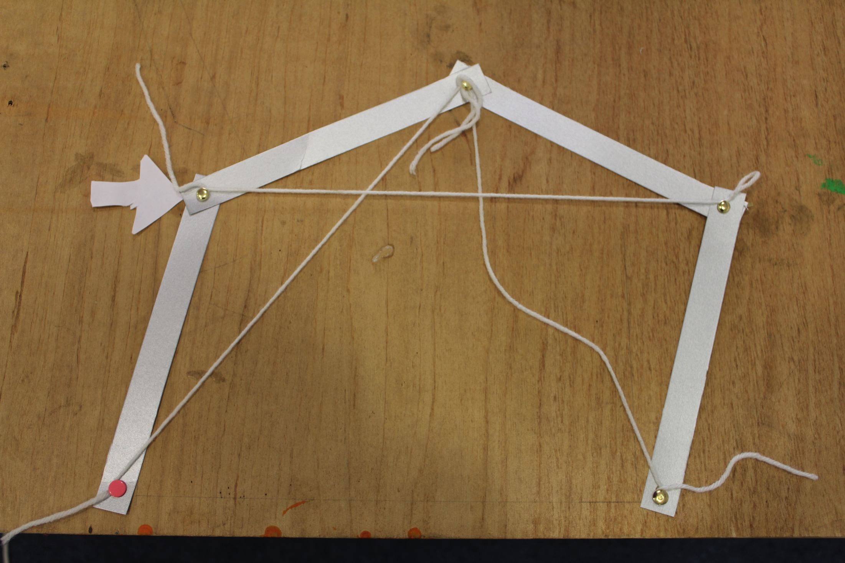
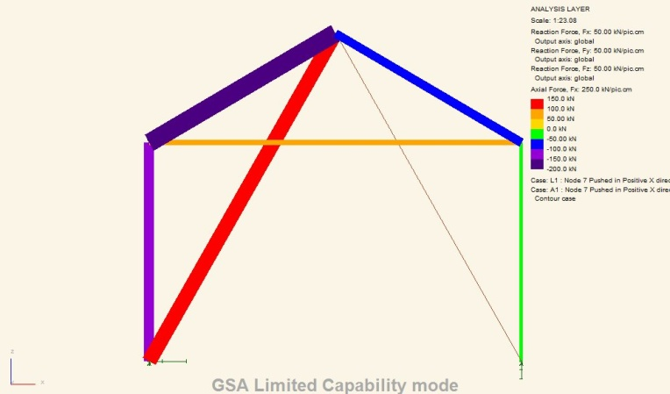
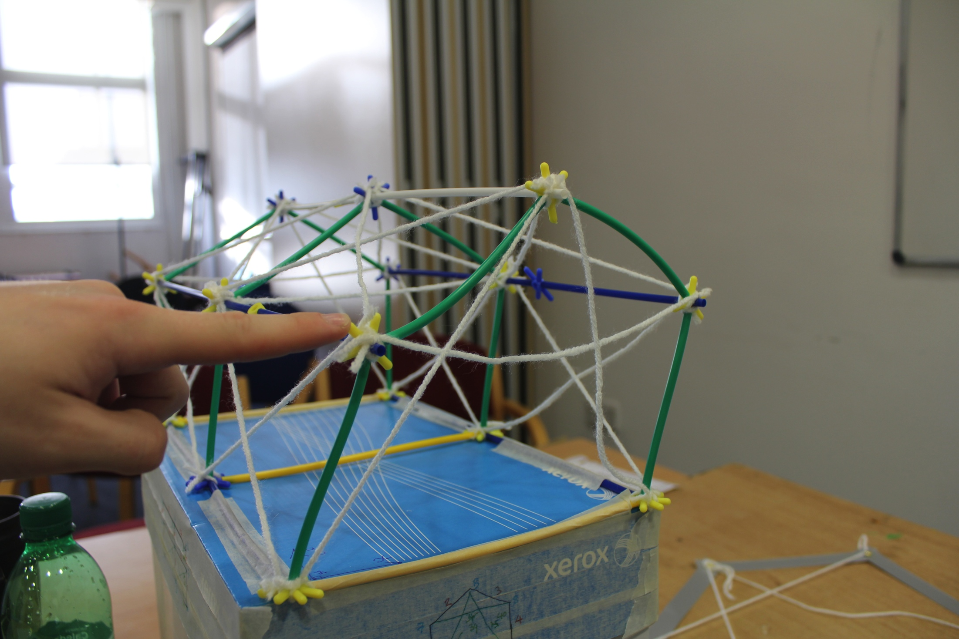
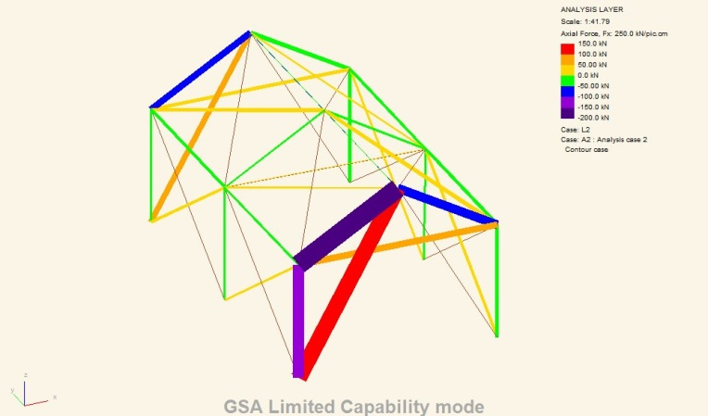
Transitional Tents
Modeling
Introduction
Calculations & Modeling
Testing & Results
Failure
6 Conclusions
Further Work
Questions

Slide 6
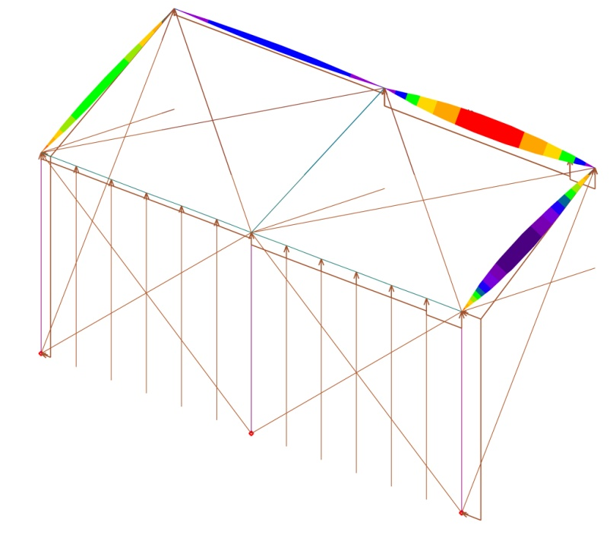
Transitional Tents
Modeling
Introduction
Calculations & Modeling
Testing & Results
Failure
6 Conclusions
Further Work
Questions

Slide 7
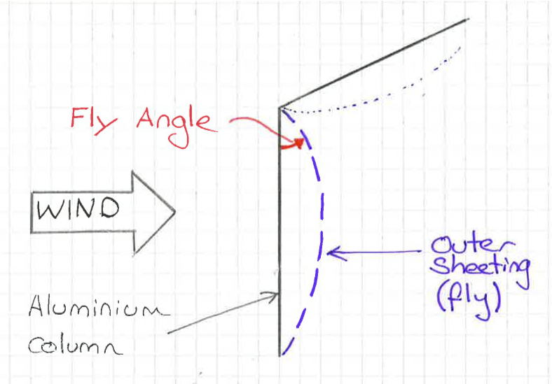
Transitional Tents
Modeling
Introduction
Calculations & Modeling
Testing & Results
Failure
6 Conclusions
Further Work
Questions
The addition of lightweight sheeting reduces the forces applied to the frame as it eliminates this effect.

Slide 8
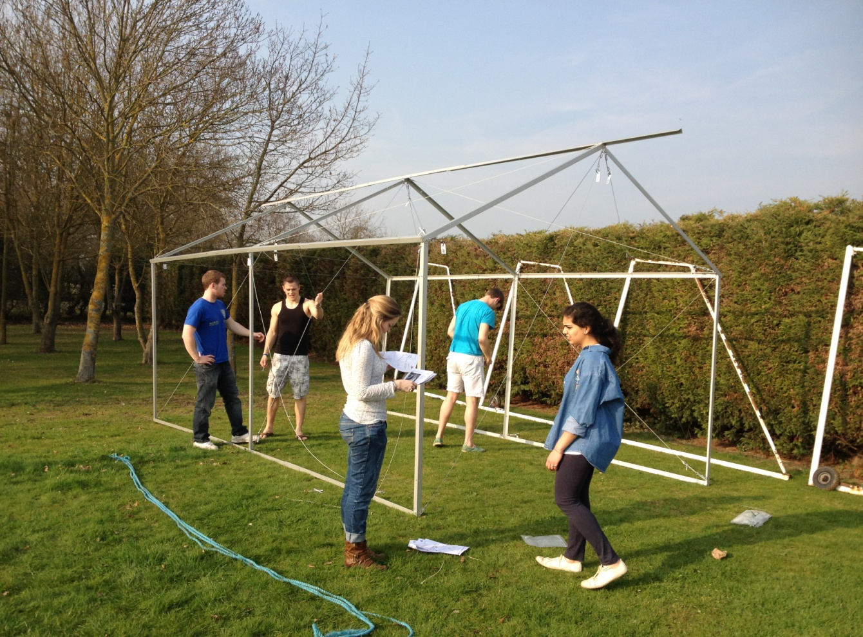
Transitional Tents
Testing
Introduction
Calculations & Modeling
Testing & Results
Failure
6 Conclusions
Further Work
Questions

Slide 9
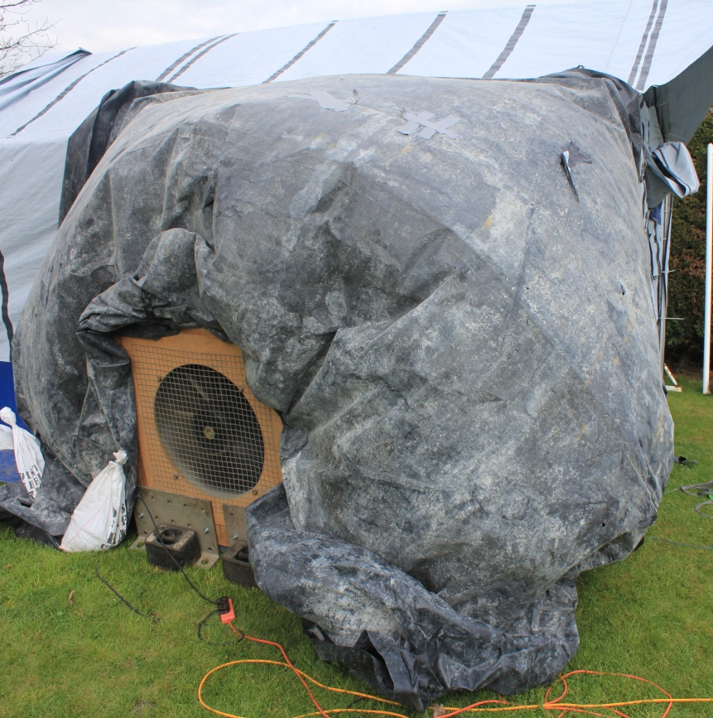
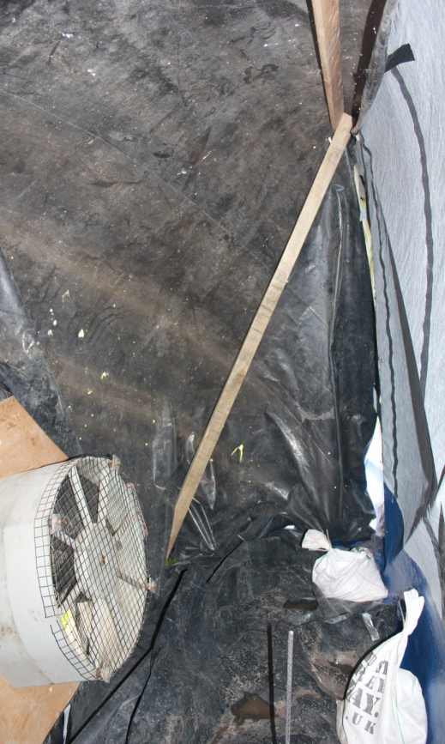
Transitional Tents
Testing
Introduction
Calculations & Modeling
Testing & Results
Failure
6 Conclusions
Further Work
Questions

Slide 10
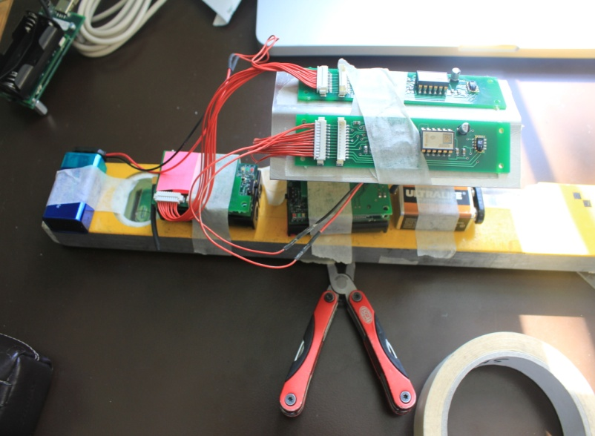
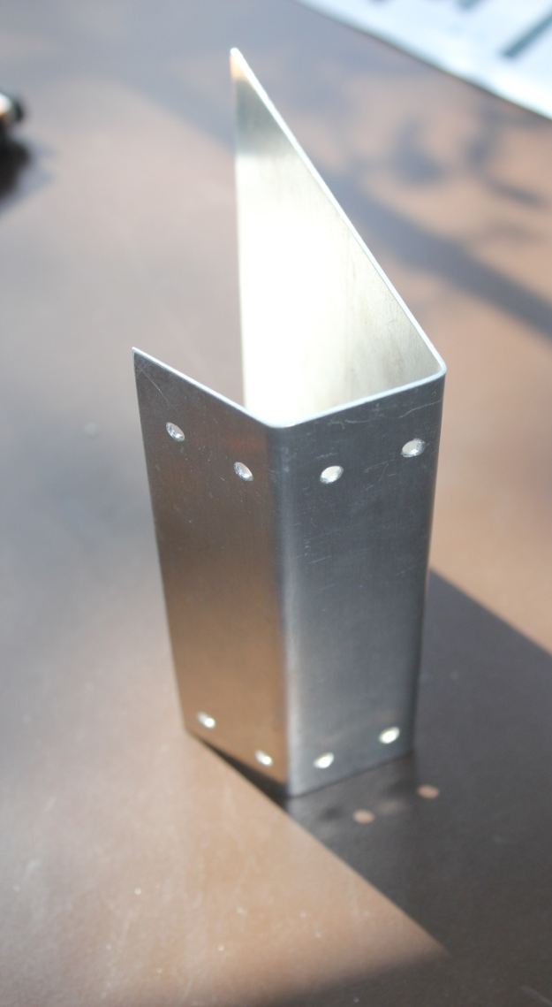
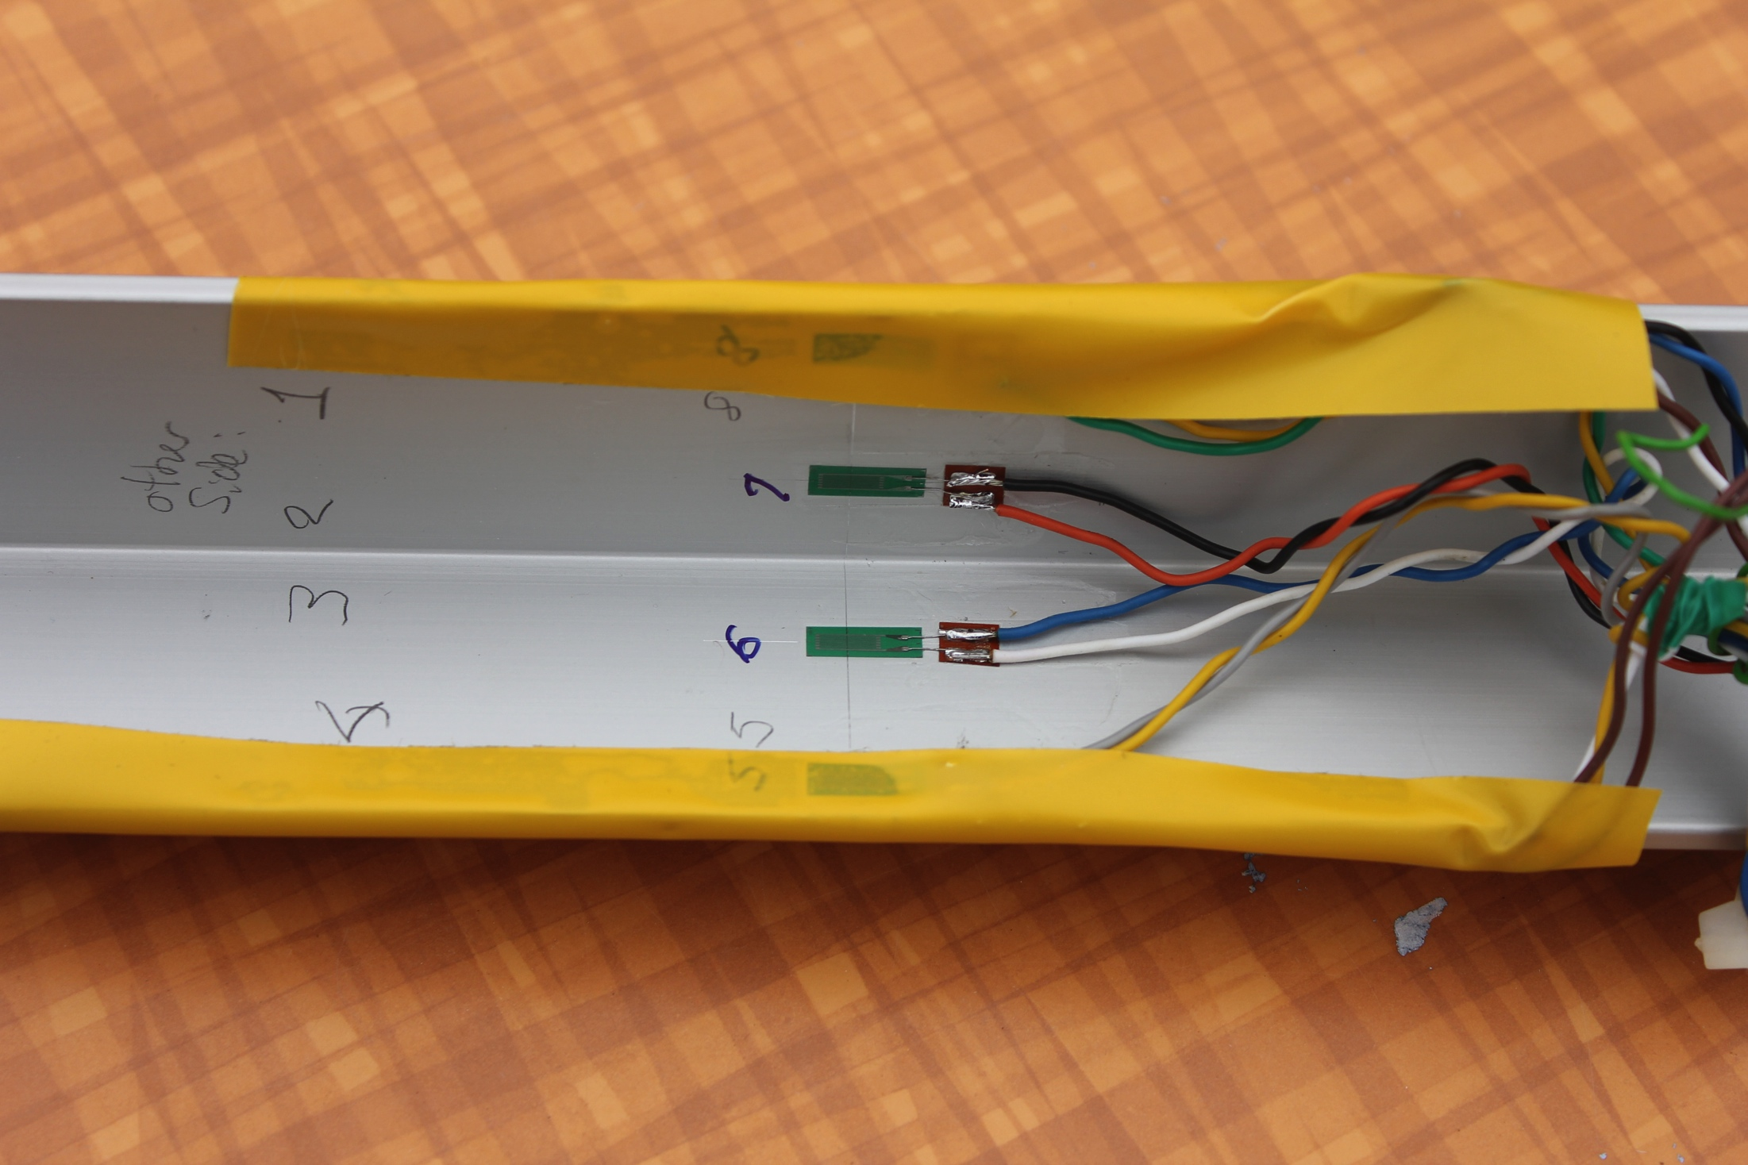
Transitional Tents
Testing
Introduction
Calculations & Modeling
Testing & Results
Failure
6 Conclusions
Further Work
Questions

Slide 11
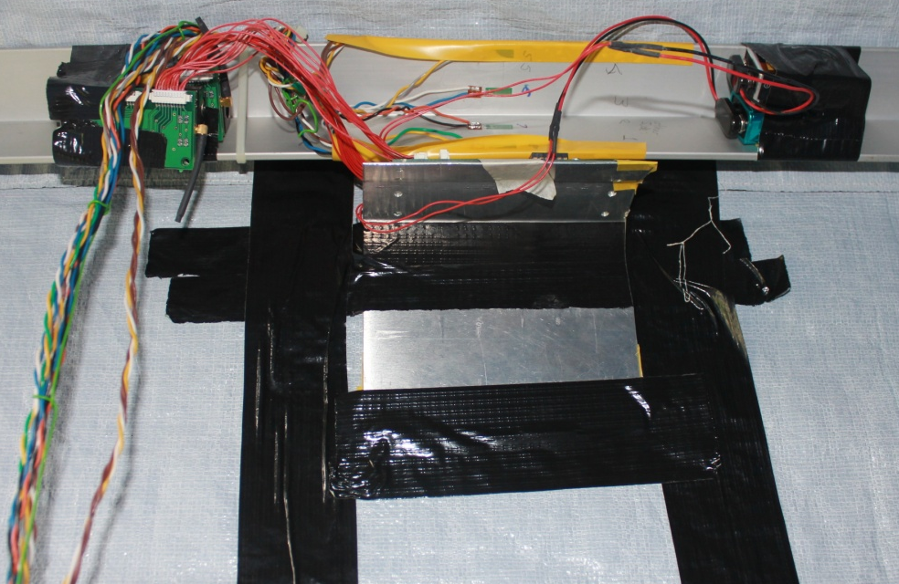
Transitional Tents
Testing
Introduction
Calculations & Modeling
Testing & Results
Failure
6 Conclusions
Further Work
Questions
Inclinometer Transmission Units
Strain Gauges
Inclinometer Battery Packs
Inclinometers
Inclinometer Bracket

Slide 12
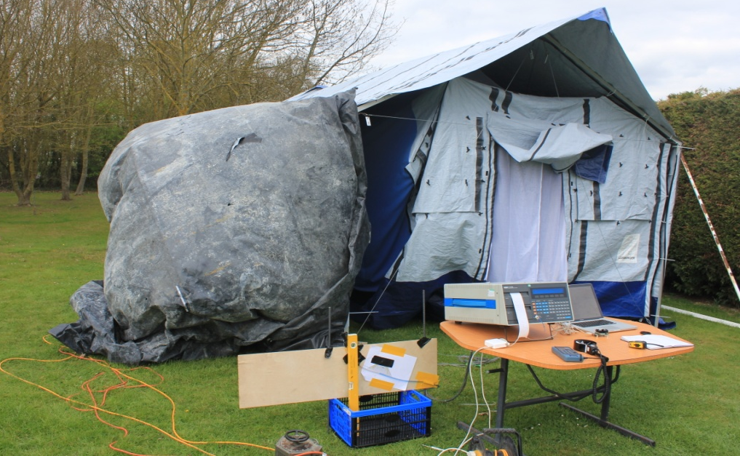
Transitional Tents
Testing
Introduction
Calculations & Modeling
Testing & Results
Failure
6 Conclusions
Further Work
Questions
Inflated Bag
Strain Gauges & Inclinometers (inside)
Data Logger and Laptop (Inclinometer Output)
Tube for pressure reading

Slide 13
Transitional Tents
Results
Introduction
Calculations & Modeling
Testing & Results
Failure
6 Conclusions
Further Work
Questions

Slide 14
Transitional Tents
Results
Introduction
Calculations & Modeling
Testing & Results
Failure
6 Conclusions
Further Work
Questions
Eave should buckle at 25ms⁻¹
Force 9 on the Beaufort Scale
This is not the most critical failure mode – uplift is
Notes:
Windspeeds stated are calculated based on the results. These may not be fully accurate as data was only collected over a short period of time at low wind speeds, further testing by the student taking the project next year will verify them.

Slide 15
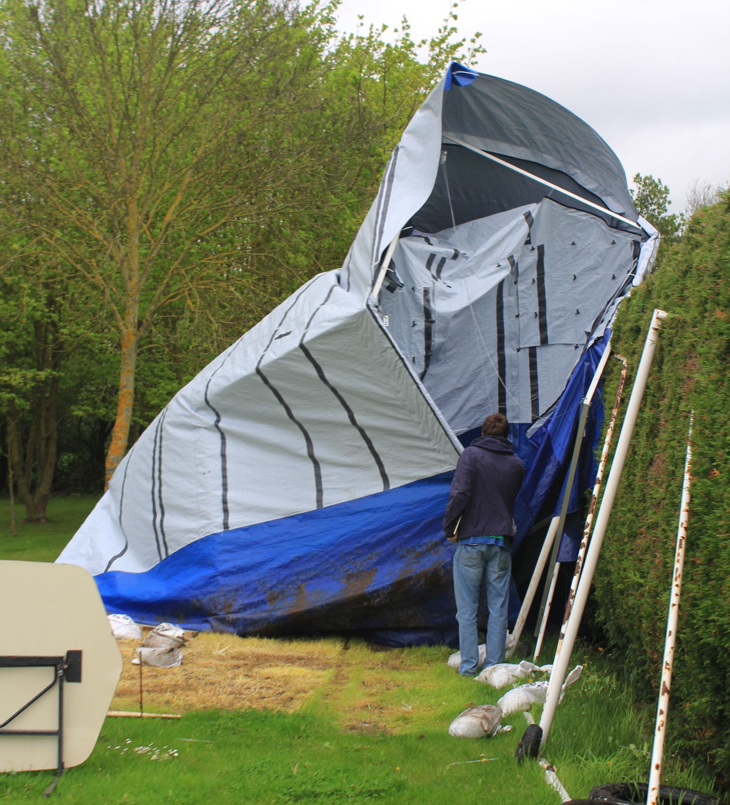
Transitional Tents
Failure
Introduction
Calculations & Modeling
Testing & Results
Failure
6 Conclusions
Further Work
Questions

Slide 16

Transitional Tents
Failure
Introduction
Calculations & Modeling
Testing & Results
Failure
6 Conclusions
Further Work
Questions
Wind
Failure 2
Failure 1

Slide 17
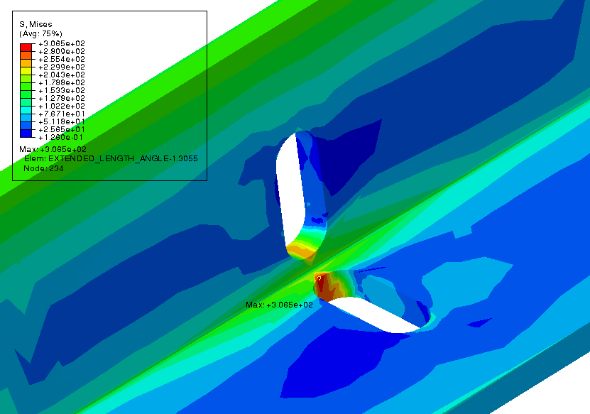
Transitional Tents
Failure 1
Introduction
Calculations & Modeling
Testing & Results
Failure
6 Conclusions
Further Work
Questions

Slide 18
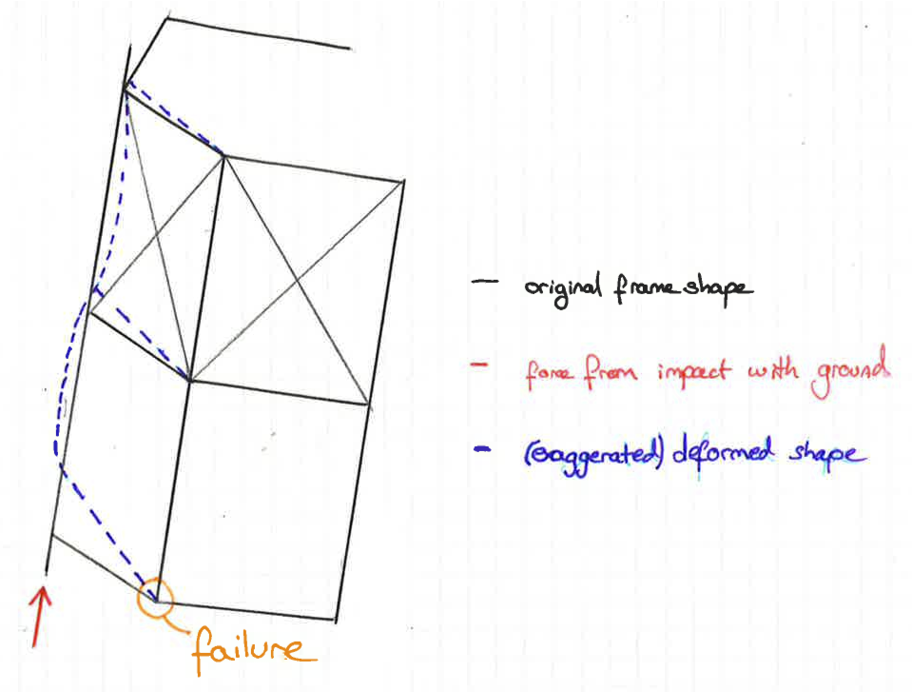
Transitional Tents
Failure 2
Introduction
Calculations & Modeling
Testing & Results
Failure
6 Conclusions
Further Work
Questions

Slide 19
Transitional Tents
Recommendations/Improvements
Introduction
Calculations & Modeling
Testing & Results
Failure
6 Conclusions
Further Work
Questions
Porch
Floor Beams
Bracing
  Coming Undone
  Both Bays
Hole Alignment
Joining Method
Peg Loops

Slide 20
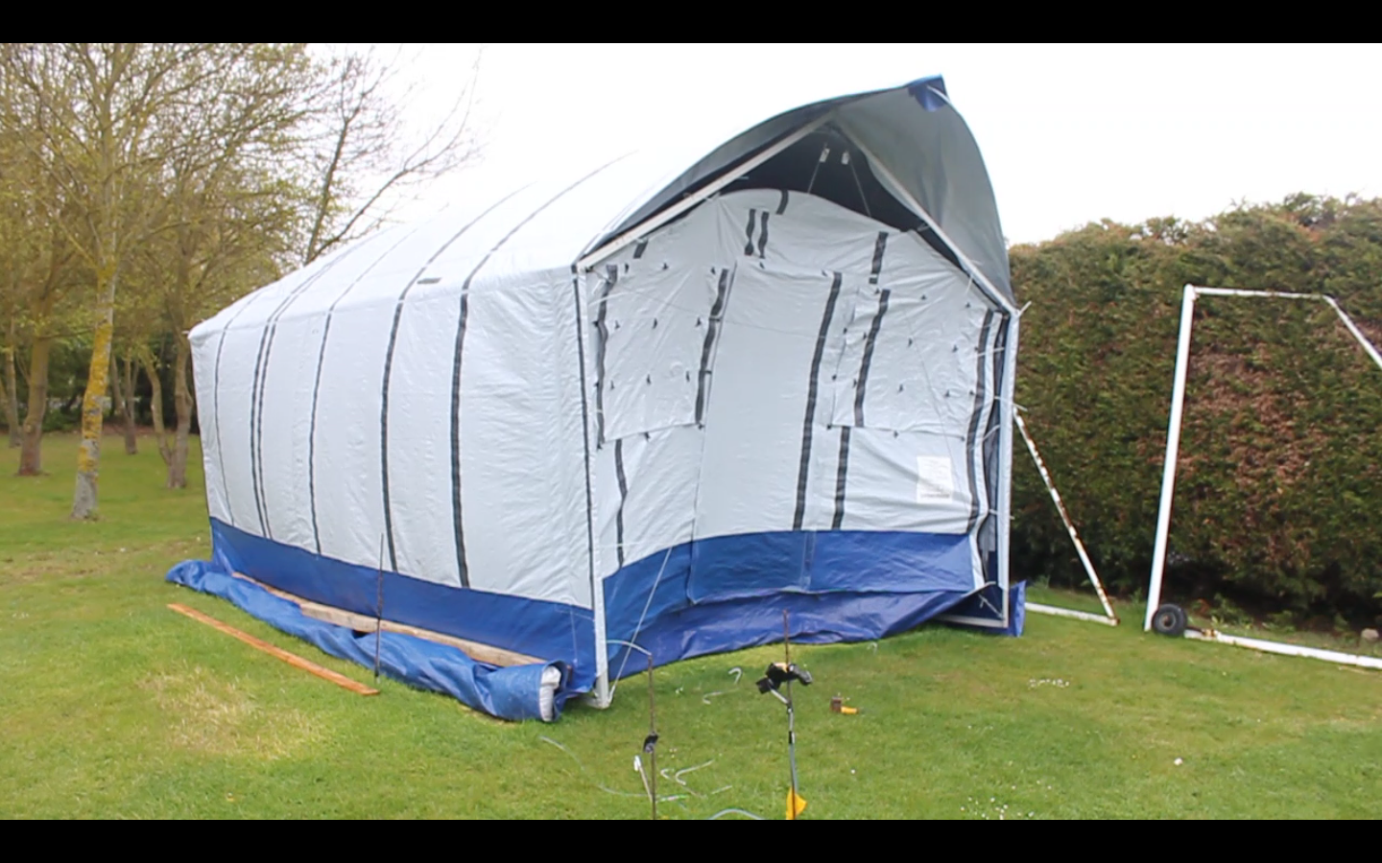
Transitional Tents
Recommendations/Improvements
Introduction
Calculations & Modeling
Testing & Results
Failure
6 Conclusions
Further Work
Questions
Porch and cavity significantly increase uplift forces

Slide 21
Transitional Tents
Recommendations/Improvements
Introduction
Calculations & Modeling
Testing & Results
Failure
6 Conclusions
Further Work
Questions
Porch
Floor Beams
Bracing
  Coming Undone
  Both Bays
Hole Alignment
Joining Method
Peg Loops

Slide 22
Transitional Tents
Recommendations/Improvements – Floor Beams
Introduction
Calculations & Modeling
Testing & Results
Failure
6 Conclusions
Further Work
Questions
                (Please Find the video attached on the shelter Centre website where this presentation was found)

Slide 23
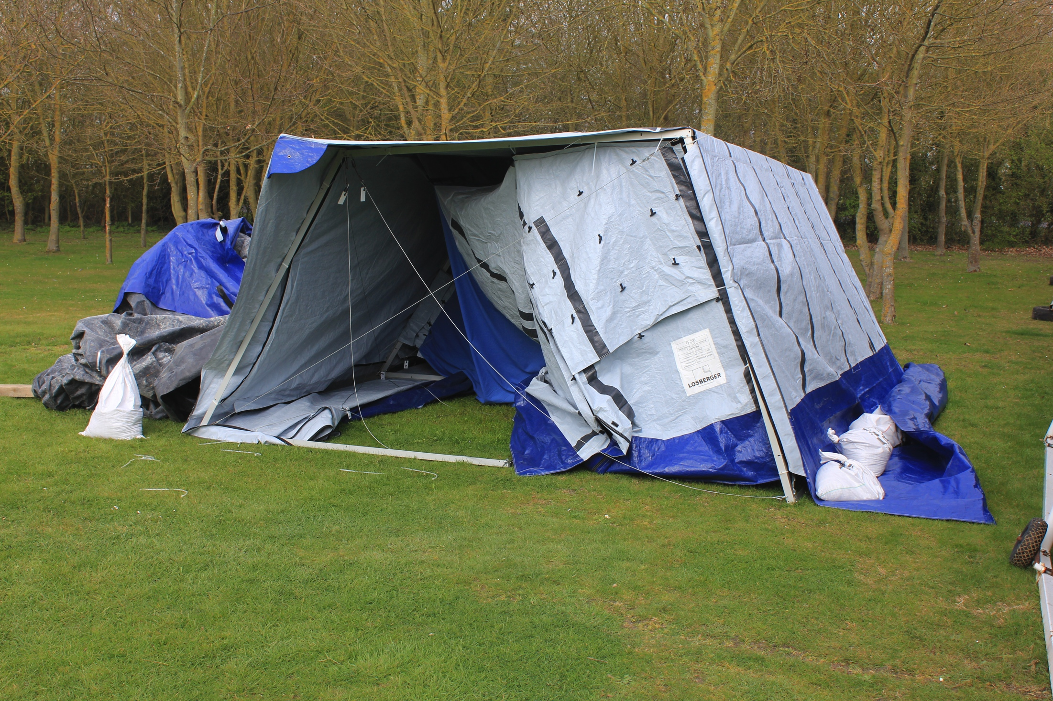
Transitional Tents
Recommendations/Improvements – Floor Beams
Introduction
Calculations & Modeling
Testing & Results
Failure
6 Conclusions
Further Work
Questions

Slide 24
Transitional Tents
Recommendations/Improvements
Introduction
Calculations & Modeling
Testing & Results
Failure
6 Conclusions
Further Work
Questions
Porch
Floor Beams
Bracing
  Coming Undone
  Both Bays
Hole Alignment
Joining Method
Peg Loops

Slide 25
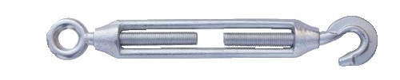
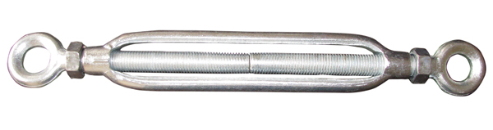
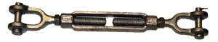
Transitional Tents
Recommendations/Improvements
Introduction
Calculations & Modeling
Testing & Results
Failure
6 Conclusions
Further Work
Questions
Existing:
Recommended:
Or, even better:

Slide 26
Transitional Tents
Recommendations/Improvements
Introduction
Calculations & Modeling
Testing & Results
Failure
6 Conclusions
Further Work
Questions
Porch
Floor Beams
Bracing
  Coming Undone
  Both Bays
Hole Alignment
Joining Method
Peg Loops

Slide 27
Transitional Tents
Recommendations/Improvements - Bracing
Introduction
Calculations & Modeling
Testing & Results
Failure
6 Conclusions
Further Work
Questions

Slide 28
Transitional Tents
Recommendations/Improvements
Introduction
Calculations & Modeling
Testing & Results
Failure
6 Conclusions
Further Work
Questions
Porch
Floor Beams
Bracing
  Coming Undone
  Both Bays
Hole Alignment
Joining Method
Peg Loops

Slide 29
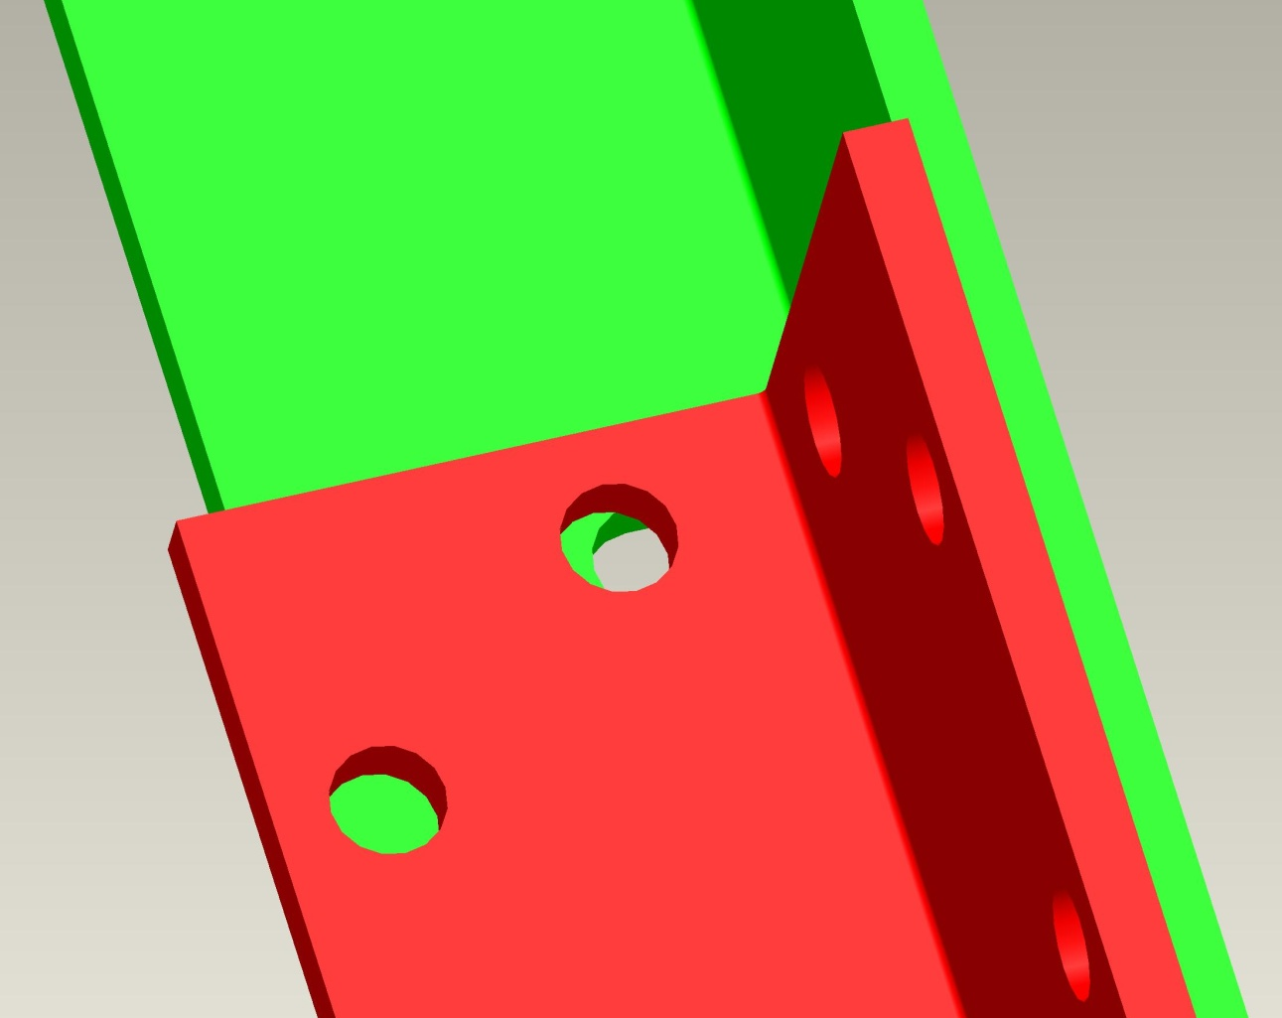
Transitional Tents
Recommendations/Improvements – Hole Alignment
Introduction
Calculations & Modeling
Testing & Results
Failure
6 Conclusions
Further Work
Questions

Slide 30
Transitional Tents
Recommendations/Improvements
Introduction
Calculations & Modeling
Testing & Results
Failure
6 Conclusions
Further Work
Questions
Porch
Floor Beams
Bracing
  Coming Undone
  Both Bays
Hole Alignment
Joining Method
Peg Loops

Slide 31
Transitional Tents
Recommendations/Improvements – Joining Method
Introduction
Calculations & Modeling
Testing & Results
Failure
6 Conclusions
Further Work
Questions

Slide 32
Transitional Tents
Recommendations/Improvements
Introduction
Calculations & Modeling
Testing & Results
Failure
6 Conclusions
Further Work
Questions
Porch
Floor Beams
Bracing
  Coming Undone
  Both Bays
Hole Alignment
Joining Method
Peg Loops

Slide 33
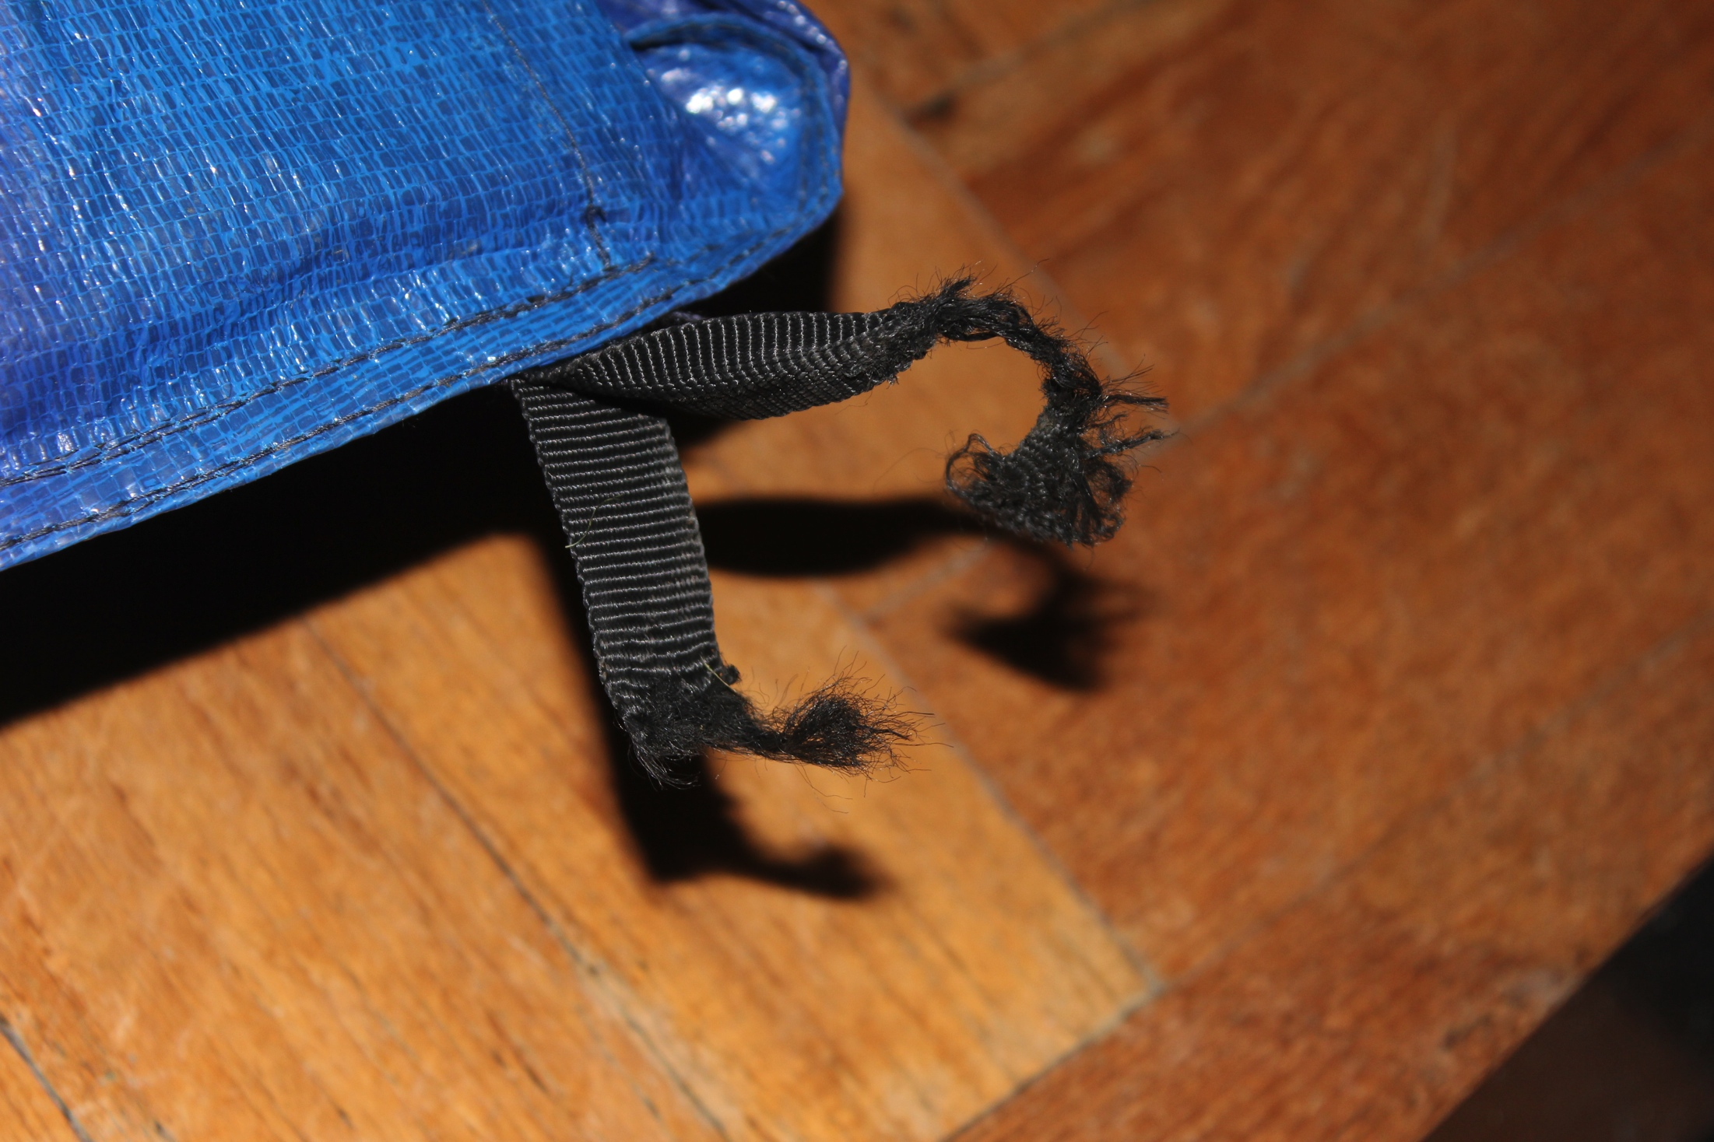
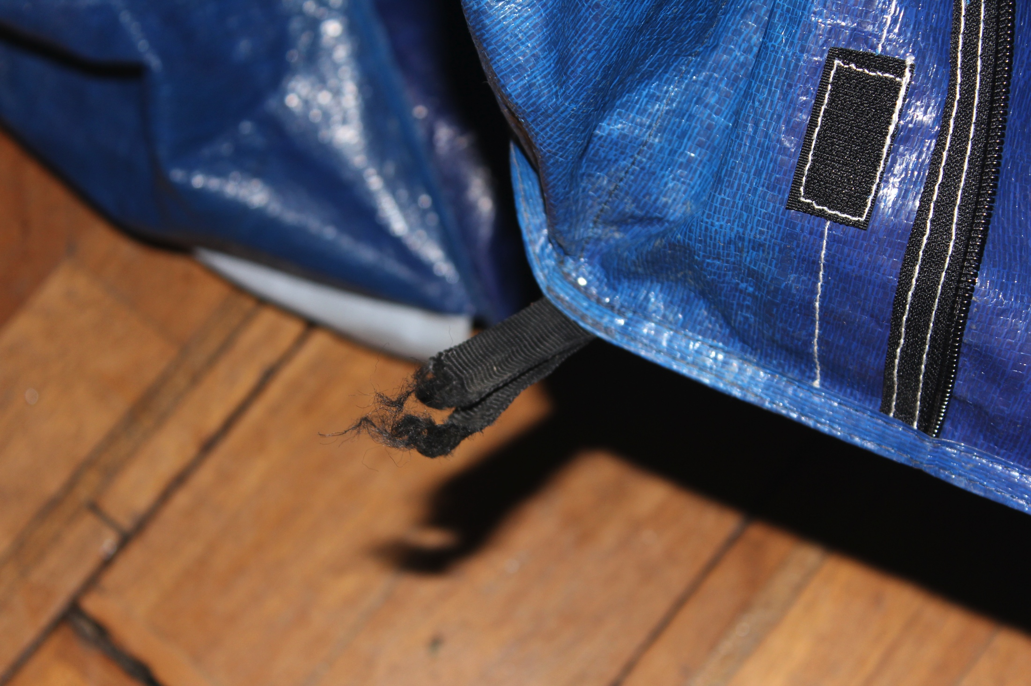
Transitional Tents
Recommendations/Improvements – Peg Loops
Introduction
Calculations & Modeling
Testing & Results
Failure
6 Conclusions
Further Work
Questions

Slide 34
Transitional Tents
Further Work
Introduction
Calculations & Modeling
Testing & Results
Failure
6 Conclusions
Further Work
Questions
Future students from Cambridge University Engineering Department will continue the project.
  Foundation Design
  Further Testing

Slide 35
Transitional Tents
Questions
Introduction
Calculations & Modeling
Testing & Results
Failure
6 Conclusions
Further Work
Questions
Questions?
Conclusions:
Porch
Floor Beams
Bracing
  Coming Undone
  Both Bays
Hole Alignment
Joining Method
Peg Loops
Tent Rating:
25ms-1 provided properly secured
Further Work:
Foundation Design
Thorough Testing

