Slide 1
Developing an environmental decision making tool
Shelter Centre and the Norwegian Refugee Council

Slide 4
Phase 1
Research BREEAM and LEED
Draw comparisons
Assess suitability for humanitarian shelter sector

Slide 5
Building Research Establishment Environmental Assessment Method (BREEAM)
First EAT
UK developed, 1990
Allows comparison of buildings
Green Building Challenge, 1996
Based on 10 criteria

Slide 6
BREEAM Criteria
Energy
Indoor environment
Innovation
Land use and ecology
Management
Materials
Pollution
Transport
Waste
Water

Slide 7
Leadership in Energy and Environmental Design (LEED)
US based, developed 1994-98
Most widely recognised
Designed for hot climates with air conditioning
Used in all US states
Based on 10 categories
Notes:
ASHRAE = American Society of Heating, Refrigerating and Air-conditioning Engineers
USGBC = US Green Building Council

Slide 8
LEED Criteria
Awareness and education
Energy
Indoor environment
Innovation
Locations and linkages
Materials
Regional priority
Resources
Site
Water

Slide 9
BREEAM
LEED
Trained BREEAM assessor is architect → BRE
UK/EU regulations
Absolute benchmarks
LEED assessor separate → USGBC
ASHRAE standards
Rewards on improvements
Notes:
ASHRAE = American Society of Heating, Refrigerating and Air-conditioning Engineers
USGBC = US Green Building Council

Slide 10
Phase 2
Research and compare EATs
18 found in total
With 29 different categories
Assess suitability for humanitarian sector

Slide 11
18 EATs sorted by number of criteria
Aspire – 12
BREEAM – 10
LEED – 10
CASBEE – 9
Green Star – 9
SI-5281 – 9
Green Globes – 8
LiderA – 8
3-Star – 7
EEWH – 7
Estidama – 7
GBCS – 7
BEAM – 6
DGNB – 6
GRIHA – 6
Green Mark – 5
HQE – 3
Minergie – 3
Notes:
More out there, such as LOTUS by Vietnamese Green Building Council

Slide 12
29 different criteria sorted by frequency
Indoor environment quality - 17
Energy - 15
Water - 12
Materials - 9
Environmental management - 8
Land use and ecology - 8
Innovation - 7
Site - 7
CO2 emission reduction - 6
Management - 5
Resources - 5
Transport - 5
Waste - 5
Locations and linkages - 3
Socioeconomic experience - 3
Awareness and education - 2
Culture - 2
Sustainable use - 2
Institutional enablers - 1
Off-site environment - 1
Pollution - 1
Preference items (strategic targets) - 1
Processes - 1
Quality of service - 1
Regional priority (extra weight given to existing criteria) - 1
Soil water content - 1
Sustainable construction - 1
Techniques - 1
Vulnerability - 1

Slide 13
29 different criteria sorted by frequency
Indoor environment quality - 17
Energy - 15
Water - 12
Materials - 9
Environmental management - 8
Land use and ecology - 8
Innovation - 7
Site - 7
CO2 emission reduction - 6
Management - 5
Resources - 5
Transport - 5
Waste - 5
Locations and linkages - 3
Socioeconomic experience - 3
Awareness and education - 2
Culture - 2
Sustainable use - 2
Institutional enablers - 1
Off-site environment - 1
Pollution - 1
Preference items (strategic targets) - 1
Processes - 1
Quality of service - 1
Regional priority (extra weight given to existing criteria) - 1
Soil water content - 1
Sustainable construction - 1
Techniques - 1
Vulnerability - 1

Slide 14
Indoor environment quality;
Energy;
Water;
Materials;
Environmental management; and
Land use and ecology.

Slide 15
Findings of comparison
Regionally specific tools
Generally comprehensive thus complex
Centralised method of certification

Slide 16
Outcomes of Phase 1 & 2
Is another tool feasible with
limited time and money; and
available skills and human resources?
Is a framework assessment tool the best direction for us?

Slide 18
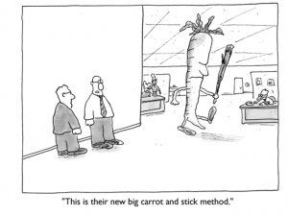
Compliance or education?

Slide 19
Compliance
Accrediting institute
Training of assessors
Support of sector
Regionally specific

Slide 20
Education
Tool to assist decisions – develop
Large body of vocational and academic knowledge – already available
Tool to assess results – available
Education and training material – available

Slide 21
Education
Tool to assist decisions – develop
Large body of vocational and academic knowledge – already available
Tool to assess results – available
Education and training material – available

Slide 22
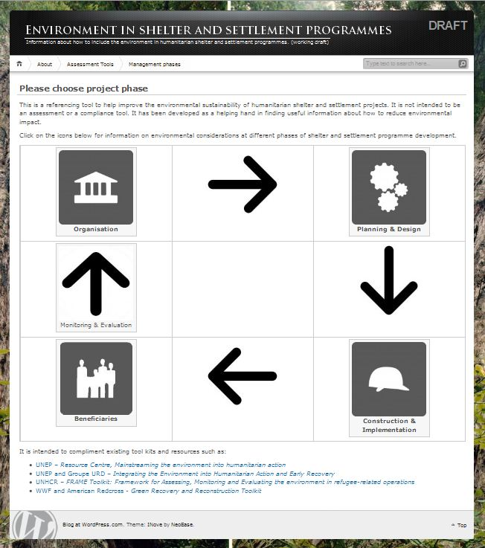

Slide 23
From EAT research
Top criteria:
Indoor environment quality;
Energy;
Water;
Materials;
Environmental management; and
Land use and ecology.

Slide 25
Direct reliance on local environment
Understand decisions of affected people
Good programming requires training
Focus on continuous resource needs

Slide 26
Questions we have
How best to market this concept?
How to include complexities of environment?
When to realistically involve this?

Slide 28
Generally positive
Needs to be more specific to:
be obvious it’s about shelter; and
define a decision making process.

Slide 29
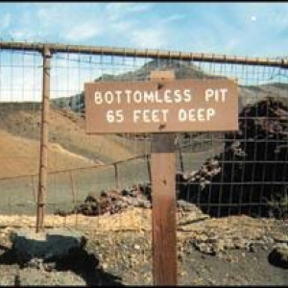
“an endless list of all things I could do if I had bottomless buckets of money”

Slide 30
Focus on the local environment
Maintain or improve?
Increase resilience
Ensure humanitarian imperative
Support income generation
Notes:
Mention comparison of CO2 emissions between people in low and high income countries

Slide 31
Still collating feedback
Feel free to use computers

Slide 33
Development of site
Where will this be hosted?
What system to use – Drupal, Wordpress, etc?
Refine usability and navigation

Slide 34
Decision making tree(s)
Further research
Consultation
Method of presentation?

Slide 35
Collaboration
Assessment tool creators
Training providers
Development sector

Slide 36
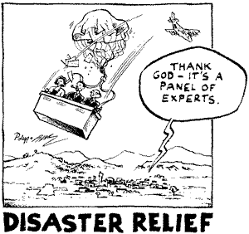
Discussion
Challenges
Benefits
Opportunities

