Slide 1
REFUGEE HOUSING UNIT RESEARCH AND DEVELOPMENT PROJECT
Notes:
A 15min presentation of the Refugee Housing Unit – an angoing design and development project of UNHCR, IKEA Foundation and RHU.

Slide 2
SCOPE
To develop an emergency to semi permanent shelter solution which significantly improve the lies of refugees and internally displaced people.
Notes:
¨SCOPE statement,
Add hand drawn skteshes-

Slide 3
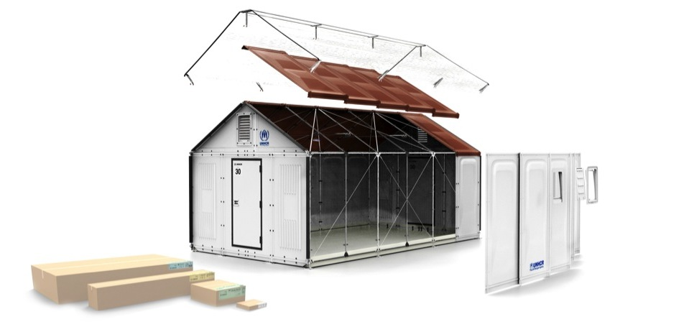
KEY REQUIREMENT AREAS:
Usability
Safety
Helath and comfort
Deplyment
Environmemt and code of conduct
Deployment
Cost effective
Notes:
A very brief overview – detail questions to be discuessed after presentation.
Usability: Lifespan 3yrs panels, 10 years for frame. Modular, 17,5m2/5people Return time and user time depending on local situation.
Safety: Structural integrity of wind = 16,8m/23m/s, snow load of 50mm (175kg), Solar load, 3 years Kenya.
Health and comfort, moitsure, Infiltration, Ventilation, etc. Calculated and beeing tested to verify
Deploymnet: Flat packed. Volume 1 cbm. Weight 120kg without shade net. Target weight 100 kg. Easy and quick to install/maintain.
Cost effective: Reasonable up-front cost, low lifecycle cost.

Slide 4
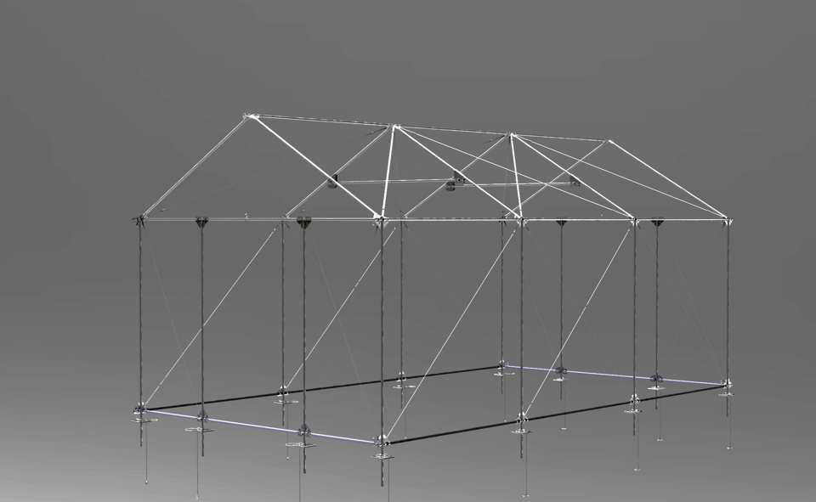
THE RHU FRAME
Notes:
THE RHU FRAME is a modular and expandable self-supported frame designed to be used with RHU Panels, plastic sheeting or locally sourced building materials in order to build an adequate shelter. To date only tested with RHU panels.

Slide 5
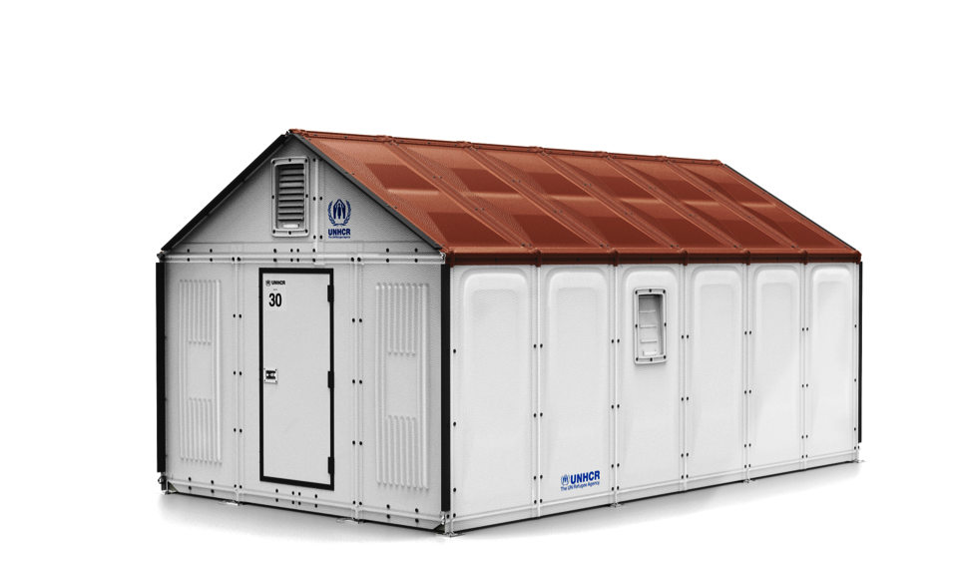
THE RHU PANELS
Notes:
THE RHU PANELS are modular wall and ceiling panels to be built on to the RHU Frame in order to quickly achieve a complete, durable shelter intended to last minimum three years. The Panels can be fitted onto a RHU Frame in any size

Slide 6
THE RHU SHADE NET
Notes:
THE RHU SHADE NET is an external screen, which significantly improves indoor thermal comfort. During the day, the Shade Net´s open structure provides 70% solar reflection and cooling. At night and in cold climates, the Shade Net helps reduce radiated heat loss.

Slide 7
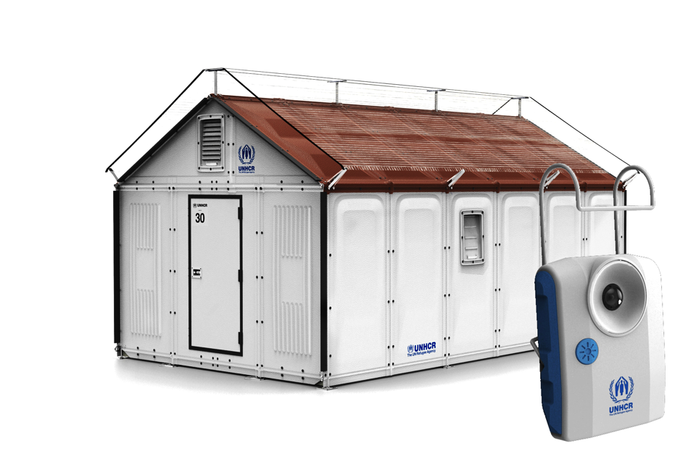
THE RHU PV SYSTEM
Notes:
THE RHU PHOTOVOLTAIC (PV) SYSTEM consists of a solar panel and a portable LED light including battery and USB power output. The solar panel can be integrated into the RHU Panel or the RHU Shade Net.
3w/330 lumens, € hrs use at max, 12 hours at min, USB out to chareg cellpohones etc.

Slide 8
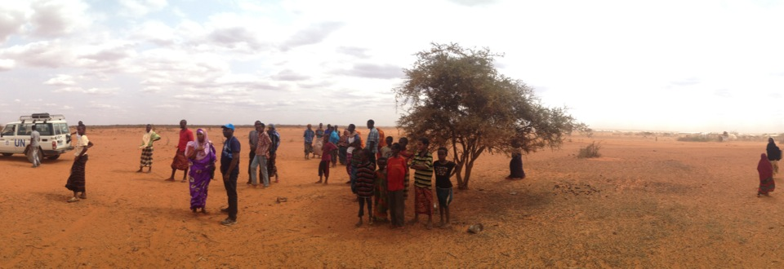
REFUGEE HOUSING UNIT PILOT DOLLO ADO, ETHIOPIA
Notes:
Pilot on Dollo Ado, Ethiopia. Somali refugee camps Hilwayen and Kobe.
Tested full supply chain, manufacturing, storage and logistics handling training, deplymnet and use.

Slide 9
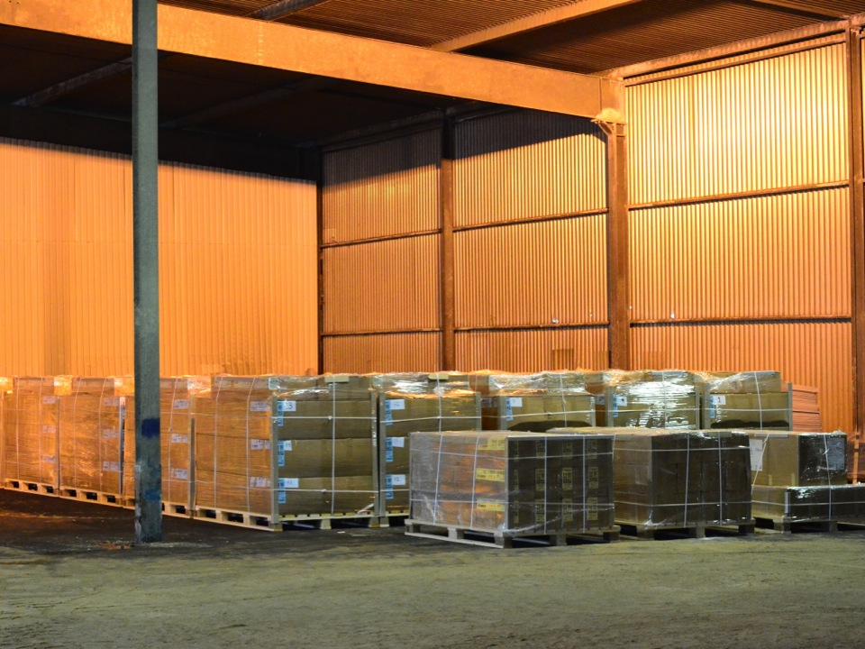
Notes:
RHU in warehouse Sweden

Slide 10
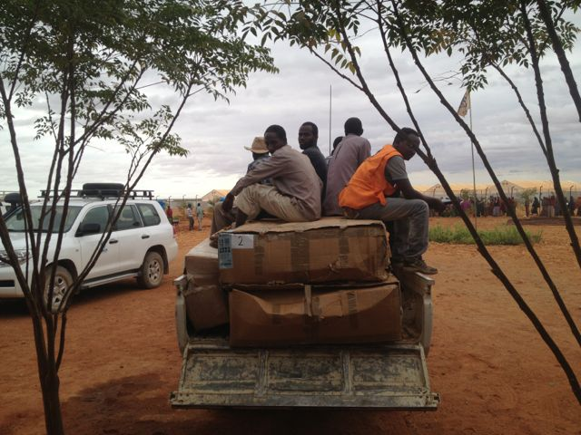
Notes:
Same RHU Pacakges after transport to Dollo…

Slide 11
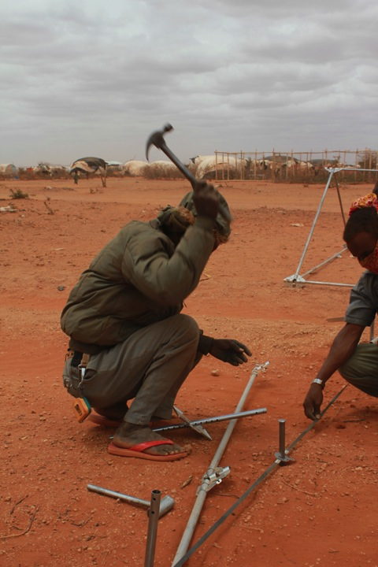
Notes:
Training – ground assembly

Slide 12
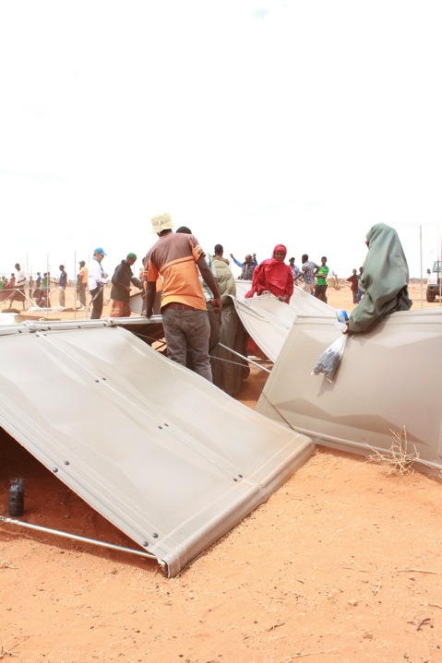
Notes:
Training - Paneling

Slide 13
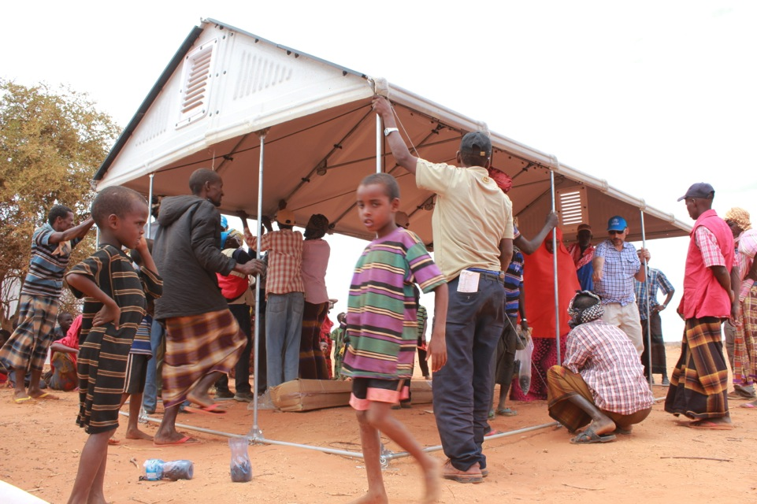
Notes:
Training - Roof and walls

Slide 14
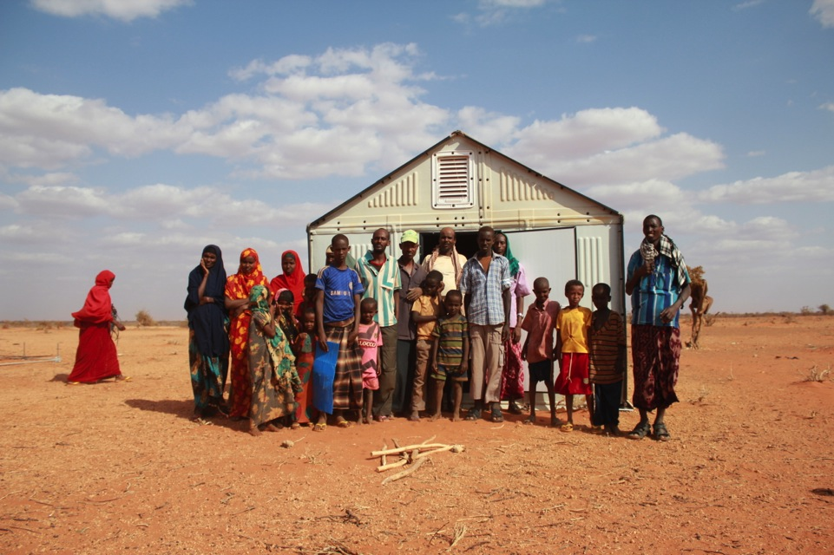
Notes:
Training – First Unit complete (no shade net)

Slide 15
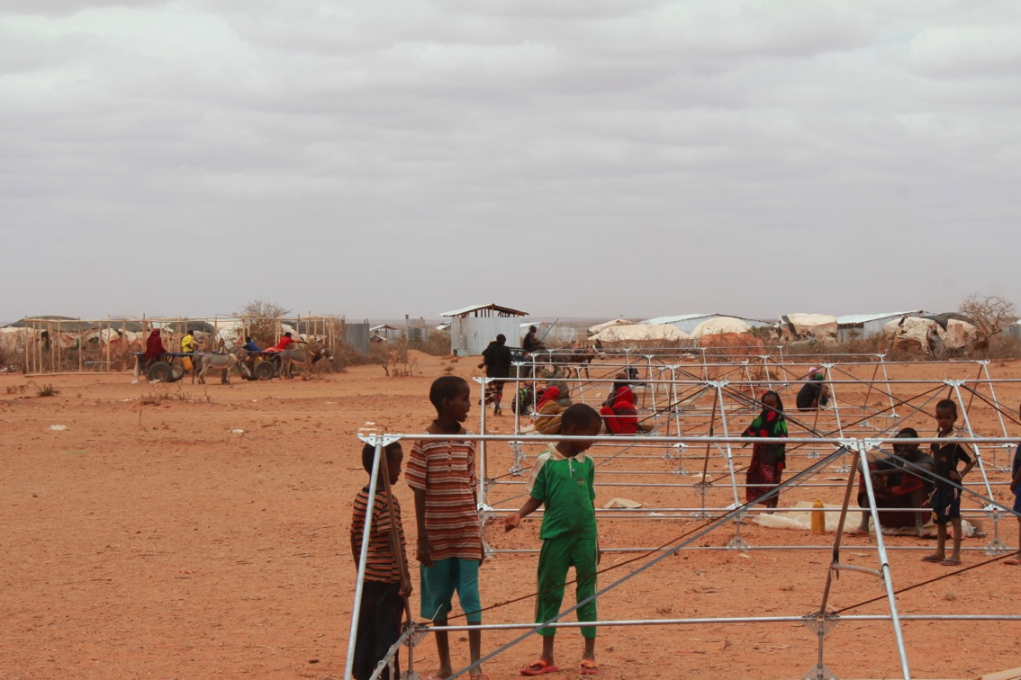
Notes:
Deployment – working in a seqential process (to speed up assembly). How to deploy in the field for best effeciency is subject to further study and testing .

Slide 16
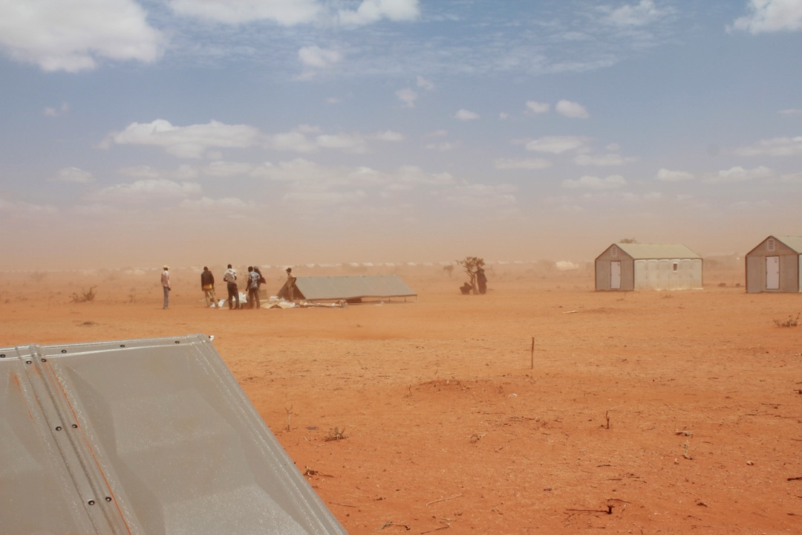
Notes:
Deploymnet – final RHUs beeing assembled.

Slide 17
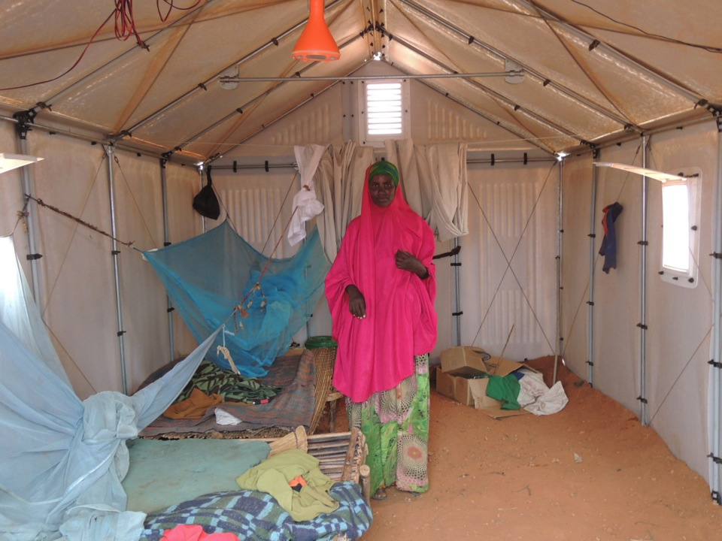
Notes:
RHU interior

Slide 18
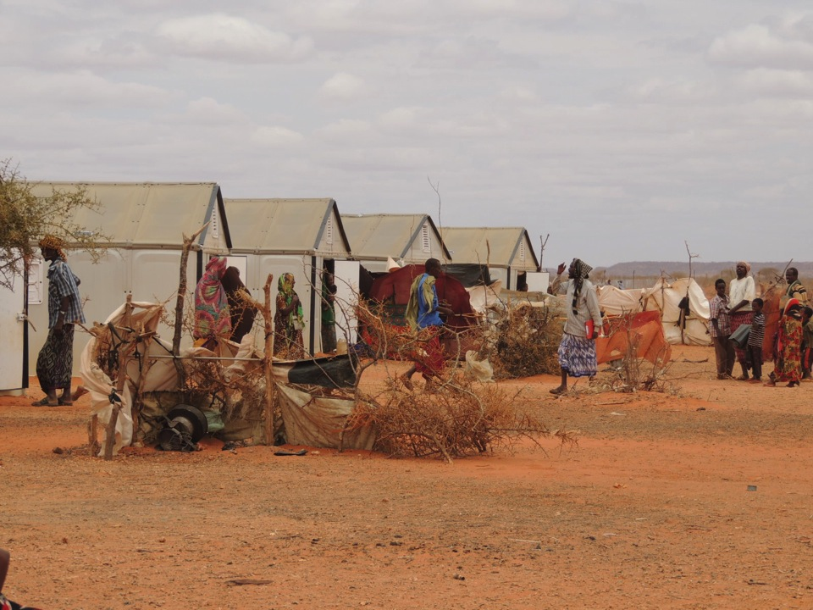
Notes:
RHU ”village” after one month – kitchenettes are beeing built in garden

Slide 19
NEXT STEP
Testing in Dohuk, Iraq start Nov 2013
Interim test Dollo Ado, Nov 2013
Final test Dollo Ado, Feb 2013
Complete specifications Feb 2013
Notes:
RHU ”village” after one month – kitchenettes are beeing built in garden

