Slide 1
Post-Disaster Shelter
Post-Disaster Shelter: Ten Designs
Ten Designs
Corinne Treherne, Shelter and Settlements Department, IFRC
Joseph Ashmore, Consultant to IFRC
Gary Lide, AMEC for IFRC
Jeff Walker, AMEC for IFRC

Slide 2
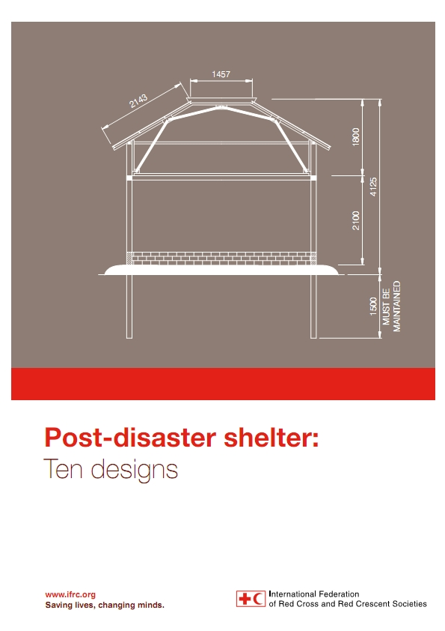
What will be presented?
Post-Disaster Shelter: Ten Designs
In this presentation, we will be introducing the upcoming second volume of post-disaster shelter designs and discussing lessons learned through the process of reviewing the designs and developing the structural analyses.

Slide 3
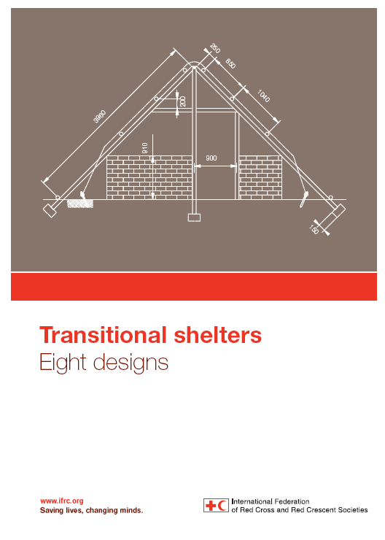
This is the Second Edition
Post-Disaster Shelter: Ten Designs
The previous edition “Transitional Shelters: Eight Designs” was published in 2011
This edition “Post-disaster shelter: Ten Designs” adds ten more designs for a total of 18 between the two volumes.
First Edition Cover
New Edition Cover

Slide 4
Focus of the Book
Post-Disaster Shelter: Ten Designs
While we recognise that terminologies [transitional / core / progressive etc] relate to a process or an approach rather than a phase of response, this book focuses on the designs of the shelters only.

Slide 5
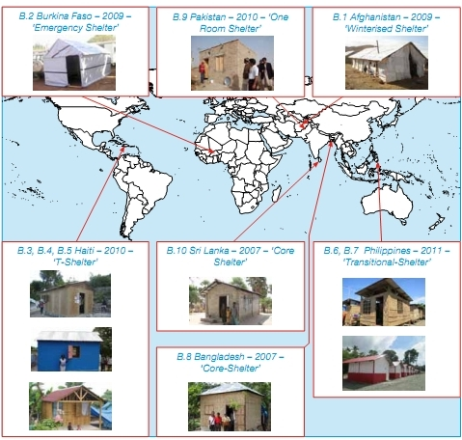
Overview of Designs - Locations
Post-Disaster Shelter: Ten Designs

Slide 6
Overview of Designs - Providers
Post-Disaster Shelter: Ten Designs
Design | Provider of Design
Afghanistan – 2009 – Winterised Shelter | NRC – National Red Cross
Pakistan – 2010 – One Room Shelter | IFRC / Pakistan Red Crescent
Sri Lanka – 2007 – Core Shelter | NRC – National Red Cross
Bangladesh – 2007 – Core Shelter | IFRC / Bangladesh Red Cross
Burkina Faso – 2009 – Emergency Shelter | IFRC
Haiti – 2010 – T Shelter | DRK – German Red Cross
Haiti – 2010 – T Shelter | Handicap International
Haiti – 2010 – T Shelter | Norwegian Red Cross / IFRC / Canadian Red Cross
Philippines – 2011 – Transitional Shelter | CRS – Catholic Relief Services
Philippines – 2012 – Transitional Shelter | QRCS – Qatar Red Crescent Society

Slide 7
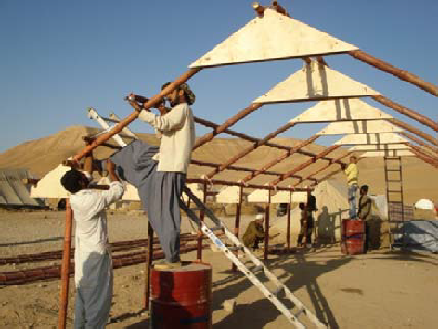
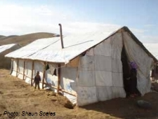
Designs Included – Bamboo Frame Shelters
Post-Disaster Shelter: Ten Designs
Afghanistan – 2009 – Winterised Shelter

Slide 8
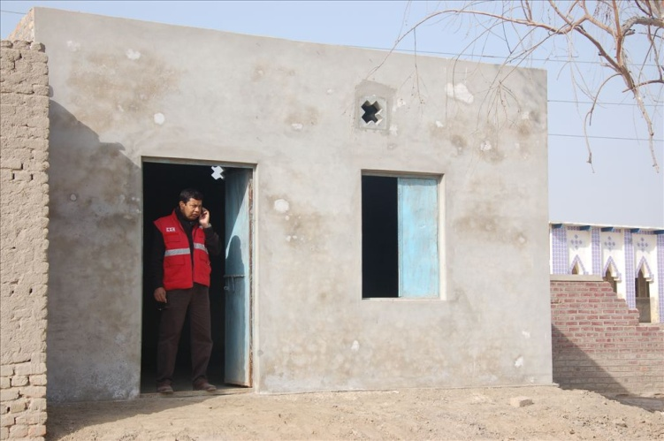
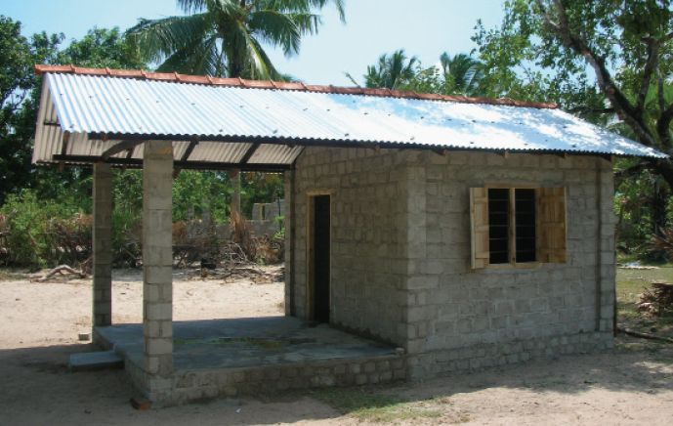
Designs Included – Masonry Shelters
Post-Disaster Shelter: Ten Designs
Pakistan – 2010 – One Room Shelter
Sri Lanka – 2007 – Core Shelter

Slide 9
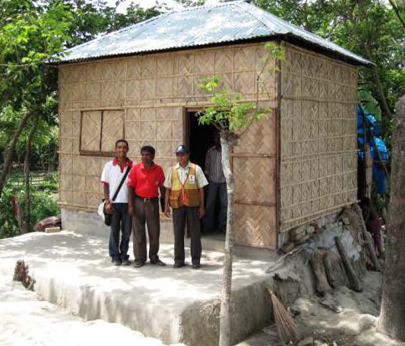
Designs Included – Steel Frame Shelters
Post Disaster Shelters: Ten Designs
Bangladesh – 2007 – Core Shelter

Slide 10
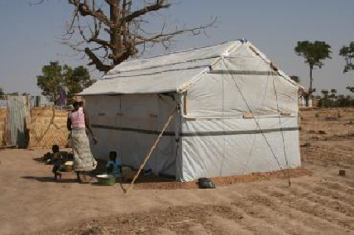
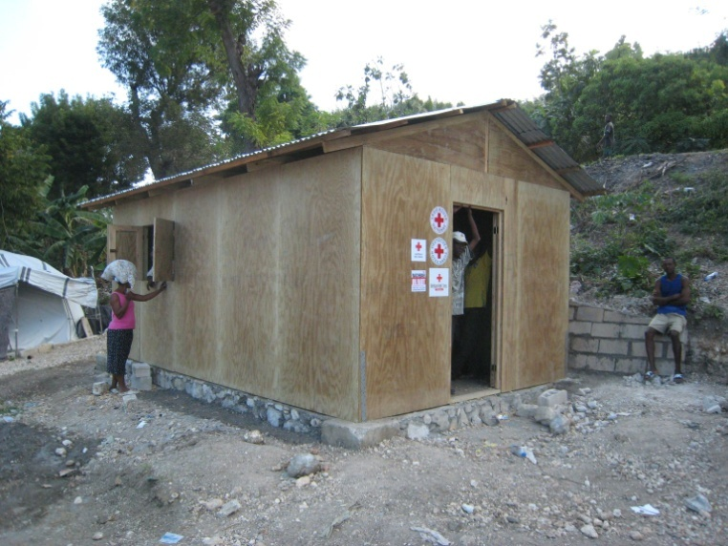
Designs included – Wood Frame Shelters
Post Disaster Shelters: Ten Designs
Burkina Faso – 2009 – Emergency Shelter
Haiti – 2010 – T Shelter

Slide 11
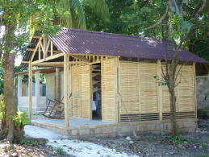
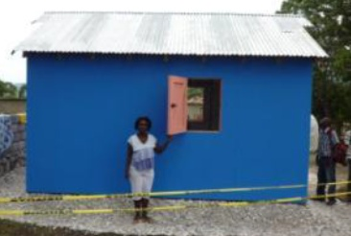
Designs Included – Wood Frame Shelters
Post-Disaster Shelter: Ten Designs
Haiti - 2010 – T Shelter
Haiti - 2010 – T Shelter

Slide 12
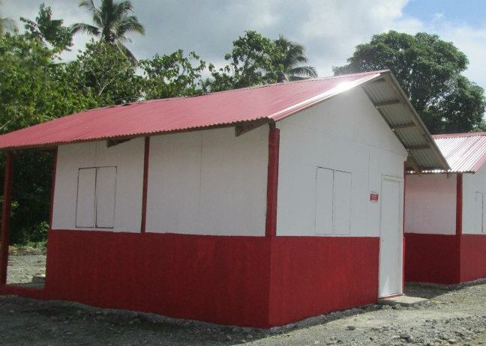
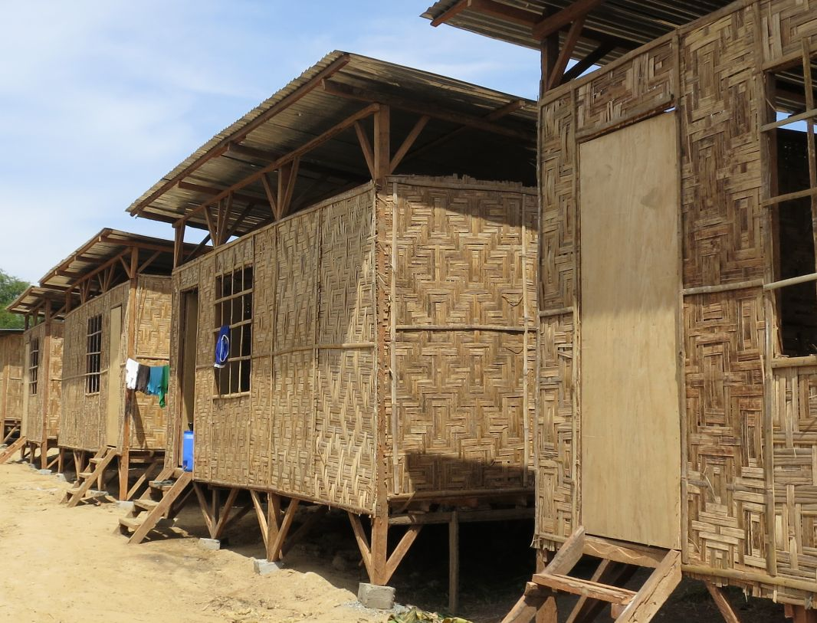
Designs Included – Wood Frame Shelters
Post-Disaster Shelter: Ten Designs
Philippines – 2011 – Transitional Shelter
Philippines – 2012 – Transitional Shelter

Slide 13
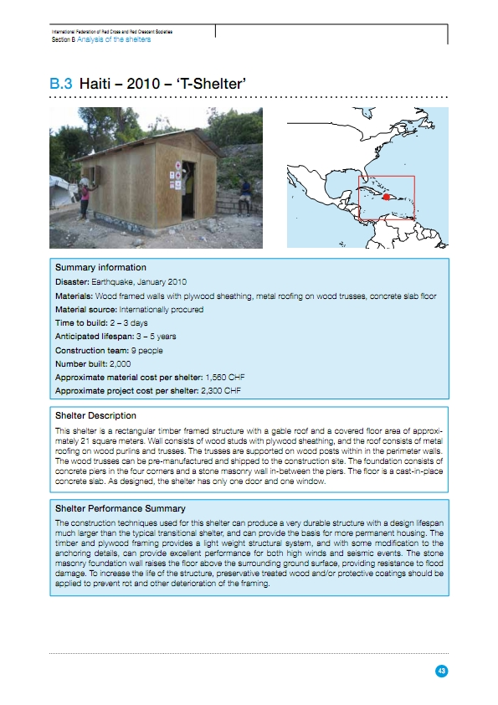
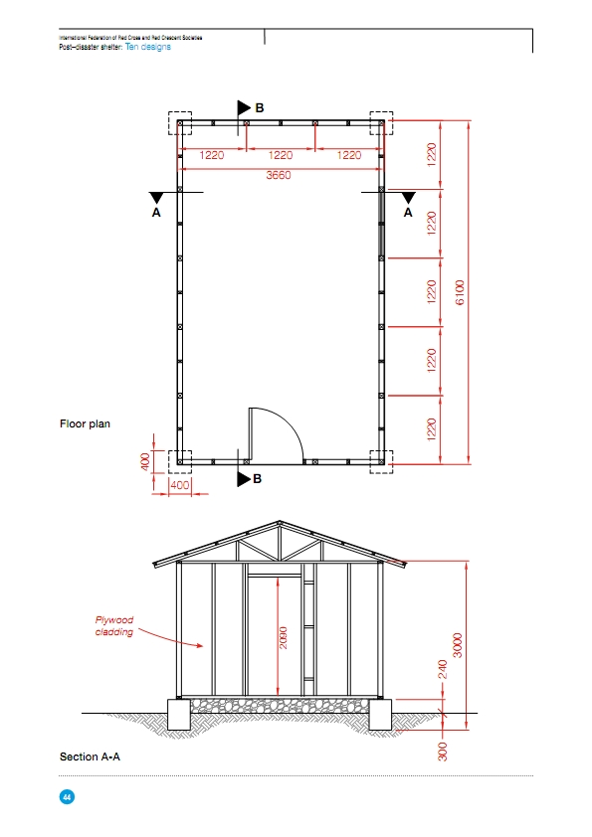
Example Section – Haiti – 2010 – T Shelter Pages 43 and 44
Post-Disaster Shelter: Ten Designs

Slide 14
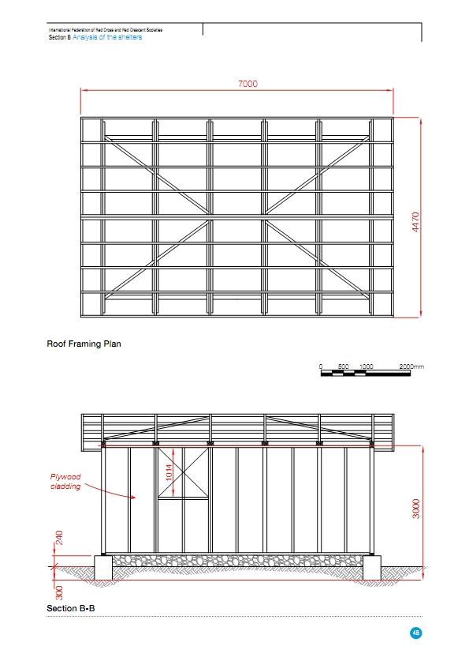
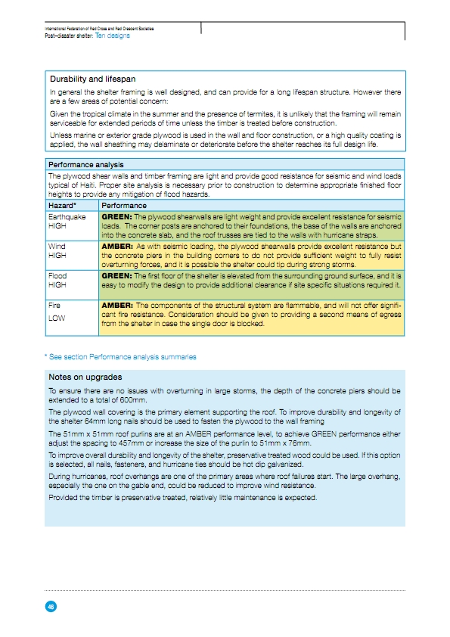
Example Section – Haiti – 2010 – T Shelter Pages 45 and 46
Post-Disaster Shelter: Ten Designs

Slide 15
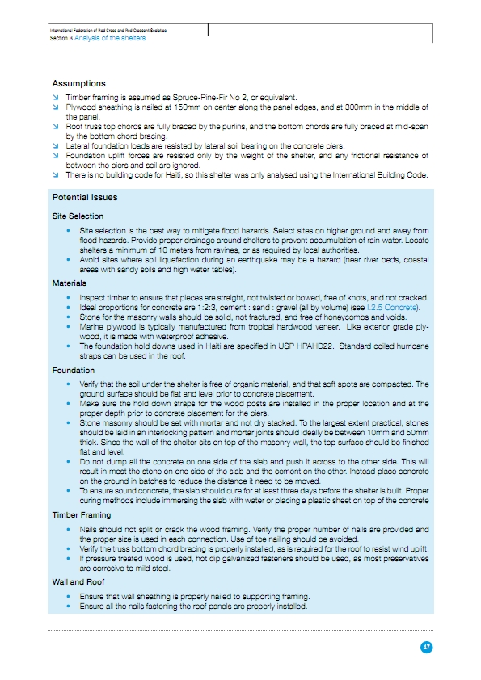
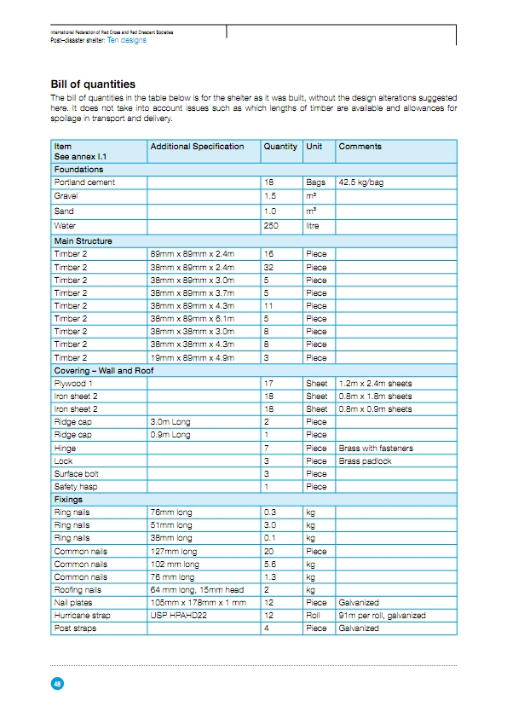
Example Section – Haiti – 2010 – T Shelter Pages 47 and 48
Post-Disaster Shelter: Ten Designs

Slide 16
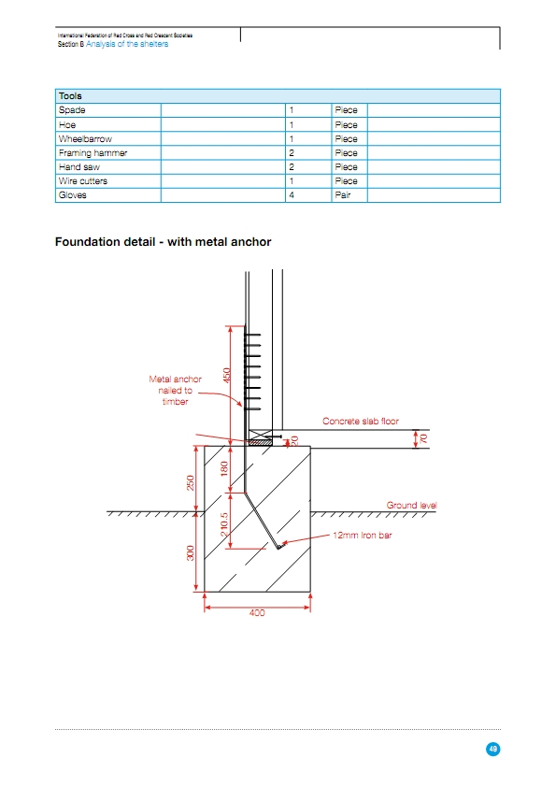
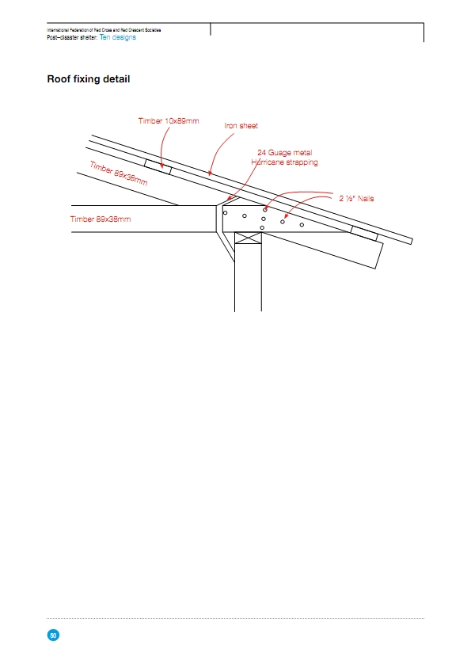
Example Section – Haiti – 2010 – T Shelter Pages 49 and 50
Post-Disaster Shelter: Ten Designs

Slide 17
What Have We Learned? (1)
Post-Disaster Shelter: Ten Designs
Building codes are useful for establishing baselines for comparison but complete compliance with codes intended for permanent structures can be major cost drivers for temporary structures. Coordination may be required with host countries in terms of established country building codes.
Wind loading must be analyzed in terms of survivability of the total structure with walls and again for survivability of the basic structure without walls. Using a structure based on thinner members and a lower profile roof maximizes the survivability of the structure during high winds.
In seismic areas lighter weight roofing provides more structural survivability than heavier roofing. This needs to be cross-referenced against wind-loading requirements.

Slide 18
What Have We Learned? (2)
Post-Disaster Shelter: Ten Designs
Bracing and fixings matter. A structure is only as strong as its weakest link. Also, the use of special fasteners or fixtures which are not readily available can hinder the speed of delivery or require make-shift work-arounds in the field.
Advance planners should review the bills of quantity contained in the work at hand carefully. They should make sure that the items listed therein are available locally and ALSO have at least one back-up item identified for each.
Small improvements can make a BIG difference (hurricane straps, adequate foundations, bracing, sufficient nailing) often without a big cost implication.

Slide 19
Next steps
Post-Disaster Shelter: Ten Designs
The document will be made available in hard copy
This is the second edition and there are now 18 designs available between the two editions.
We hope to capture more examples in the future, also from other shelter agencies
Open for new partnerships

Slide 20
For Discussion
Post-Disaster Shelter: Ten Designs
Questions:
How can we best disseminate this work?
Would you like further editions?
If so, what improvements should be made or additional information added?

Slide 21
FOR FURTHER INFORMATION ON POST DISASTER SHELTERS: TEN DESIGNS, PLEASE CONTACT:

