Slide 1
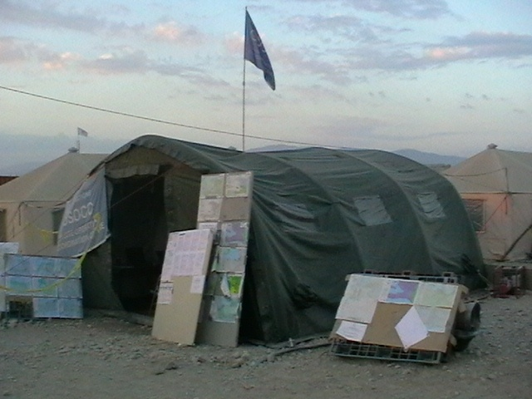
Shelter Partners Forum
‘Developing engagement between the private and humanitarian sectors’
Wednesday 1st December 2010

Slide 2
Welcome
Welcome, Conference Purpose and Agenda
Tom Corsellis, Shelter Centre

Slide 3


Welcome
Thank you CAGI for hosting Shelter Partners Forum.
Thank you Habitat for Humanity for supporting Shelter Partners Forum.

Slide 4

Forum purpose
This forum was developed at the request of the participants of the last Shelter Meeting 10a (May 2010).
The forum purpose is to provide a regular venue for the engagement between the private and humanitarian sectors and to complement existing initiatives for partnership between these sectors.
The deliverable for this forum is the development of working groups designed to address some of the issues raised.

Slide 5
Forum context
As this is the first Shelter Partners Forum, it is essential to understand if this conference is of value to the shelter sector. Your feedback will be used to determine whether the forum will be repeated in future. Please fill in and return the feedback form included in your information pack.
In order to support future Shelter Partners events, funding resources will be required.

Slide 6
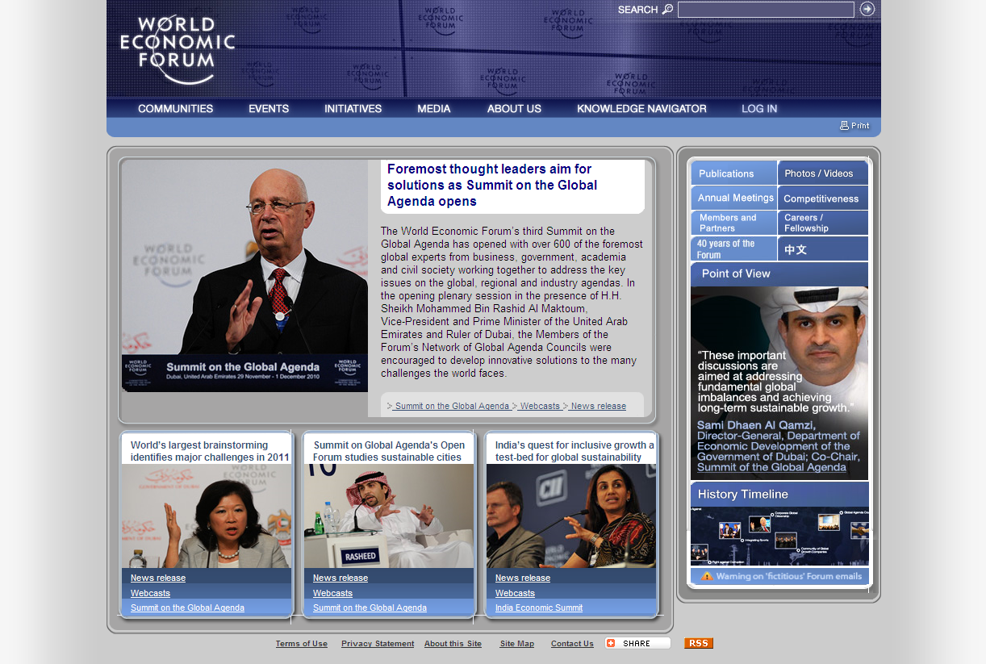
Current initiatives
Shelter Partners Forum should complement current initiatives such as:
The World Economic Forum

Slide 7
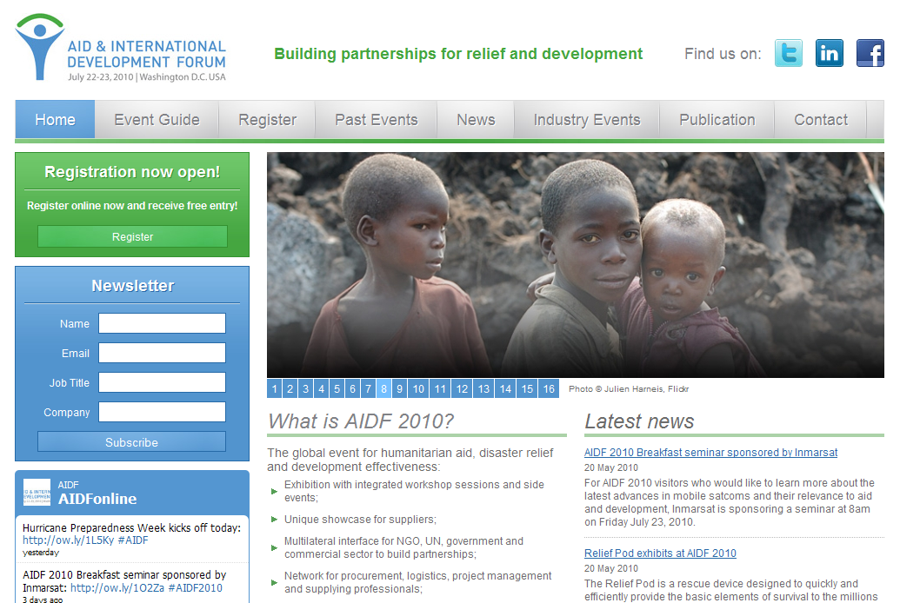
Current initiatives
Shelter Partners Forum should complement current initiatives such as:
The World Economic Forum
Aid and Trade

Slide 8
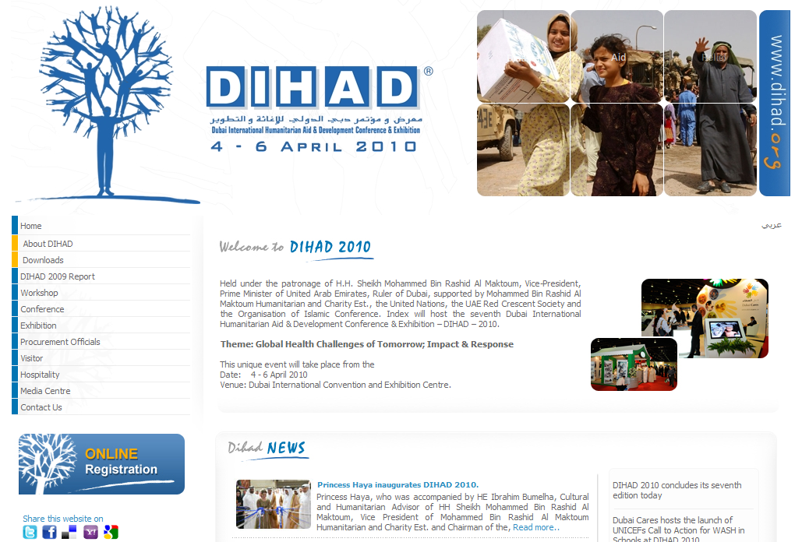
Current initiatives
Shelter Partners Forum should complement current initiatives such as:
The World Economic Forum
Aid and Trade
DIHAD

Slide 9

Agenda
08:30 – 09:00
09:00
09:15
09:30
09:45
10:00
10:15
10:30 – 11:00
11:00
12:30 – 13:30
13:30
14.30
15.00
15:15
15:30 – 15:45
15:45
16:30
17:30
19:30
Arrival and coffee
Welcome, conference purpose and agenda – Tom Corsellis, Shelter Centre
Keynote speech – Niels Scott, UN/OCHA
Keynote speech – Alex Wong, World Economic Forum
Keynote speech – Dr. Randolph Kent, Kings College London
Keynote speech – Lee Malany, American Red Cross
Introduction to breakout groups
Coffee break
Breakout groups Stakeholder discussions
Lunch
Plenary Breakout group feedback to the plenary
Plenary Humanitarian “Yellow Pages”
Plenary Future of Shelter Partners Forum
Plenary Introduction to the Transitional Shelter Prototype project
Coffee break
Demonstration Prototype Shelter Tour
Plenary Transitional Shelter Prototype Consortium
Close
Shelter Partners Forum and Shelter Meeting dinner. Flyer in information pack

Slide 10
Keynote speech
Niels Scott, UN/OCHA

Slide 11
Keynote speech
Alex Wong, World Economic Forum

Slide 12
Keynote speech
Dr. Randolph Kent, Kings College London

Slide 13
Keynote speech
Lee Malany, American Red Cross

Slide 14
Breakout groups
Introduction to breakout groups
Tom Corsellis, Shelter Centre

Slide 15



Breakout groups
After coffee this morning there will be parallel breakout groups
There will be an introduction to each group prior to coffee
Sign up sheets outside, attended by shelter centre staff– on your way to coffee please indicate which group you wish to participate in
After coffee, we will meet back here and you will be guided to the appropriate locations

Slide 16
Breakout groups
Breakout groups framework
Feedback of priorities, objectives, plans to plenary
Feedback at next Shelter Partners Forum
Formation of working groups
Sign up to working groups
Breakout groups
Actions?

Slide 17
Breakout groups
There will be three breakout groups.
Resources
Contracting
Code of Conduct

Slide 18
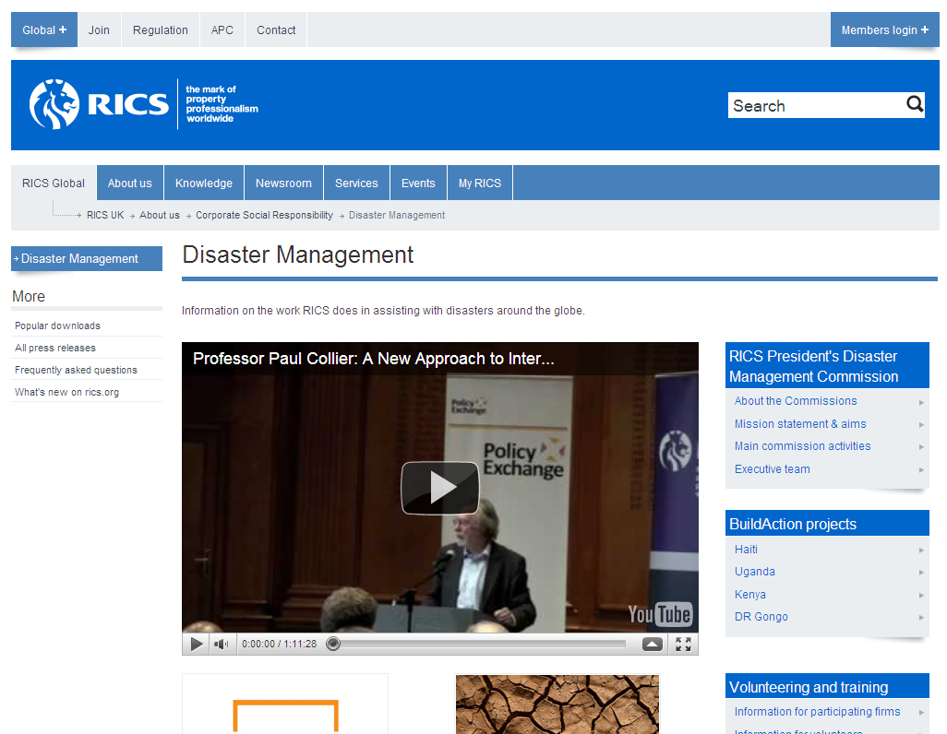
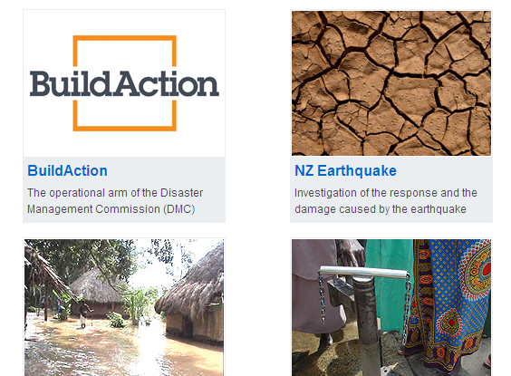
Breakout groups
1. Resources
What resources may be useful to inform private sector/humanitarian engagement? For example:
Website
Guidelines

Slide 19
Breakout groups
2. Contracting
What types of contract need to be considered?
Variation/change orders
Rapid contracting
Equipment rental agreements
Varying rates of lease for items kept on hold
Cool down agreements
National stockpiles

Slide 20
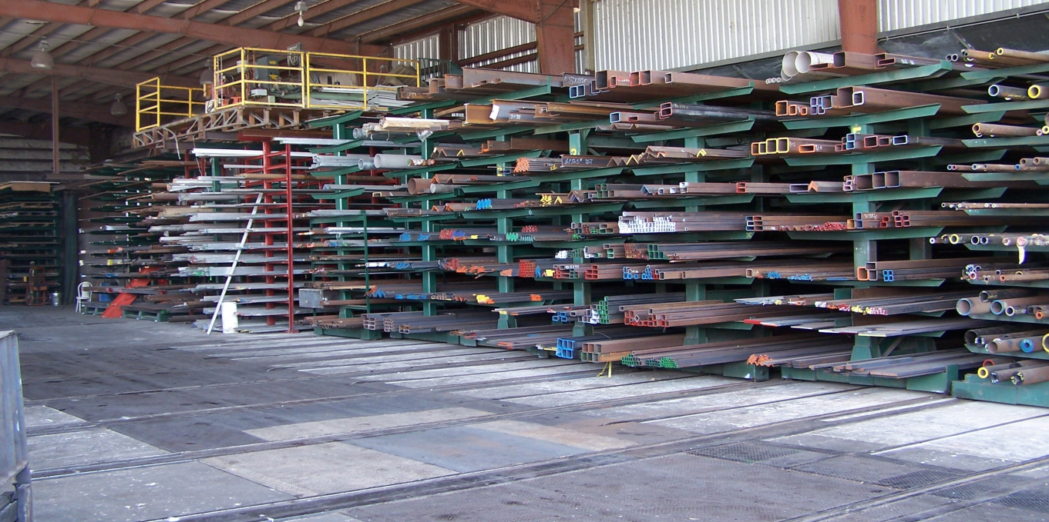
Breakout groups
2. Contracting
With whom will contracts need to be made?
Local
Regional
International

Slide 21
Breakout groups
3. Code of Conduct
What issues should the code of conduct cover, and what stance should be taken?
Similar codes do exist:
The Oslo Agreement
The Red Cross code of conduct

Slide 22

Breakout groups
Principles of Conduct for The International Red Cross and Red Crescent Movement
The humanitarian imperative comes first.
Aid is given regardless of the race, creed or nationality of the recipients and without adverse distinction of any kind. Aid priorities are calculated on the basis of need alone.
Aid will not be used to further a particular political or religious standpoint.
We shall endeavour not to act as instruments of government foreign policy.
We shall respect culture and custom.

Slide 23
Breakout groups
Principles of Conduct for The International Red Cross and Red Crescent Movement
The humanitarian imperative comes first.
Aid is given regardless of the race, creed or nationality of the recipients and without adverse distinction of any kind. Aid priorities are calculated on the basis of need alone.
Aid will not be used to further a particular political or religious standpoint.
We shall endeavour not to act as instruments of government foreign policy.
We shall respect culture and custom.

Slide 24
Breakout groups
Breakout group activities
Discuss the selected topic within each group
Identify who will lead and who will participate in future meetings
Define how participants will meet and when
Form working groups to continue progress on these topics
Produce Terms of Reference for the working group
Plan what outputs are to be expected by SM11a

Slide 25
Breakout groups
Breakout group activities
Take time to discuss issues and stakeholder needs at both a local and an international level:
30 minutes
Local
National
Regional
30 minutes
International
30 minutes
Consolidation of findings

Slide 26

Shelter Partners Forum
Coffee break
Please sign up for a breakout group and be back in time for continuation of the conference at 11:00
Membership of working groups does not depend on attendance at the respective breakout group!

Slide 27
Agenda
08:30 – 09:00
09:00
09:15
09:30
09:45
10:00
10:15
10:30 – 11:00
11:00
12:30 – 13:30
13:30
14.30
15.00
15:15
15:30 – 15:45
15:45
16:30
17:30
19:30
Arrival and coffee
Welcome, conference purpose and agenda – Tom Corsellis, Shelter Centre
Keynote speech – Niels Scott, UN/OCHA
Keynote speech – Alex Wong, World Economic Forum
Keynote speech – Dr. Randolph Kent, Kings College London
Keynote speech – Lee Malany, American Red Cross
Introduction to breakout groups
Coffee break
Breakout groups Stakeholder discussions
Lunch
Plenary Breakout group feedback to the plenary
Plenary Humanitarian “Yellow Pages”
Plenary Future of Shelter Partners Forum
Plenary Introduction to the Transitional Shelter Prototype project
Coffee break
Demonstration Prototype Shelter Tour
Plenary Transitional Shelter Prototype Consortium
Close
Shelter Partners Forum and Shelter Meeting dinner. Flyer in information pack

Slide 28
Breakout groups
Breakout group activities
Discuss the selected topic within each group
Identify who will lead and who will participate in future meetings
Define how participants will meet and when
Form working groups to continue progress on these topics
Produce Terms of Reference for the working group
Plan what outputs are to be expected by SM11a

Slide 29
Breakout groups
15 minutes remaining!
Breakout group activities

Slide 30

Shelter Partners Forum
Lunch
Please be back in time for the feedback plenary at 13:45

Slide 31
Agenda
08:30 – 09:00
09:00
09:15
09:30
09:45
10:00
10:15
10:30 – 11:00
11:00
12:30 – 13:30
13:30
14.30
15.00
15:15
15:30 – 15:45
15:45
16:30
17:30
19:30
Arrival and coffee
Welcome, conference purpose and agenda – Tom Corsellis, Shelter Centre
Keynote speech – Niels Scott, UN/OCHA
Keynote speech – Alex Wong, World Economic Forum
Keynote speech – Dr. Randolph Kent, Kings College London
Keynote speech – Lee Malany, American Red Cross
Introduction to breakout groups
Coffee break
Breakout groups Stakeholder discussions
Lunch
Plenary Breakout group feedback to the plenary
Plenary Humanitarian “Yellow Pages”
Plenary Future of Shelter Partners Forum
Plenary Introduction to the Transitional Shelter Prototype project
Coffee break
Demonstration Prototype Shelter Tour
Plenary Transitional Shelter Prototype Consortium
Close
Shelter Partners Forum and Shelter Meeting dinner. Flyer in information pack

Slide 32

Breakout groups
Feedback
Breakout group presentations
Including:
What issues were discussed?
Who will lead the group?
What outputs are expected, and when?

Slide 33


Breakout groups
Conclusions
Formation of working groups
Resources
Contracting
Coordination

Slide 34
Humanitarian “Yellow Pages”?
How can the humanitarian sector quickly access
the private sector?
Tom Corsellis, Shelter Centre
?
Proposal

Slide 35
Contents of this proposal
This proposal is to gauge interest in setting up a working group for the development of a web listing of private sector capacities, nationally, regionally and globally
  Problem statement
  Current resources and models
  Opportunities
  Proposed working group remit
  Plenary

Slide 36
1. Problem statement
Private sector capacities and commodities available to governmental and humanitarian stakeholders are not generally recorded, except by major agencies for major international suppliers for core commodities
Governmental and humanitarian stakeholders have no way of understanding the reliability or quality of private sector capacities and commodities
Governmental and humanitarian stakeholders have no way of understanding whether private sector capacities and commodities meet agreed standards
Private sector capacities have limited access to agreed standards

Slide 37
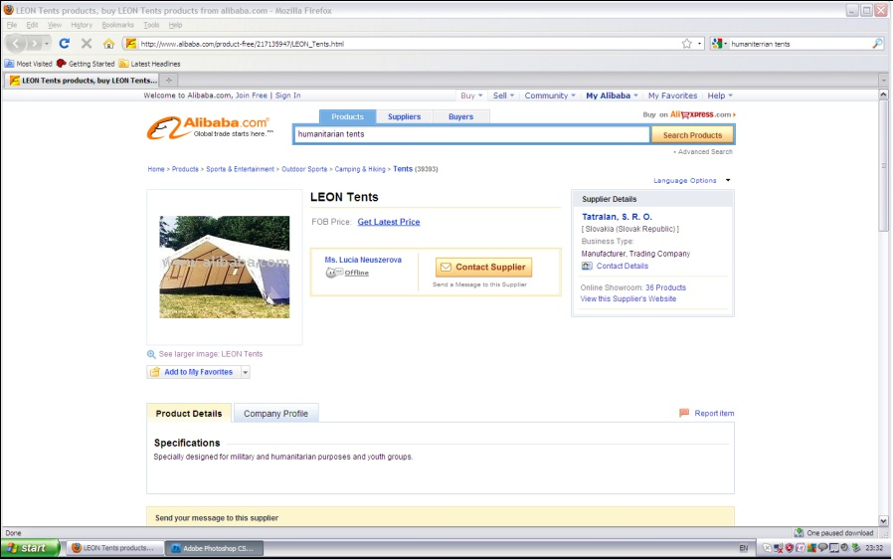
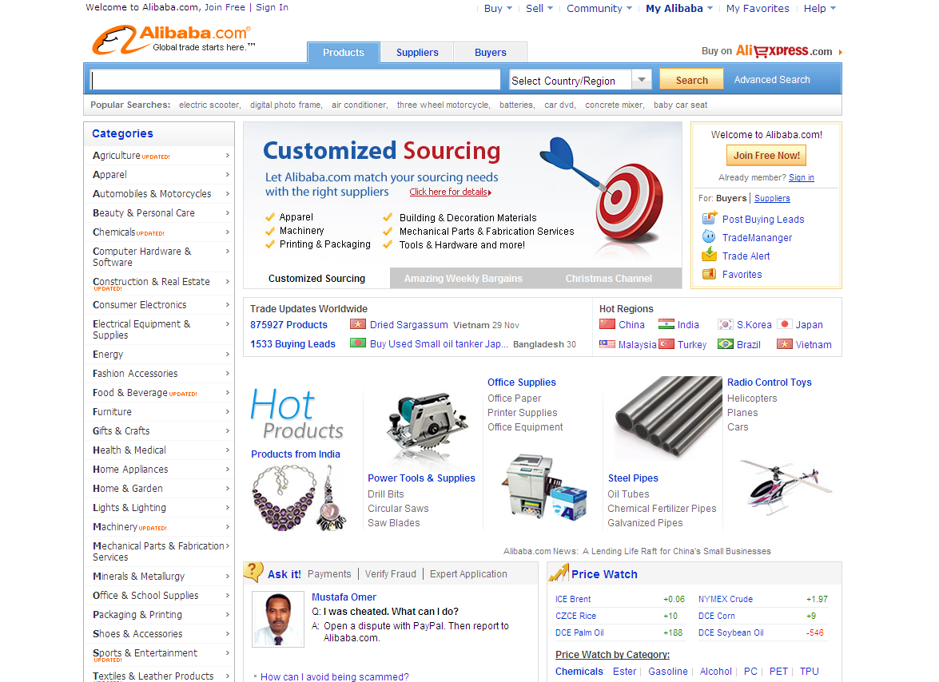
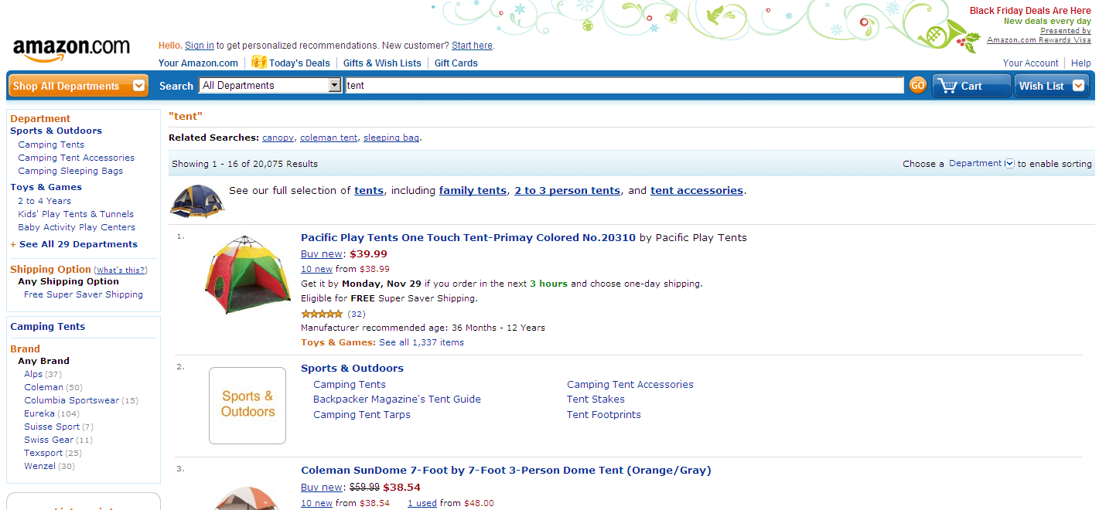
  2. Current resources & models
Sophisticated databases exist of private sector capacities and commodities, both those maintained by the website provider and those maintained by the advertising private sector capacities

Slide 38
3. Opportunities
Opportunities in creating an humanitarian ‘Yellow Pages’, listing private sector capacities include the following:
national, regional and global capacities identified during a specific response may be captured and become part of preparedness
capacities may be rated by governmental and humanitarian customers in terms of quality and service
products may be listed against agreed existing standards and the catalogues of humanitarian agencies, such as those of Oxfam, MSF and the Red Cross Movement
agreed standards may be listed

Slide 39
4. Proposed working group remit
The working group proposed would collaborate between this forum and the next Shelter Partners forum in order to:
determine the level of support for the proposal, within the governmental, humanitarian and private sectors
explore with existing similar resources and models likely opportunities and challenges
explore potential hosting and maintennace models
explore potential software models
explore potential funding models

Slide 40



5. Plenary
The questions for completion in your feedback sheet are:
Do you feel that a humanitarian “Yellow Pages” tool would be useful?
Do you want to join the working group to develop this project?
Please do not forget to fill in your feedback sheet and hand it in to a Shelter Centre assistant before leaving
For more information, questions and comments, contact
info@sheltercentre.org

Slide 41
Future of the Shelter Partners Forum
Tom Corsellis, Shelter Centre

Slide 42
Plenary
The future of the Shelter Partners Forum
Question 1
Do you feel that Shelter Partners Forum has the potential to develop engagement between the private and humanitarian sectors?
Question 2
How often would your organisation be likely to attend a Shelter Partners Forum?
Please don’t forget to fill in your question sheet and hand it in to a SC assistant before leaving

Slide 43
Travel Update
Lyon
Airport now open with occasional flights leaving
033 826 800 826
Airport closed until at least 18h00
Further information will be available at 16h00
Airport is open
0900 300 313
Geneva
Zurich

Slide 44
Shelter Partners Forum
Shelter Partners Forum 10b
CLOSED

Slide 45
Timeline for this afternoon
The Transitional Shelter Prototype project: A case study of humanitarian/private sector engagement
Coffee break
Demonstration Prototype Shelter tour
Plenary Transitional Shelter Prototype Consortium
Close
Shelter Partners Forum and Shelter Meeting dinner – Il Fornello Napoletano - flyer in information pack
15:15
15:30
15:45
16:30
17:30
19:30

Slide 46
An example of engagement
The Transitional Shelter Prototypes Project is a good case study of successful engagement between the private sector and the humanitarian sector
Funded by DFID: 2006 – 2011 as part of 10 deliverables
Collaborative process between the humanitarian and private sectors
Outputs expected to include standards and a field test of a prototype shelter

Slide 47
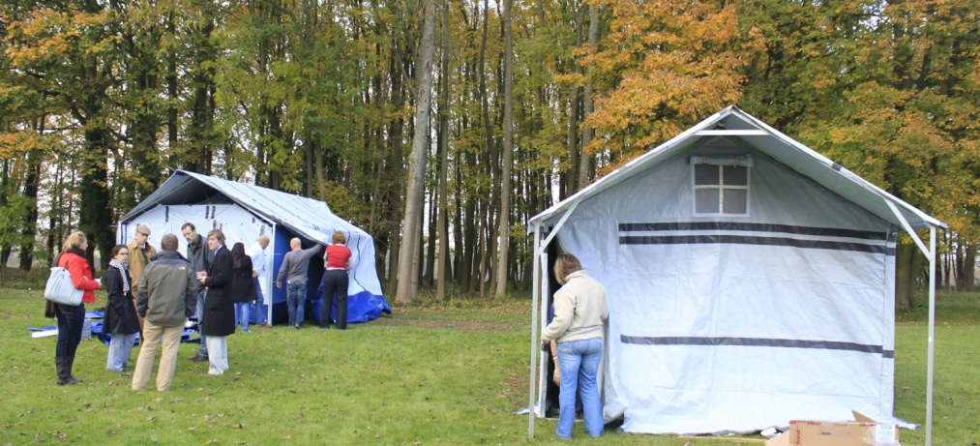
Introduction to the Transitional Shelter Prototype project
Harry Crofton, Shelter Centre

Slide 48

Content of this presentation
  Definitions
  The project so far
4. The evaluation at Kemble
5. Conclusion

Slide 49

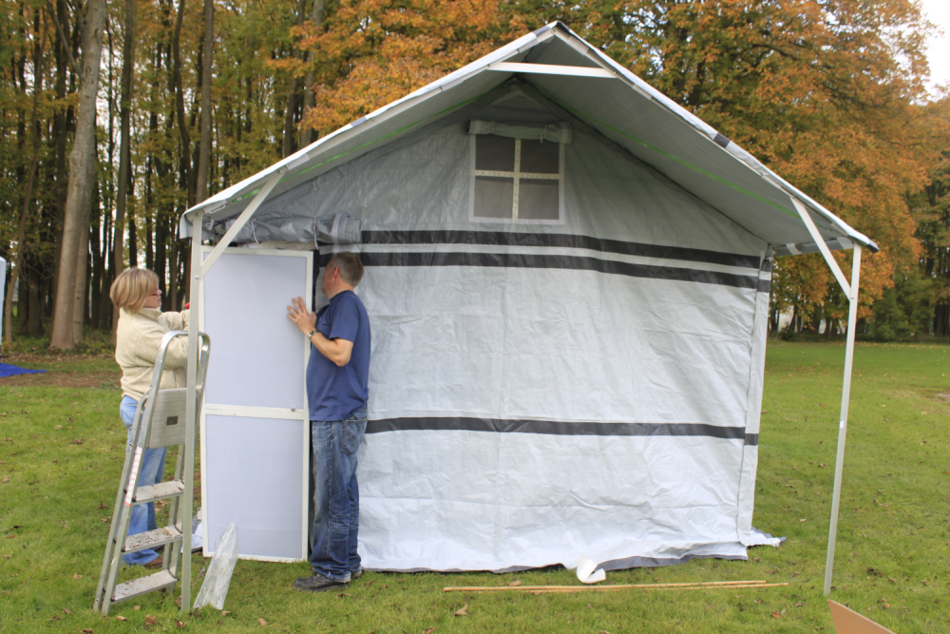
1. Definitions
What is a stockpilable transitional shelter?
Transitional shelter is an approach, not a product
A stockpilable transitional shelter is useful in certain situations

Slide 50
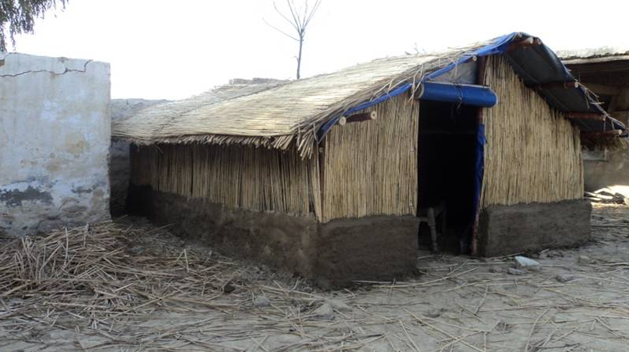
1. Definitions
What is a stockpilable transitional shelter?
Stockpilable transitional shelters are not a panacea!
Response is not necessarily linear – transitional shelters can be used to fill current or future gaps
Pakistan, 2010, photo by Swiss Labour Association

Slide 51
Content of this presentation
  Definitions
  The project so far
4. The evaluation at Kemble
5. Conclusion

Slide 52
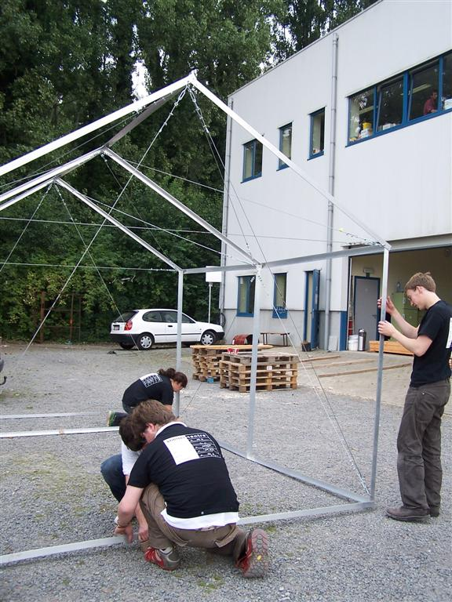
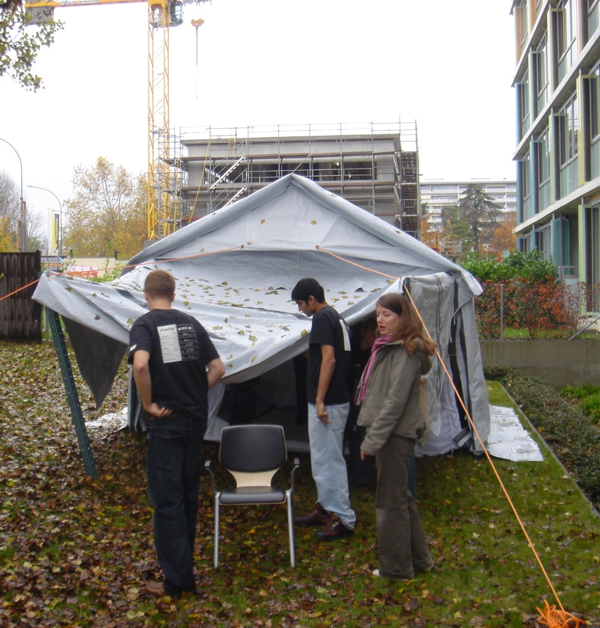
2. The project so far
Shelter Centre developed a prototype shelter in 2006

Slide 53
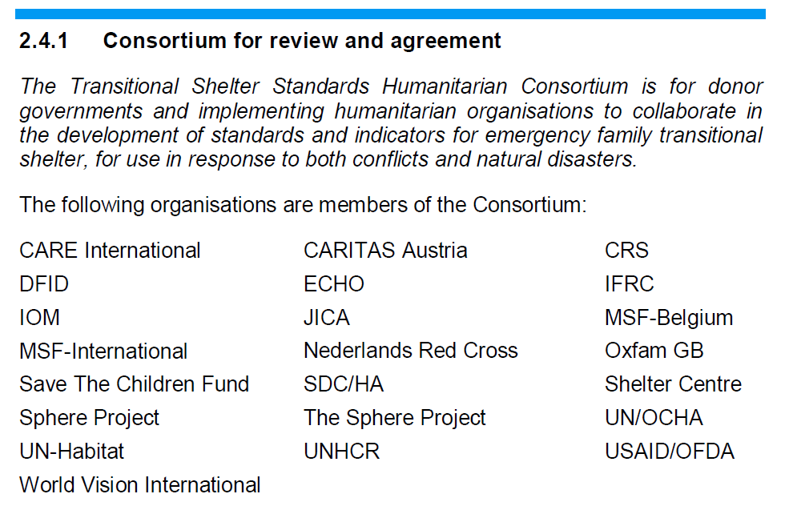
2. The project so far
A consortium of humanitarian agencies was formed at the beginning of the prototypes project in 2006

Slide 54










2. The project so far
The private sector was engaged at ‘Aid and Trade’ in 2008
At the same time the first Transitional Shelter Standards were launched
Manufacturers Prototypes at SM10a

Slide 55

2. The project so far
Standards are in development and are in the process of finalisation

Slide 56
Content of this presentation
  Definitions
  The project so far
4. The evaluation at Kemble
5. Conclusion

Slide 57
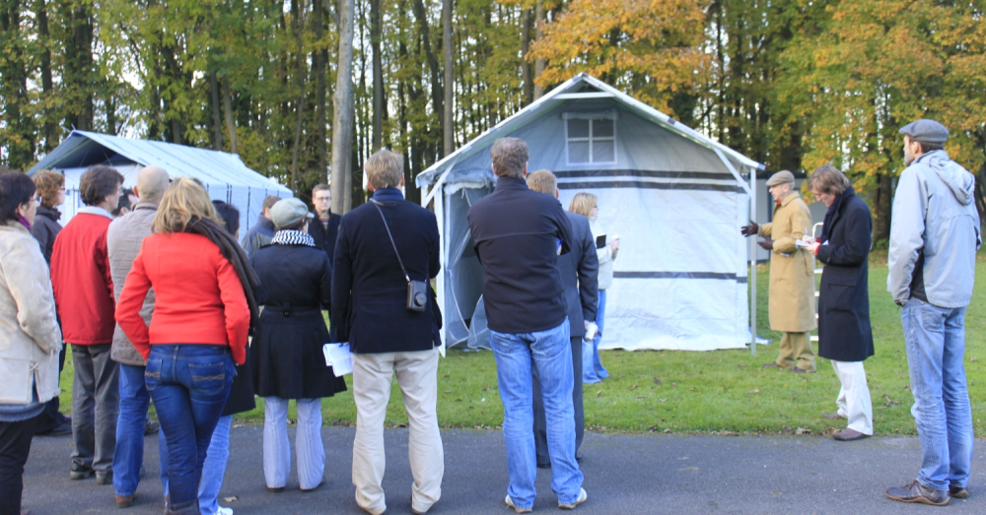
3. The evaluation at Kemble
Focused evaluation of two shelters at the DFID facility in Kemble, UK
Wide participation from the humanitarian, private and academic sectors
Expert commentary on the displayed shelters

Slide 58
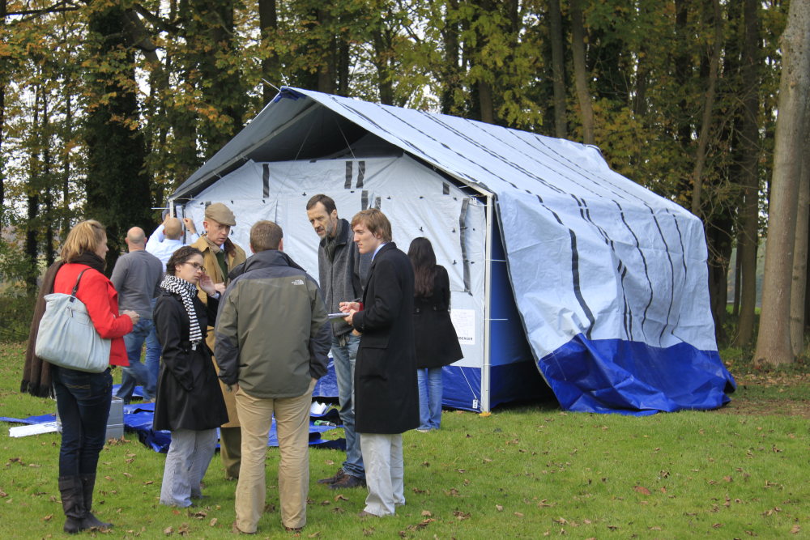
3. The evaluation at Kemble
Lessons learned
Upgradability options for hazard resistance are very important
Whole life cycle costs must be taken into account
Many organisations cannot afford a ‘super shelter’ that does everything

Slide 59
Content of this presentation
  Definitions
  The project so far
4. The evaluation at Kemble
5. Conclusion

Slide 60
4. Conclusion
Standards will be presented on Friday
What are the barriers to procurement?
Feedback and more information: prototypes@sheltercentre.org

Slide 61
Thank you

Slide 62
Shelter Partners Forum
Coffee break

Slide 63
Agenda
08:30 – 09:00
09:00
09:15
09:30
09:45
10:00
10:15
10:30 – 11:00
11:00
12:30 – 13:30
13:30
14.30
15.00
15:15
15:30 – 15:45
15:45
16:30
17:30
19:30
Arrival and coffee
Welcome, conference purpose and agenda – Tom Corsellis, Shelter Centre
Keynote speech – Niels Scott, UN/OCHA
Keynote speech – Alex Wong, World Economic Forum
Keynote speech – Dr. Randolph Kent, Kings College London
Keynote speech – Lee Malany, American Red Cross
Introduction to breakout groups
Coffee break
Breakout groups Stakeholder discussions
Lunch
Plenary Breakout group feedback to the plenary
Plenary Humanitarian “Yellow Pages”
Plenary Future of Shelter Partners Forum
Plenary Introduction to the Transitional Shelter Prototype project
Coffee break
Demonstration Prototype Shelter Tour
Plenary Transitional Shelter Prototype Consortium
Close
Shelter Partners Forum and Shelter Meeting dinner. Flyer in information pack

Slide 64
Demonstration
Prototype Shelter Tour

Slide 65
Plenary
Transitional Shelter Prototype Consortium
Tom Corsellis, Shelter Centre

Slide 66
Plenary
Transitional Shelter Prototype consortium
Question 1
What are the barriers to procurement?
More questions?!
Please don’t forget to fill in your question sheet and hand it in to a SC assistant before leaving

Slide 67
Agenda
08:30 – 09:00
09:00
09:15
09:30
09:45
10:00
10:15
10:30 – 11:00
11:00
12:30 – 13:30
13:30
14.30
15.00
15:15
15:30 – 15:45
15:45
16:30
17:30
19:30
Arrival and coffee
Welcome, conference purpose and agenda – Tom Corsellis, Shelter Centre
Keynote speech – Niels Scott, UN/OCHA
Keynote speech – Alex Wong, World Economic Forum
Keynote speech – Dr. Randolph Kent, Kings College London
Keynote speech – Lee Malany, American Red Cross
Introduction to breakout groups
Coffee break
Breakout groups Stakeholder discussions
Lunch
Plenary Breakout group feedback to the plenary
Plenary Humanitarian “Yellow Pages”
Plenary Future of Shelter Partners Forum
Plenary Introduction to the Transitional Shelter Prototype project
Coffee break
Demonstration Prototype Shelter Tour
Plenary Transitional Shelter Prototype Consortium
Close
Shelter Partners Forum and Shelter Meeting dinner. Flyer in information pack

Slide 68
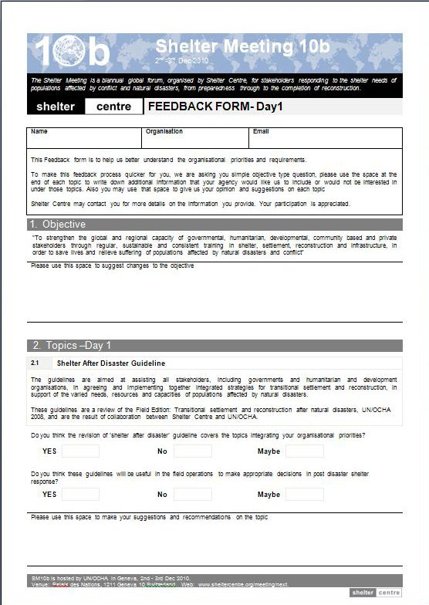
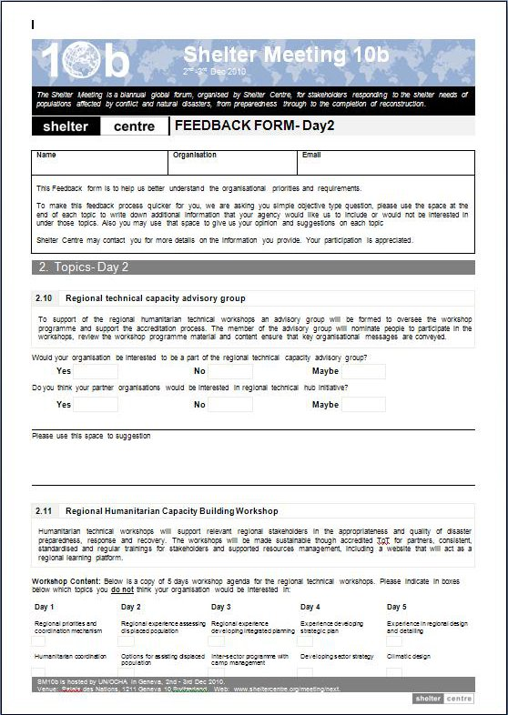
Feedback
!
Please don’t forget to fill in your question sheet and hand it in to a SC assistant before leaving

