Slide 1
Co-organized by:

Slide 2
WHEN / WHERE
2nd Asia-Pacific Housing Forum (first in 2007 hosted in Singapore)
Hosted in the Philippines
7 – 9th September 2009
Attended by 440 delegates from 36 countries
NGOs (52%); Government (16%); Private (12%)
2nd Asia-Pacific Housing Forum
Co-organized by:
www.aphousingforum.org

Slide 3
AIMS
examine concrete solutions for housing the urban poor;
alternative approaches for housing the urban poor
scalable models involving government authorities, businesses and social organizations
relief and development stakeholders can explore strategies to bridge the gaps
2nd Asia-Pacific Housing Forum
Co-organized by:
www.aphousingforum.org

Slide 4
PANEL TOPICS
Housing Policy and the Global Financial Crisis
Linking Disaster Response with Sustainable Development
Addressing the Problem of Urban Slums
Innovative Housing Finance
2nd Asia-Pacific Housing Forum
Co-organized by:
www.aphousingforum.org

Slide 5
TRACKS / THEMES
UNESCAP Training on Housing the Urban Poor
Housing Policy and Strategy
Housing Technology and Finance
Housing Indicators, Impact and Support Services
Rethinking Housing & Emergencies
2nd Asia-Pacific Housing Forum
Co-organized by:
www.aphousingforum.org

Slide 6
Housing & Emergencies
Presentations
Enhancing Community Participation in Disaster Response: The Yogyakarta Experience
Post-Disaster Reconstruction to Promote Sustainable Development
Rethinking Emergencies: Linking Water and Sanitation in Disasters with Long Term Development
Sphere Revision: Update and Implications for Sheltering in Emergencies
Coordinated Pro-Bono Professional Services for Construction NGOs
Rethinking Emergencies: Alternative Emergency Shelter
Steel Frames: Making High-End Technology Work for the Poor
Disaster-Proof Development
Developing Partnerships in Logistics for an Effective Disaster Response
Challenges in Mainstreaming DRR in Urban Local Government Sector
2nd Asia-Pacific Housing Forum
Co-organized by:
www.aphousingforum.org

Slide 7
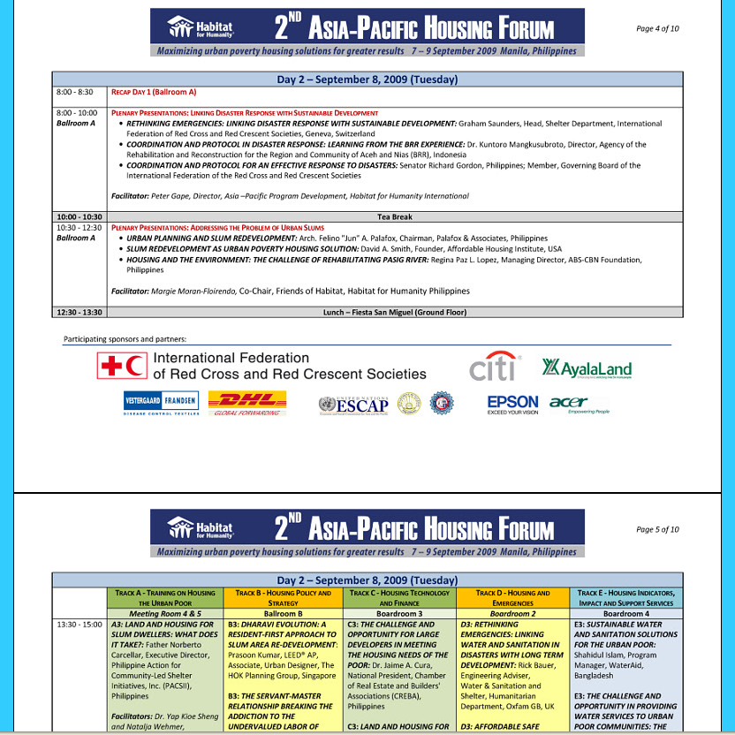
Full three day program
2nd Asia-Pacific Housing Forum
Co-organized by:
www.aphousingforum.org

Slide 8
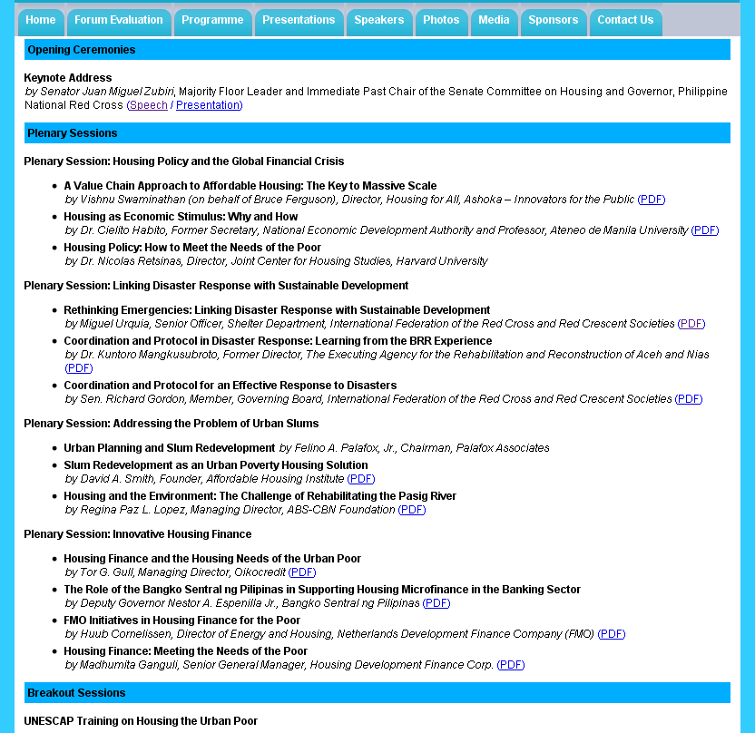
80+ Presentations in PDF format
2nd Asia-Pacific Housing Forum
Co-organized by:
www.aphousingforum.org

Slide 9
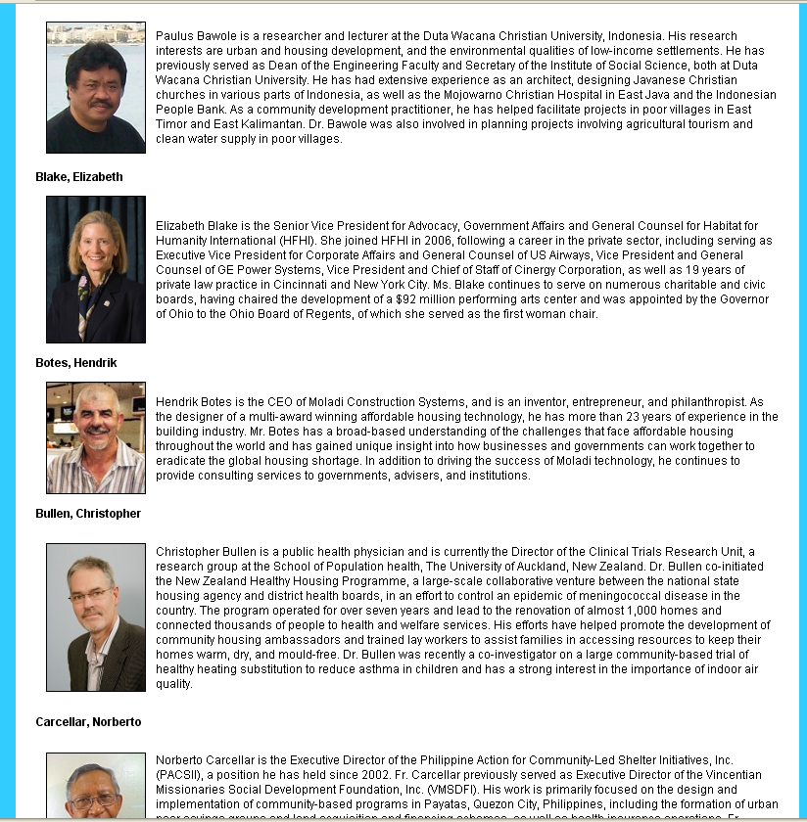
70+
Speaker Profiles
2nd Asia-Pacific Housing Forum
Co-organized by:
www.aphousingforum.org

Slide 10
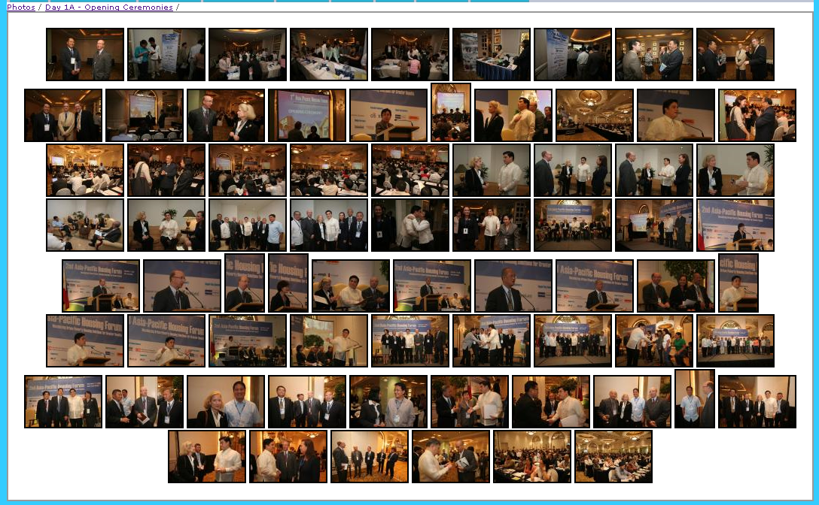
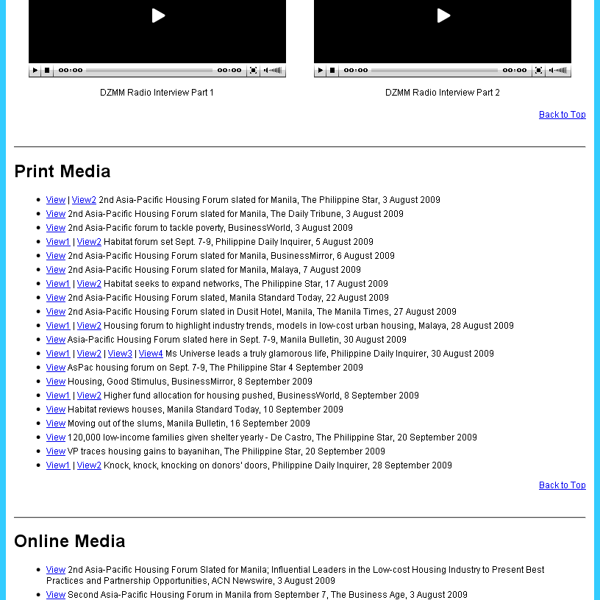
Event
Photos
Sponsors
Recognition
Media Coverage
2nd Asia-Pacific Housing Forum
Co-organized by:
www.aphousingforum.org

Slide 11
WHAT NEXT
3rd Asia-Pacific Housing Forum
Bangkok
12 – 14 September 2011
Call for papers / speakers next year, subjects to include disaster response, DRR, climate change and all their links with shelter, housing and settlements, and your suggestions
2nd Asia-Pacific Housing Forum
Co-organized by:
www.aphousingforum.org

Slide 12
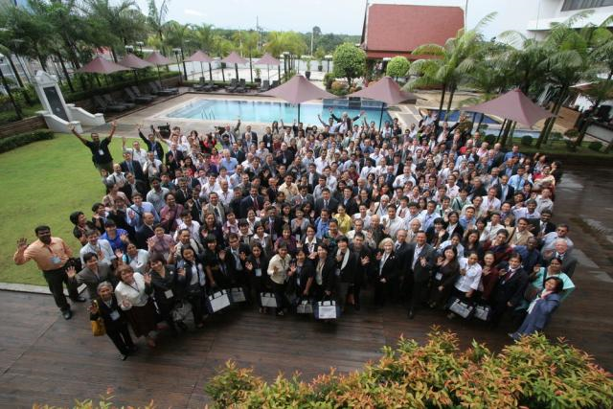
www.aphousingforum.org
Thank You!
2nd Asia-Pacific Housing Forum
Co-organized by:
www.aphousingforum.org

