Slide 1



The Shelter and Settlement Library
Tom Corsellis, Shelter Centre

Slide 2



Contents
- Project overview
- From current, beta to final library
- Existing and new features
- More than 1000 new resources
- Channels
- Regional Advisory Groups (RAGs)
- Humanitarian Taxonomy
- Humanitarian Library

Slide 3
Project overview
  Scope
  - Objective 1: Develop and support the Shelter Library
  - Objective 2: Develop and support a community of practice to sustain Objective 1
  Timeline
  - Original timeframe was 1 year
  - Started in August 2012
  Ends November 2013 (with no-cost extension of 2 months)
What’s still to come?
Finetuning of design
Developing world’s first Humanitarian Taxonomy
Migration of content from http://sheltercentre.org/library
- Regional Tour to Promote Library

Slide 4
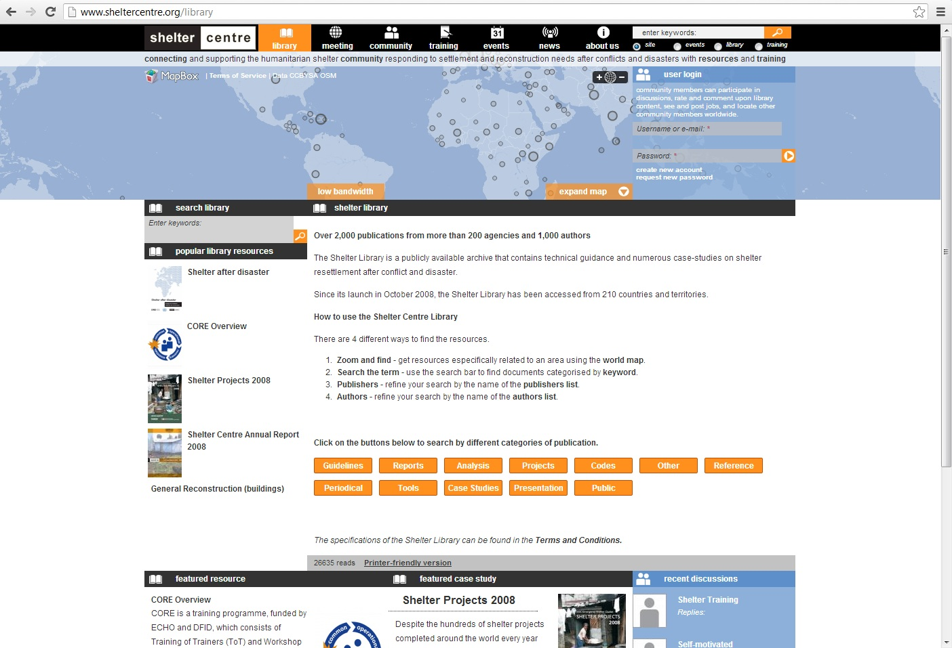
Current Shelter Centre library

Slide 5
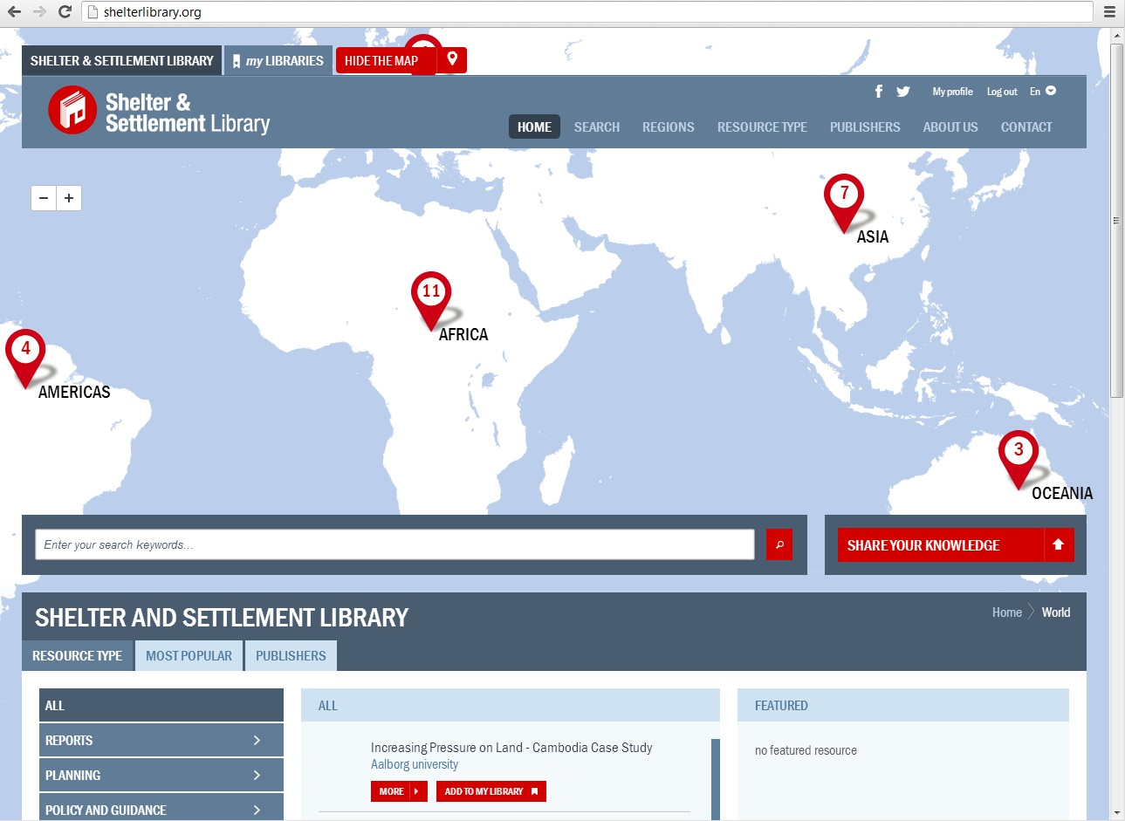
Beta version of Shelter & Settlement Library

Slide 6
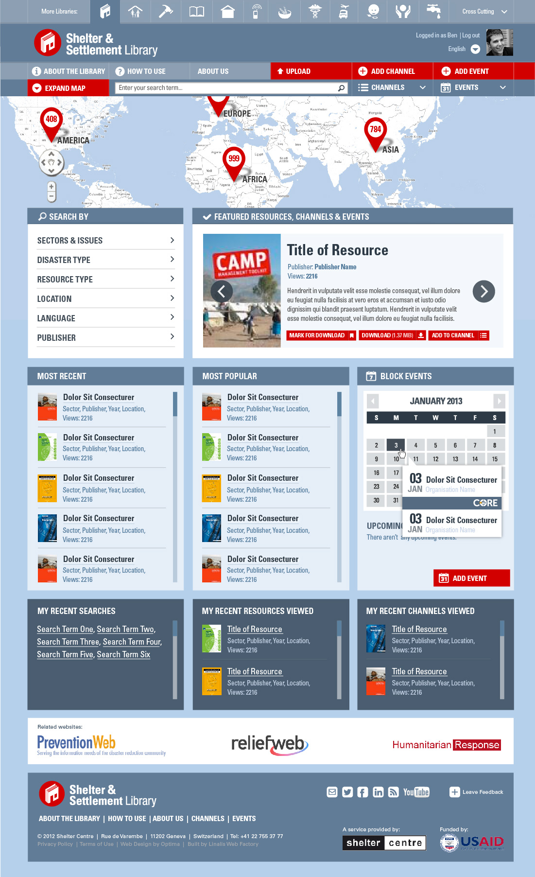
Final version of Shelter & Settlement Library

Slide 7
Existing features of the library
- Users can upload documents – in any language
- Users can create and share ‘channels’ within the library, supporting specific organisations, operations, topics, handovers and trainings
- Intelligent searches list search results based
on the popularity of documents
- Searches of the library will suggest other
documents of interest to users

Slide 8
New features of the library
- Users can comment on resources and channels, allowing for discussion around certain topics
- Trusted users can promote resources, giving them more visibility in the library
- Users can bookmark resources for later download, this is useful in areas with low bandwidth
- Humanitarian library with libraries for each cluster/sector ensures that resources are properly categorised

Slide 9
More than 1000 new resources
- Capacity and location of the country’s main suppliers of relevant goods and services
- Housing typologies and their vulnerabilities to prevalent hazards
- Hazard vulnerability
- Relevant local laws and regulations such as building and zoning codes, land tenure regulations and labour regulations

Slide 10

Channels
Click ‘create channel’ on the library website
Upload new resources, or add already existing ones to your channel

Slide 11
Regional Advisory Groups (RAGs)
- RAG members support with identification of resources and dissemination of the library amongst their peers
- Currently around 20 RAG members, covering Africa, Americas, Asia and Europe
- Initial meetings held via WebEx in June 2013
- Feedback from RAG members has been included in the redesign of the library website

Slide 12
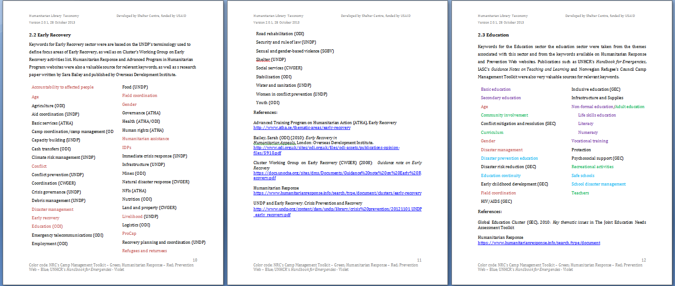
Humanitarian Taxonomy
Shelter Centre is developing a Humanitarian Taxonomy, which is based on existing UN taxonomies and expanded with terms from other reputable sources such as PreventionWeb, ShelterCluster.org and Shelter Centre’s existing taxonomy.

Slide 13
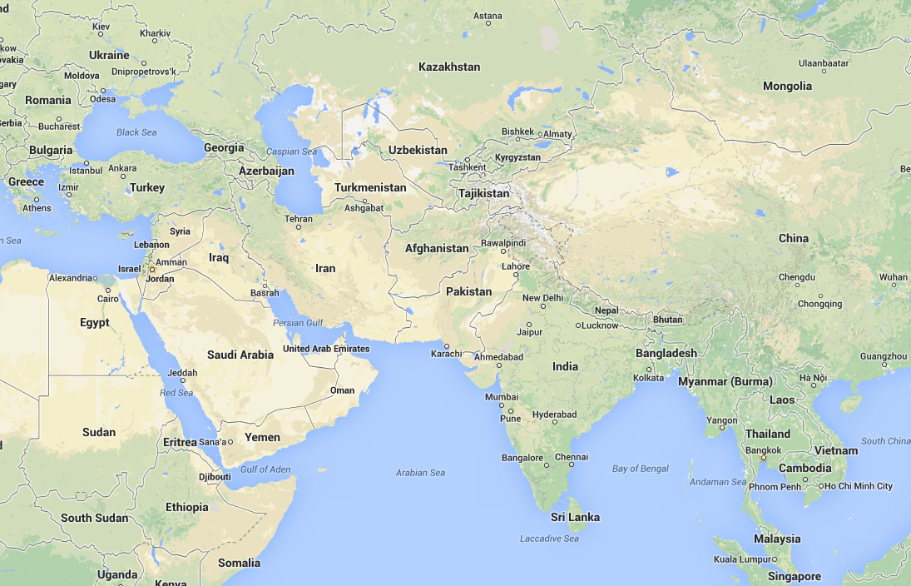
Regional Tour
- Receiving feedback and increasing uptake and usage of the library
- Regional consultation for the one-week training
- Takes place in November

Slide 14


Slide 15
Humanitarian Library
- Born out of the need for a library the encompasses all sectors: USAID, for instance, uses a definition for shelter & settlement that is wider than the cluster definition of shelter, so where do you go to find all information related to shelter & settlement or any other sector?
  - There is currently no other global humanitarian library: the UN/OCHA global resources www.reliefweb.int and www.humanitarianresponse.info support information management, not knowledge management: they do not have common libraries
  - Global humanitarian library knowledge management compliments global UN information management

Slide 16
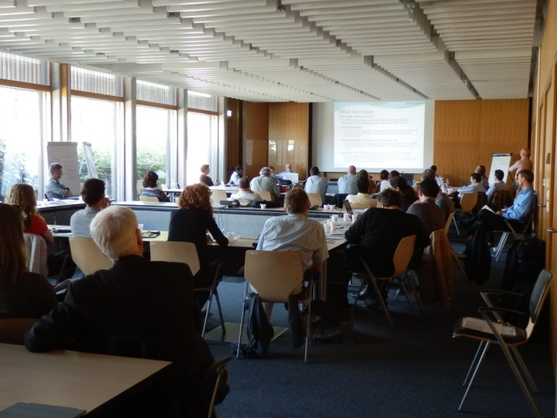
Today’s break out sessions
14h30 – 15h00
  How might the channels be of most use to agencies and initiatives?
  How might the channels be of most use to field workers and operations?
  How might the channels be of most use to new innovations and research?
  How might we best engage and involve the existing knowledge bases that you use? e.g. ReliefWeb, PreventionWeb, HumanitarianResponse, academia, private sector etc.
15h00 – 15h30
Plenary session

