Slide 1
One-Week Shelter and Settlement Training Course
Tom Corsellis, Shelter Centre

Slide 2
Contents
Project overview
Project phases
Proposed one-week agenda
Today’s break out sessions

Slide 3
Project overview
one-week training curriculum
USAID/OFDA funded
open-source
consistent with previous trainings
modular character enables trainers to tailor their course to their own needs
available on the USAID website and Shelter and Settlement Library

Slide 4
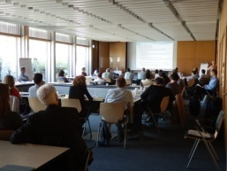
Project phases
consultations
1st round Shelter Meeting break out sessions, Oct 2013
2nd round Amman, Bangkok, Nov 2013
3rd round InterAction, Dec 2013
pilot training in USA, Feb 2014
production of open-source materials
trainer manual
participant manual

Slide 5
Proposed one-week agenda
focus on sector terminology and strategic planning approaches
Day 1 Coordination and Assessment
Day 2 Strategies, Programmes and Projects
Day 3 Settlement Options
Day 4 Shelter Options
Day 5 Protection, Risks and Hazards

Slide 6
Today’s break out sessions
14.00 – 15.00
Who should training be for?
e.g. government, NGOs, INGOs
2. How should training be delivered?
e.g. consultancy, franchise, centralised
3. What content should be included?
e.g. proposed one-week agenda
4. What should a sample session look like?
e.g. structure and methodology
15.00 – 15.30
Plenary session

Slide 7
Please sign up to a break out group over lunch
Thank you!

