Slide 1
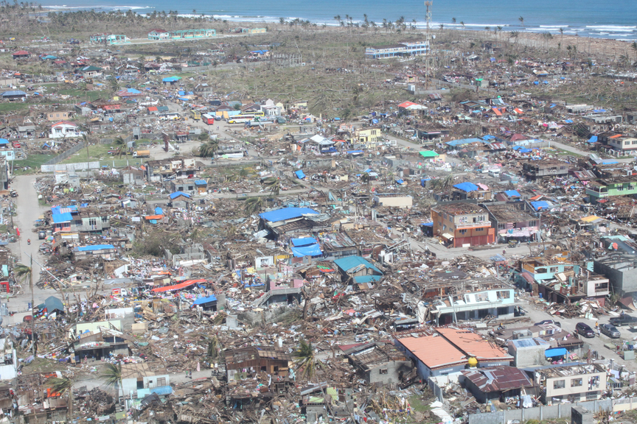
Philippines Typhoon Bopha, 4 Dec. 2012
647 dead; 1,482 injured; 780 missing; Approximately 490,000 households (5.4 million people) were considered affected in 30 provinces

Slide 2
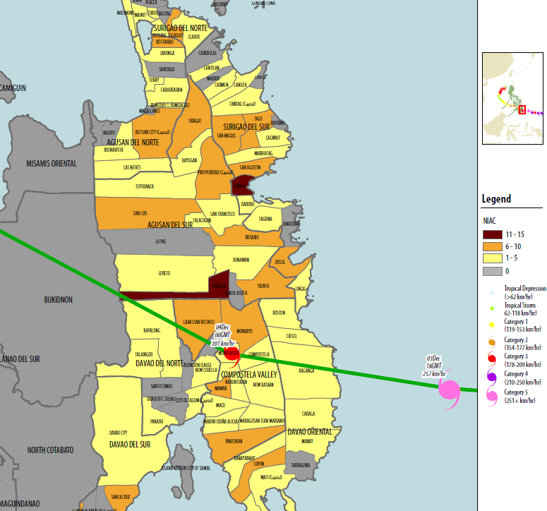

Slide 3
Objectives:
The population receive assistance for the reconstruction of their damaged or destroyed houses.
The population have a better knowledge of good construction practices, so that the reconstructed houses are more resistant to natural disasters.
Local skilled and unskilled labourers receive work and training and thus an income opportunity.
Partial cleaning of arable land of fallen trees (which will favour an increased agricultural productivity).

Slide 4
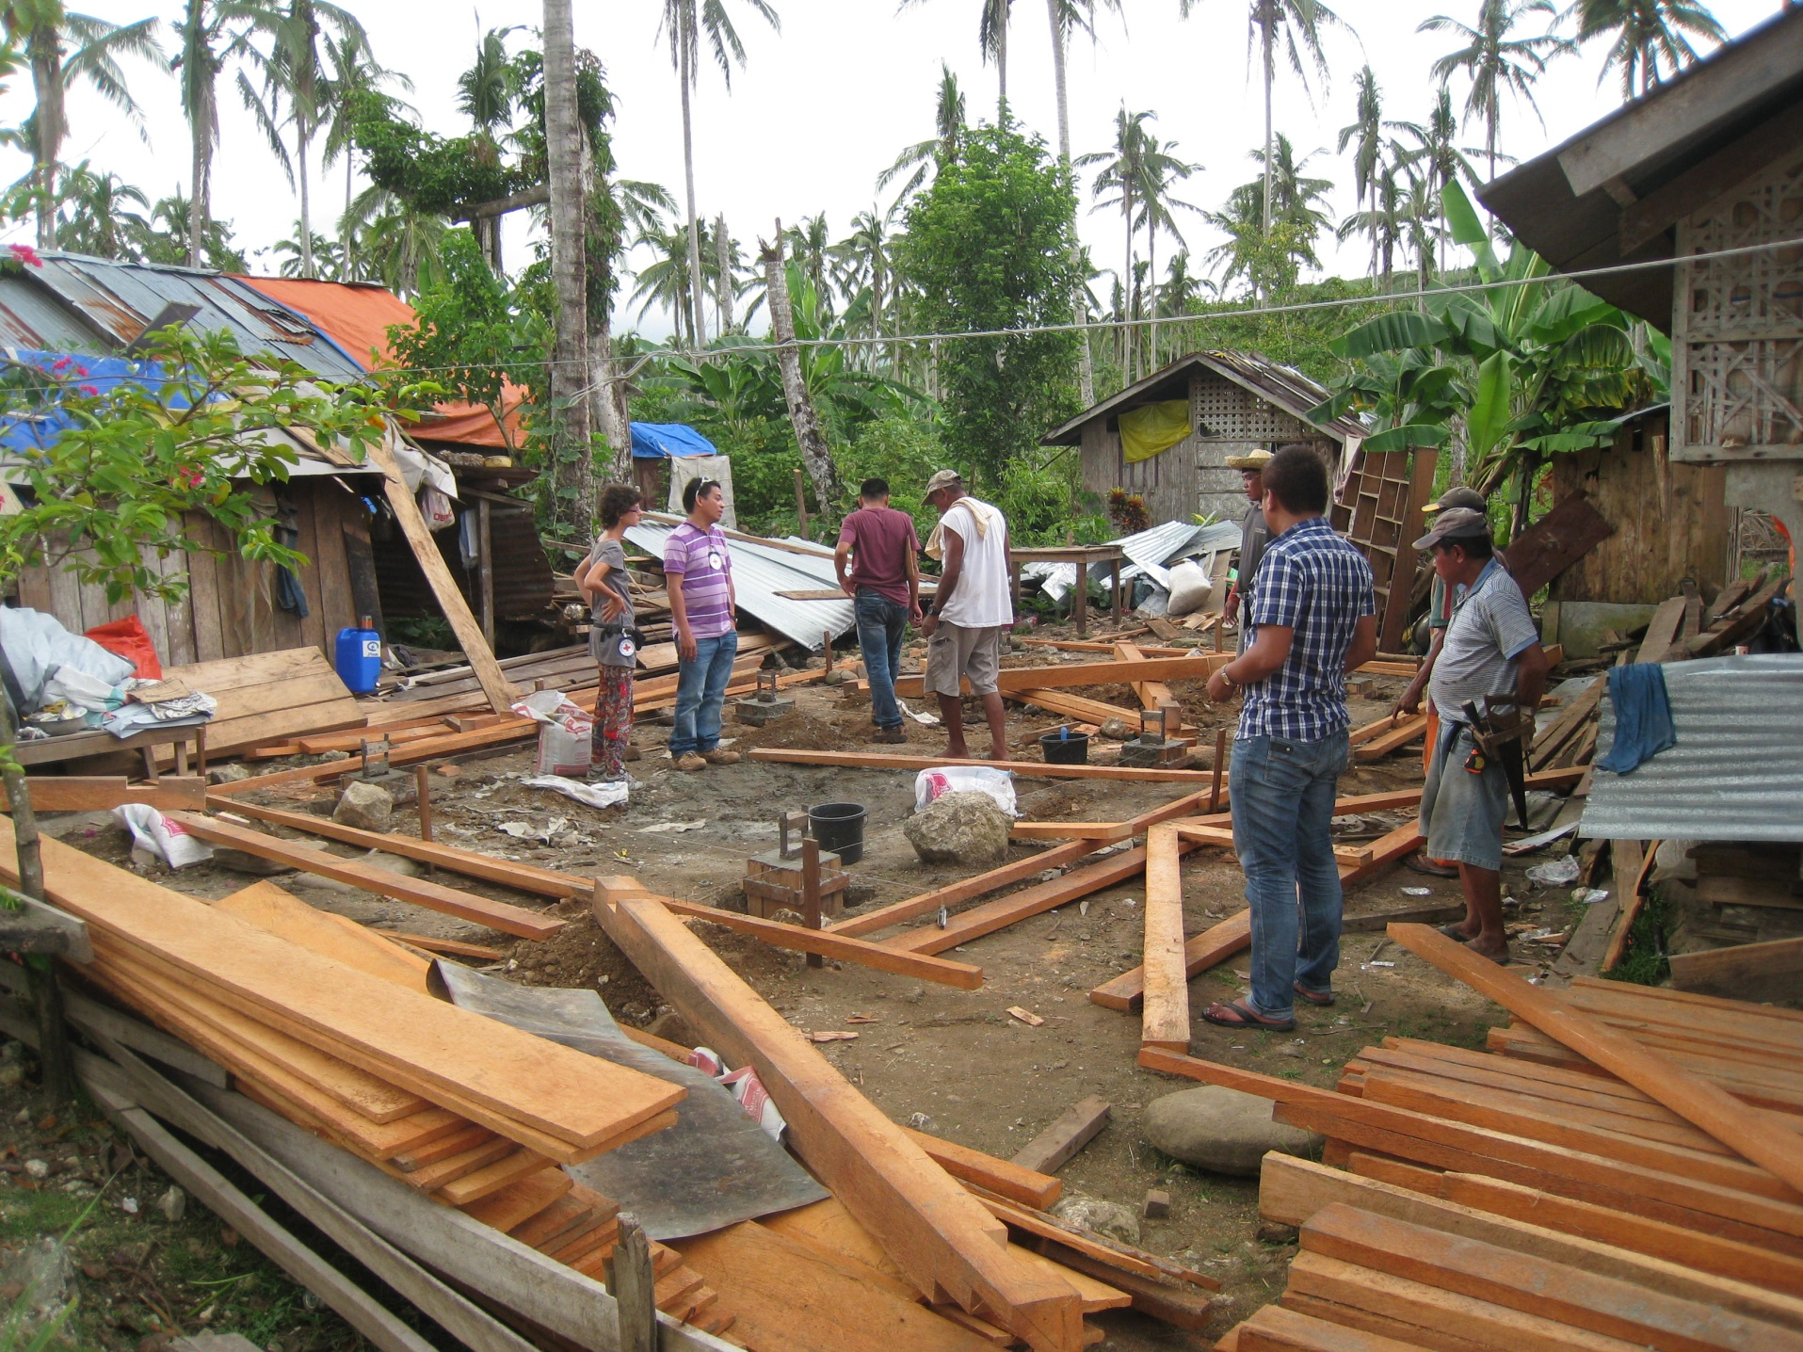
Selection of Beneficiaries
Households that are not enrolled in other organisations’ reconstruction programs
Totally destroyed houses are prioritised over damaged ones
Own a plot of land eligible for construction. (Not in a no-build zone.)
Vulnerability

Slide 5
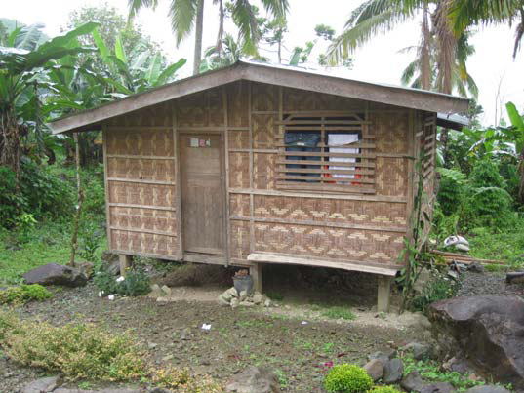
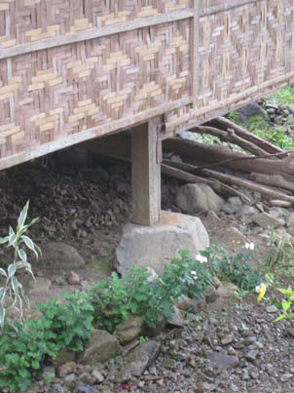
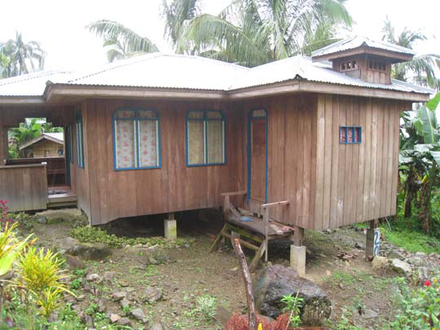
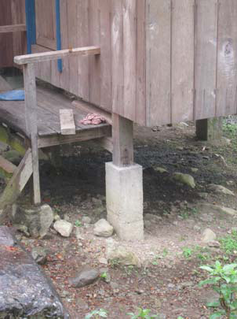

Slide 6
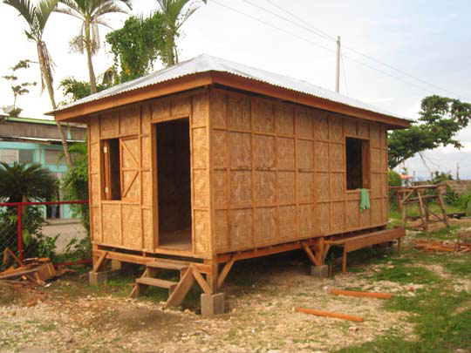
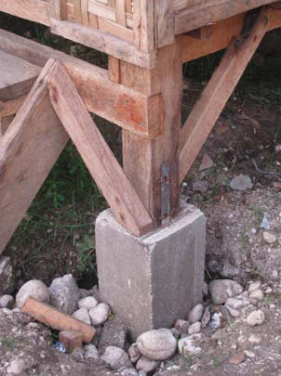
Proposed shelter

Slide 7
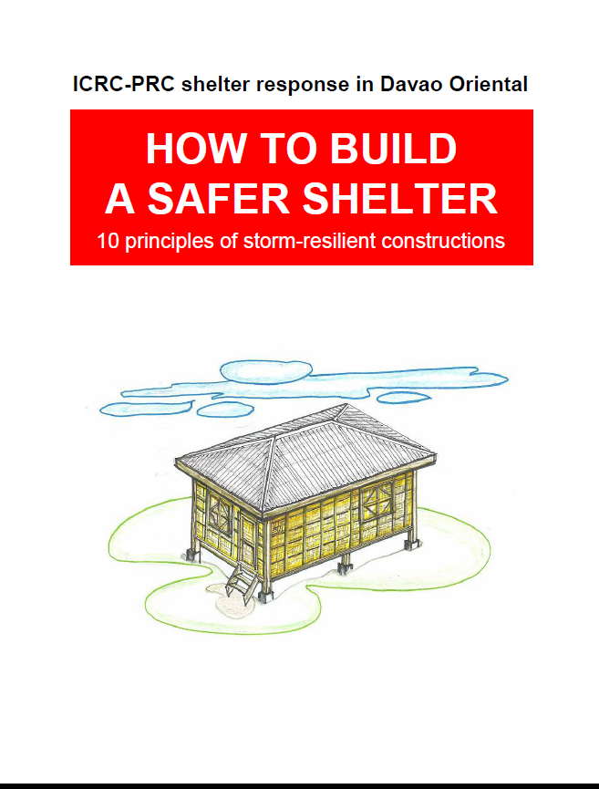

Slide 8
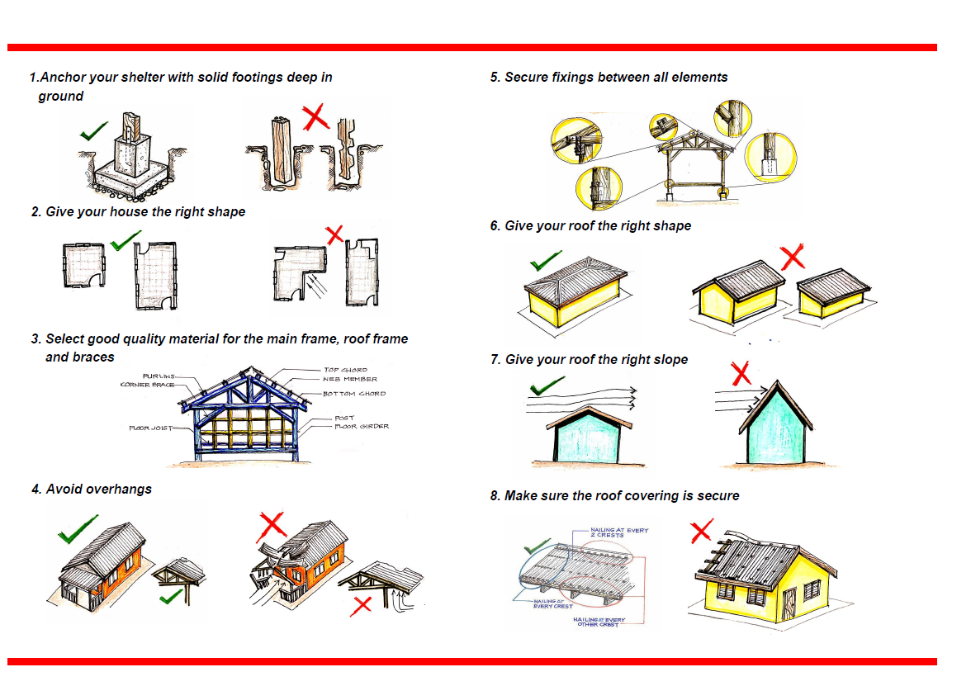

Slide 9
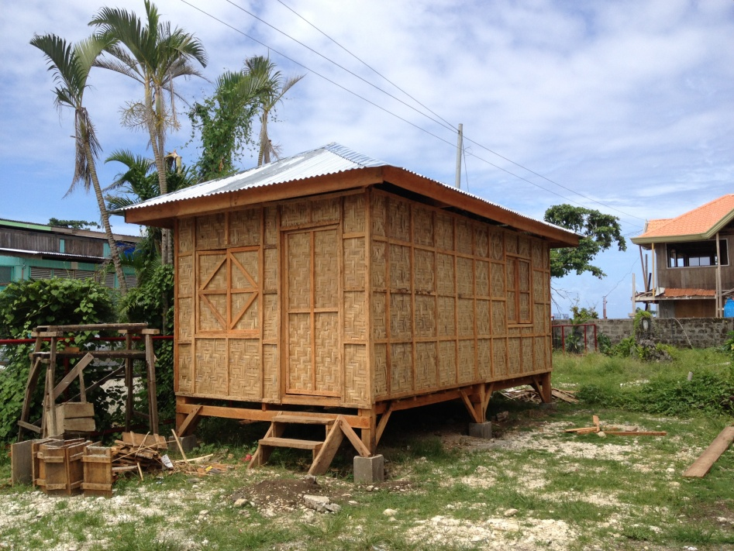
2 types: Full and skeleton houses

Slide 10
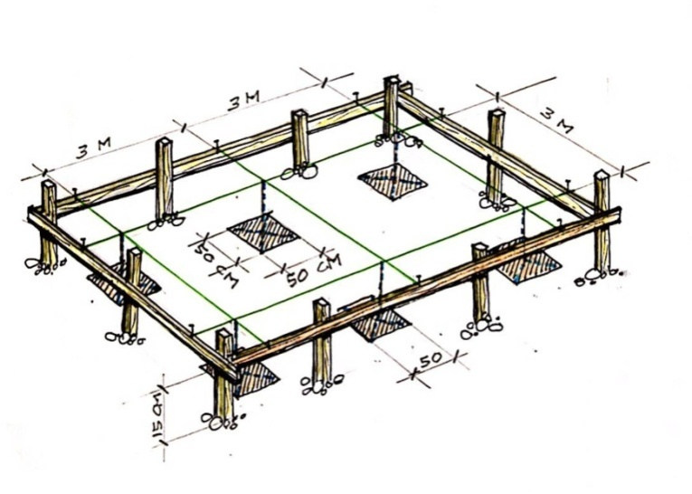
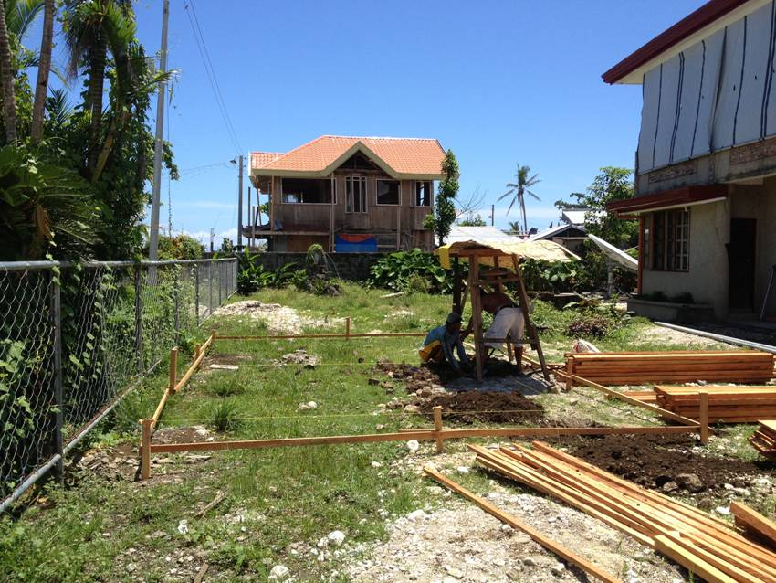
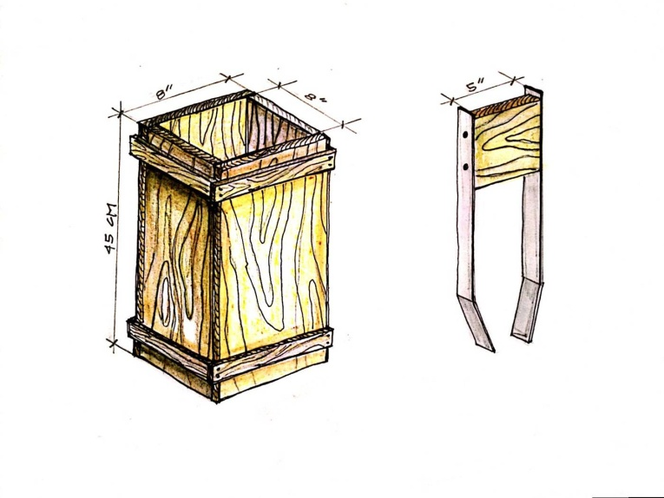
Skilled people training

Slide 11
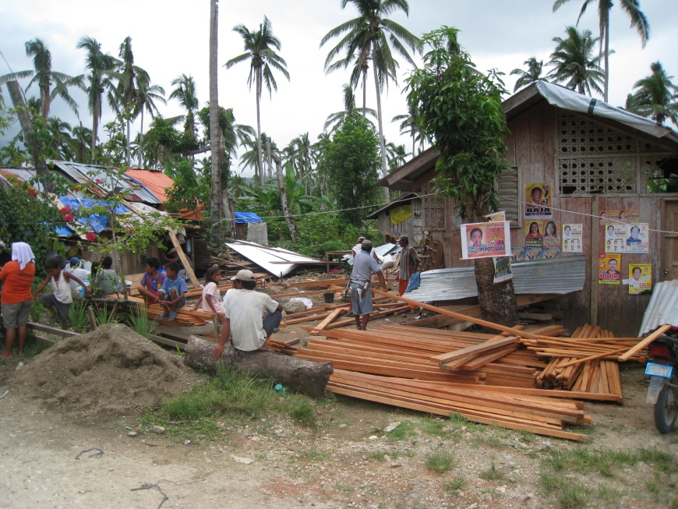
Chainsaw operators Re-use of fallen trees!!
Beneficiaries selection
Delivery of material

Slide 12
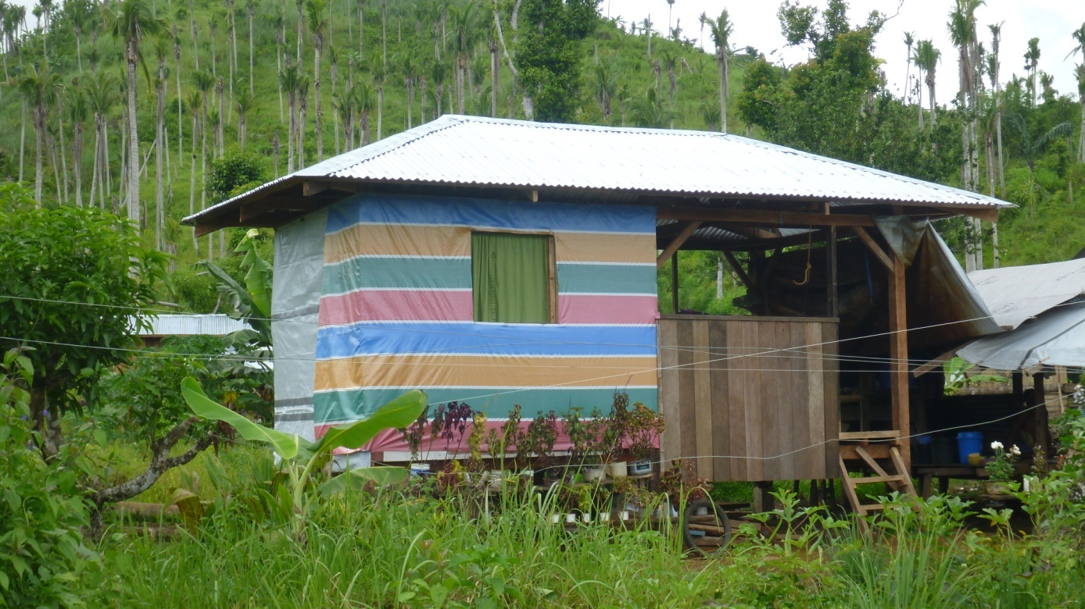
300 full houses 870.- CHF/House
2’850 skeleton houses
615.- CHF/House

Slide 13
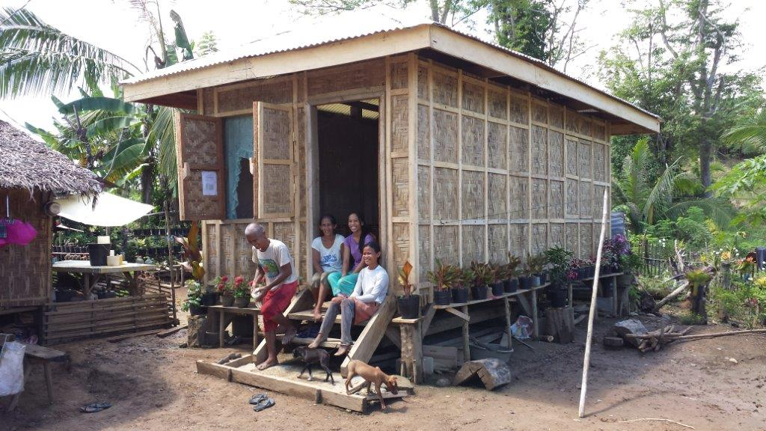
3’150 HH = 15’800 people assisted 2’000 skilled/unskilled people involved Onset of the project: February 2013 Implementation phase: March 2013 End of the project: November 2013 Direct cost: 2 mio CHF

