Slide 1
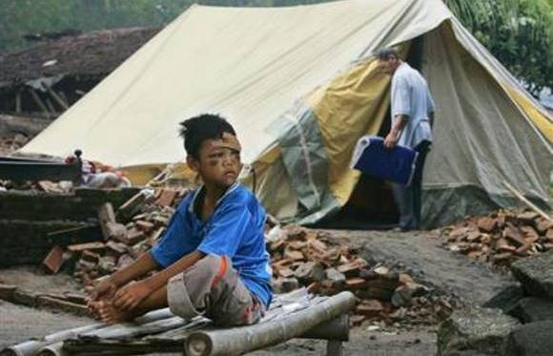



How does the shelter assistance provided affect the recovery and resilience of communities affected by disasters?
Victoria Maynard
Programme Research and Development
vmaynard@habitatforhumanity.org.uk

Slide 2
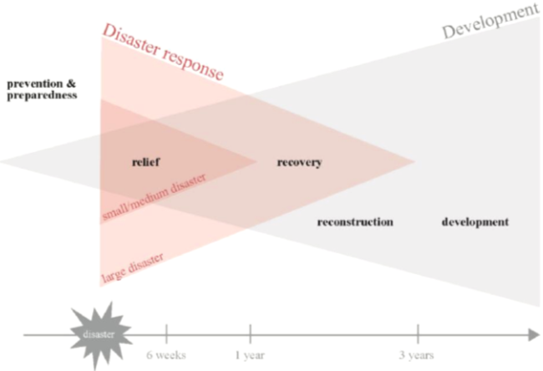
Context
Shelter
  Lots of interest = lots of new guidelines
  Little is known about the impact of our work
Recovery/early recovery
  Renewed interest in ‘early recovery’
  Early recovery has been defined as ‘a multi-dimensional process of recovery that begins in a humanitarian setting… It encompasses the restoration of basic services, livelihoods, shelter governance, security and rule of law, environment and social dimensions, including the reintegration of displaced populations.’
adapted from CWGER, 2008

Slide 3
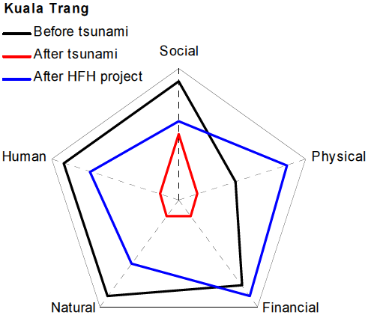
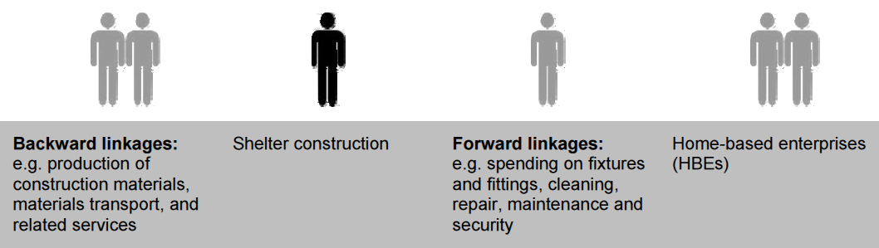
The challenge
Although we know that shelter:
  provides security, safety and protection
  promotes resistance to ill health and disease
  can build social capital
  can contribute to environmental recovery
  construction can create livelihood opportunities
  is critical to home-based enterprises
  can contribute to risk reduction and resilience
Shelter after disaster is under-researched
Recovery is the least researched phase of DM
Shelter + recovery has had little research
The tension between shelter as a ‘process’
and a ‘product’.
Shelter programmes build assets: Arup (2010) HFH post-tsunami sustainability assessments
Shelter programmes catalyse economic recovery:
illustrating Setchell, 2001

Slide 4
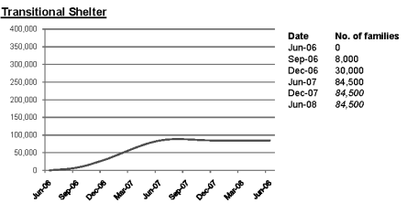
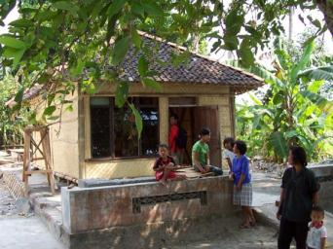
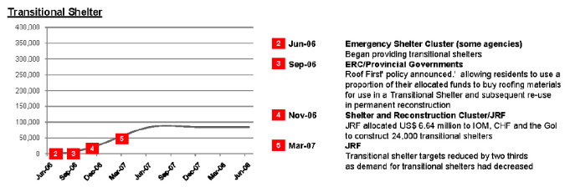
MA Dissertation @ CENDEP
How does the shelter assistance provided affect the recovery of communities after disaster?
Two case studies in Indonesia:
  Earthquake and tsunami in Aceh (26.12.04)
  Earthquake Yogyakarta/Central Java (27.05.06)
For each case study:
  What happened?
  Why did it happen?
  What impact did it have?
Focus at sector, rather than agency or programme
By the time [the T-shelter programme] was rolled out, the situation had changed and what most people really needed was cement, sand and reinforcing steel, not bamboo and gedeg.
MacRae and Hodgkin, 2011: 256

Slide 5
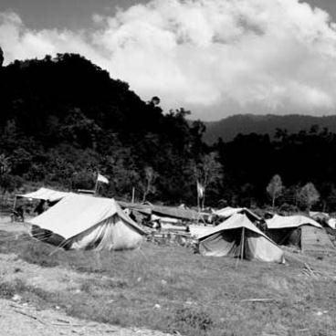
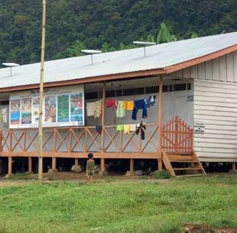
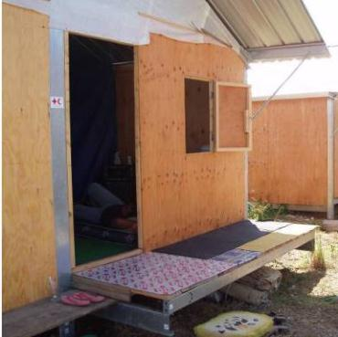
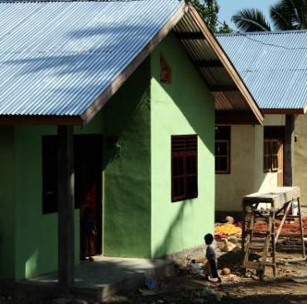
Earthquake and tsunami in Aceh
Impact of the disaster:
  165,708 people died, 500,000 affected
  127,325 houses destroyed, 151,652 damaged
  10,000 households needed to be relocated
  25% of the population lost their jobs
Shelter response:
  Tents
  ‘Barracks’
  Host families
  Transitional shelters
  Permanent houses

Slide 6
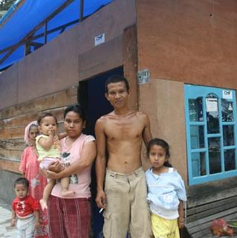
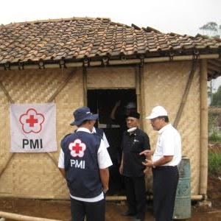
Earthquake in Yogyakarta
Impact of the disaster:
  5,716 people died, +3 million affected
  52% of damage was housing
  300,000 houses destroyed or heavily damaged
  1.6 million people without homes
Shelter response:
  Tents, tarpaulins, toolkits
  Transitional shelters
  Cash grants for permanent housing

Slide 7
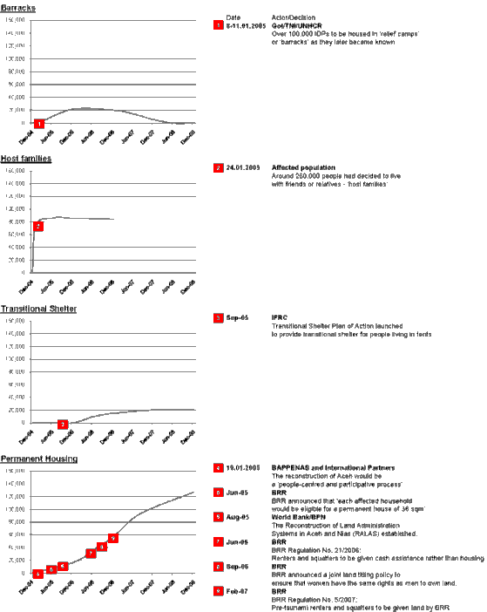
Findings: Aceh
Within 3-6 months:
  Tents for 35% of affected families (50,000 HH)
  GoI ‘barracks’ for 15% of affected families (20,000 HH)
  +50% of people chose to live with host families (+80,000 HH)
12-24 months after the disaster:
  T-Shelters for 15% of families (20,000 HH)
Within 4 years:
  140,000 permanent houses built

Slide 8
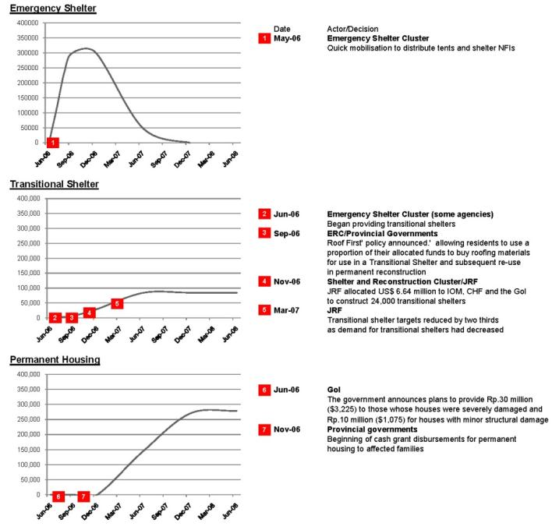
Findings: Yogyakarta
Within 3 months:
  80% of affected families (300,000 HH received roofing materials/temporary shelters
3-12 months after the disaster:
  30% of affected families (85,000 HH) received T-shelters
6-18 months after the disaster:
  Cash grants disbursed to 280,000 HH
Within two years:
  280,000 permanent houses built

Slide 9
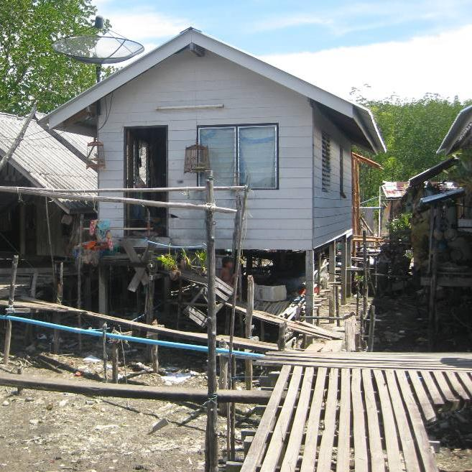
Conclusions
Support “rapid reconstruction” (ref. UNDRO, 1982)
Ensure adequate technical support
Minimise displacement
Support the recovery of communities holistically
Use transitional shelter to support specific groups
Ensure appropriate timing of shelter assistance
Communicate the shelter strategy adopted
Full MA dissertation available in the Shelter Library

Slide 10
Limitations/further research
Limitations:
  Based on secondary sources
  Focussed on short-term (recovery) impacts
Further research:
  Verify this research through KIIs/fieldwork
  Additional case studies
  Investigate both short-term (recovery) and long-term (resilience) impacts
PhD research @ UCL:
How does the shelter assistance provided affect the recovery and resilience of communities affected by disasters?

Slide 11
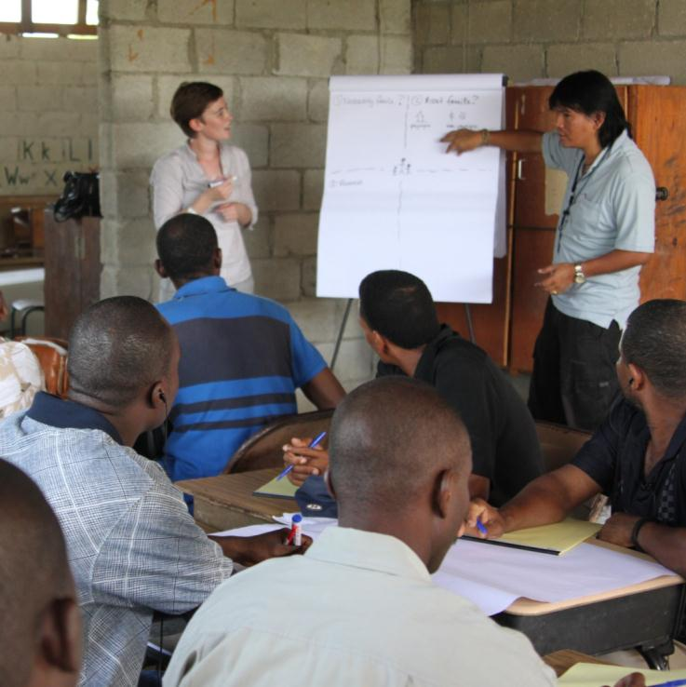
Methodology
Year One: Attending lectures at UCL, undertaking a literature review, developing a research methodology and identify case studies for in-depth research.
Year Two: Field-based research and technical analysis of both the original shelter assistance provided and the extent to which it has been maintained, adapted or extended over time.
Year Three: Comparative analysis of several case studies will identify common patterns of decisions, activities and impact.
HFH Haiti, 2010

Slide 12
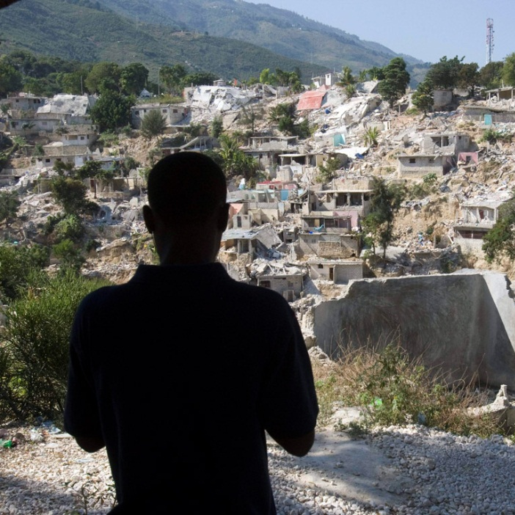
Next steps…
Some questions:
  What is recovery? What is resilience? How to measure either of them?
  Do we need more evidence? Or better use of the evidence we already have?
  Do our problems lie in decision-making? Or in the challenges of implementing decisions?
Some ideas…
  Habitat for Humanity’s ‘Pathways to Permanence’

Slide 13
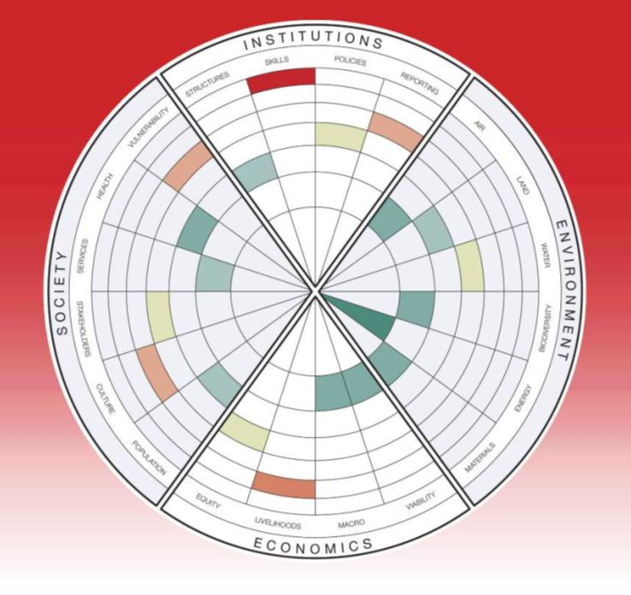
Next steps…
Some questions:
  What is recovery? What is resilience? How to measure either of them?
  Do we need more evidence? Or better use of the evidence we already have?
  Do our problems lie in decision-making? Or in the challenges of implementing decisions?
Some ideas…
  Habitat for Humanity’s ‘Pathways to Permanence’
  Evaluating the long-term impact of shelter programmes (2010)
Evaluating the impact of HFH tsunami-response shelter programmes (Shelter Meeting 10a)

Slide 14
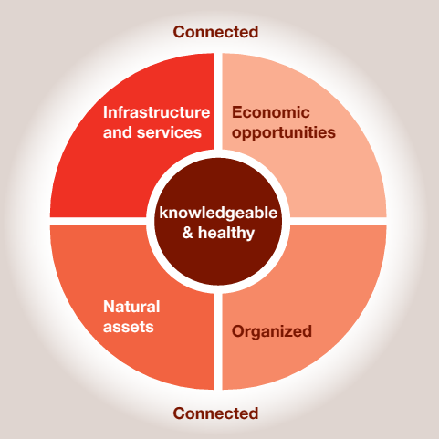
Next steps…
Some questions:
  What is recovery? What is resilience? How to measure either of them?
  Do we need more evidence? Or better use of the evidence we already have?
  Do our problems lie in decision-making? Or in the challenges of implementing decisions?
Some ideas…
  Habitat for Humanity’s ‘Pathways to Permanence’
  Evaluating the long-term impact of shelter programmes (2010)
  Understanding community resilience (2011)
The ‘characteristics’ of a safe and resilient community (Arup, 2011)

Slide 15
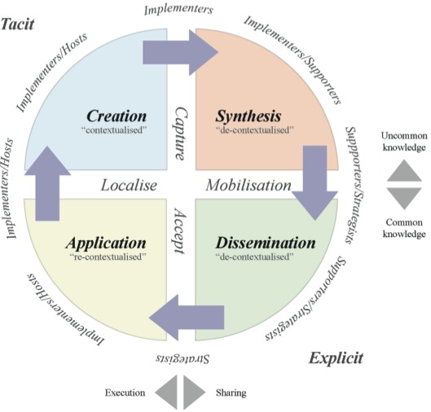
Next steps…
Some questions:
  What is recovery? What is resilience? How to measure either of them?
  Do we need more evidence? Or better use of the evidence we already have?
  Do our problems lie in decision-making? Or in the challenges of implementing decisions?
Some ideas…
  Habitat for Humanity’s ‘Pathways to Permanence’
  Evaluating the long-term impact of shelter programmes (2010)
  Understanding community resilience (2011)
  Research undertaken for the Qatar Shelter Initiative (2012)
Knowledge management for the shelter and settlements sector (Shelter Meeting 12a)

Slide 16
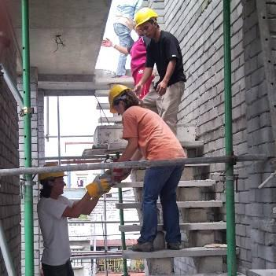
Keep in touch
Comment on my paper (available soon)
Keep in touch via:
  Email vmaynard@habitatforhumanity.org.uk
  Twitter @vcmaynard
  LinkedIn www.linkedin.com/in/vcmaynard
  Project blog (available soon) http://engd-usar.cege.ucl.ac.uk/projects/
See you at Shelter Meeting 13a…
HFH Philippines, 2008

