Slide 1
Multi-hazard GIS analysis for Evacuation Centre locations
…an open data approach
Presentation by Lukasz Kruk

Slide 2
Project background
Student exercise at UN Lisboa
  One month
  Eleven GIS students
  With support from Protecção Civil and Red Cross
Available data
  Elevation
  Road network
  Land cover
  Census

Slide 3
Project background
Student exercise at UN Lisboa
  One month
  Eleven GIS students
  With support from Protecção Civil and Red Cross
Available data
  Elevation
  Road network
  Land cover
  Census

Slide 4
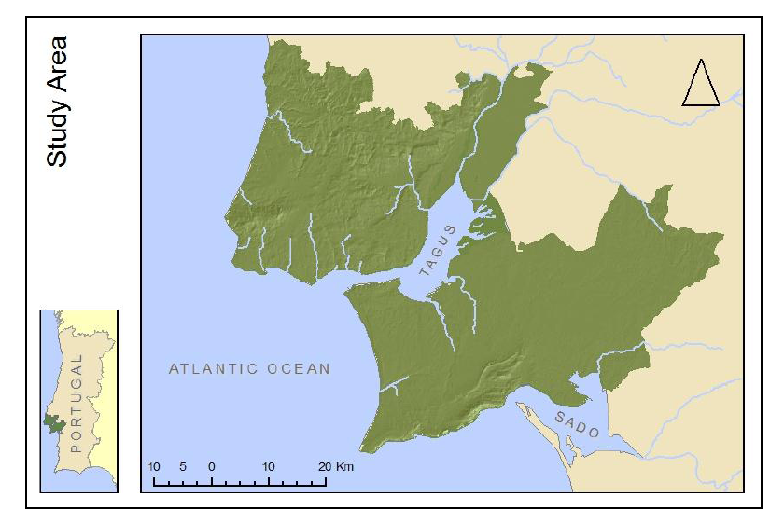

Slide 5
Definitions
Risk
Hazard
Frequency
Magnitude
Vulnerability
Flood
Tsunami
Forest fire
Notes:
This slide goes back to yesterday’s notion of translation - not just between languages, but also between people of various backgrounds
Common understanding

Slide 6
Definitions
Risk
Hazard
Frequency
Magnitude
Vulnerability
Flood
Tsunami
Forest fire
Notes:
This slide goes back to yesterday’s notion of translation - not just between languages, but also between people of various backgrounds
Common understanding

Slide 7
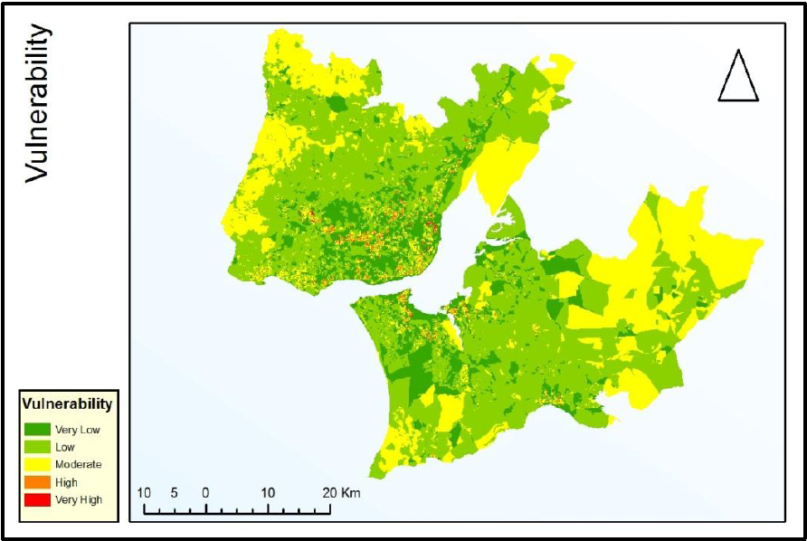
Notes:
Low houses
Dependency ratio

Slide 8
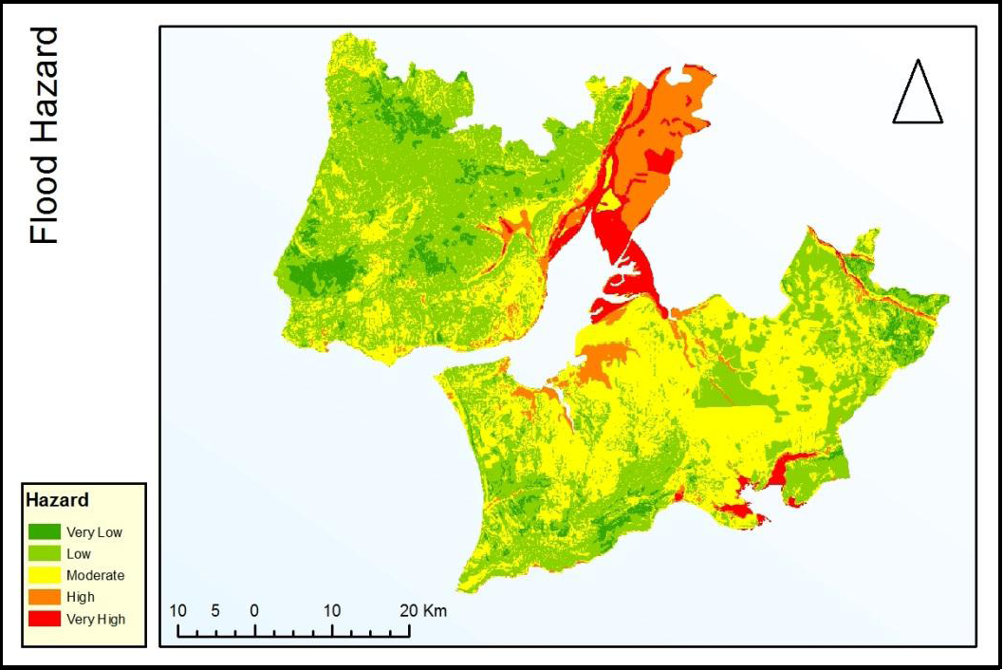
Notes:
Ground Permeability

Slide 9
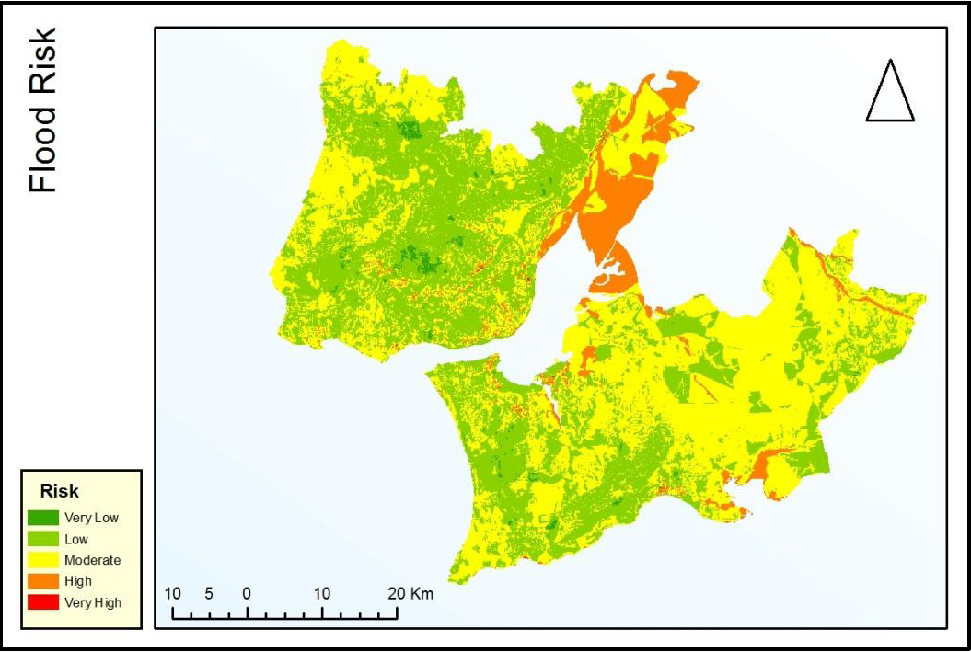

Slide 10
Analysis process
Evacuation Centre locations
Proximity to affected people
Population density
Multi Risk
Floods
Tsunami
Forest fires
Suitability
Outside of hazard zone
Available space

Slide 11
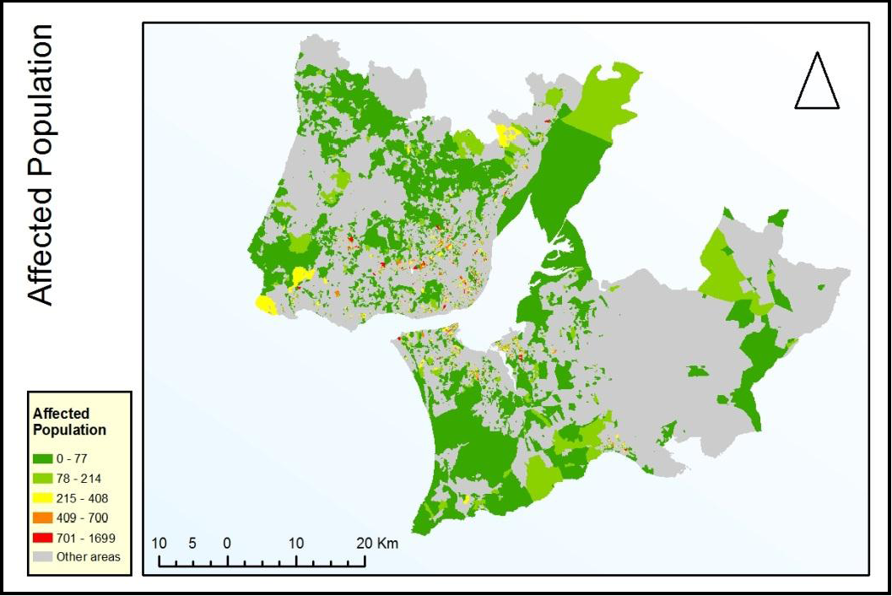

Slide 12
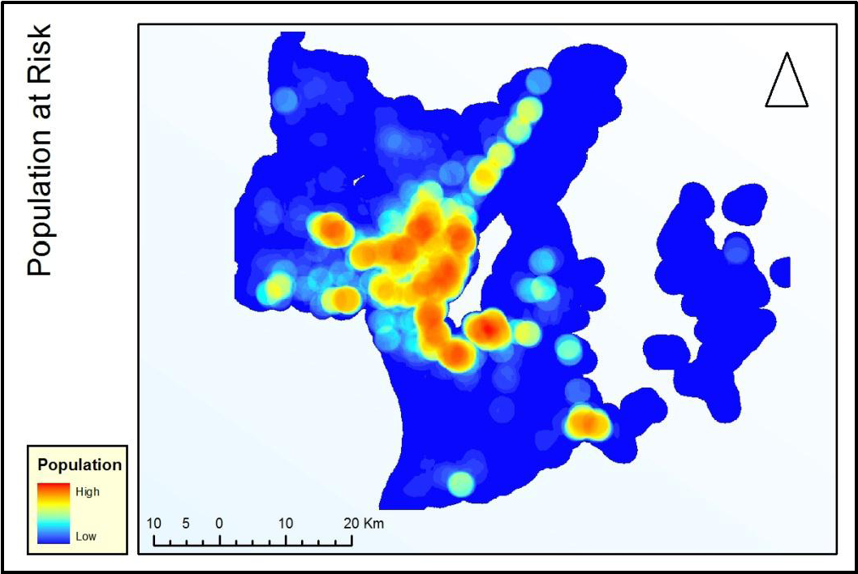

Slide 13
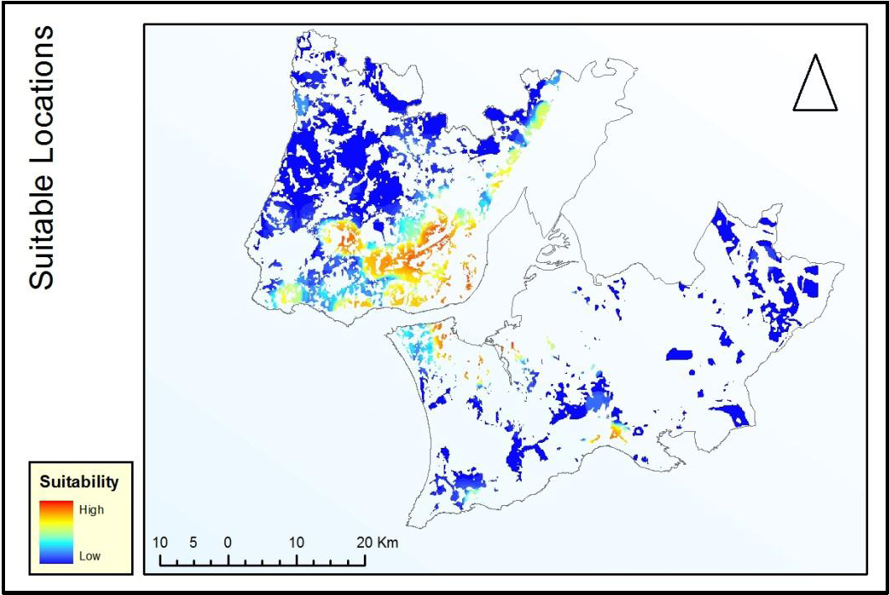

Slide 14
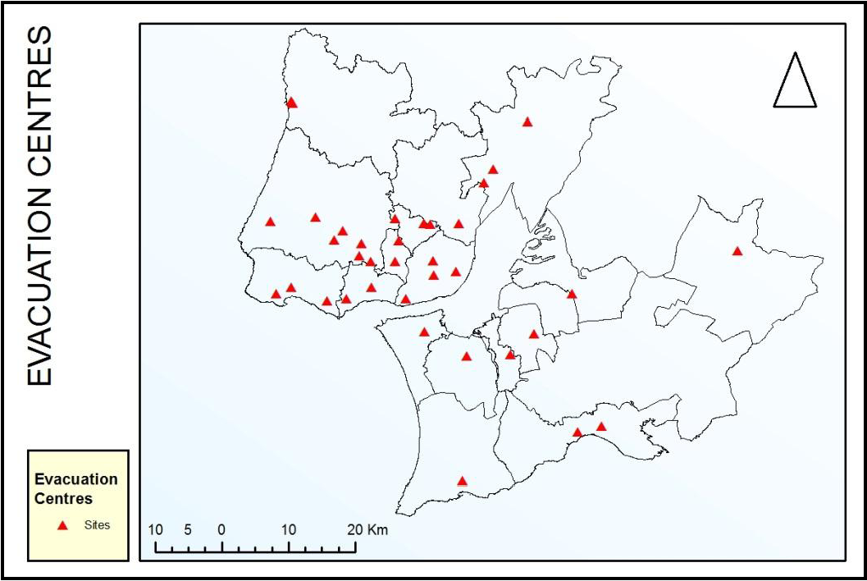
bbbbbb

Slide 15
EC locations
Suitability
Satellite images
Exclu-ded areas
Population at risk
Multi risk
Fire risk
Tsunami risk
Tsunami hazard
Flood vulnera-bility
Flood risk
Flood hazard
Rain
Flood vulnerability
Depen-dency
Low buiildings
…
Population density
census
Slope
…
DEM
Notes:
The Forest Fire Risk Map (Figure 18) is the result of multi-criteria analysis (Almeida et al., 1995 and Chuvieco et al., 1989) and conducted by the ANPC (Autorida de Nacional de Protecção Civil), DGRF (Direcção Geral de Recursos Florestais), IGEO (Instituto Geográfico Português) and INE (Instituto Nacional de Estatistica).

Slide 16
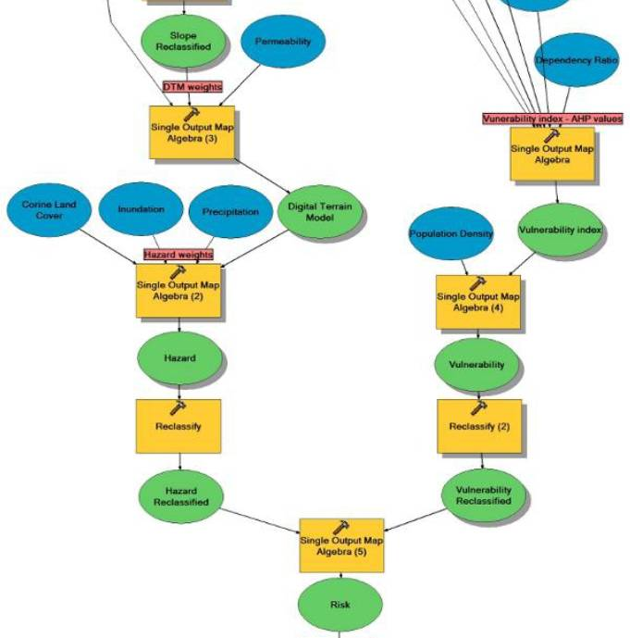
Analysis as a model
Notes:
Around 5th of the entire model

Slide 17
Analysis as a model
Entire process was written in ArcGIS Model Builder
  Which means it can be re-run with other data
  ...as long as it is standardised
  ...and done with domain expertise
  ...and it is not completely automated
  CODs and FODs
  HXL
Notes:
Improvements in modelling → potential for on the fly updating and re-modelling as live data comes in

Slide 18
Analysis as a model
Entire process was written in ArcGIS Model Builder
  Which means it can be re-run with other data
  ...as long as it is standardised
  ...and done with domain expertise
  ...and it is not completely automated
  CODs and FODs
  HXL

Slide 19
Analysis as a model
Entire process was written in ArcGIS Model Builder
  Which means it can be re-run with other data
  ...as long as it is standardised
  ...and done with domain expertise
  ...and it is not completely automated
  CODs and FODs
  HXL

Slide 20
Conclusions
Ability to automate significant part of the process, but
Data availability is a problem, and
Domain experts are critical for meaningful analysis
Notes:
Experts: geological engineer,

Slide 21
Thank you
https://sites.google.com/site/mgtgps2011/
Avit Bhowmik
Joao Blasquez
Susan Bumpus
Sergio Clark
Elias Fekade
Yitea Getahun
Rene de Groot
Lukasz Kruk
Manu Limbu
Dian Melati
Unal Okyay

