Slide 1
Shelter meeting 12b
Geneva, 30.Oct. 2012
UPDATE
Compendium of transitional learning spaces
in emergency ( TLS),
2012
planning and design in emergencies
UNICEF
Carlos Vasquez, UNICEF, NY
Annika Grafweg, Project consultant
Compendium of Transitional Learning Spaces 2012, planning and design in emergencies

Slide 2
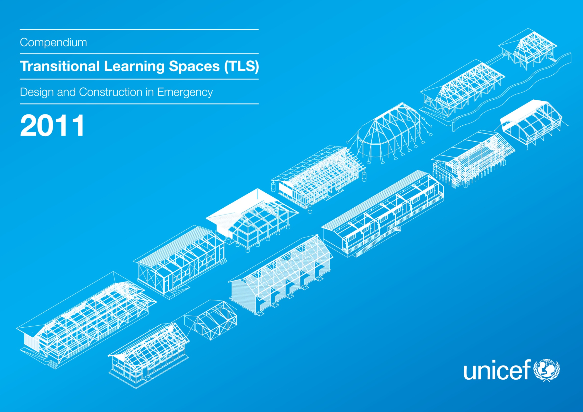
2012

Slide 3
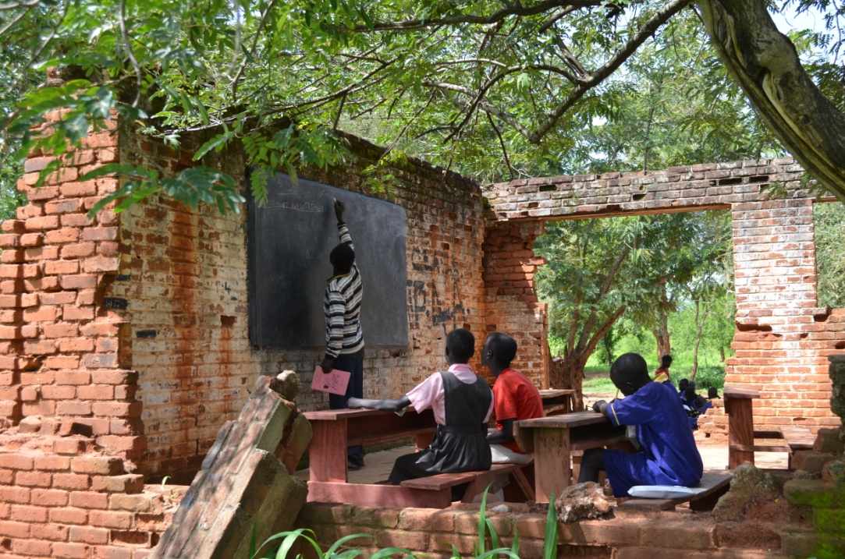
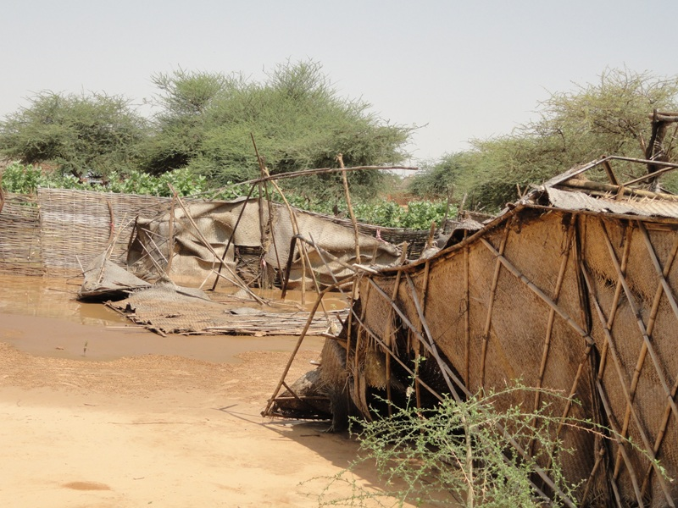
Introduction
Emergencies have a devastating impact on children, youth including physical harm, loss of life and wide-reaching psychosocial harm
result in the damage/destruction of schools/ schools used as emergency shelter
prolonged disruption of education, limited access to schooling, and decreased education quality
exacerbating the exclusion of some 70 mil children out of school worldwide,
rolling back years of progress toward attaining Education for All commitments and the MDGs’
South Sudan, destroyed school building
Compendium of Transitional Learning Spaces 2012, planning and design in emergencies

Slide 4
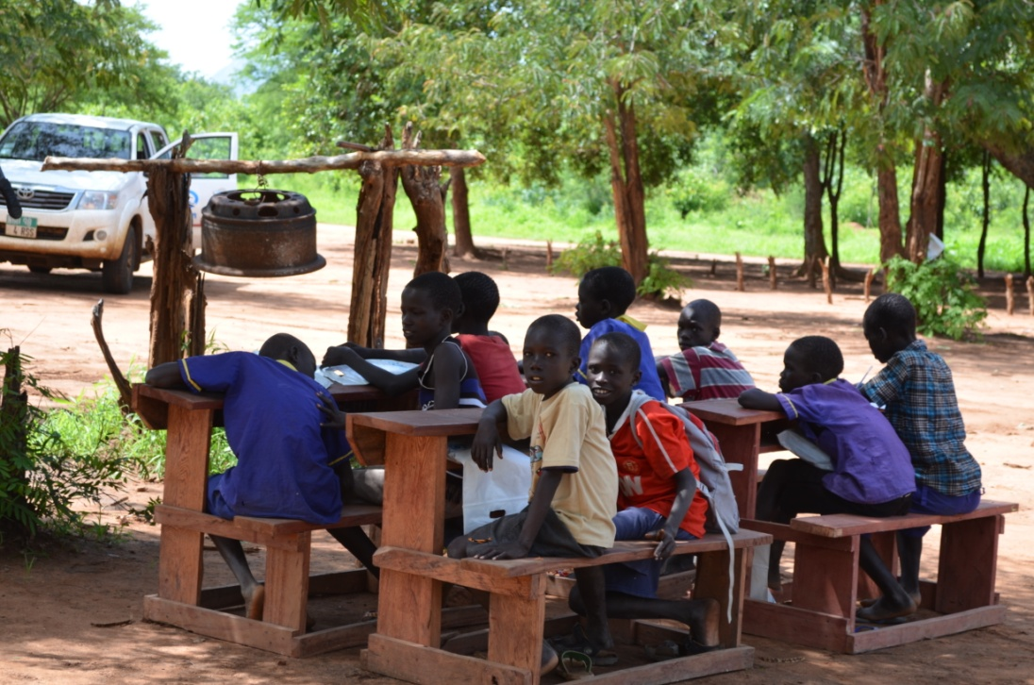
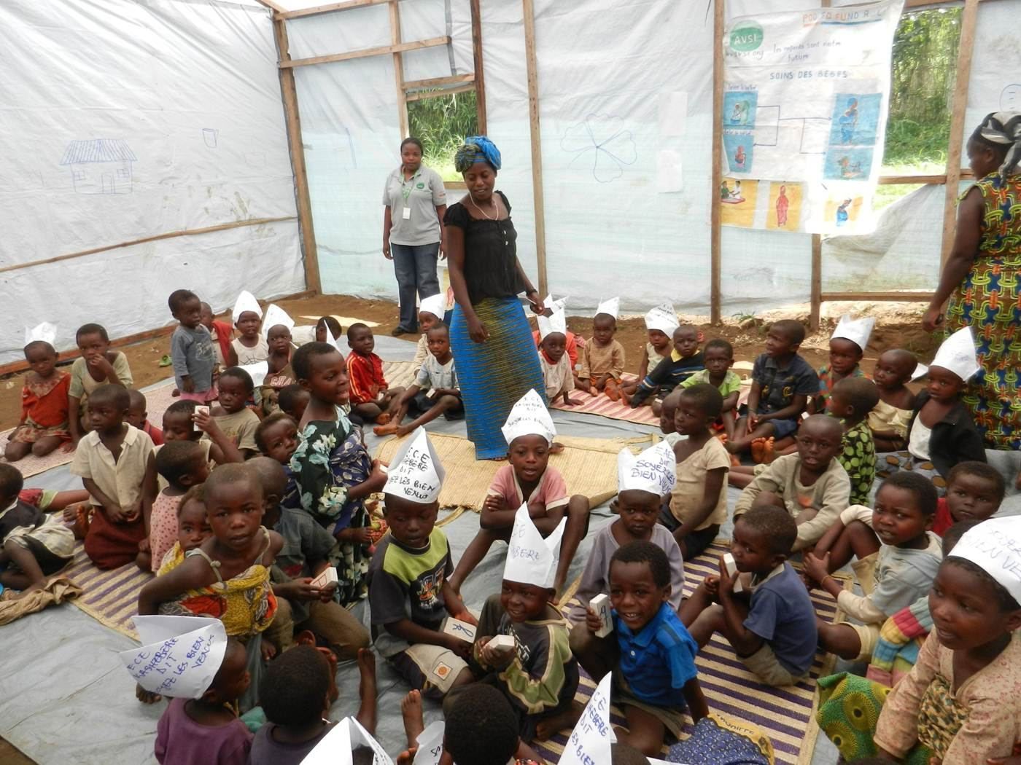
Introduction
Recent emergencies: Iran, Pakistan, Philippines, Somalia, Syria
most vulnerable and marginalized communities and children are often disproportionally affected by disasters. ( emphasis on inclusiveness and accessibility)
the challenges of providing child-friendly temporary learning spaces, that are safe and healthy, inclusive environment
South Sudan, “classroom” a tree
Compendium of Transitional Learning Spaces 2012, planning and design in emergencies
ECD- Goma, DRC
Notes:
driven from field experience
Education is a fundamental right of every child. In emergencies, UNICEF is committed to getting
all children – with a special focus on girls – back to school. In emergencies, schooling is a means
of restoring a sense of normalcy to the lives of children and can help them overcome psychological
and other forms of distress. Education offers a regular routine, opportunities for self-expression
and the chance to engage with peers – all vital elements of normalcy for children whose lives have
been disrupted by conflict and displacement.

Slide 5
TLS 2011
TLS 2012
Section A:
Principles of temporary learning spaces
general guidance
Section A:
Typology of child-friendly spaces
ECD/ children’s spaces
Section B:
General design guidance
spatial planning classrooms
Section B:
DRR and Preparedness
environmental factors
Section C:
Case studies
Natural disasters
Section C:
Case studies
IDP/ refugee camps
Contributing agencies:
Education for all
NRC
PLAN
SAVE
UNICEF
UNHCR
FINN church
Section D:
Innovative practices
Section D:
Innovative practices
Compendium of Transitional Learning Spaces 2012, planning and design in emergencies

Slide 6
Objective
Equip field practitioners with documentation and illustration of TLS that have been implemented in past emergencies (technical drawings, BoQ, photos, etc.)
Provide practical recommendations and design solutions disaster resilient construction (flood, earthquake, high winds)
Offer updates and lessons learned from last years case studies
Assist the process of site planning/selection (site and context specific )
Suggest improvements to the case studies to be considered in future implementations and illustrate challenges faced
Compendium of Transitional Learning Spaces 2012, planning and design in emergencies
Notes:
Equipping field practitioners with a compendium of TLS that have been implemented in past emergencies
Offer information and recommendation as a bases for decision makers (field practitioners, technical staff (engineers, architects) local communities and all partners) to easily access relevant information to help rapid development of site context specific solutions for temporary learning spaces in accordance with their national standards and local settings
Provide practical recommendations and information on how to implement TLS (appropriate for the situation, links to WASH in schools initiatives, safe
by selecting and illustrating field examples of temporary learning spaces (TLS) designs in emergencyTLS (technical drawings, Boq, photos, data sheet)
.

Slide 7
Section A Typology of child-friendly spaces
Section C Case studies
A.1 CFS Principles (TLS 2011)
A.2 ECD (e.g.: Haiti, DRC)
A.3 Child-friendly spaces (e.g.: Ethiopia)
A.4 Transitional schools (TLS 2011)
A.5 How to plan ‘child-friendly school’ in emergencies- Jordan - a case study
C.1 Earthquake
CRS- Pakistan
FINN Church- Haiti
SAVE - Haiti – ECD (retrofit)
Iran
UNICEF- Haiti –Update
SAVE- Haiti –Update
C.2 Flooding
SAVE - Pakistan
UNICEF- Pakistan - Update
UNICEF- Philippines
C.3 High winds
C.4 IDP/refugee camps
SAVE- Ethiopia
Plan international - South Sudan
Plan international – Sudan, Darfur
UNICEF- DRC- ECD
UNHCR- Rwanda
NRC – Somalia – Update
Section B DRR and Preparedness
B.1 Environmental factors
B.1.1 What to consider when choosing a site for TLS?
B 1.2 How to choose a site for TLS ?
B 1.3 What to consider when planning TLS on a
specific site?
B.2 ‘Hardware’- hazard resistant
construction techniques
B 2.1 Typology of building elements
B.2.2 Construction Materials
B.3 ‘Software’- Disaster risk reduction activities
B 3.1 Community participation/ PTA/ student groups
B 3.2 Issues of psycho-emotional impact on children
B 3.3 Emergency plans/ drills
B 3.3 Maintenance, Operations Manuals
B 3.4 DRR in curriculum
B.4 Disaster risk preparedness
B 4.1 What could assist in being prepared?
B.5 What if- Schools used as emergency shelters
Section D Innovative practices
DRAFT
Compendium of Transitional Learning Spaces 2012, planning and design in emergencies

Slide 8
DRAFT
Compendium of Transitional Learning Spaces 2012, planning and design in emergencies

Slide 9
DRAFT
2005/ Earthquake
Compendium of Transitional Learning Spaces 2012, planning and design in emergencies

Slide 10
DRAFT
Compendium of Transitional Learning Spaces 2012, planning and design in emergencies

Slide 11
DRAFT
Compendium of Transitional Learning Spaces 2012, planning and design in emergencies

Slide 12
DRAFT
Compendium of Transitional Learning Spaces 2012, planning and design in emergencies

Slide 13
DRAFT
Compendium of Transitional Learning Spaces 2012, planning and design in emergencies

Slide 14
DRAFT
Compendium of Transitional Learning Spaces 2012, planning and design in emergencies

Slide 15
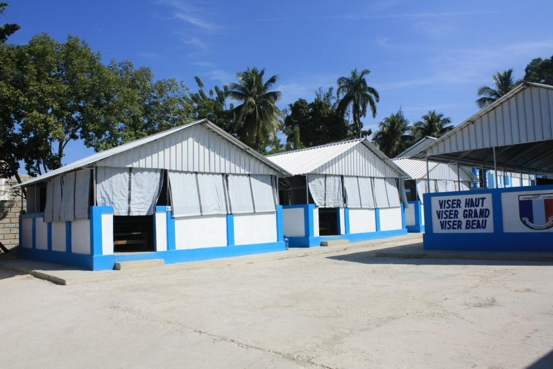
DRAFT
Compendium of Transitional Learning Spaces 2012, planning and design in emergencies

Slide 16
DRAFT
Compendium of Transitional Learning Spaces 2012, planning and design in emergencies

Slide 17
DRAFT
Compendium of Transitional Learning Spaces 2012, planning and design in emergencies

Slide 18
DRAFT
Compendium of Transitional Learning Spaces 2012, planning and design in emergencies

Slide 19
DRAFT
Compendium of Transitional Learning Spaces 2012, planning and design in emergencies

Slide 20
DRAFT
Compendium of Transitional Learning Spaces 2012, planning and design in emergencies

Slide 21
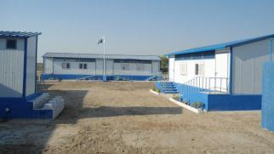
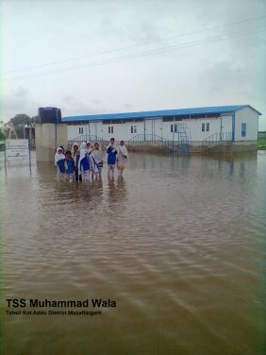
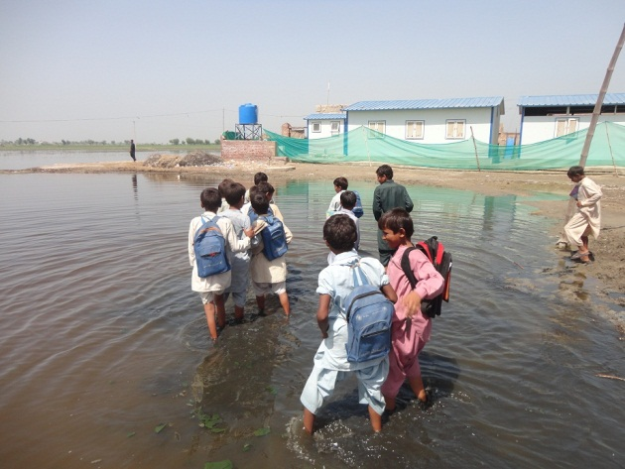
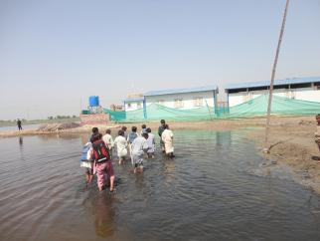
UPDATE
Compendium of Transitional Learning Spaces 2012, planning and design in emergencies

Slide 22
UPDATE
Compendium of Transitional Learning Spaces 2012, planning and design in emergencies

Slide 23
DRAFT
Refugee camp
Compendium of Transitional Learning Spaces 2012, planning and design in emergencies

Slide 24
DRAFT
Compendium of Transitional Learning Spaces 2012, planning and design in emergencies

Slide 25
DRAFT
Compendium of Transitional Learning Spaces 2012, planning and design in emergencies

Slide 26
DRAFT
Compendium of Transitional Learning Spaces 2012, planning and design in emergencies

Slide 27
DRAFT
IDP camp
Compendium of Transitional Learning Spaces 2012, planning and design in emergencies

Slide 28
DRAFT
Compendium of Transitional Learning Spaces 2012, planning and design in emergencies

Slide 29
DRAFT
Compendium of Transitional Learning Spaces 2012, planning and design in emergencies

Slide 30
Thank you
Would you like to participate in the 2012 TLS compendium?
please e-mail:
Carlos Vasquez : cvasquez@unicef.org
Annika Grafweg: annika@humanitarianschools.org
Compendium of Transitional Learning Spaces 2012, planning and design in emergencies

