Slide 1
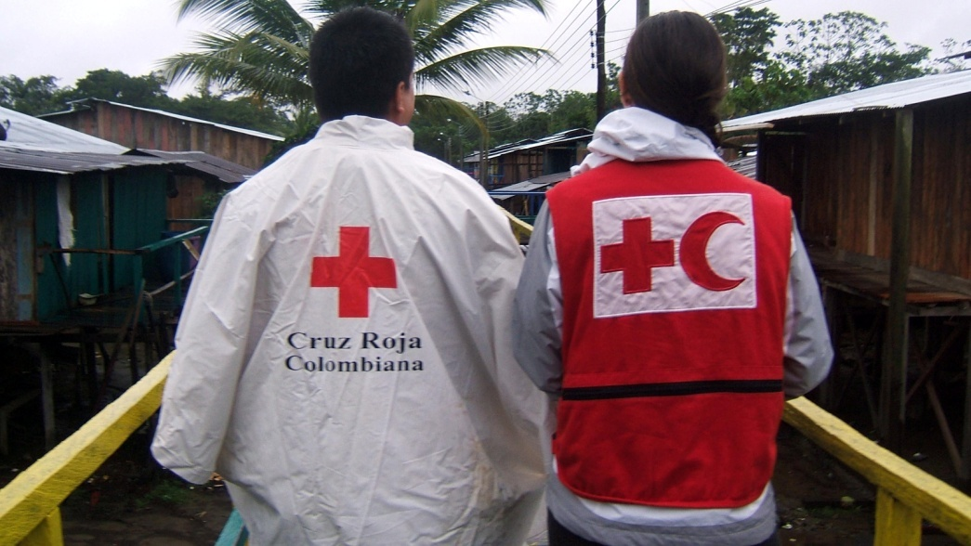
Community Resilience in Action Supporting people to cope with floods in Choco’ (Colombia)
Sandra D’ Urzo, senior officer , Shelter & Settlements department, IFRC, Geneva
On behalf of Colombian Red Cross and Netherlands Red Cross
Shelter Centre Meeting,12b

Slide 2
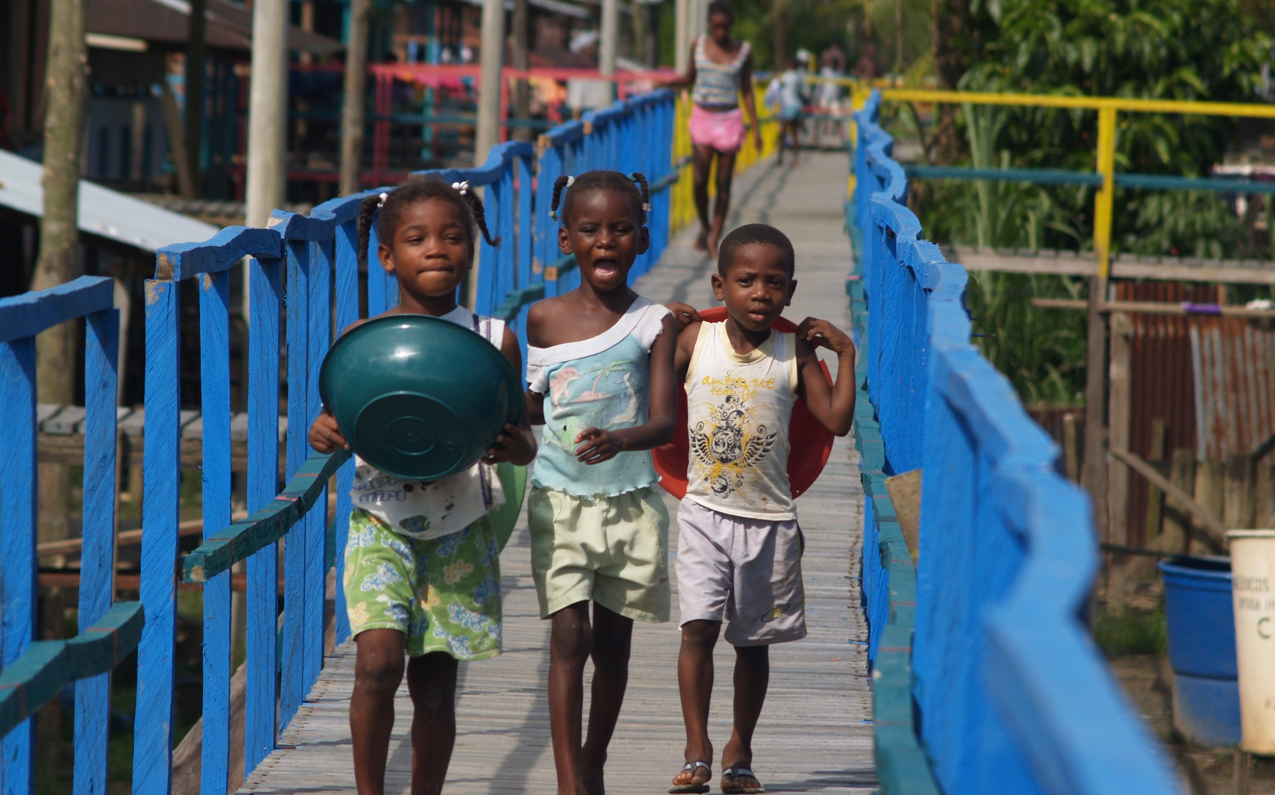

Slide 3
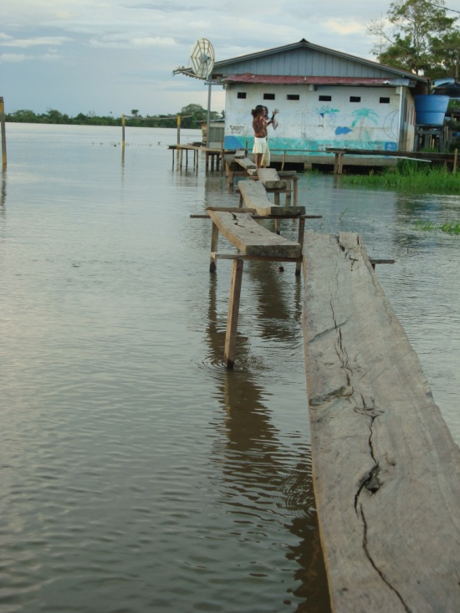
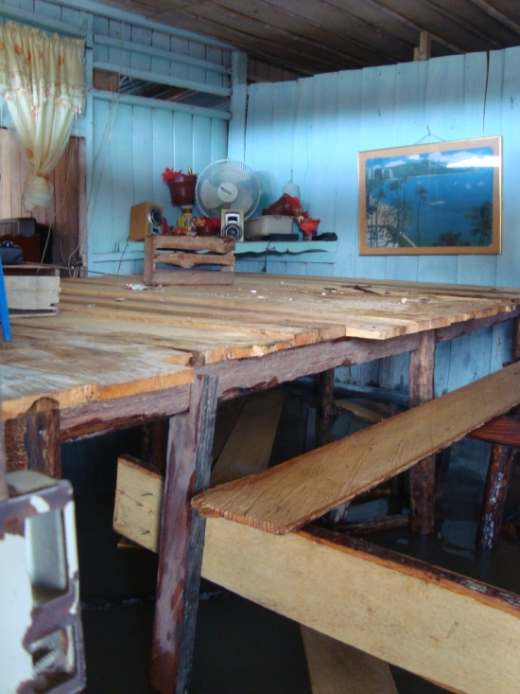
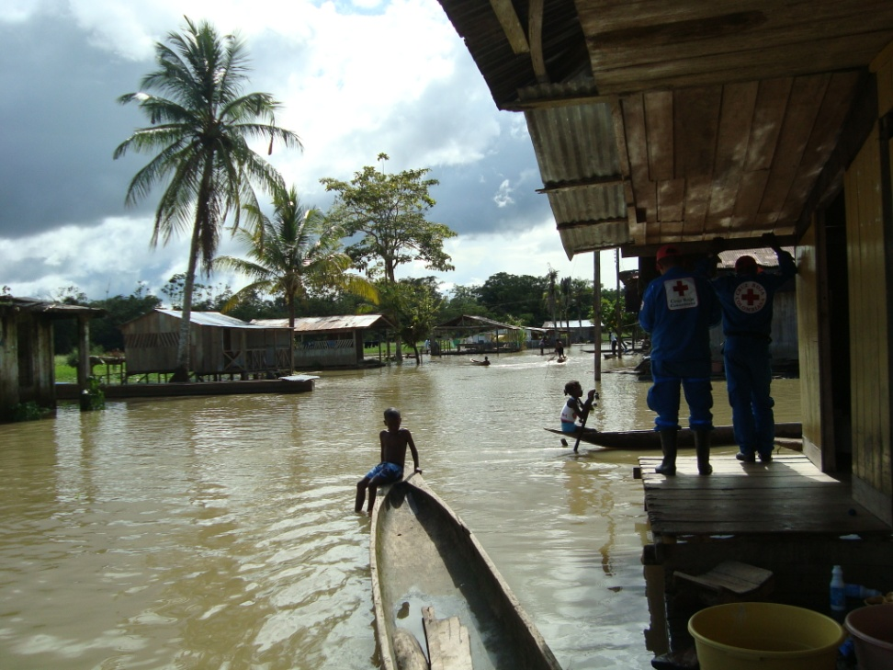
Living with floods…

Slide 4
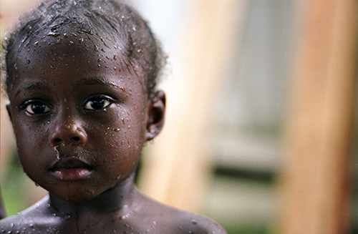
break the vulnerability cycle?

Slide 5
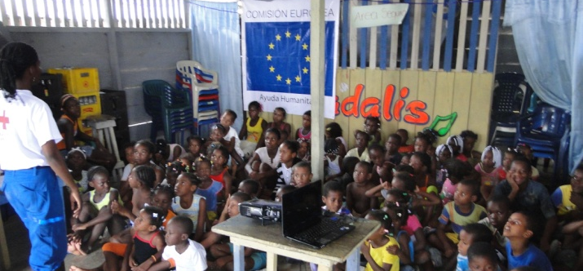
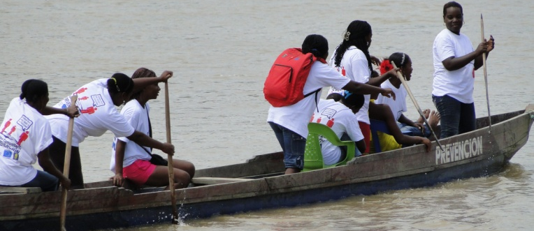
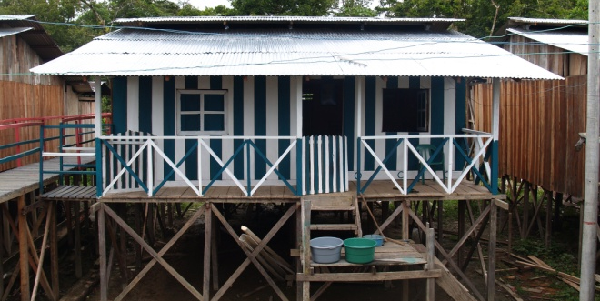
The programme objectives
4 main results:
1. Disaster Preparedness (schools, simulations…)
2. Environmental Risk Management
3. Vulnerability Reduction
4. Knowledge Management

Slide 6
The Programme
Strengthening disaster preparedness of flood affected communities in the Choco department
Who funded it?
DIPECHO (DG ECHO), Netherlands Red Cross, Norwegian Red Cross, Colombian RC, UNGRD, Diócesis de Quibdó, PMA
Where is it?
Chocó Department, Municipio de Bojayá (San José de la Calle, Puerto Conto, Napipi, Opogado, Isla de los Palacios)
How many people?
5.463 people
Financial data
$1.883.741.803 COP (778.457 EUR / 1.000.000 USD)
How long?
18 months (April 15th de 2011 / October 14th 2012)

Slide 7
Result 3: reducing vulnerability

Slide 8
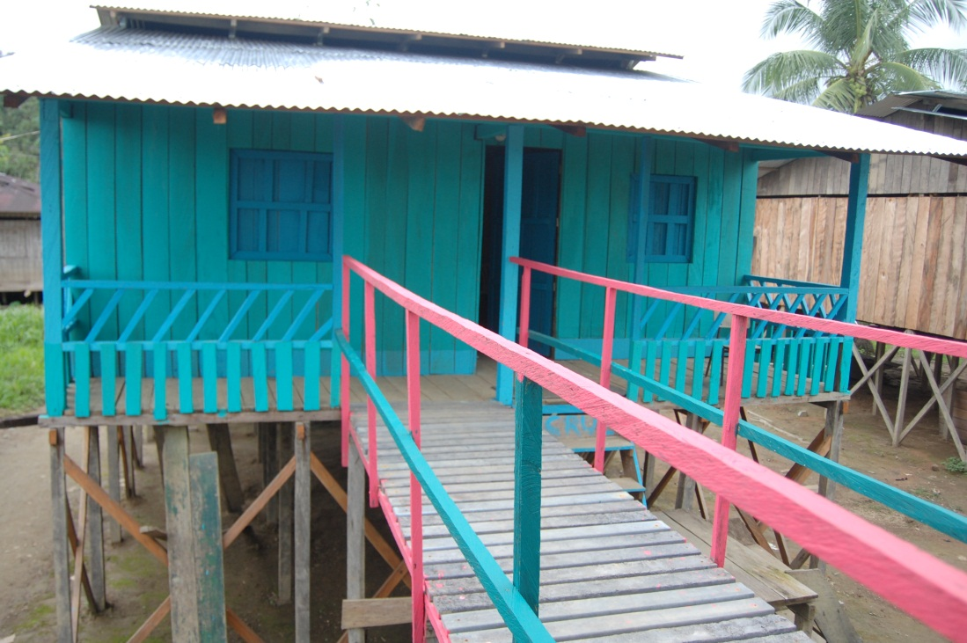
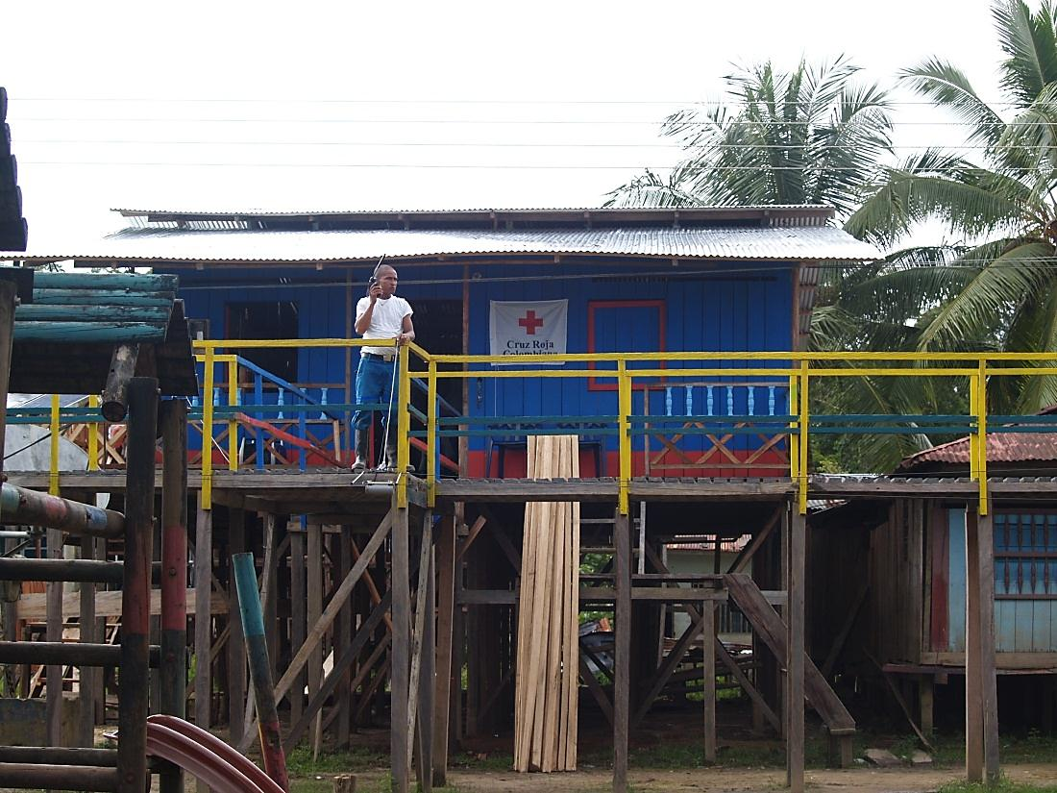
Construction of 80 basic units of rural housing of 70 M2 with shared model 35 people trained in elevation of homes and buildings safer constructions. "Raising" of a school, a computer room and one house; KEY DATA: 24,500 sawn boards, transported by boat to be used during construction; 5,000 pounds of lace used during construction were transported from Quibdo’; 11 ‘woodcutters’ and 5 timber man participated in the construction.

Slide 9
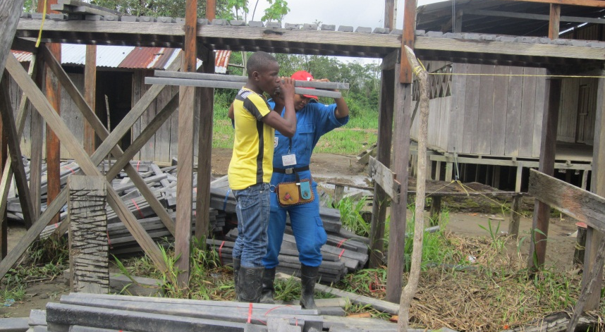
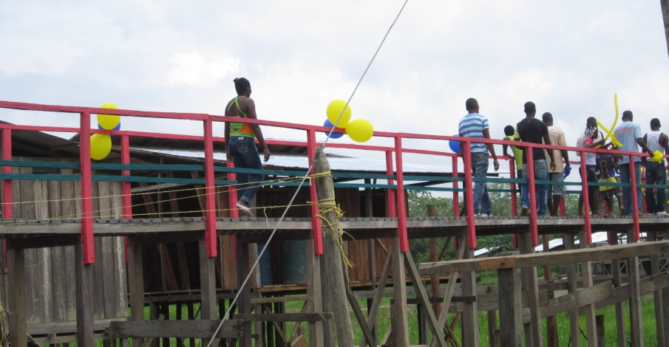
12 months to change the living environment...

Slide 10
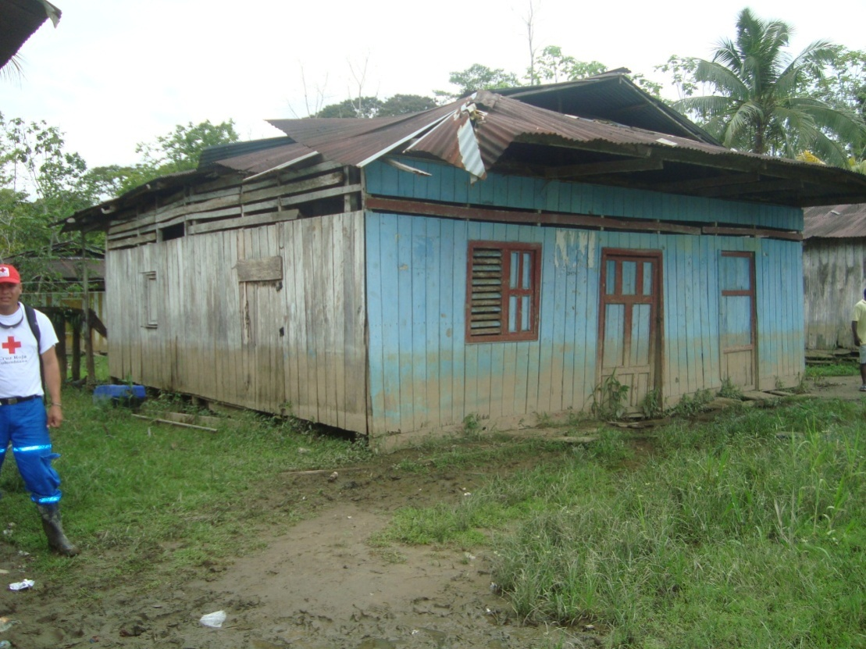
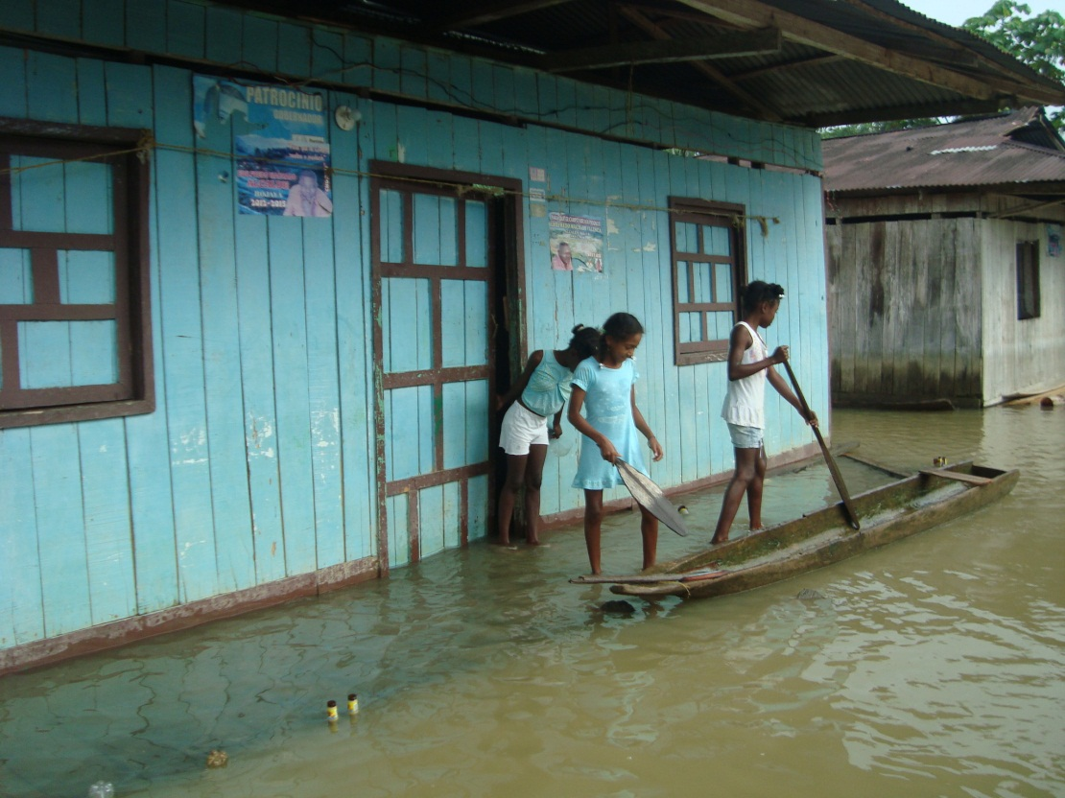
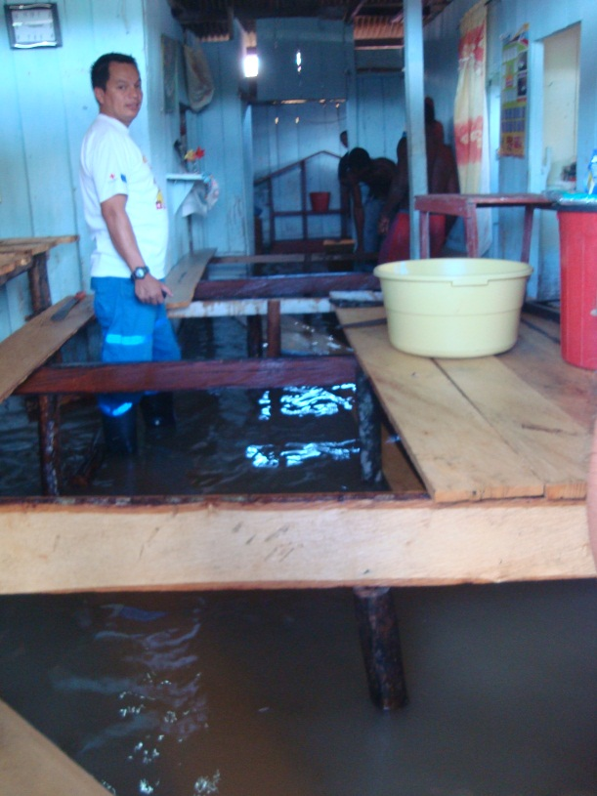
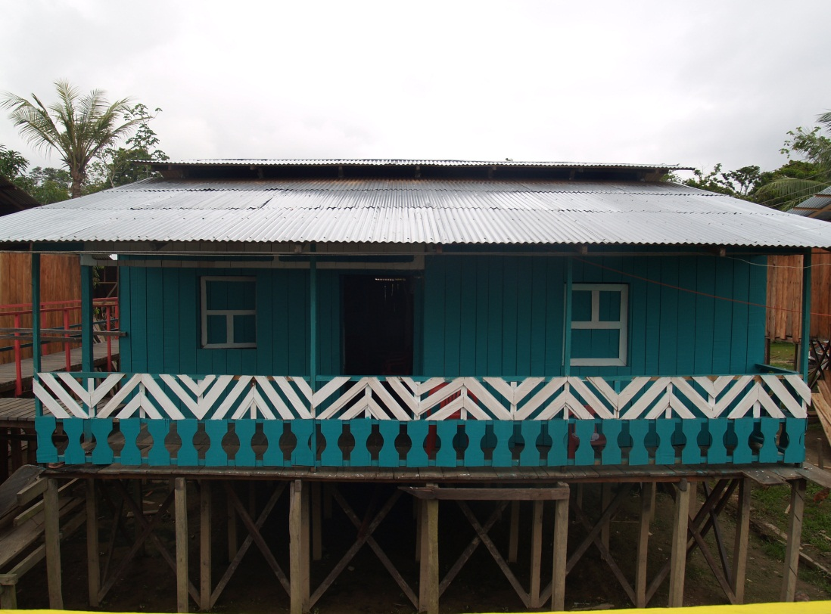
BEFORE THE PROJECT
FLOODS SEASON
FLOODS
AFTER THE PROJECT

Slide 11
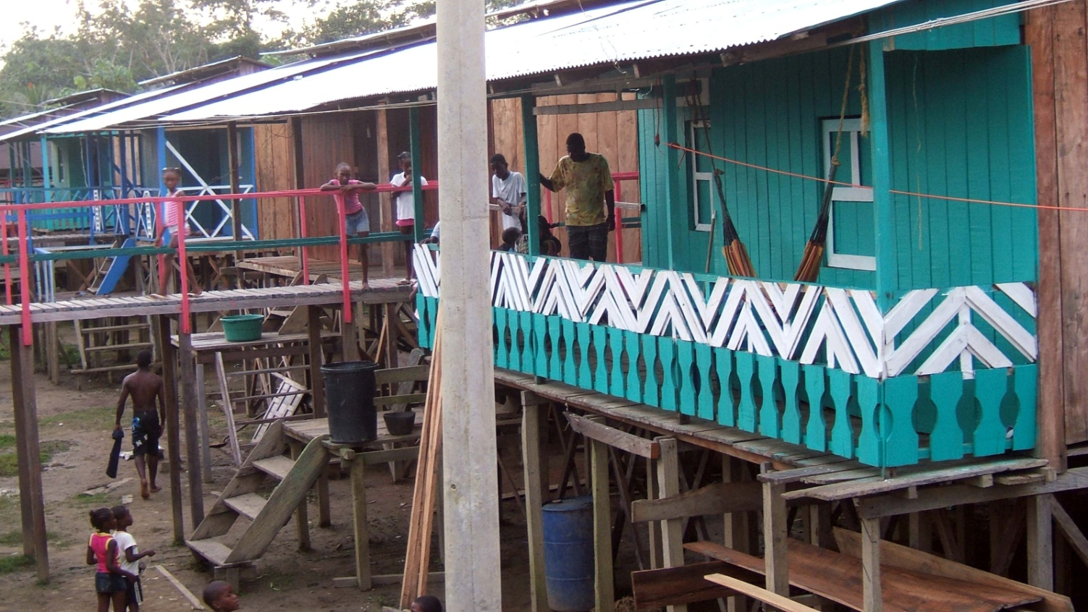
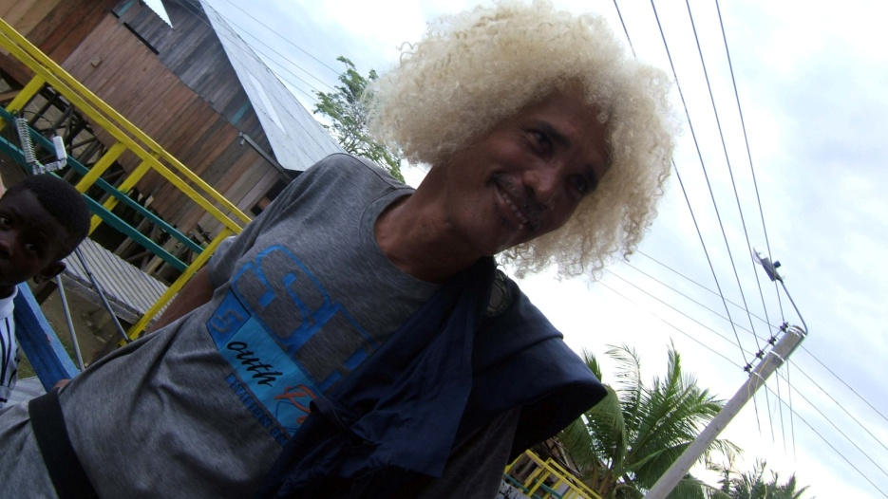
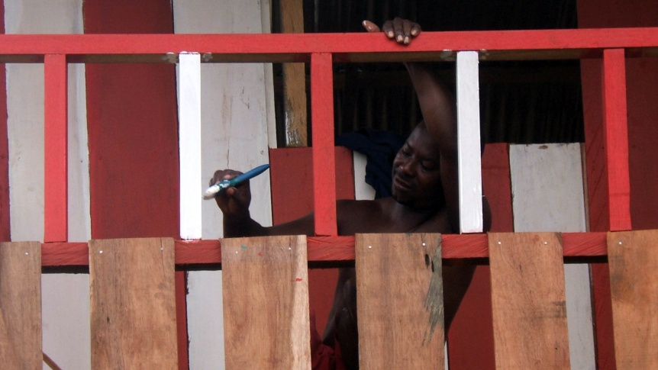
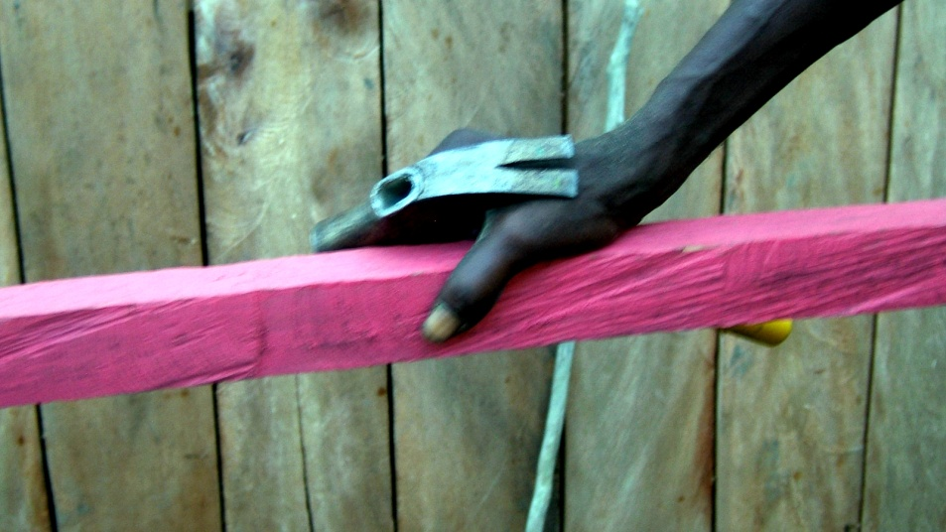

Slide 12
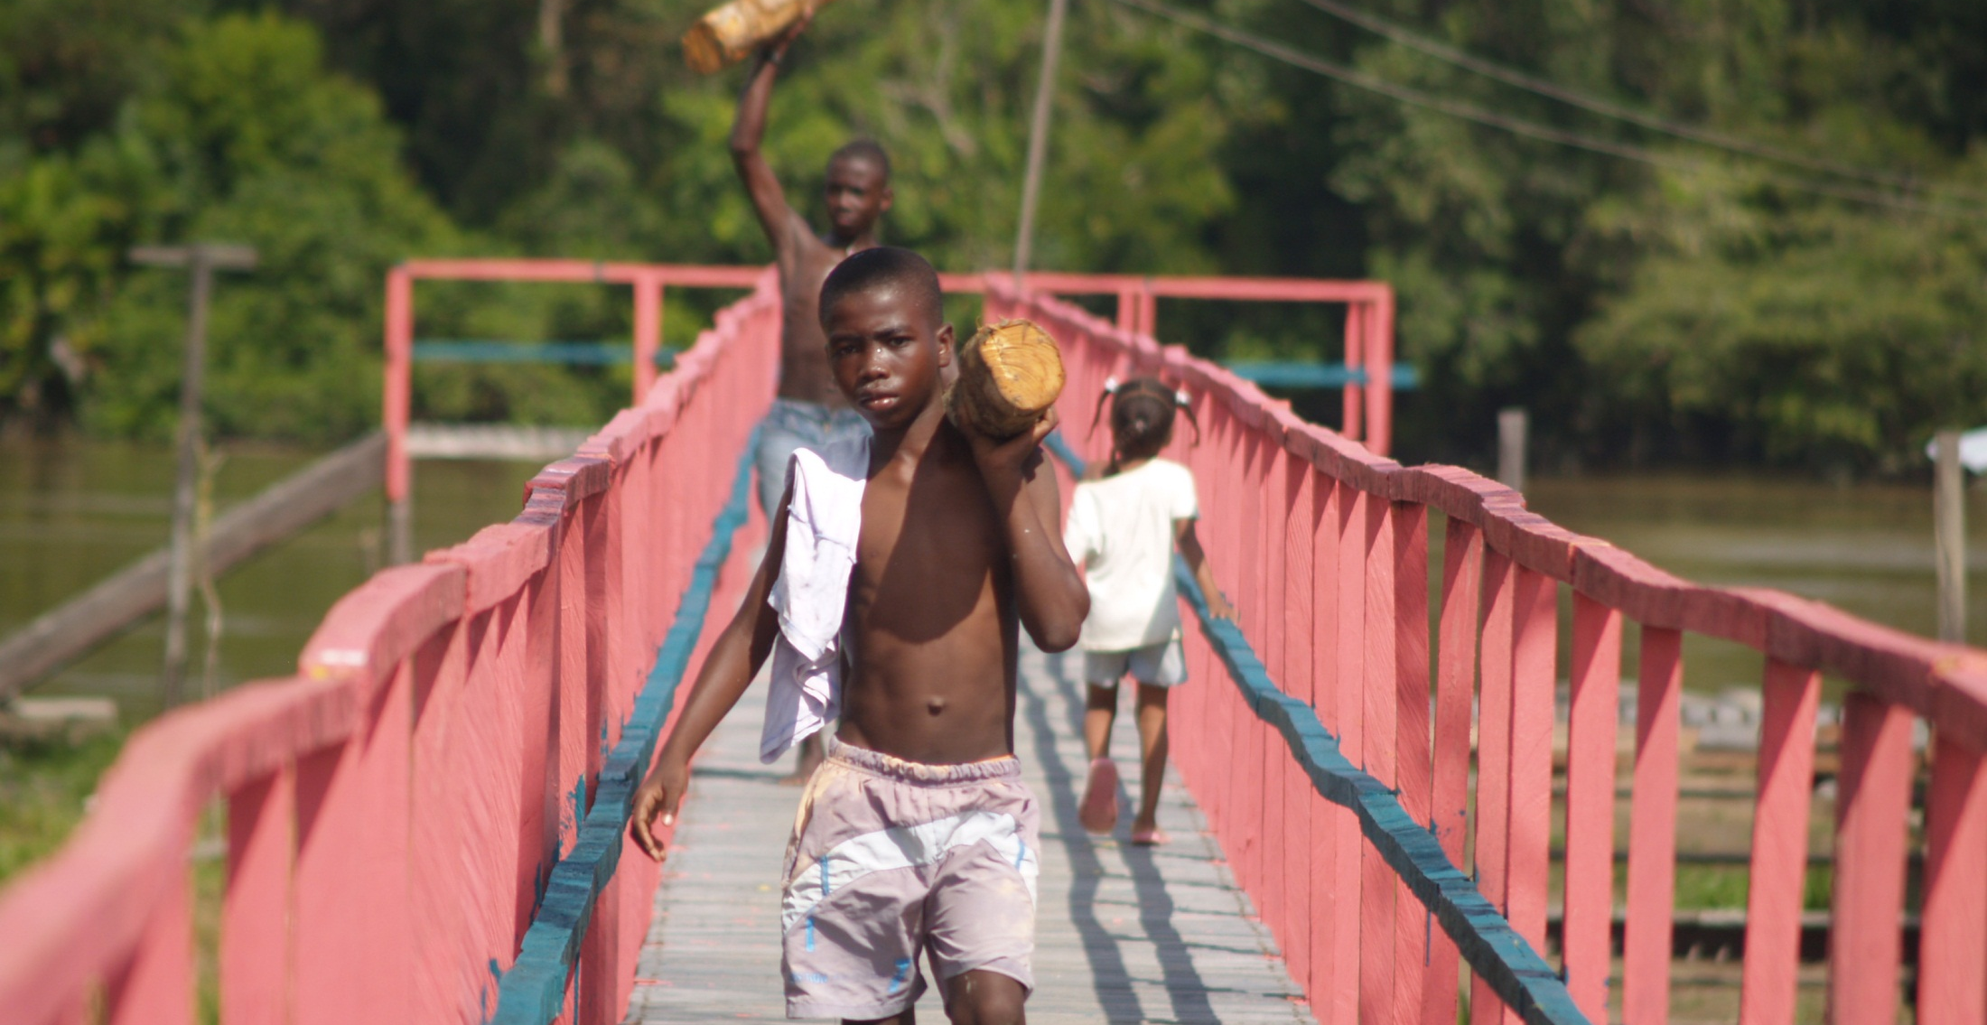
Construction of several footbridges (total length of 1km) elevated at 2.5 m connecting the main dock with most homes, schools, community building, and community garden square. KEY FACT: An estimated 985,000 plastic bottles of 600 ml were used for processing the 8600 plastic tables used in the bridge.

Slide 13
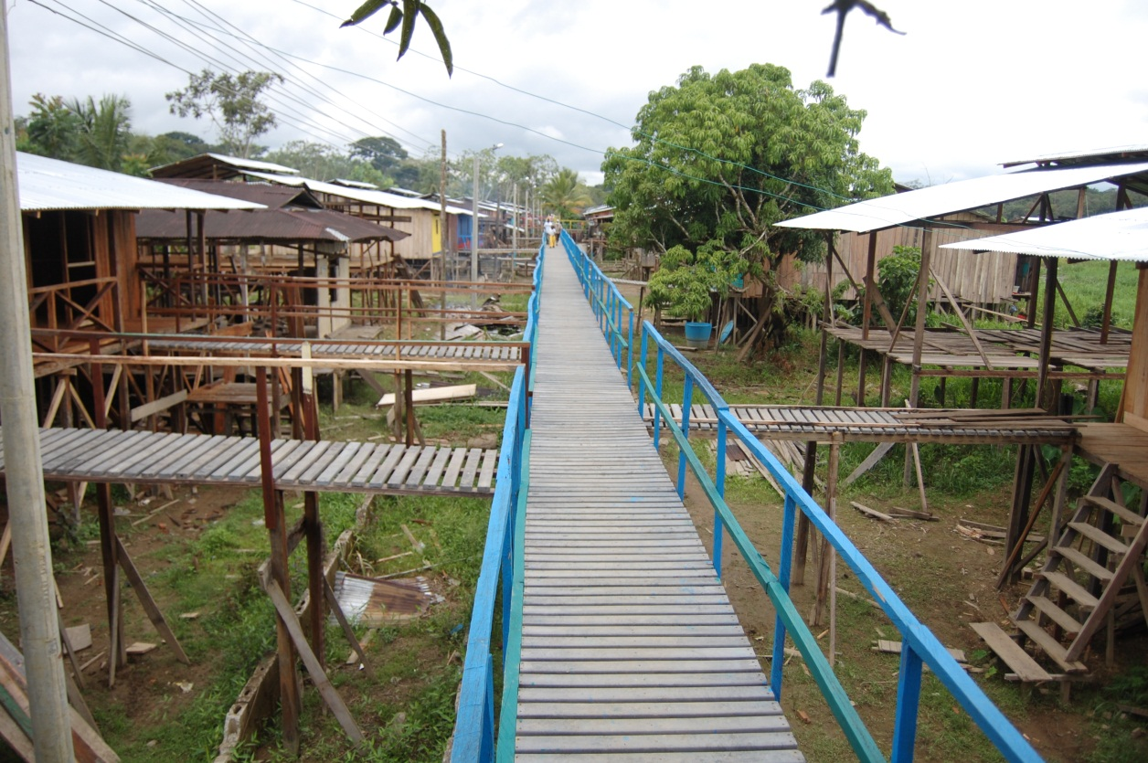
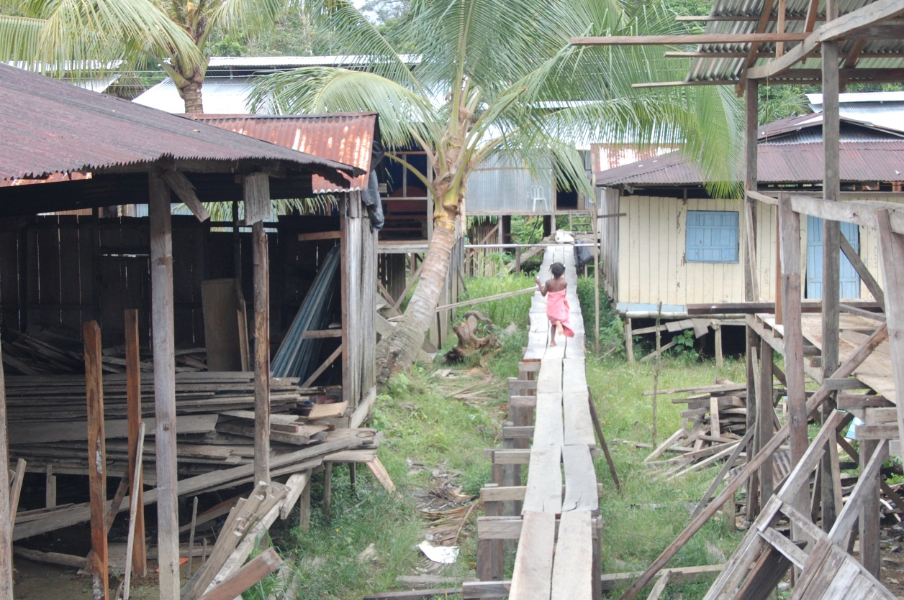
GENERAL FEATURES: Bridge built out of a wooden structure, at a height of 2.50 m x 1.20 m wide, with plastic tables and recycled wood railings. Cost: $ 130,000 COP (70 US$) Ml were used for the processing of 8600 recycled plastic slats.
GENERAL FEATURES: Bridge built on wooden structure, at a height of 1.30 meters x 0.70 meters wide, with wooden boards.
Cost: $ 192,000 COP (104 US$)
Notes:
Se empleo 5.800 tablas plásticas provenientes de 250.000 botellas PET 600 ML
Usar material reciclado permitió ahorrar 2.800 tablas de madera y evitar cortar 15 arboles nativos, los cuales duran cerca de 40 años para desarrollarse.
El plástico es un material con mayor durabilidad y sostenibilidad. La ficha técnica estima 20 años con mantenimiento ocasional. La tabla de madera duraría tan solo 7 años.

Slide 14
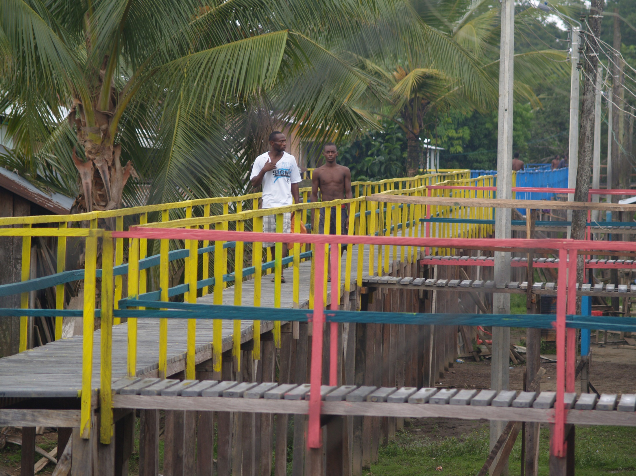

Slide 15
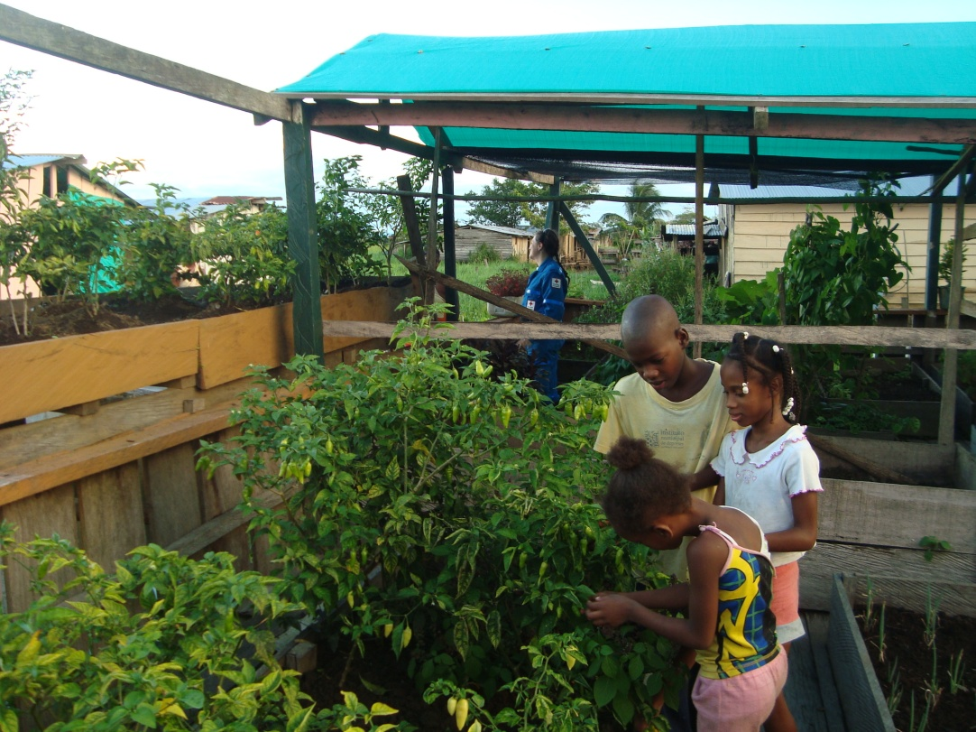
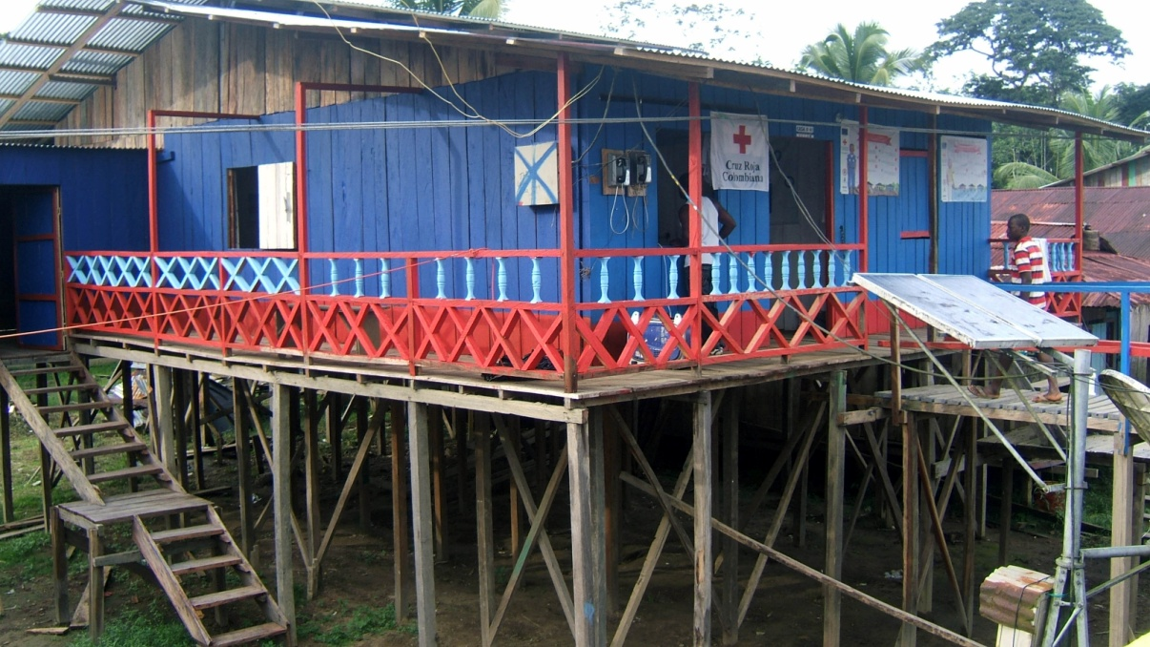
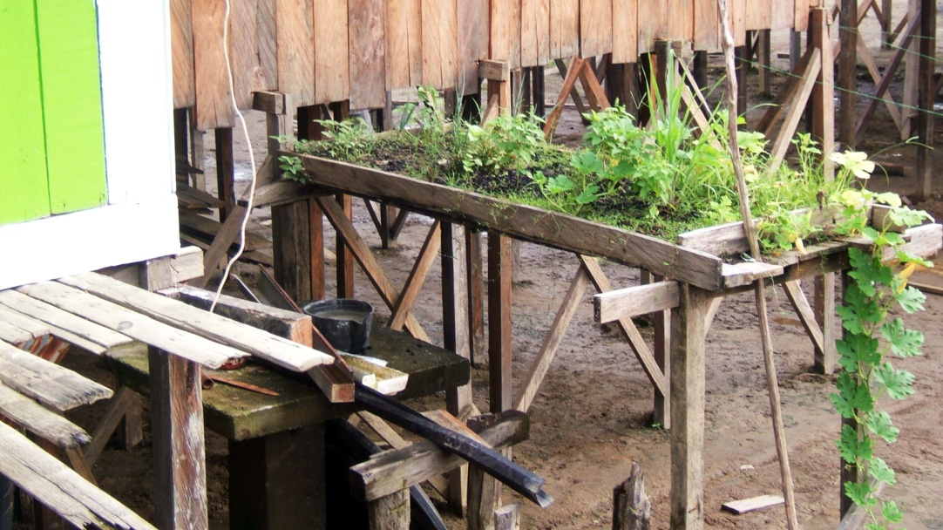
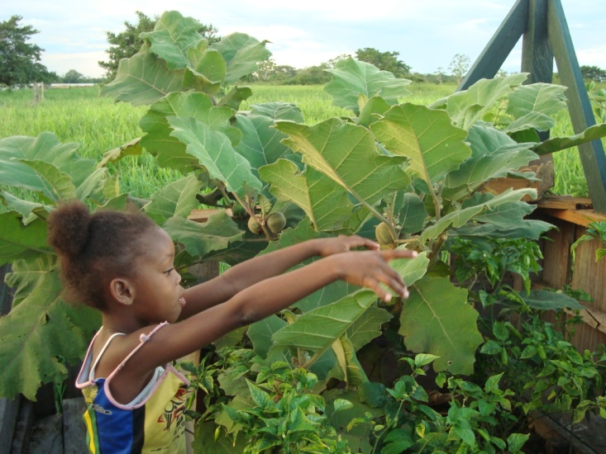

Slide 16
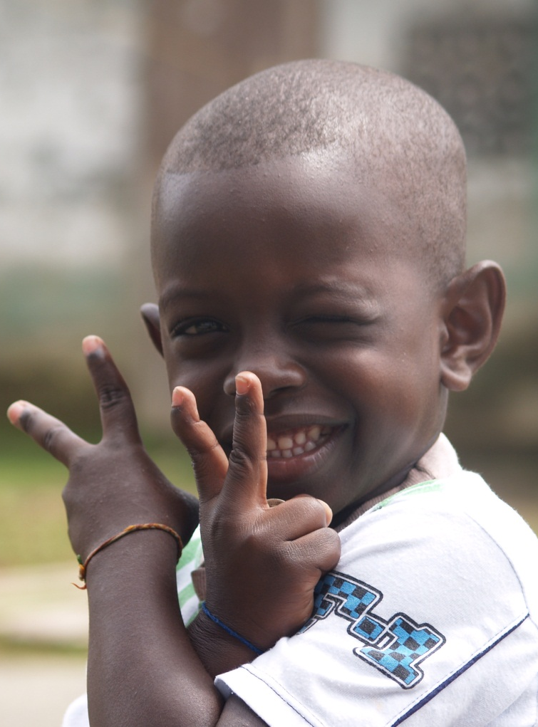
Lessons learned
Risk reduction need "hard and soft solutions". Addressing disaster preparedness with complementary actions to reduce the vulnerability of communities; "Recognize and empower others." Coordination must exceed the mere assumption of official communication with authorities, but must strengthen local networks, using the capacities of other partners and share both limitations and achievement; Act locally but seeking to influence globally. Projects must be confined to a strategy that is intended to influence public policy and plans, that affects development plans and strengthen the risk management system. (replicability)
There is an alternative to resettlement. Also in extreme conditions, communities do have an alternative to continue living in their own environment, even if their living patterns need to change considerably.

Slide 17
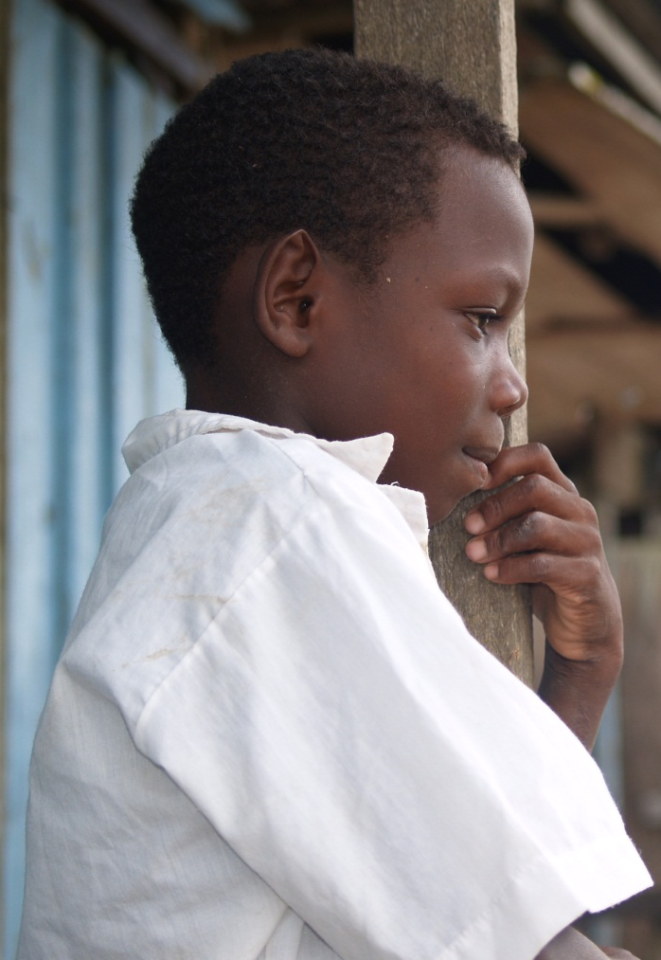
Challenges to be addressed
Communicate and influence. A strong communication plan that would help the National Society to develop an advocacy strategy and show simple actions that reduce risk. Involve local government. Municipal Government involvement was instrumental but arrived only at a later phase. Water and sanitation. Since this was not a housing project per se’, water and sanitation solutions/improvement were not budgeted for. Today this is still an unresolved issue.
Convince donors and be realistic on project timelines. The project needed to consider cultural construction practices, that conditioned the timeframe and need donor flexibility. Livelihoods and genuine participation need to balance out.
Concentrate and focus. In areas with complex risk such as Choco and with high logistics costs, greater impact is achieved by concentrating in some communities, integrating many DRR aspects and promoting community resilience.

Slide 18
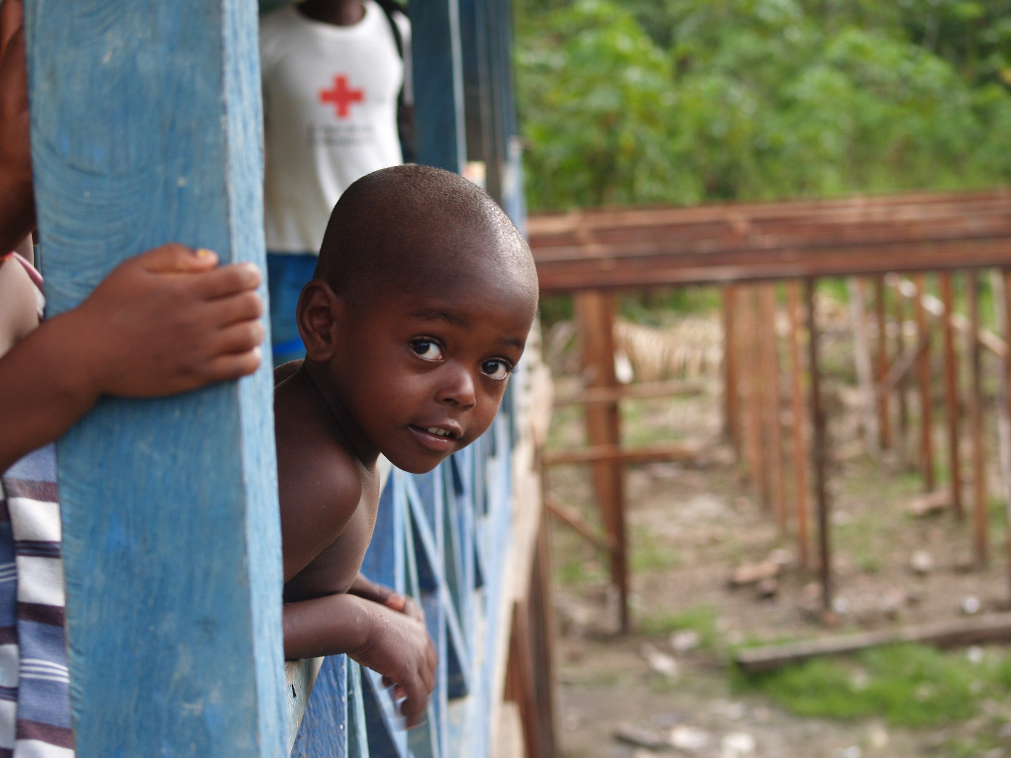
“We are happy because we are going to resist the waters, when the river will come, we will be here, ready, making resistance to flooding”, Eleodora Asprilla – Beneficiaria.

Slide 19
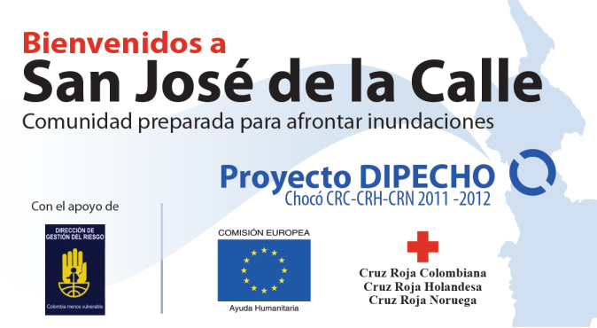
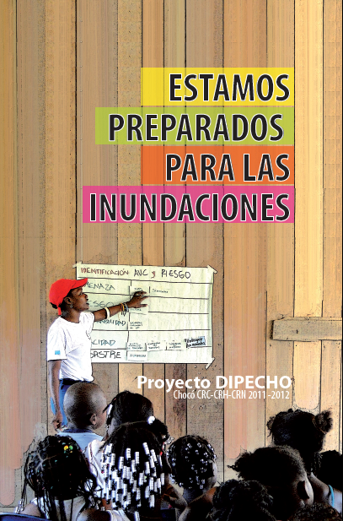
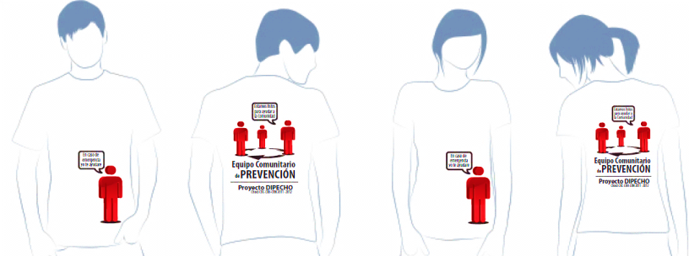
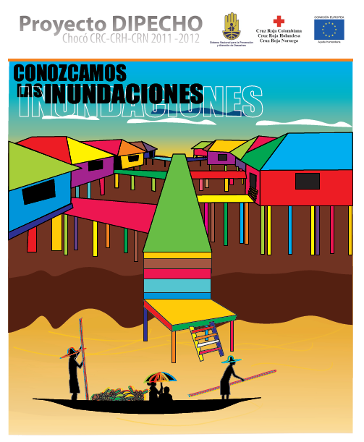
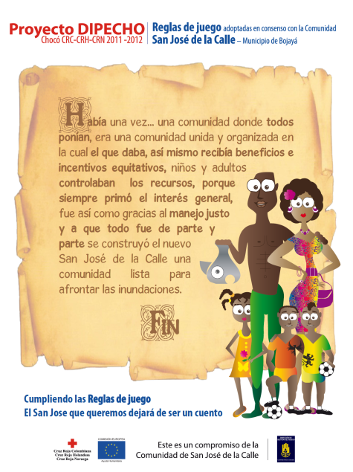
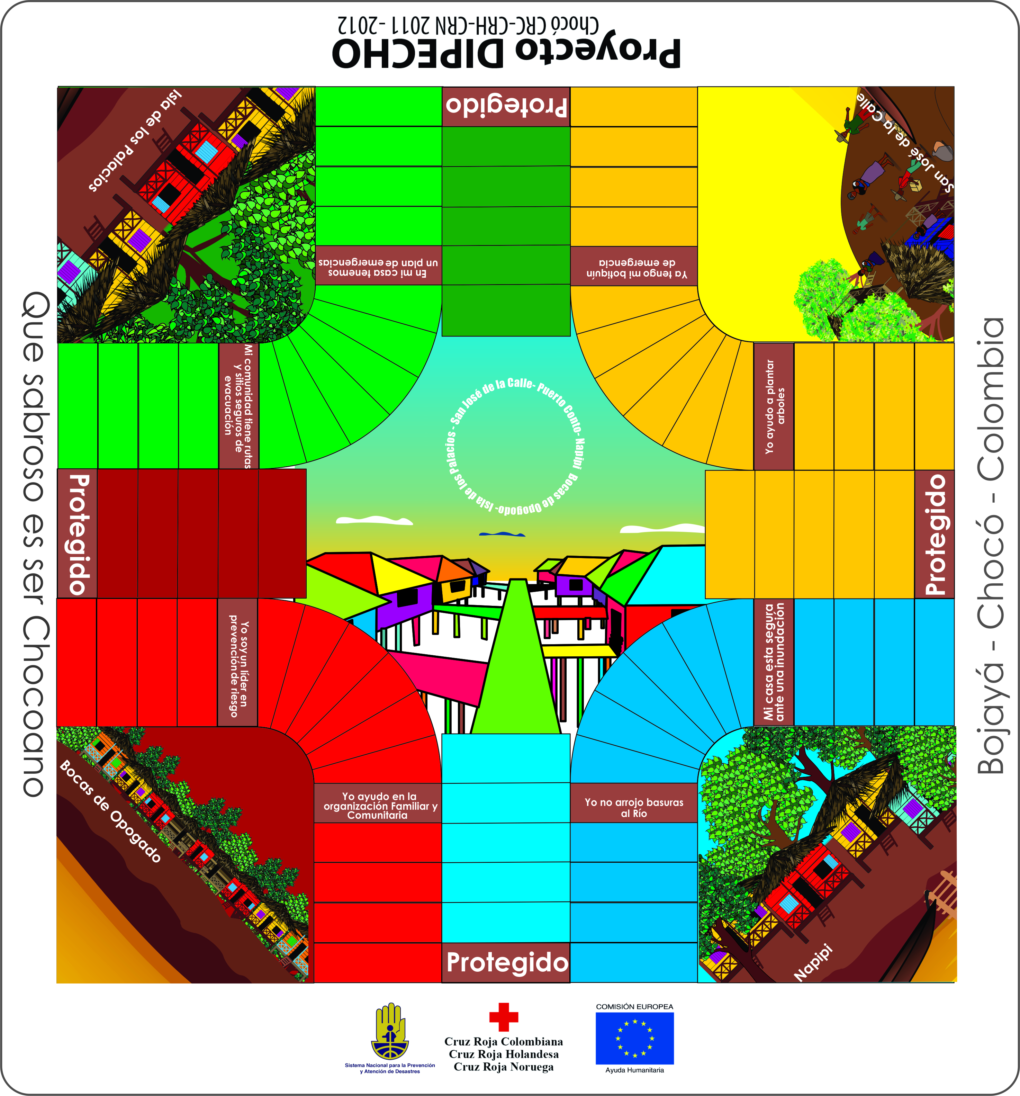
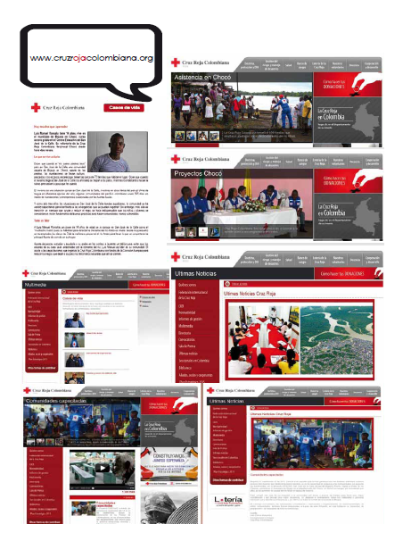
SOME PUBLICATIONS

Slide 21
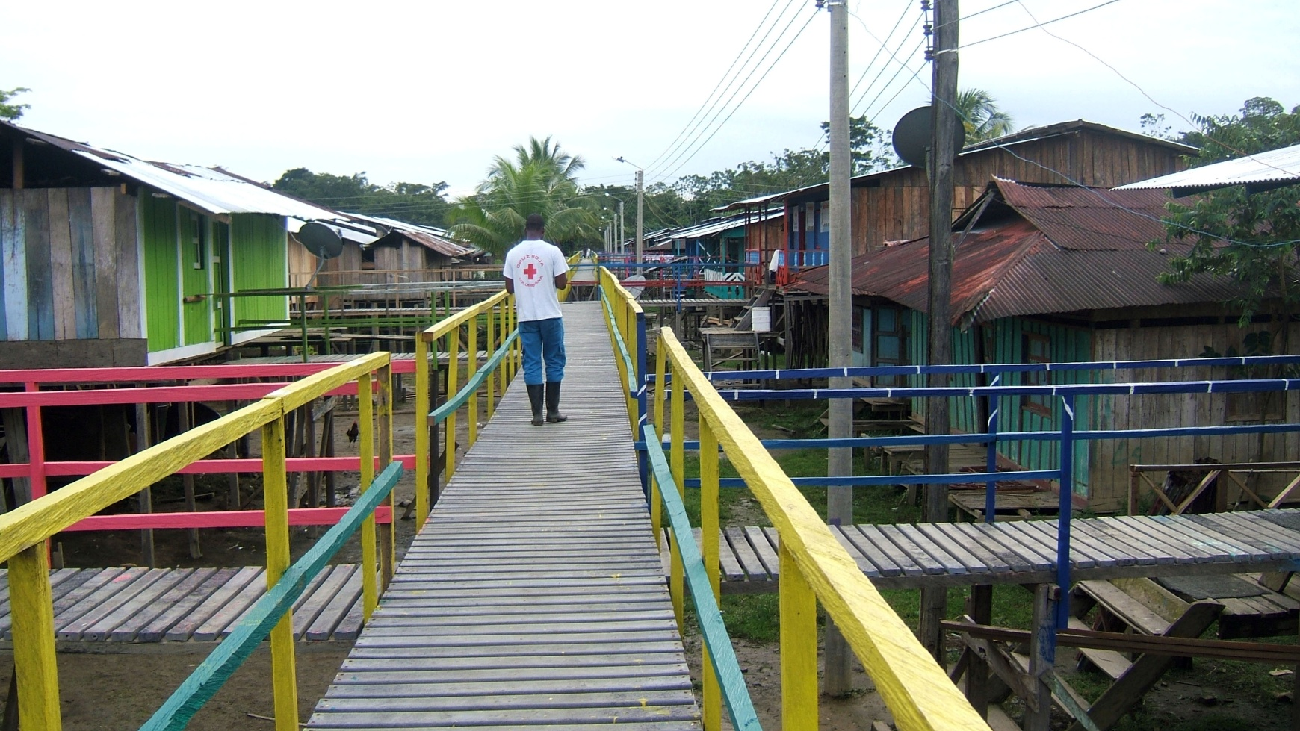
Gracias! thanks!

