Slide 1
Structural Mitigation of Disaster Risks – case study of the island Gram Panchayat of Mousini in the Indian Sunderbans Delta, West Bengal, India.
Shelter Meeting 12b
30th -31st October 2012. National History Museum, Genève
Sujoy Chaudhury
Programme Manager
GOAL India Field Office
www.goal.ie

Slide 2
Disaster Risk Reduction- Mitigation
Mitigation relates to concrete actions which are put into practice to reduce the risk of destruction and casualties.
Mitigation is generally split into two main types of activities:
Structural mitigation refers to any physical construction to reduce or avoid possible impacts of hazards, which include engineering measures and construction of hazard-resistant and protective structures and infrastructure.
Non-structural mitigation refers to policies, awareness, knowledge development, public commitment, and methods and operating practices, including participatory mechanisms and the provision of information, which can reduce risk with related impacts.

Slide 3
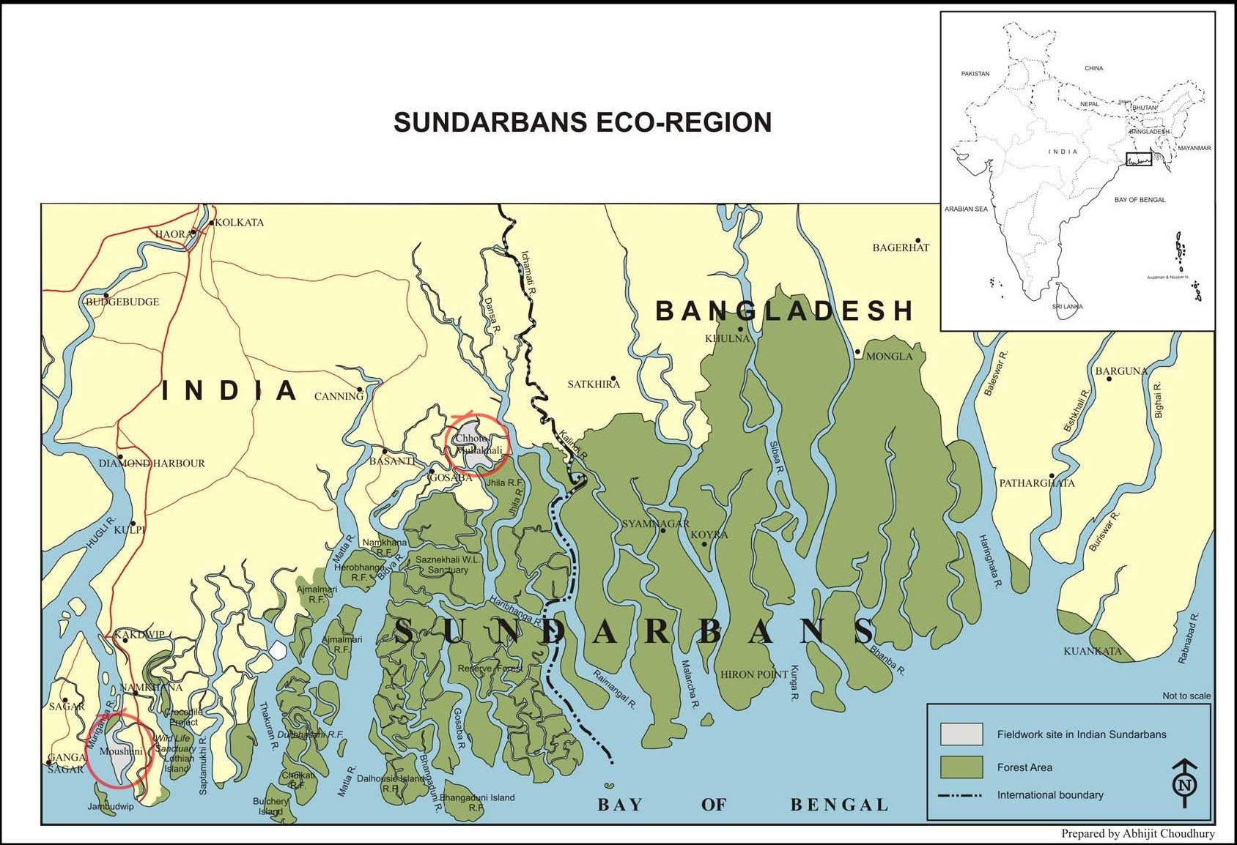
M
Mousini Island

Slide 4
Sunderbans
The Sunderbans is the largest single block of tidal halophytic mangrove forest in the world. The forest lies at the mouth of the Ganges and is spread across areas of Bangladesh and West Bengal, India, forming the seaward fringe of the delta. The forest covers 10,000 sq. km of which about 4,000 are in India. It became inscripted as a Ramsar site in 1992 and a UNESCO world heritage site in 1997.
It is estimated that about 4.2 million people live in the Indian Sundarbans Delta (ISD).

Slide 5
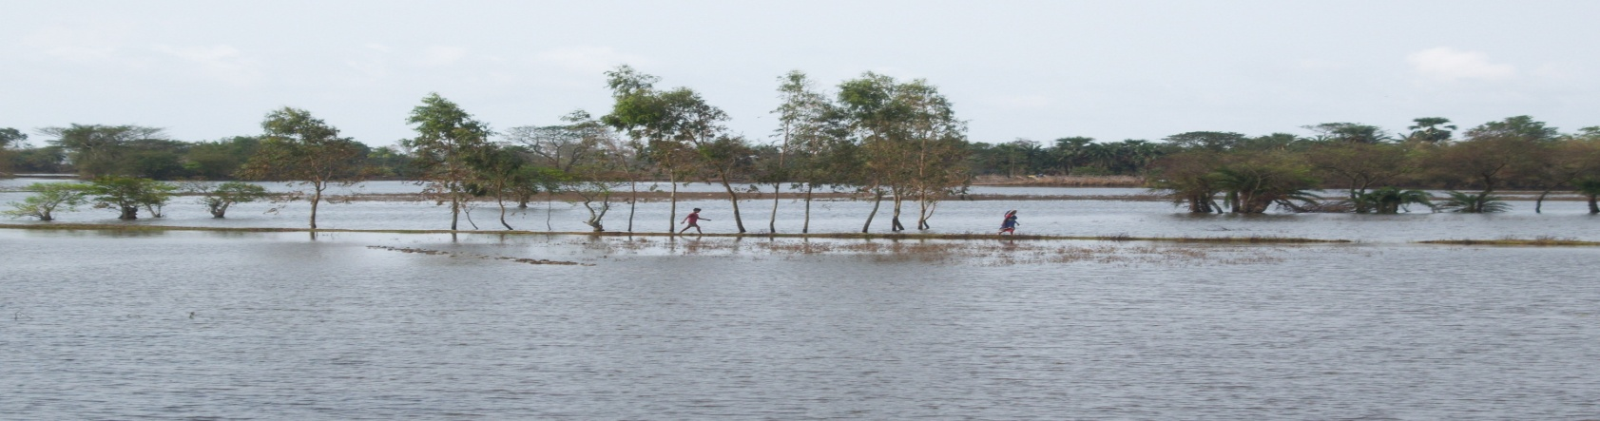
Sunderbans…….
Recurring natural disasters, inaccessibility and remoteness, complete lack of infrastructure and access to limited resources make these populations some of the very poorest in the world. Unsustainable practices, increase in population and increase in the intensity and frequency of natural events have stressed the coping capacities of the people particularly the poorest of the poor. The loss of homestead and agricultural lands has compelled large number of families to migrate as environmental refugees. As more and more land continues to be claimed by rising sea waters, newer families find themselves joining the growing ranks of climate change refugees.

Slide 6
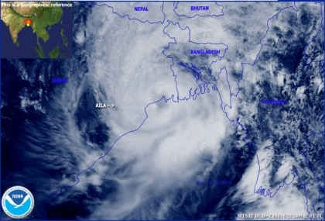
Sunderbans……. Natural hazards, tropical cyclones

Slide 7
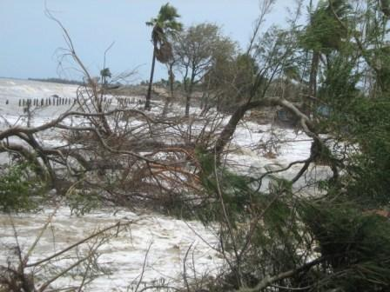
Sunderbans……. Natural hazards, Tidal surges

Slide 8
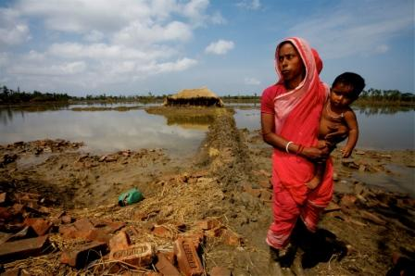
Sunderbans……. Natural hazards, flooding

Slide 9
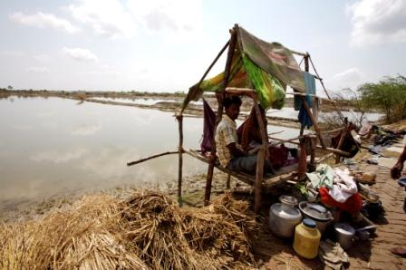
GOAL’s DRR interventions in the Indian Sunderbans Delta- Mousini Island.
Following cyclone “Aila” in 2009 , GOAL intervened with an emergency response programme which was supplemented by a Disaster Risk Reduction intervention that focused on structural mitigation.

Slide 10
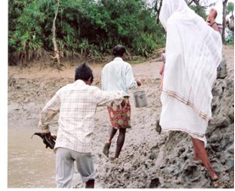
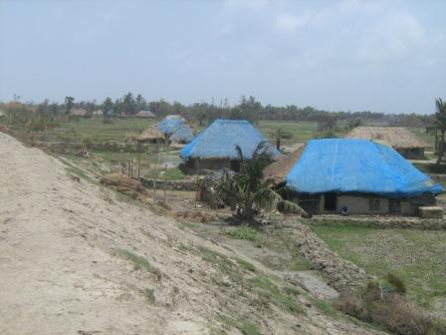
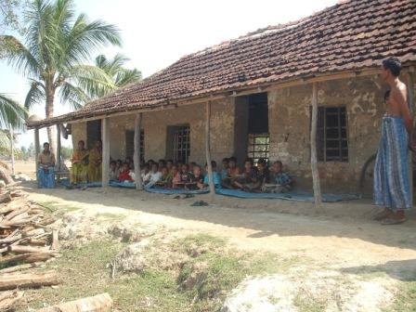
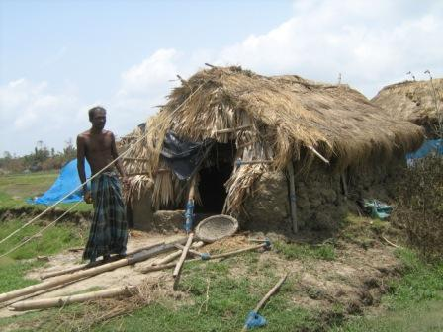
Mousini – difficult to access and poor infrastructure

Slide 11
Intervention logic
The island is severely prone to recurring climate events.
People in the island are extremely poor and have very little coping capacities.
Largely difficult to access and very poor access infrastructure.
Quality of housing & institutional infrastructure stock extremely poor.
Few concrete buildings including the Gram Panchayat office, Primary Health Centre and High Schools located on one side of the island and not equipped to serve as shelters during emergencies.
Knowledge of Risk reduction limited to preparedness only.

Slide 12
Disaster Risk – Mitigation strategy.
While non- structural mitigation strategies are important, that the people of Mousini would be able to cope with the next disaster, GOAL decided to adopt structural mitigation strategies which included
Improving access to and from the island by developing all weather piers.
Improving access to early childhood care and development centers for mothers and infants, through the construction of hazard resistant centers using low carbon technologies in the most vulnerable areas of the island.
Improving access to primary education for children, through the construction of hazard resistant primary school buildings using low carbon technologies in the most vulnerable areas of the island.

Slide 13
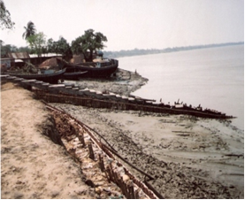
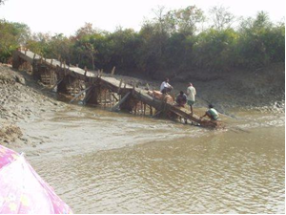
Improving access to and from the island- construction of 2 all weather RCC piers on brick masonry foundation, resting on manually driven timber piles ( 1/7th the cost of conventional RCC piers with machine driven pre-cast concrete piles)

Slide 14
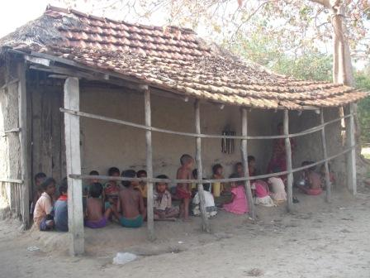
Improving access to infants and mothers- construction of 16 hazard resistant early childhood care and development (ECCD) centers using low carbon technology.

Slide 15
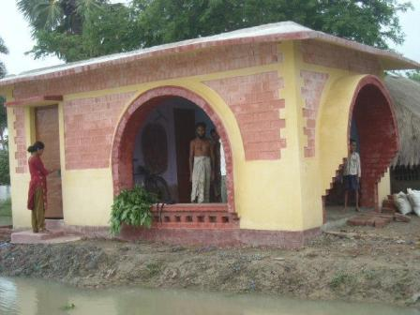
ECCD centers………

Slide 16
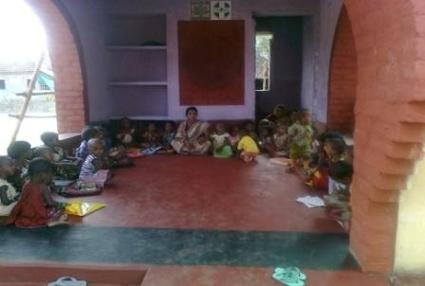
ECCD centres- reducing risks and improving all weather access.

Slide 17
Improving access to children- construction of 7 hazard resistant primary schools using low carbon technology.

Slide 18
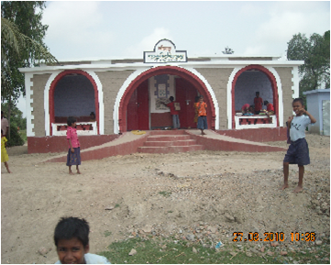
Primary Schools …….

Slide 19
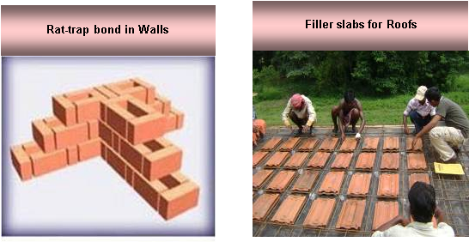
Construction highlights.

Slide 20
Construction highlights…….
Use of Vernacular architecture- arches and extensive corbelling.
Raised plinths above HFL
Use of Locally sourced bricks and building materials.
Training provided to local masons and artisans.
All buildings equipped with toilets and drinking water.
All building have access ramps .
Roofs can be accessed using ladders and can be used to store fodder.

Slide 21
Learning…..
Instead of constructing large centralized shelters which are expensive and only useful during emergencies, construction of small decentralized shelters constituting primary schools, ECCD centers, health centers etc. offer a feasible and viable option for reducing disaster risks.
Adequate resources for training of masons & artisans to be considered in planning as turnover can be high.

Slide 22
THANK YOU

