Slide 1
Shelter, Resilience & YOU
Inputs from Shelter Meeting 12B

Slide 2
It’s about….
providing field staff and managers with practical guidance on what disaster risk reduction might look like
using common principles for effective programmes & advocacy
linking activities to programme cycle management
promoting DRR in challenging contexts (incl. emergency & recovery phases /urban contexts)

Slide 3
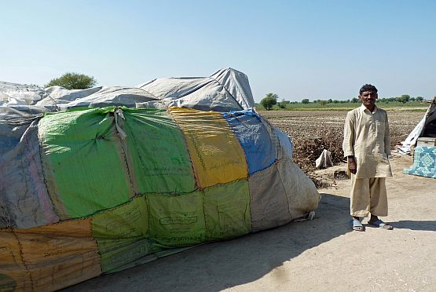
It forgot to include….
a section on shelter

Slide 4
but….
we have an opportunity…
in groups of 4/5, discuss actions that shelter practitioners & managers can do to integrate these DRR/CCA principles into our work
give real life examples when possible

Slide 5
example
integrated disaster risk reduction and climate change adaptation principles in WASH
2. Increase understanding of exposure, vulnerability and capacity. | Using a participatory method, assess the extent to which the target population’s water and sanitation needs are/aren’t met, how this affects their general health and nutritional status, and in which ways it creates vulnerability to hazards and the effects of climate change. | Conduct a hygiene-focused Knowledge, Attitudes and Practices (KAP) survey to identify causes of vulnerability as well as capacities to be strengthened through hygiene promotion strategies.

Slide 6
principles of an integrated approach
Increase understanding of the hazard and climate change context
Increase understanding of exposure, vulnerability and capacity
Recognize rights & responsibilities
Strengthen participation and agency of the population at risk
Promote systematic engagement and change
Foster synergy between multiple levels
Draw on and build diverse sources of knowledge
Instil flexibility and responsiveness
Address different time scales
Do no harm

Slide 7
thank you
For more information:
http://developmentbookshop.com/toward-resilience
seki.hirano@crs.org rbauer@oxfam.org.uk

