Slide 1
Welcome to day 6
Notes:
Notes in ITALICS are general training guidance
Facilitators can add notes below to assist training
Notes in BOLD are material references and sources
EC (30/03/10): from SC08b, Day 2 03, p.2 and 3
CM (26/04/10): changed objectives to make them shorter and more SMART

Slide 2
Notes:
Notes in ITALICS are general training guidance
Facilitators can add notes below to assist training
Notes in BOLD are material references and sources
EC (30/03/10): from SC08b, Day 2 03, p.2 and 3
CM (26/04/10): changed objectives to make them shorter and more SMART

Slide 3
Participant led sessions
Protection principles
105
Minutes

Slide 4
Participant led session
1
Notes:
Notes in ITALICS are general training guidance
Facilitators can add notes below to assist training
Notes in BOLD are material references and sources
EC (30/03/10): from SC08b, Day 2 03, p.2 and 3
CM (26/04/10): changed objectives to make them shorter and more SMART

Slide 5
Refer to preparation sessions 3.2 and 5.4
Present
Ask questions

Slide 6
Coffee break
Please be back in time for
30 min
Back at
11:00
Notes:
Notes in ITALICS are general training guidance
Facilitators can add notes below to assist training
Notes in BOLD are material references and sources
EC (30/03/10): from SC08b, Day 2 03, p.2 and 3
CM (26/04/10): changed objectives to make them shorter and more SMART

Slide 7
Participant led sessions
Non-food items distribution
90
Minutes

Slide 8
Disaster risk reduction
2
Notes:
Notes in ITALICS are general training guidance
Facilitators can add notes below to assist training
Notes in BOLD are material references and sources
EC (30/03/10): from SC08b, Day 2 03, p.2 and 3
CM (26/04/10): changed objectives to make them shorter and more SMART

Slide 9
Refer to preparation sessions 3.2 and 5.4
Present
Ask questions

Slide 10
Lunch break
Please be back in time for
30 min
Back at
14:00
Notes:
Notes in ITALICS are general training guidance
Facilitators can add notes below to assist training
Notes in BOLD are material references and sources
EC (30/03/10): from SC08b, Day 2 03, p.2 and 3
CM (26/04/10): changed objectives to make them shorter and more SMART

Slide 11
Energiser session
Notes:
Notes in ITALICS are general training guidance
Facilitators can add notes below to assist training
Notes in BOLD are material references and sources
EC (30/03/10): from SC08b, Day 2 03, p.2 and 3
CM (26/04/10): changed objectives to make them shorter and more SMART

Slide 12
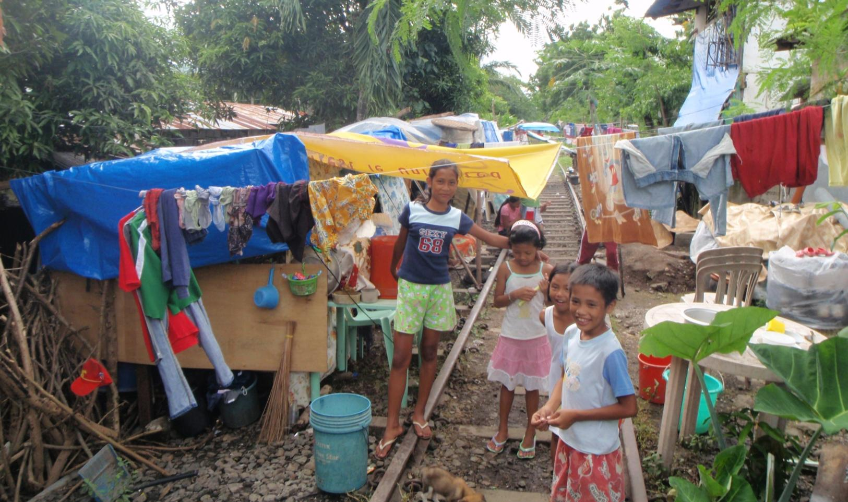
Wrap up session
Wrap up session
90
Minutes
3

Slide 13
Wrap up session
3
Notes:
Notes in ITALICS are general training guidance
Facilitators can add notes below to assist training
Notes in BOLD are material references and sources
EC (30/03/10): from SC08b, Day 2 03, p.2 and 3
CM (26/04/10): changed objectives to make them shorter and more SMART

Slide 14
Coffee break
Please be back in time for
30 min
Back at
16:00
Notes:
Notes in ITALICS are general training guidance
Facilitators can add notes below to assist training
Notes in BOLD are material references and sources
EC (30/03/10): from SC08b, Day 2 03, p.2 and 3
CM (26/04/10): changed objectives to make them shorter and more SMART

Slide 15
Feedback session
Feedback session
90
Minutes
4

Slide 16
Feedback session
₀
3
Notes:
Notes in ITALICS are general training guidance
Facilitators can add notes below to assist training
Notes in BOLD are material references and sources
EC (30/03/10): from SC08b, Day 2 03, p.2 and 3
CM (26/04/10): changed objectives to make them shorter and more SMART

Slide 17
Thank you Don’t forget to fill in your feedback form
Notes:
Notes in ITALICS are general training guidance
Facilitators can add notes below to assist training
Notes in BOLD are material references and sources
EC (30/03/10): from SC08b, Day 2 03, p.2 and 3
CM (26/04/10): changed objectives to make them shorter and more SMART

