Slide 1
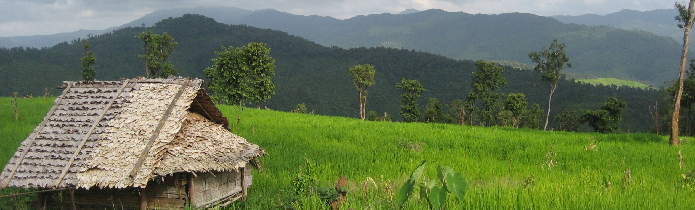
Welcome to day 5
Notes:
Notes in ITALICS are general training guidance
Facilitators can add notes below to assist training
Notes in BOLD are material references and sources
EC (30/03/10): from SC08b, Day 2 03, p.2 and 3
CM (26/04/10): changed objectives to make them shorter and more SMART

Slide 2
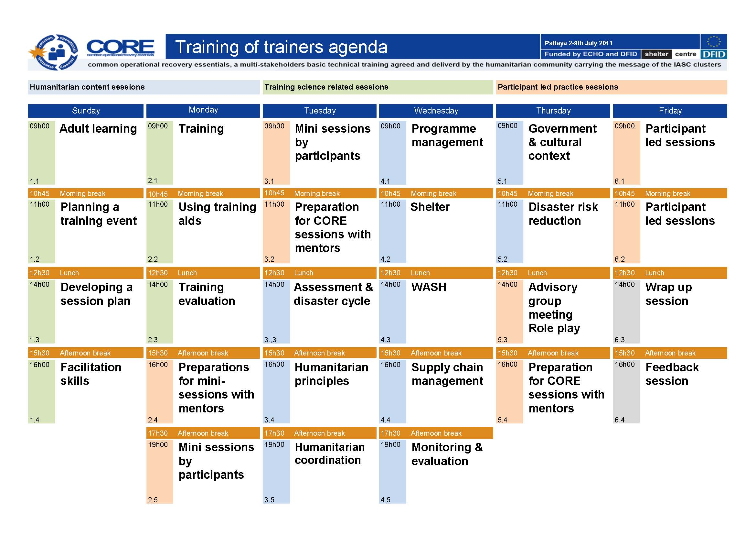
Notes:
Notes in ITALICS are general training guidance
Facilitators can add notes below to assist training
Notes in BOLD are material references and sources
EC (30/03/10): from SC08b, Day 2 03, p.2 and 3
CM (26/04/10): changed objectives to make them shorter and more SMART

Slide 3
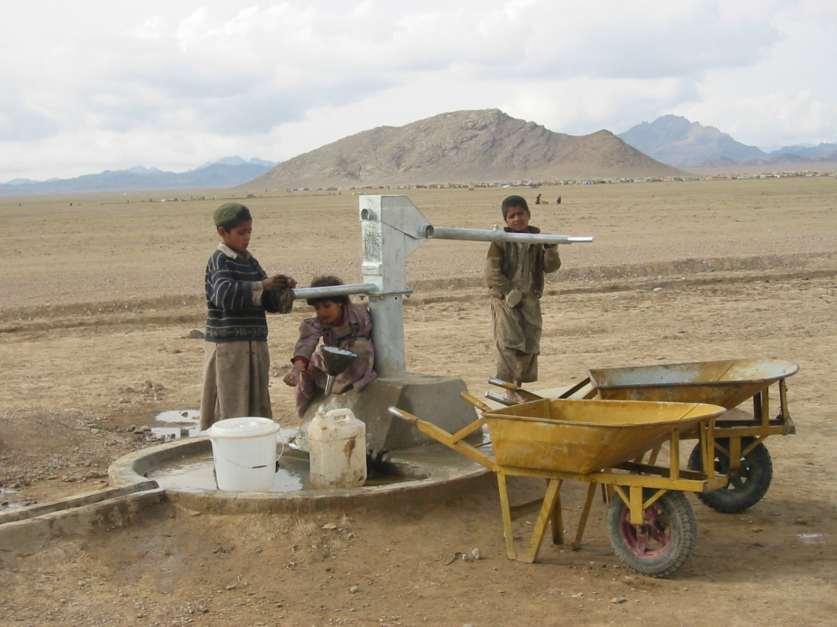

Government and cultural context
Government and context – cultural sensitivity
105
Minutes
Notes:
Notes in ITALICS are general training guidance
Facilitators can add notes below to assist training
Notes in BOLD are material references and sources
EC (30/03/10): from SC08b, Day 2 03, p.1

Slide 4
Government & cultural context
1
Notes:
Notes in ITALICS are general training guidance
Facilitators can add notes below to assist training
Notes in BOLD are material references and sources
EC (30/03/10): from SC08b, Day 2 03, p.2 and 3
CM (26/04/10): changed objectives to make them shorter and more SMART

Slide 5
By the end of this session, you will have an understanding of:
Objective 1 Governmental context
Objective 2 Cultural context

Slide 6



What shapes our cultures?
Write down key points
Traditions
Lifestyle
Religion
Education
Economics
Conflict
Gender
Language
Environment
Discussion as a group
5 minutes

Slide 7
Watch video
http://www.youtube.com/watch?v=mUCODUvKbzE&feature=related
5 minutes

Slide 8


Objective 1 Governmental context
National government will have:
Legal structure – national law, customary law
Organisation structure – national and local
Coordination mechanisms

Slide 9
Objective 1 Governmental context
What happens when disaster hits?
Government might have an emergency response plan
A task force is created either structured or adhoc
Capacity to cope can be overwhelmed, particularly at local level
Humanitarian community can offer to support the government

Slide 10
Objective 1 Governmental context
How can the humanitarian community help?
Offer immediate assessment and response capacity
Provide gap filling where capacity has been lost and where additional is needed
Use international law to support national law
Develop projects coordinated with government to meet recovery aims

Slide 11
Discussion in groups
Write down key points
Task In your last response share how you assisted the national government and how they assisted you
Discussion in groups
10 minutes

Slide 12
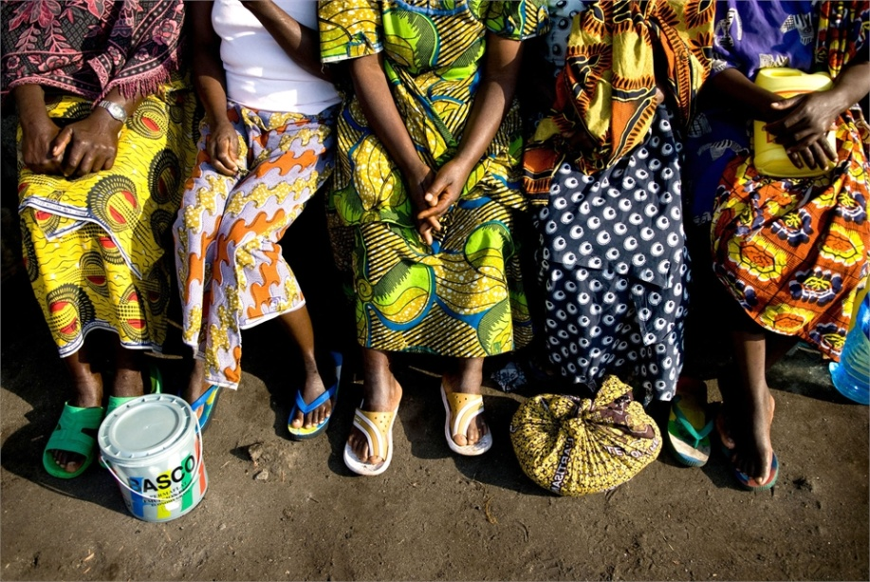
Objective 2 Cultural context
Cultural context creates social structures influencing our approach to gender, age and ability
Social roles are cultural constructs and vary:
  across communities
  over time
  in different economic conditions
Between of different:
  ages individuals
  ethnic communities
  economic status

Slide 13

Discussion in pairs
Write down key points
Task 1 Write down a summary of your typical weekend
Task 2 Discuss in groups what you have written noting the cultural differences
Discuss in pairs
10 minutes

Slide 14
Objective 2 Cultural context
Disasters have a negative effect on local culture which may then need support
Previously vulnerable groups will be most affected
Local social structures can be damaged
Normal life is disrupted – cultural traditions affected
Social fragmentation occurs during conflict

Slide 15
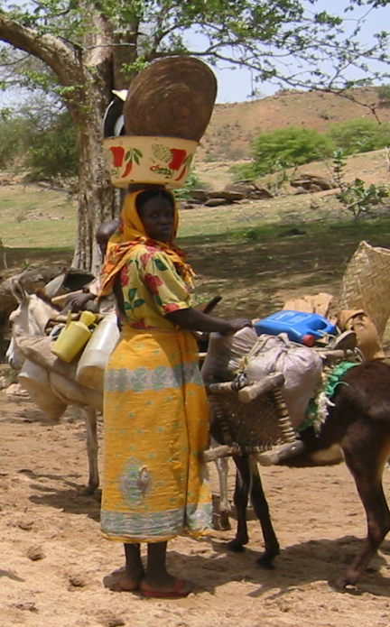
Objective 2 Cultural context
Particular gender issues
Engage with both gender groups on needs assessment and delivery
Aim to improve sustainable, equitable gender roles, and promote empowerment
Recovery process and programme development should allows employment options for men and women

Slide 16
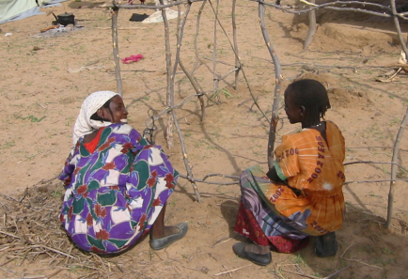
Objective 2 Cultural context
Equality, making all voices heard
Marginalized groups are even more vulnerable in emergencies and in post-disaster situations
It can be difficult to access these groups
Particularly, women, elderly, disabled and children

Slide 17
Objective 2 Cultural context
WASH project cultural considerations
Hygiene facilities constructed to maintain appropriate level of privacy needs between men and women
Facilities for bathing and collecting water should be located so as to protect women and children from threat
Ensure men and women have equal access

Slide 18
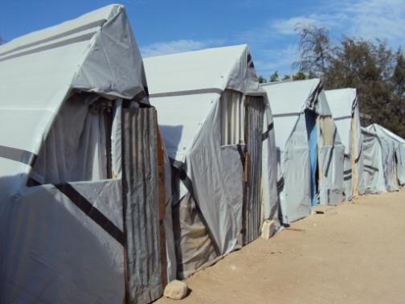
Objective 2 Cultural context
Shelter project cultural considerations
Cultural norms for shelters, i.e. appropriate materials
Provision for cooking inside or out
Separate rooms for men and women
Provision for livestock

Slide 19
Objective 2 Cultural context
Religious or spiritual significance:
Some water sources might be treated with special reverence, and should be treated with sensitivity
Provision of religious meeting spaces in camps
Sensitivity of images on messaging

Slide 20
Discussion in groups
Write down key points
    Task 1 Discuss from your experience how you have engaged vulnerable people groups in your projects?
    Task 2 Discuss how cultural sensitivity has influenced your projects?
    Task 3 What are flexible, adaptive solutions to overcome potential barriers?
Discussion in groups
20 minutes

Slide 21


Any questions?
Any questions
Do you have any questions?
Do you have any comments or experiences you would like to share?
Share your experiences
10 minutes

Slide 22

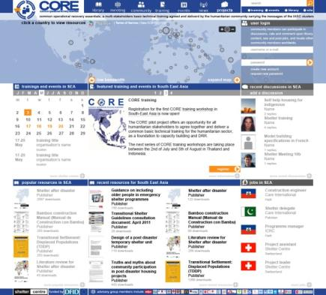
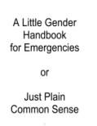
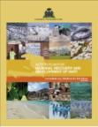
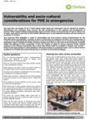
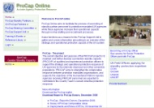

Further reading
A Little Gender Handbook for Emergencies (or Just Plain Common Sense)
Oxfam UK, 2004
Vulnerability and socio-cultural considerations for PHE in emergencies
Oxfam, 2004
ProCap, UNOCHA
http://procaponline.unocha.org/index.aspx
GenCap, IASC
http://oneresponse.info/crosscutting/GenCap/Pages/GenCap.aspx
Notes:
Notes in ITALICS are general training guidance
Facilitators can add notes below to assist training
Notes in BOLD are material references and sources
EC (30/03/10): from SC08b, Day 2 03, p.2 and 3
CM (26/04/10): changed objectives to make them shorter and more SMART

Slide 23

Coffee break
Please be back in time for
30 min
Back at
11:00
Notes:
Notes in ITALICS are general training guidance
Facilitators can add notes below to assist training
Notes in BOLD are material references and sources
EC (30/03/10): from SC08b, Day 2 03, p.2 and 3
CM (26/04/10): changed objectives to make them shorter and more SMART

Slide 24
Disaster risk reduction
2
Notes:
Notes in ITALICS are general training guidance
Facilitators can add notes below to assist training
Notes in BOLD are material references and sources
EC (30/03/10): from SC08b, Day 2 03, p.2 and 3
CM (26/04/10): changed objectives to make them shorter and more SMART

Slide 25
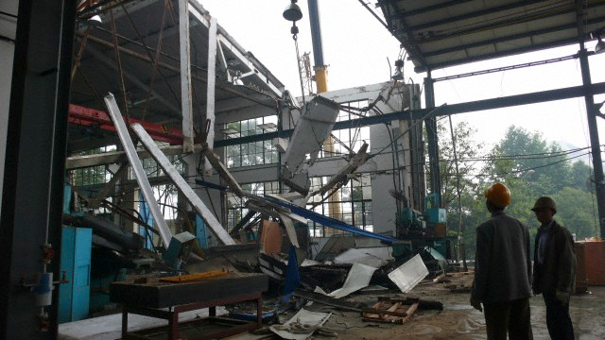

Disaster Risk Reduction
Closing the loop, Relief to development continuum
90
Minutes

Slide 26

Lunch break
Please be back in time for
30 min
Back at
14:00
Notes:
Notes in ITALICS are general training guidance
Facilitators can add notes below to assist training
Notes in BOLD are material references and sources
EC (30/03/10): from SC08b, Day 2 03, p.2 and 3
CM (26/04/10): changed objectives to make them shorter and more SMART

Slide 27
Objective 1 Risk
Objective 2 Security and natural hazards
Objective 3 Risk assessment
Objective 4 Risk management
Objective 5 Disaster mitigation: Case study

Slide 28



Objective 1 Risk
A disaster is the result of a multi-factor action involving the following:
Hazard
a natural or man-made event causing damage
Vulnerability
the conditions which increase the susceptibility of a community
to the impact of hazards
Risk
the probability of harmful consequences
Hazard x Vulnerability = Risk
e.g. landslide x high-risk location = damaged house

Slide 29
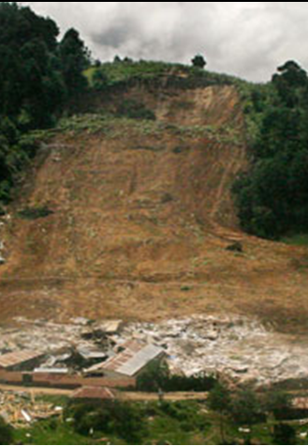
Objective 1 Risk
It is important to recognize that different hazards
create different types of disaster
Emergency risk assessment and
management should cover the major
types of hazards:
Security hazards
Natural hazards

Slide 30
Objective 2 Security and natural hazards
  Security hazards include ongoing and potential hazards:
Communal violence
Civil unrest
Conflict resources
Sexual and gender-based violence (SGBV)
Wars
Ethnic conflicts
Conflicts may occur in areas suffering from natural disasters

Slide 31







Objective 2 Security and natural hazards
Natural disasters are often caused by a combination of hazards,
e.g. earthquakes and fires
Meteorological |  | Geological |  | Biological
Floods Landslides Cyclones Fires Drought |  | Earthquakes Tsunamis Volcanoes |  | Epidemic diseases Plant or animal contagion Insect plagues and extensive infestations
Natural disasters may occur in insecure environments

Slide 32
Discussion in groups
Task 1 Discuss the risks in the area where you are currently working by evaluating the potential hazards and vulnerabilities
Task 2 Use a table to calculate risk in the area where
you are currently working (H x V = R):
Hazard: high (3), medium (2), low (1)
Vulnerability: high (3), medium (2), low (1)
hazard
vulnerability
risk
earthquake
…
3
…
1
…
3
…

Slide 33

Objective 3 Risk assessment
  Risk Assessment is a 2-step process that allows understanding, identification and quantification of the risk:
  R = H x V
Hazard assessment
regional databases, models, …
Vulnerability assessment
social, economic, physical,
environmental, political and cultural factors

Slide 34
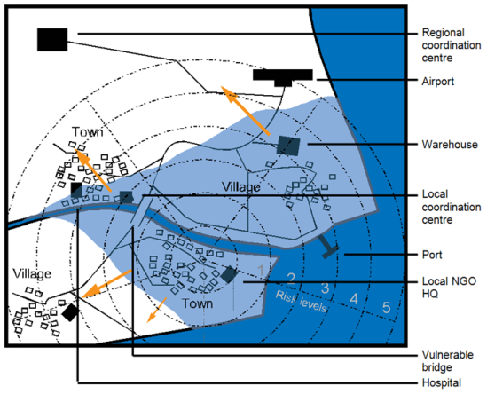
Objective 3 Risk assessment
  The objective of risk assessment is to develop with the participation
  of communities a risk map

Slide 35
Objective 3 Risk assessment
Hazard assessment:
Frequency
e.g. is there a seasonal pattern?
Magnitude or intensity
e.g. what is a ‘normal’ vs. ‘extreme’ circumstance?
Duration
e.g. how long will flood waters remain?
Area of extent
e.g. where are the high, medium and low risk areas?
Speed of onset
e.g. does the hazard occur rapidly without warning?

Slide 36
Objective 3 Risk assessment
Vulnerability assessment
The vulnerability of the affected population should be assessed and depends upon:
Where you are | Who you are
Earthquake – e.g. proximity to epicentre Flood – e.g. elevation Cyclone – e.g. exposure Fire – e.g. drought regions | Displaced populations Low-income populations High-risk locations Poor-quality buildings Marginal groups
Example of zones of housing damage, and population movements between zones, following an earthquake

Slide 37
Objective 3 Risk assessment
Vulnerability and livelihoods assets
The vulnerability of a population depends on their capacity
to cope with hazards. Their livelihoods assets should be taken into account:
Human – skills, knowledge, health
Social assets – community, political structures
Natural assets – land, water
Physical assets – buildings, transport, energy
Economic assets – money, tools, livestock

Slide 38
Objective 3 Risk assessment
  The risk assessment framework is an integral part of the policy/decision-making process:
Risk assessment
Risk analysis
Risk Identification:
Hazard
Exposure
Vulnerability
Risk Profiling
Risk evaluation
Establishment of acceptable levels of risk:
Elaboration of risk scenarios and measures
Social & economic cost/effective analysis
Establishment of priorities

Slide 39




Discussion in groups
Write down key points
Task Plan the steps that you would take in developing
with a community a sustainable risk map
Discussion in groups
15 minutes

Slide 40
Objective 4 Risk management
Risk management offers the following measures to deal with
ongoing and potential hazards:
Mitigation
e.g. flood defenses
Preparedness
e.g. testing warning system
Advocacy
e.g. training and education

Slide 41
Objective 4 Risk management
Sustainable risk management requires the involvement of all
stakeholders, through:
Regulations
e.g. improved building codes/planning/zoning
Education
e.g. technical inspectors and information centres
Incentives
e.g. subsidies for safer construction magnitude of hazards

Slide 42
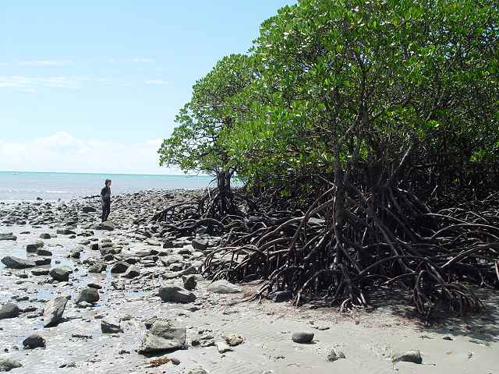
Objective 5 Disaster mitigation – Case study
Disaster mitigation and prevention through restoration of littoral vegetation in Sri Lanka (ProAct Network 2008)

Slide 43
Objective 5 Disaster mitigation – Case study
20 million people live within the coastal zone
Heavy losses on coastal vegetation due to over exploitation and the impact of the Asian Tsunami (2004)
Consequences: high vulnerability of families living in these areas (e.g. no buffer from tropical storms, erosion and flood activity due to heavy rains and rough sea, limited livelihood and food security)
Aim of project: establishing a Green Belt and mangrove vegetation along the coast in order to protect the coastal communities

Slide 44
Discussion in groups
Task 1 How did you incorporate disaster risk reduction in your last project. If you haven’t how could you have included it?

Slide 45


Any questions?
Share your experiences
Do you have any comments or experiences you would like to share?
Do you have any questions?
Any
questions
15 Minutes

Slide 46





Further reading
www.unisdr.org
www.preventionweb.net
www.cadri.org
Handbook for Emergencies
UNHCR, 2007
Words Into Action
ISDR, 2007
Notes:
Notes in ITALICS are general training guidance
Facilitators can add notes below to assist training
Notes in BOLD are material references and sources
EC (30/03/10): from SC08b, Day 2 03, p.2 and 3
CM (26/04/10): changed objectives to make them shorter and more SMART

Slide 47
Energiser session
Notes:
Notes in ITALICS are general training guidance
Facilitators can add notes below to assist training
Notes in BOLD are material references and sources
EC (30/03/10): from SC08b, Day 2 03, p.2 and 3
CM (26/04/10): changed objectives to make them shorter and more SMART

Slide 48
Advisory Group meeting
& role play
90
Minutes

Slide 49
Advisory group meeting
3
Notes:
Notes in ITALICS are general training guidance
Facilitators can add notes below to assist training
Notes in BOLD are material references and sources
EC (30/03/10): from SC08b, Day 2 03, p.2 and 3
CM (26/04/10): changed objectives to make them shorter and more SMART

Slide 50
Coffee break
Please be back in time for
30 min
Back at
16:00
Notes:
Notes in ITALICS are general training guidance
Facilitators can add notes below to assist training
Notes in BOLD are material references and sources
EC (30/03/10): from SC08b, Day 2 03, p.2 and 3
CM (26/04/10): changed objectives to make them shorter and more SMART

Slide 51

Preparation for CORE sessions
with mentors
90
Minutes

Slide 52
Preparation for CORE sessions
4
Notes:
Notes in ITALICS are general training guidance
Facilitators can add notes below to assist training
Notes in BOLD are material references and sources
EC (30/03/10): from SC08b, Day 2 03, p.2 and 3
CM (26/04/10): changed objectives to make them shorter and more SMART

Slide 53
Participants allocated a session
Help from mentor
Receive feedback from video sessions
Participant led sessions on day 5

Slide 54
Thank you
Don’t forget to fill in your feedback form
Notes:
Notes in ITALICS are general training guidance
Facilitators can add notes below to assist training
Notes in BOLD are material references and sources
EC (30/03/10): from SC08b, Day 2 03, p.2 and 3
CM (26/04/10): changed objectives to make them shorter and more SMART

