Slide 1

Welcome to day 4
Notes:
Notes in ITALICS are general training guidance
Facilitators can add notes below to assist training
Notes in BOLD are material references and sources
EC (30/03/10): from SC08b, Day 2 03, p.2 and 3
CM (26/04/10): changed objectives to make them shorter and more SMART

Slide 2
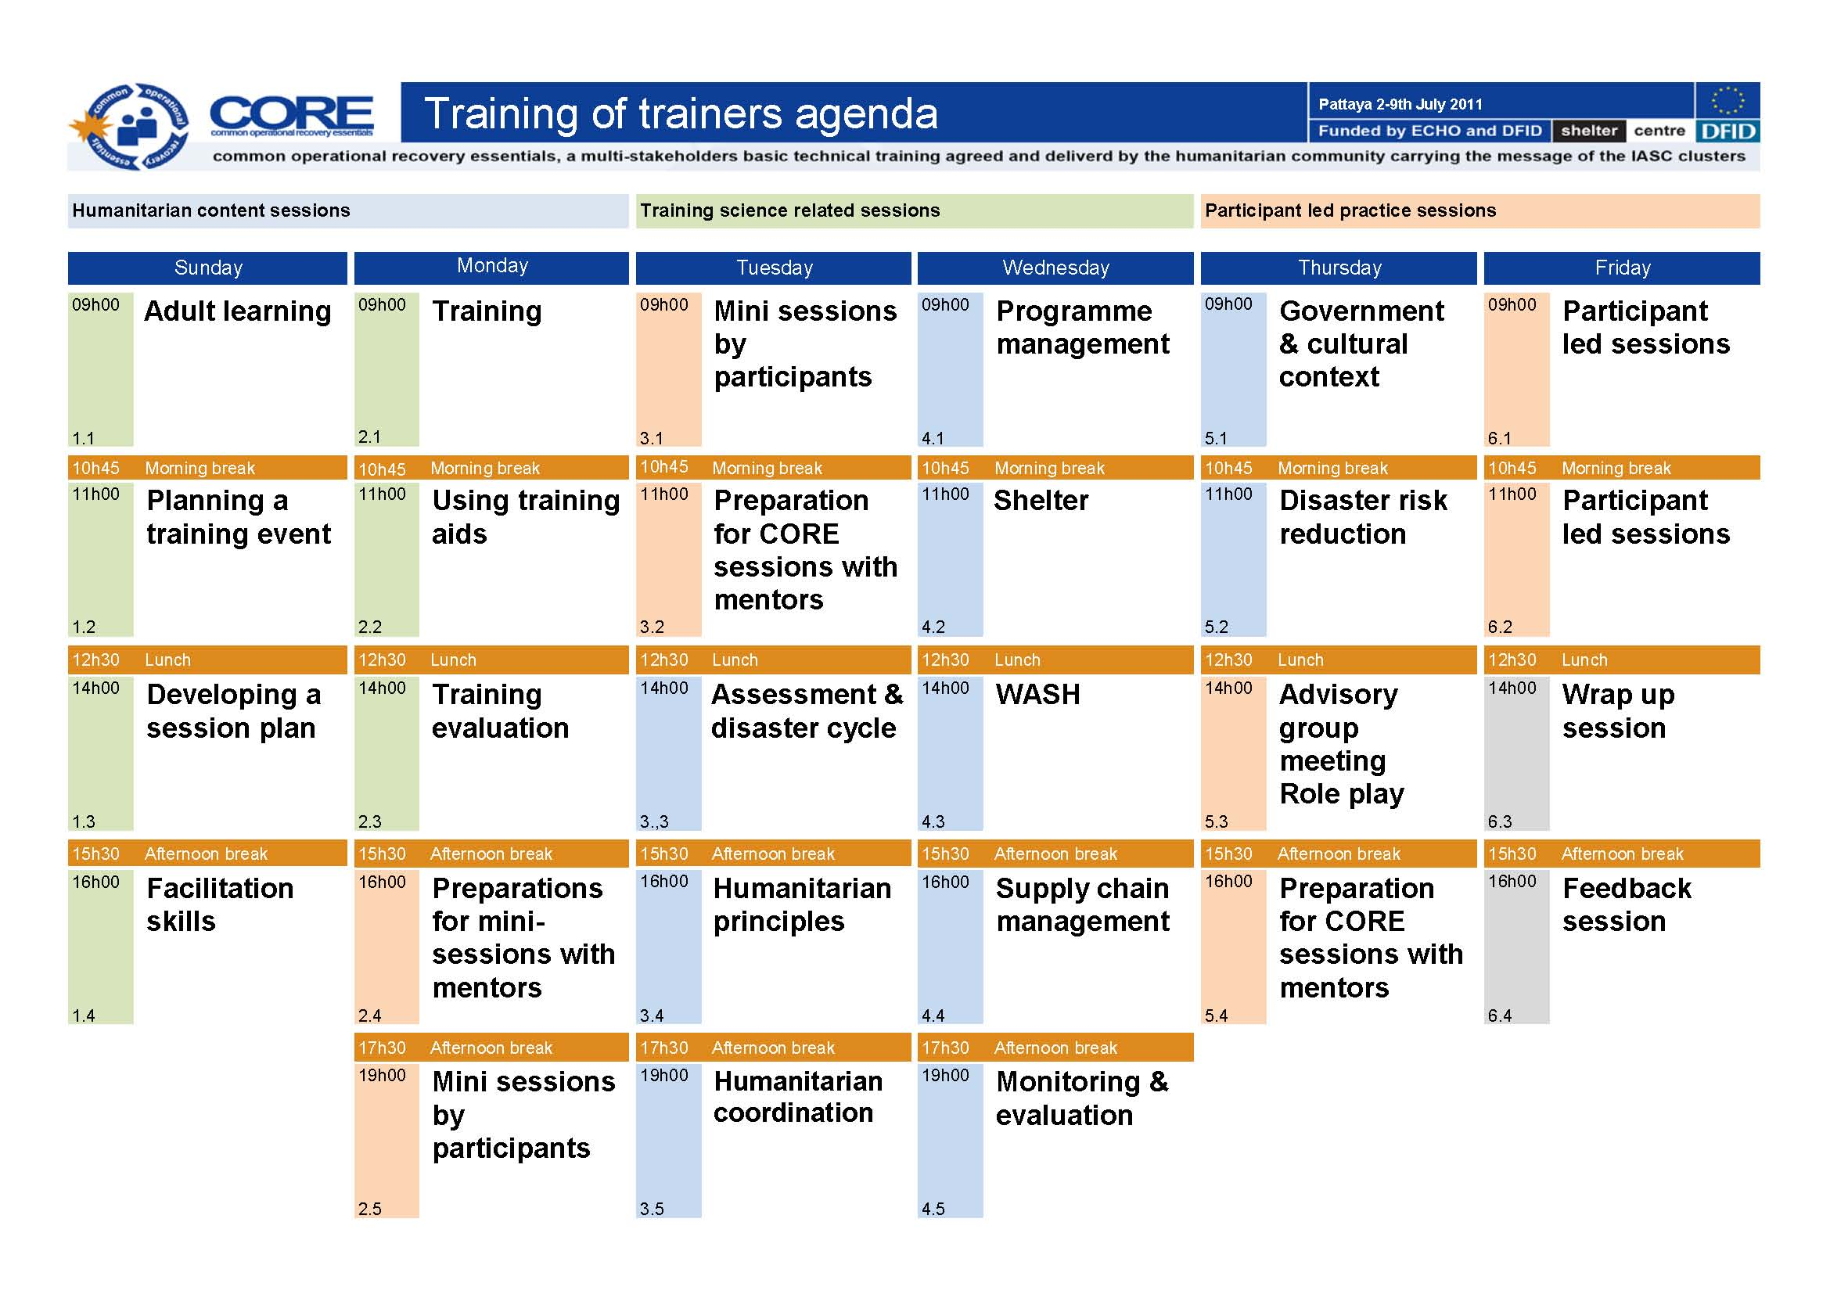
Notes:
Notes in ITALICS are general training guidance
Facilitators can add notes below to assist training
Notes in BOLD are material references and sources
EC (30/03/10): from SC08b, Day 2 03, p.2 and 3
CM (26/04/10): changed objectives to make them shorter and more SMART

Slide 3
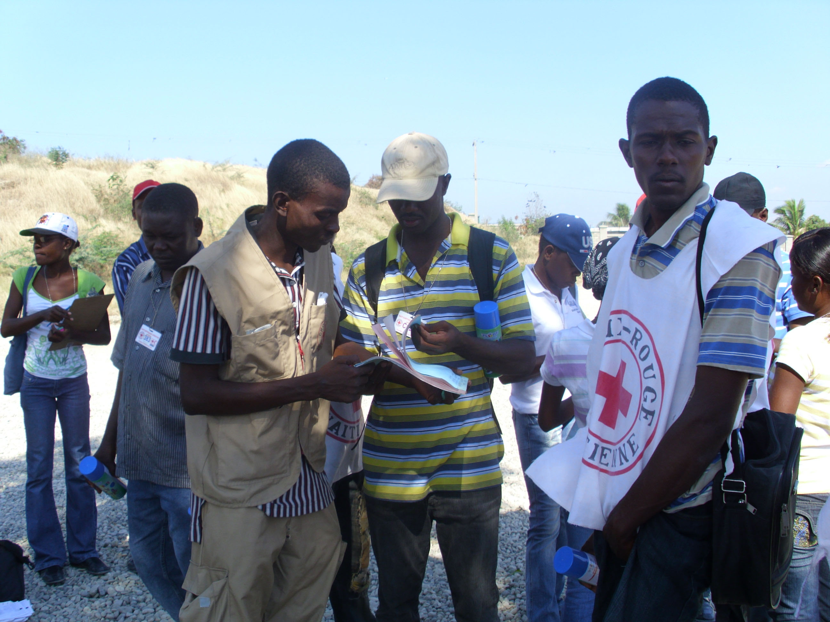

Programme management
Programme and project cycle management
105
Minutes
Notes:
Notes in ITALICS are general training guidance
Facilitators can add notes below to assist training
Notes in BOLD are material references and sources
EC (30/03/10): from SC08b, Day 2 03, p.1

Slide 4
Programme management
1
Notes:
Notes in ITALICS are general training guidance
Facilitators can add notes below to assist training
Notes in BOLD are material references and sources
EC (30/03/10): from SC08b, Day 2 03, p.2 and 3
CM (26/04/10): changed objectives to make them shorter and more SMART

Slide 5

Learning objectives
By the end of this session, you will have an understanding of:
Objective 1 Programme and project cycle
Objective 2 Problem analysis
Objective 3 Logical framework analysis
Objective 4 Operations support
Notes:
Notes in ITALICS are general training guidance
Facilitators can add notes below to assist training
Notes in BOLD are material references and sources
EC (30/03/10): from SC08b, Day 2 03, p.2 and 3
CM (26/04/10): changed objectives to make them shorter and more SMART

Slide 6

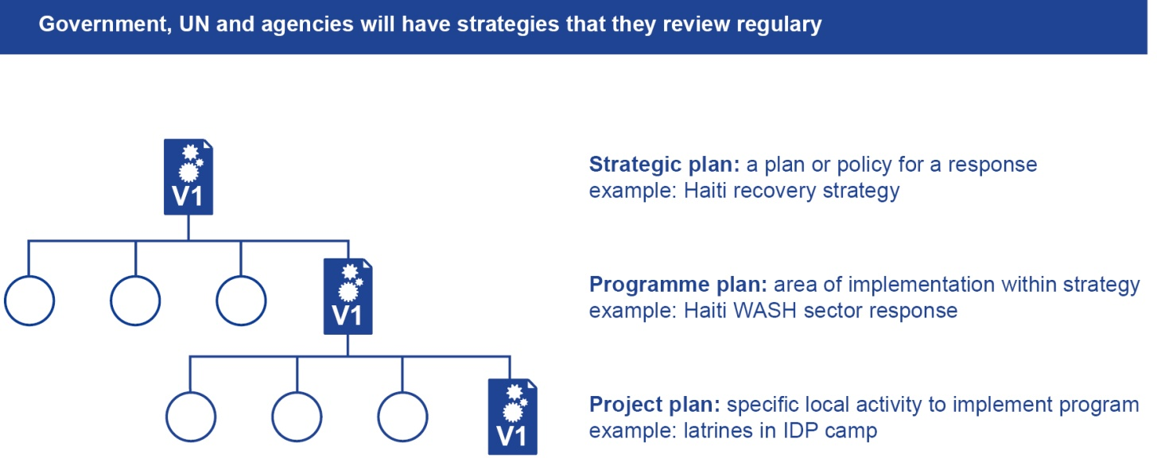
Objective 1 Programme and project cycle
What are they:
A programme is a series of projects designed to produce a specific outcome (overall objective) within a limited time frame
A project is a series of activities with set objectives, designed to produce a specific outcome within a limited time frame
Notes:
Notes in ITALICS are general training guidance
Facilitators can add notes below to assist training
Notes in BOLD are material references and sources
EC (30/03/10): from SC08b, Day 2 03, p.2 and 3
CM (26/04/10): changed objectives to make them shorter and more SMART

Slide 7
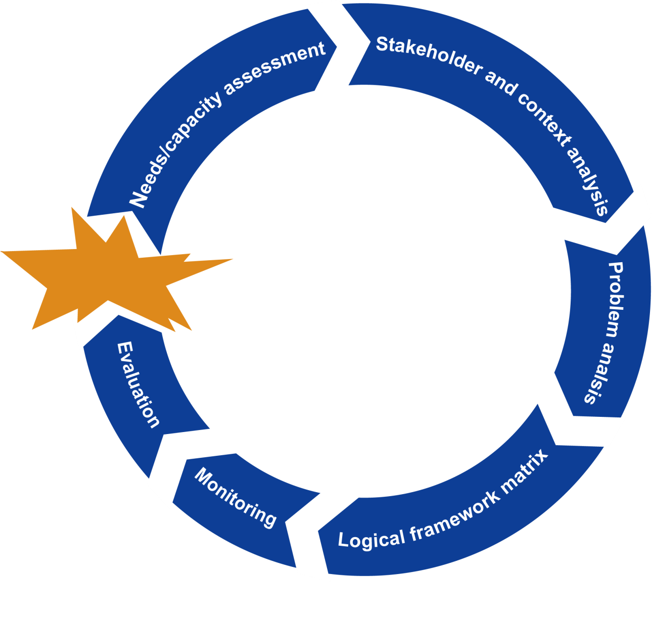
Objective 1 Programme and project cycle
Notes:
Notes in ITALICS are general training guidance
Facilitators can add notes below to assist training
Notes in BOLD are material references and sources
EC (30/03/10): from SC08b, Day 2 03, p.2 and 3
CM (26/04/10): changed objectives to make them shorter and more SMART

Slide 8
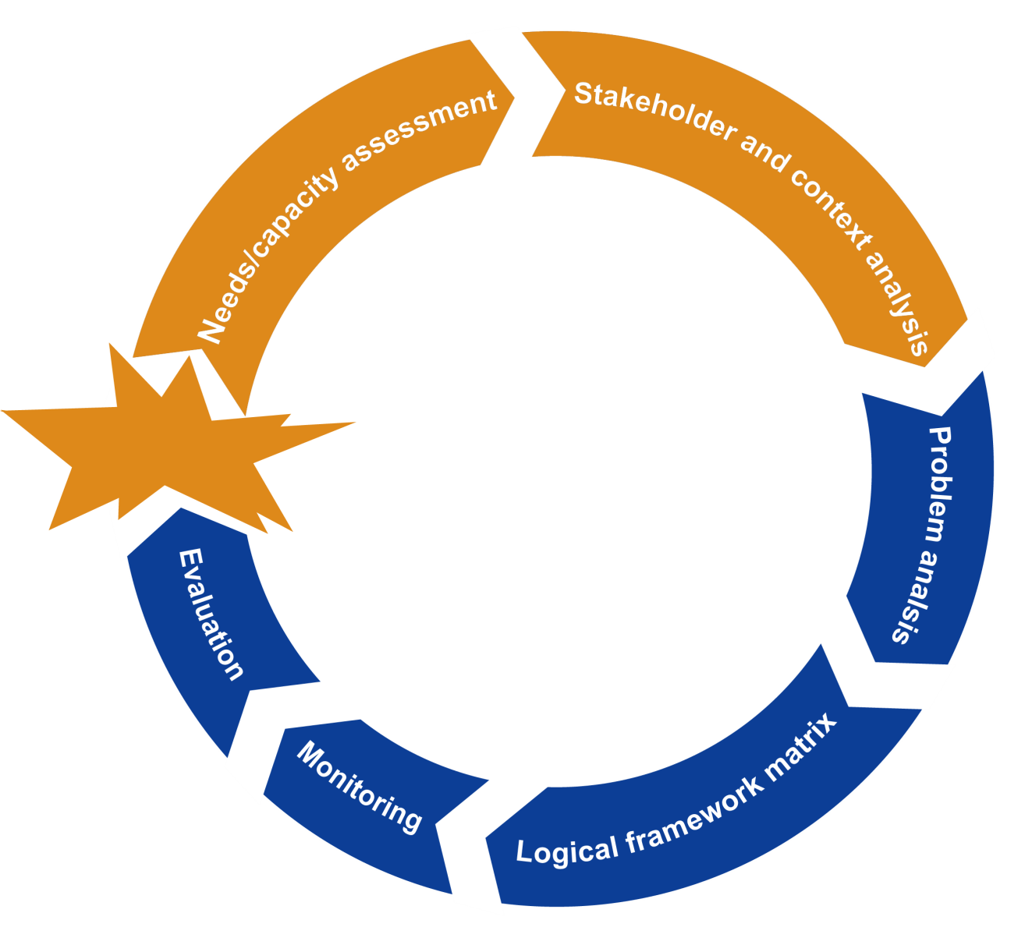
Objective 1 Programme and project cycle
Covered already in session 4.1
Notes:
Notes in ITALICS are general training guidance
Facilitators can add notes below to assist training
Notes in BOLD are material references and sources
EC (30/03/10): from SC08b, Day 2 03, p.2 and 3
CM (26/04/10): changed objectives to make them shorter and more SMART

Slide 9
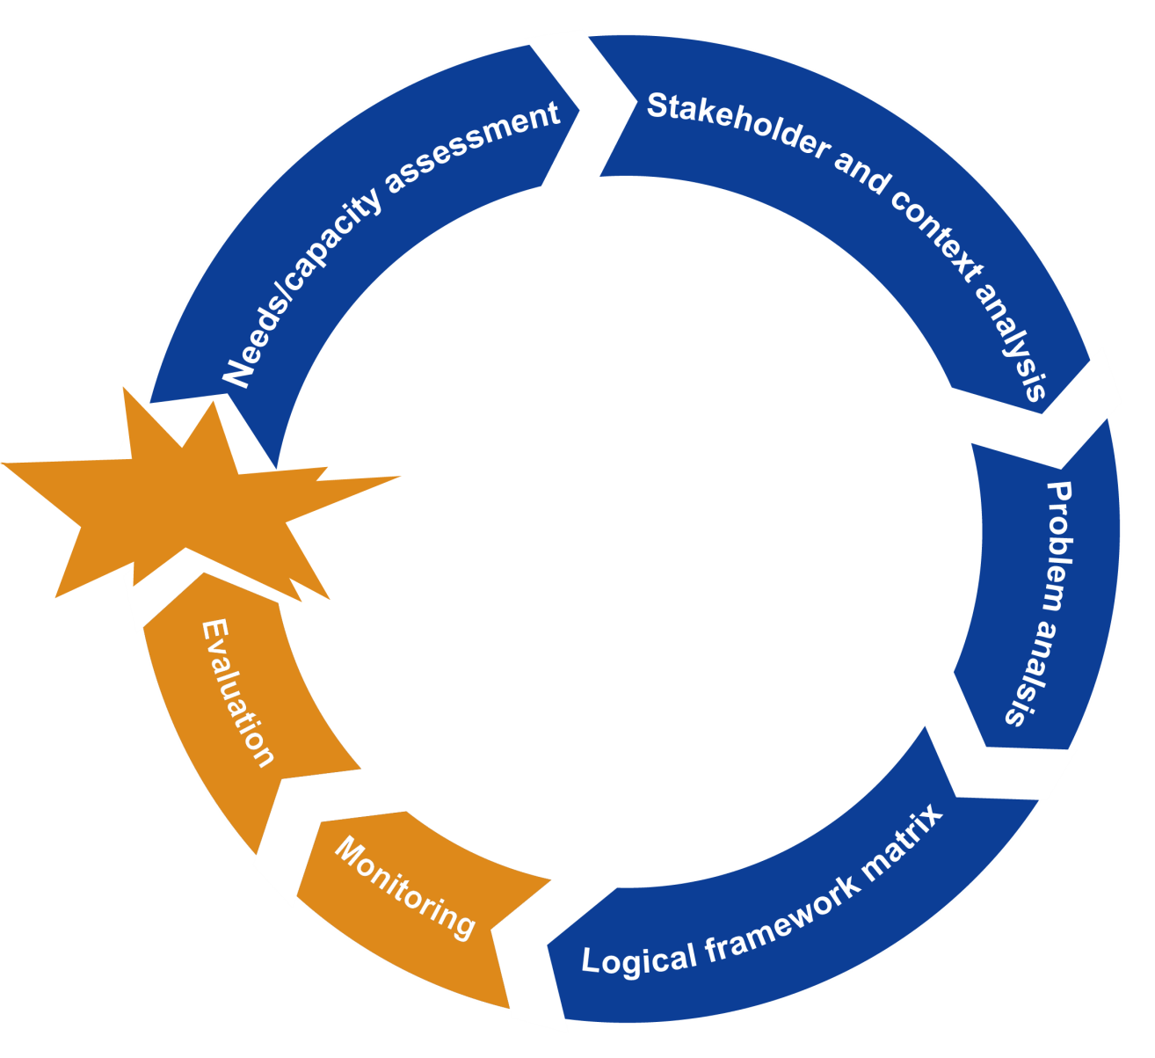
Objective 1 Programme and project cycle
To be covered in session 4.5
Notes:
Notes in ITALICS are general training guidance
Facilitators can add notes below to assist training
Notes in BOLD are material references and sources
EC (30/03/10): from SC08b, Day 2 03, p.2 and 3
CM (26/04/10): changed objectives to make them shorter and more SMART

Slide 10
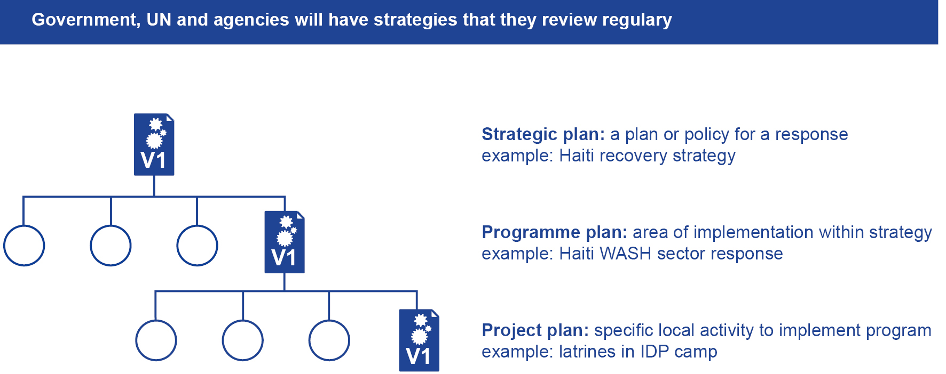
Objective 1 Programme and project cycle
Notes:
Notes in ITALICS are general training guidance
Facilitators can add notes below to assist training
Notes in BOLD are material references and sources
EC (30/03/10): from SC08b, Day 2 03, p.2 and 3
CM (26/04/10): changed objectives to make them shorter and more SMART

Slide 11
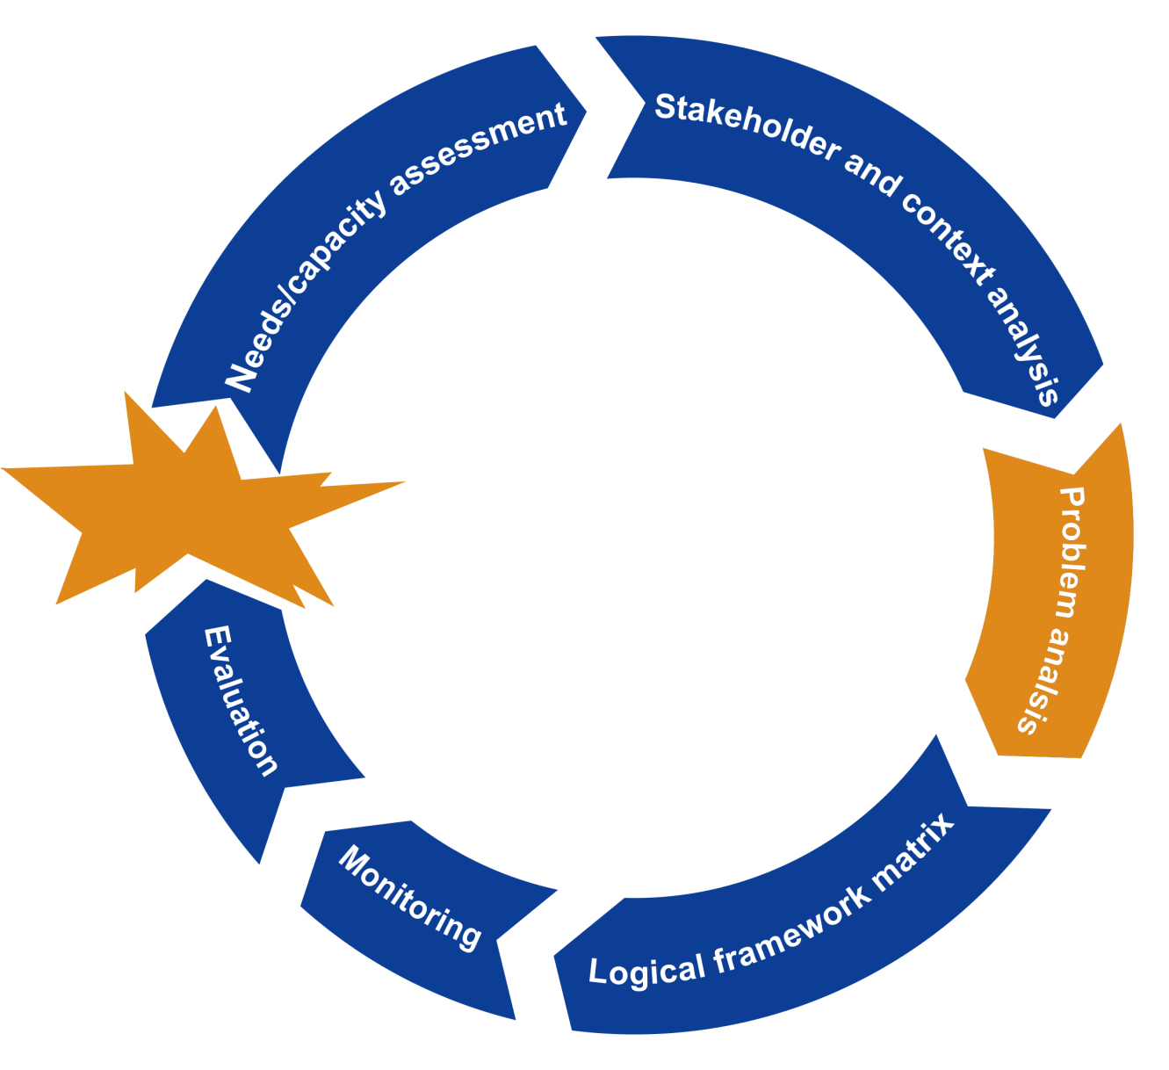
Objective 2 Problem analysis

Slide 12
Objective 2 Problem analysis
A useful tool is a problem analysis diagram
Method for developing the diagram involves:
Agree on main problem that you want to improve
To identify causes of problem – ask “but why”
To identify effects of problem – ask “so what”
Select the identified causes that your project will address

Slide 13
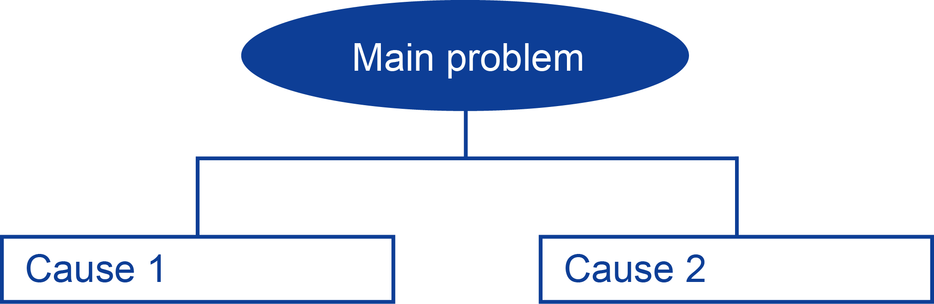
Objective 2 Problem analysis
  Creating a problem tree
Causes analysis diagram
Continue to ask ‘but why’ to expand diagram

Slide 14
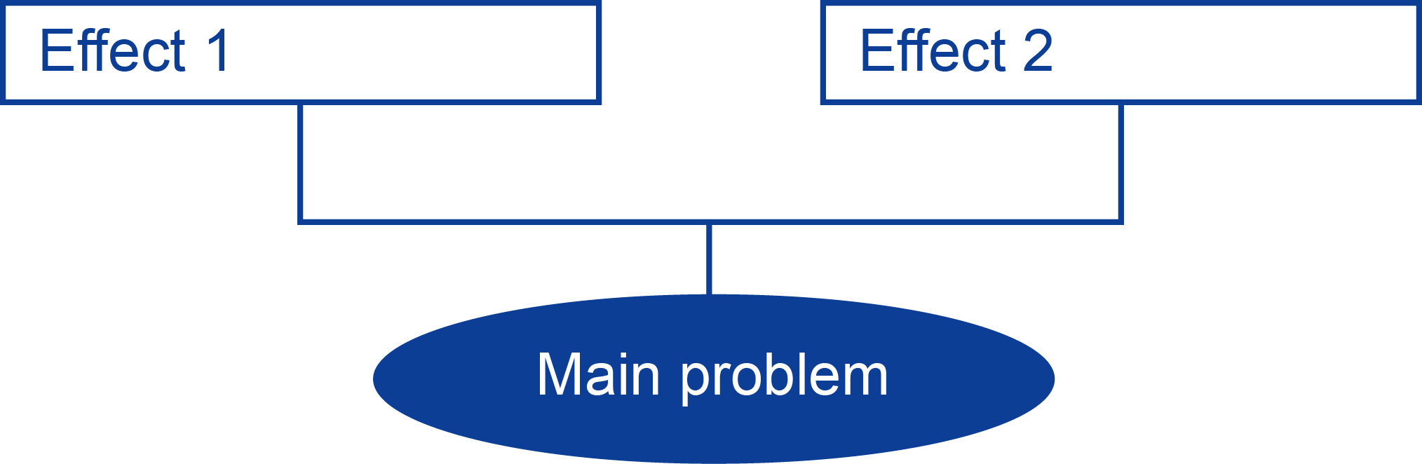
Objective 2 Problem analysis
  Creating a problem tree
Effects analysis diagram
Continue to ask ‘so what’ to expand diagram

Slide 15
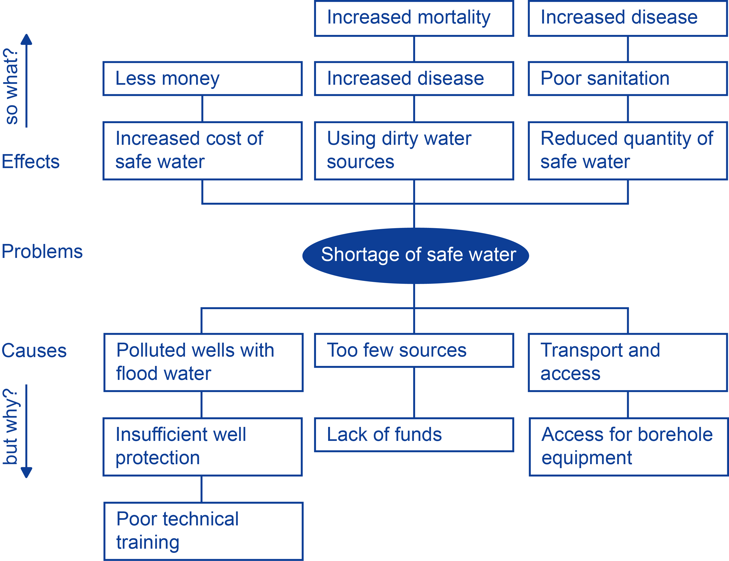
Objective 2 Problem analysis
A completed problem tree
Combines cause and effect diagrams

Slide 16
Objective 2 Problem analysis
Identification of possible projects to address causes and mitigate effects
Project to deliver training on well protection

Slide 17



Exercise
Read and discuss the case study provided in the CORE TOT Manual and carry out the exercise:
Write down key points
  Exercise You have been tasked with developing projects to counter the effects of displacement after severe floods
  Group 1 Create a causes diagram
  Group 2 Create an effects diagram
  Combine diagrams
Discussion in groups
15 minutes
Notes:
Notes in ITALICS are general training guidance
Trainer should make sure there is at least 3 people in each group
Notes in BOLD are material references and sources
Developers can add notes below if changes are made to the slides
EC (26/04/10): new slide to integrate stakeholders perspectives

Slide 18
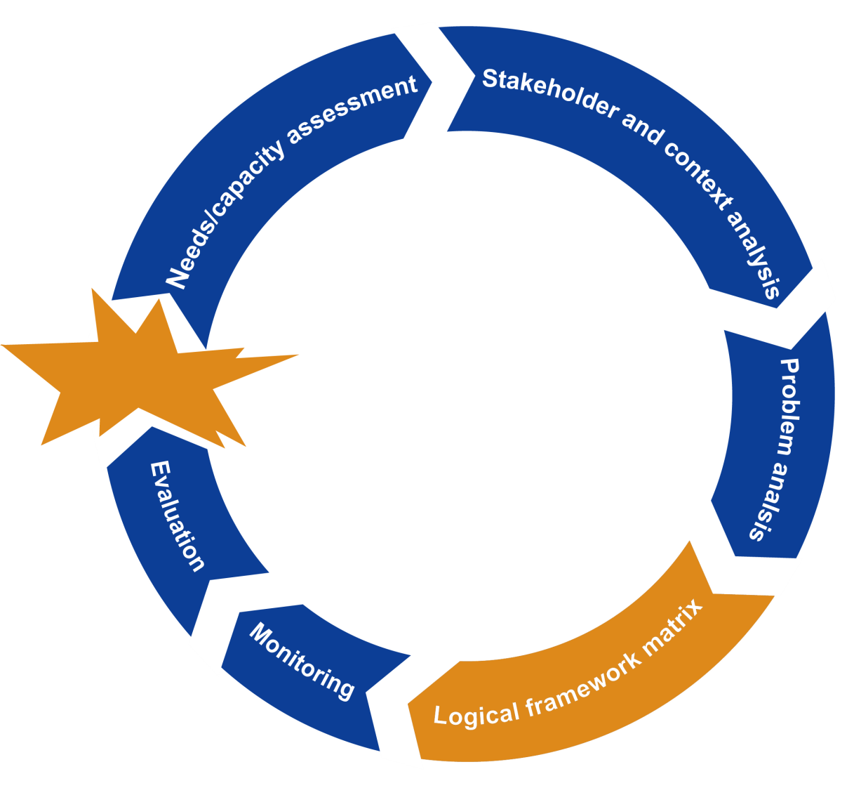
Objective 3 Logical framework analysis

Slide 19
Objective 3 Logical framework analysis
The purpose of a logical framework analysis is to identify the logical relationship between essential elements of a project
This ensures that the project is
well designed
described objectively
can be monitored and evaluated
is clearly structured

Slide 20
Objective 3 Logical framework analysis
Content of the logical framework analysis
Statement of project logic, what are you trying to achieve
Indicators that are SMART (Specific, Measurable, Achievable, Realistic, and Timely)
Detailed sources of verification stating by who and when
Assumptions, what problems might occur along the way

Slide 21
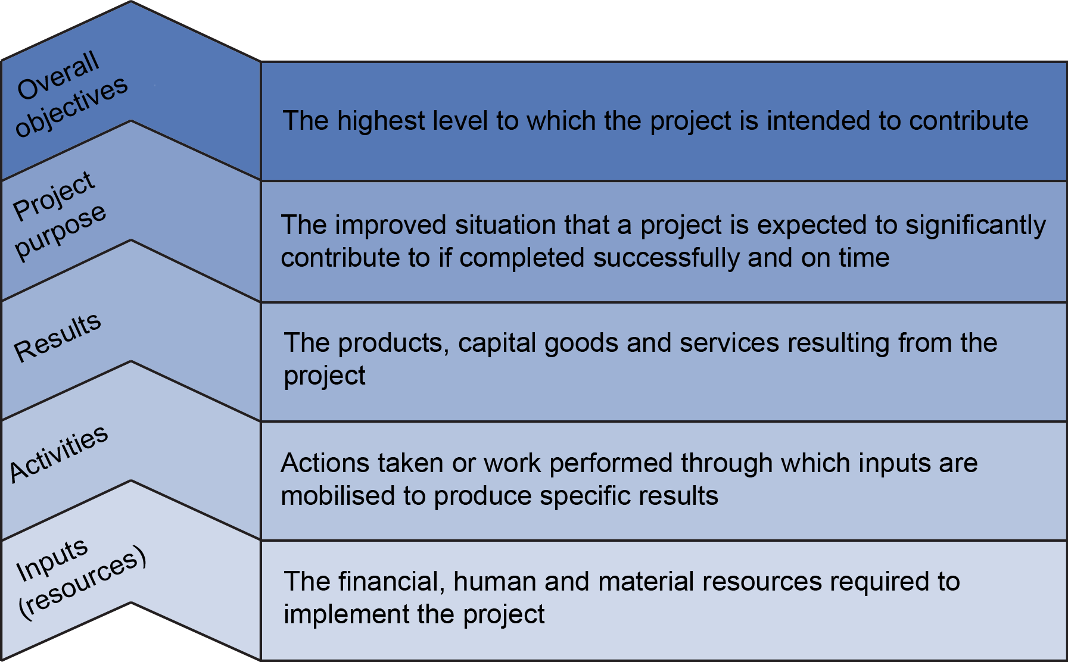
Objective 3 Logical framework analysis
Intervention logic of matrix

Slide 22
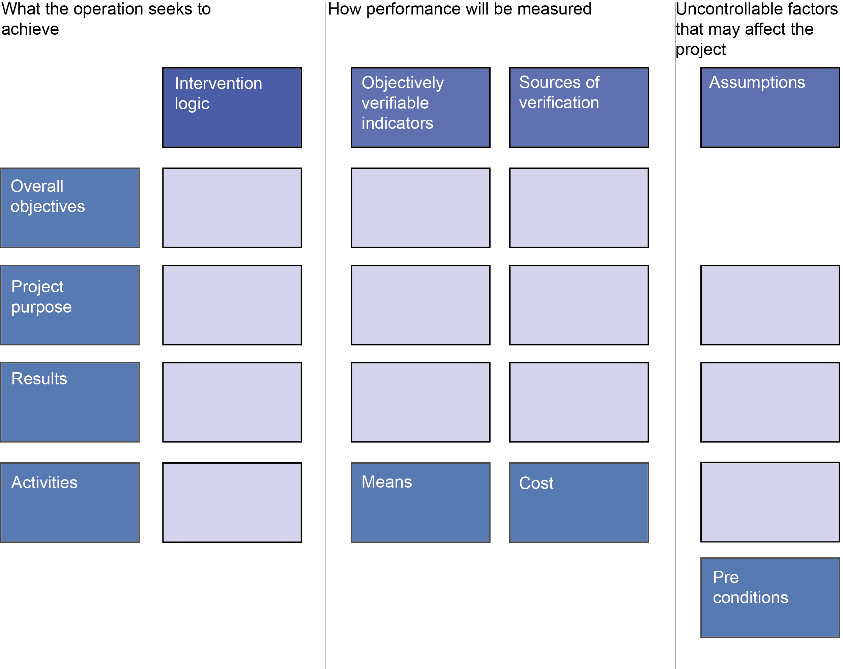
Objective 3 Logical framework analysis
Describe project in clear statements

Slide 23
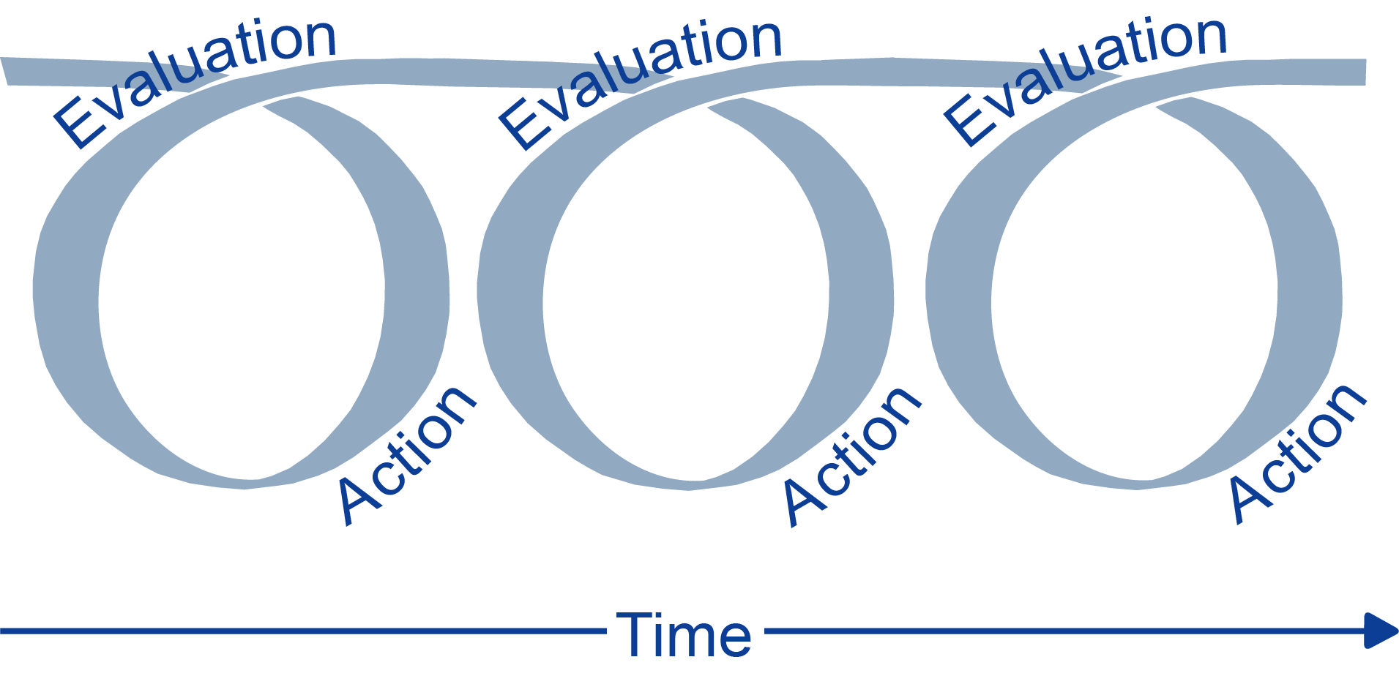
Objective 3 Logical framework analysis
Implementation

Slide 24
Objective 4 Operations support
Operations support to programme delivery is provided by good management of:
Human resources
Information technology / communication
Finances
Logistics

Slide 25
Discussion
Divide into four groups and assign one of the four operation support activities to each group
Task Write brief terms of reference (TOR) for the activity and present back to the whole group
Use the following TOR headings:
Introduction
Objective
Tasks
Outputs
Timeline
Write down key points
Discussion in groups
15 minutes
Notes:
Notes in ITALICS are general training guidance
Trainer should make sure there is at least 3 people in each group
Notes in BOLD are material references and sources
Developers can add notes below if changes are made to the slides
EC (26/04/10): new slide to integrate stakeholders perspectives

Slide 26
Objective 4 Operation support
Human resources
Production of clear and detailed job descriptions
Fair and timely recruitment processes
Production of contracts and terms of reference
Staff evaluations
Training

Slide 27
Objective 4 Operation support
Information technology / communication
Simple tools for data collection and collation
Systems for data analysis
Resilient systems for storage and exchange of information
Reliant communication tools

Slide 28
Objective 4 Operation support
Financial management
Preparing and managing budgets
Using appropriate financial tools (spreadsheets or paper)
Clear financial guidelines and procedures
  Cash security rules
  Personnel purchasing limits
Clear definition of financial roles and responsibilities
Procurement

Slide 29
Objective 4 Operation support
Logistics and supply chain management
Contract management of suppliers
Procurement of equipment and materials
Storage locally or nationally
Delivery
Supply chain management is covered further in session 4.4

Slide 30


Any questions?
Any questions
Do you have any questions?
Do you have any comments or experiences you would like to share?
Share your experiences
10 minutes

Slide 31




Further reading
UNHCR Handbook for emergencies
Third edition, Feb 2007
Engineering in disasters - A practical guide for relief workers
Jan Davis and Robert Lambert, Third edition, 2002
All in diary- A practical tool for field based humanitarian workers
Second edition, 2009
www.allindiary.org
Notes:
Notes in ITALICS are general training guidance
Facilitators can add notes below to assist training
Notes in BOLD are material references and sources
EC (30/03/10): from SC08b, Day 2 03, p.2 and 3
CM (26/04/10): changed objectives to make them shorter and more SMART

Slide 32

Coffee break
Please be back in time for
30 min
Back at
11:00
Notes:
Notes in ITALICS are general training guidance
Facilitators can add notes below to assist training
Notes in BOLD are material references and sources
EC (30/03/10): from SC08b, Day 2 03, p.2 and 3
CM (26/04/10): changed objectives to make them shorter and more SMART

Slide 33
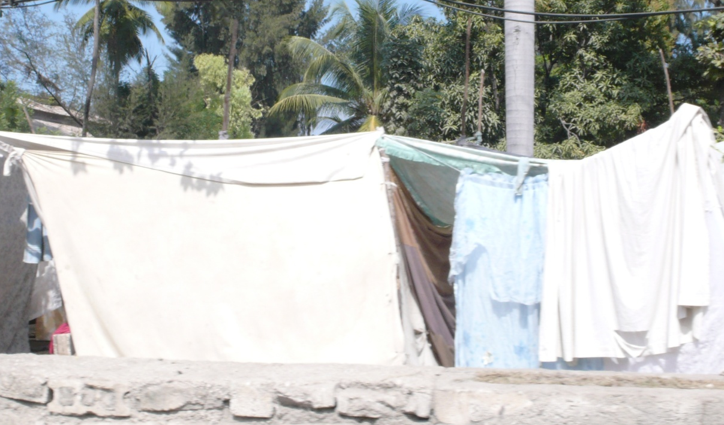
Shelter
Shelter and settlements
90
Minutes
Notes:
Notes in ITALICS are general training guidance
Facilitators can add notes below to assist training
Notes in BOLD are material references and sources
EC (30/03/10): from SC08b, Day 2 03, p.1

Slide 34
Shelter
2
Notes:
Notes in ITALICS are general training guidance
Facilitators can add notes below to assist training
Notes in BOLD are material references and sources
EC (30/03/10): from SC08b, Day 2 03, p.2 and 3
CM (26/04/10): changed objectives to make them shorter and more SMART

Slide 35
By the end of this session, you will have an understanding of:
Objective 1 Shelter and settlements
Objective 2 Response options
Objective 3 Sphere standards
Objective 4 Non-food items

Slide 36
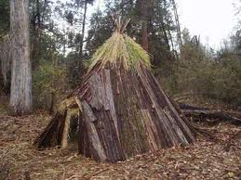
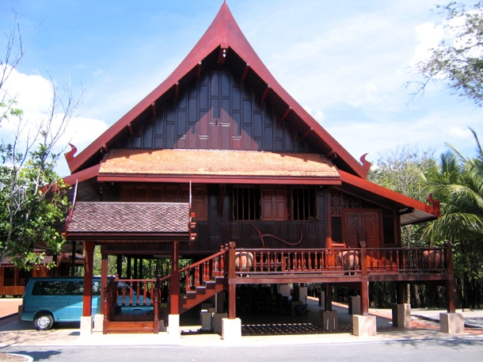
Discussion
Write down key points
Question ‘Shelter’ versus ‘Home’?
Group discussion
Discussion in groups
15 minutes

Slide 37

Objective 1 Shelter and settlements
“Shelter and settlement strategies contribute to the security, safety, health and well-being of both displaced and non-displaced affected populations and promote recovery and reconstruction where possible.”
Humanitarian Charter and Minimum Standards in Humanitarian Response, The Sphere Project, 2011

Slide 38

Objective 1 Shelter and settlement
Guiding principles
Principle |  | Explanation
Strategy Reconstruction Community DRR Coordination Development Relocation Stakeholders Assessment Sustainability |  | Engage and support the communities To begin the day after the disaster Partners in developing strategy Strategies should be realistic in scale Mechanisms must support national institutions Responses should prepare for future disaster Expensive and unsuccessful Involves different groups within different roles Must be continuous, coordinated and integrated Community livelihoods are the basis of recovery

Slide 39

Objective 2 Response options
A crisis can affect population in three different ways
Displaced population
Non-displaced population
Indirectly affected population

Slide 40
Objective 2 Response options
There are 6 different response options for displaced people:
Host families
Urban self-settlements
Rural self-settlements
Collective centres
Self-settled camps
Planned camps
The final objective of every response must be that the displaced population wants to return home

Slide 41
Objective 2 Response options
There are 6 different response options for non-displaced people:
Occupancy with no legal status
House tenant
Apartment tenant
Land tenant
Apartment owner-occupier
House owner-occupier

Slide 42

Objective 2 Response options
Dispersed transitional settlements
Host families
Local families shelter displaced populations within their household or on their property
e.g. a displaced family could erect a transitional shelter on the land owned by a host family

Slide 43

Objective 2 Response options
Dispersed transitional settlements
Urban self-settlements
Urban unclaimed properties or land unaffected by the disaster are used informally by displaced populations
e.g. a displaced family could erect a transitional shelter in an urban settlement occupying unclaimed land

Slide 44

Objective 2 Response options
Dispersed transitional settlements
Rural self-settlements
Displaced populations create a settlement on collectively owned rural land
e.g. a displaced family could erect a transitional shelter on rural land that is owned collectively

Slide 45

Objective 2 Response options
Grouped transitional settlements
Collective centres
Existing, large structures such as transit facilities can serve as collective shelters
e.g. transitional shelters can be built in the grounds of a sport stadium

Slide 46

Objective 2 Response options
Grouped transitional settlements
Self-settled camps
Independent of support from government or other organisations, camps are formed by the displaced population
e.g. a group of displaced families could erect a transitional shelter in a camp independent of assistance

Slide 47

Objective 2 Response options
Grouped transitional settlements
Planned camps
Government or aid organisations plan camps including infrastructure to house displaced populations.
e.g. a displaced family could erect a transitional shelter on a purpose built site where a full services infrastructure is provided

Slide 48

Objective 2 Response options
Tenant settlements
Occupancy with no legal status
The occupant informally lives on property without explicit permission of the owner
e.g. a family is provided with a transitional shelter on the same site while they seek tenure and while reconstruction take place

Slide 49

Objective 2 Response options
Tenant settlements
House tenant
The occupant rents housing and land from the owner in a formal or informal arrangement.
e.g. a family who rented a house and the land it occupies are provided with a transitional shelter on the same site, to provide them with shelter during the period of reconstruction

Slide 50

Objective 2 Response options
Tenant settlements
Apartment tenant
The apartment is rented by the occupant formally or informally
e.g. a family who rented an apartment are provided with a transitional shelter on the site of the apartment block, to provide shelter during the period of reconstruction

Slide 51

Objective 2 Response options
Tenant settlements
Land tenant
The occupant rents land but owns the house
e.g. a family who owned a house but rented the land are provided with a transitional shelter on the same site, to provide shelter during the period of reconstruction

Slide 52

Objective 2 Response options
Owner settlements
Apartment owner-occupier
The occupant owns their apartment, a self-contained housing unit that occupies only part of a building, formally or informally
e.g. a family who owned an apartment are provided with a transitional shelter on the same site, to provide shelter during the period of reconstruction

Slide 53

Objective 2 Response options
Owner settlements
House owner-occupier
The occupant owns or partially owns the house and land. Includes a mortgage or a loan and formal and informal ownership agreements.
e.g. a family owned a house and the land are provided with a transitional shelter on the same site, to provide shelter during the period of reconstruction

Slide 54
Discussion in groups
Write down key points
Task 1 In your last humanitarian mission, categorise which people were displaced and describe what happened
Discussion in groups
15 minutes

Slide 55
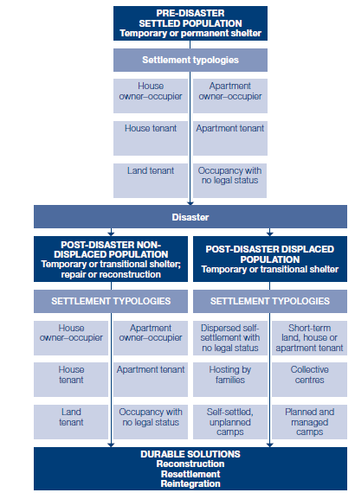

Objective 3 Sphere standards
Response options from the Sphere Project minimum standards

Slide 56
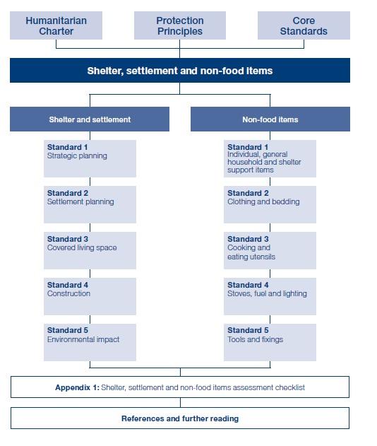
Objective 3 Sphere standards
Sphere Project minimum standards for shelter and non-food items (NFI)

Slide 57
Objective 4 Non-food items
Clothing, bedding and household items
“All affected population will have individual and household non-food item needs that must be assessed and met as appropriate. Population secondarily affected may also require non-food item assistance to meet the additional burden of hosting.”
Humanitarian Charter and Minimum Standards in Humanitarian Response, The Sphere Project, 2011
=> The choice of non-food items to distribute will vary according to each response

Slide 58
Objective 4 Non-food items
Assessment of beneficiaries to identify NFI packages
“Blanket” distribution
distribution of the same NFI package to all beneficiaries
e.g. all residents of IDP camps
Targeted distribution
distribution of the same NFI package to a specific beneficiary group
e.g. female-headed families
Disaggregated distribution
distribution of tailored NFI package to disaggregated beneficiaries
e.g. extra blankets to elderly people

Slide 59
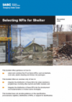
Objective 4 Non-food items
One major factor to be taken in consideration is the type of climate:
Cold
Warm and humid
Hot and dry
The order of priority for NFI distribution vary according to each climate

Slide 60
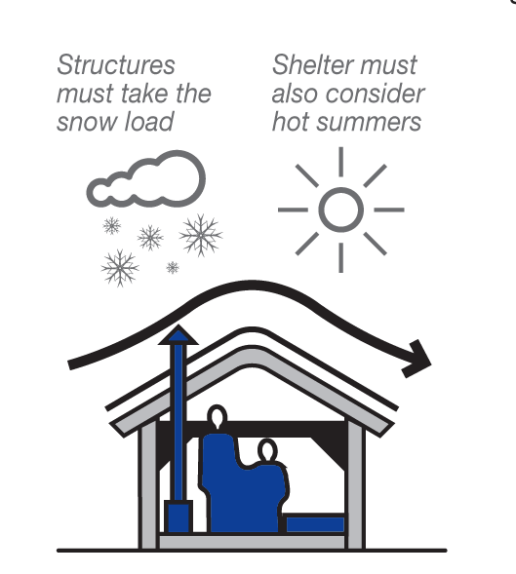
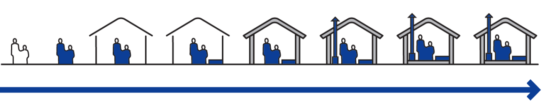
Objective 4 Non-food items
Cold climates
Clothes
Blankets
Shelter
Mattress
Wind proofing
Stove
Flooring
Wall and roof insulation

Slide 61
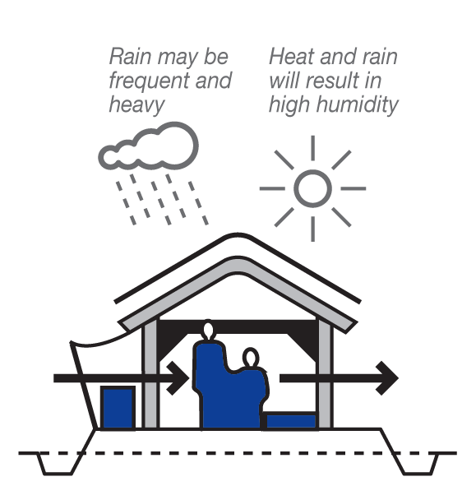
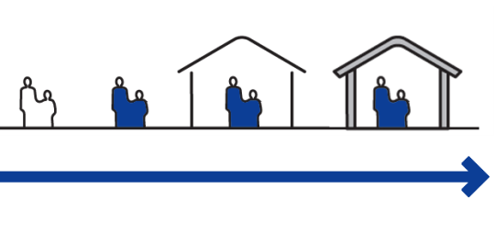
Objective 5 Non-food items
Warm and humid climates
Clothing and bedding
Covering and walls to protect from rain
Covering and walls to protect from sun

Slide 62
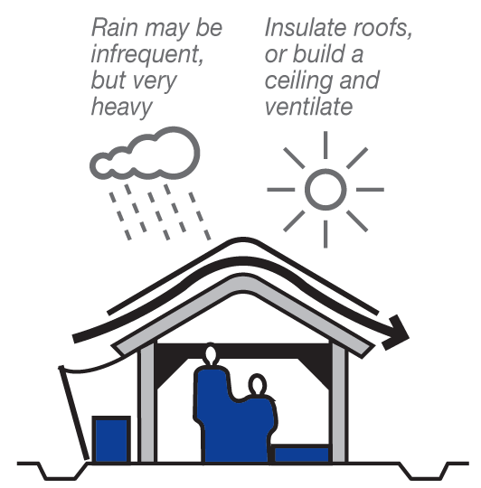
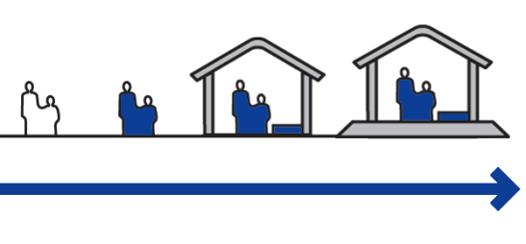
Objective 5 Non-food items
Hot and dry climates
Clothing and bedding
Covering to protect from sun
Insulation to protect from cold nights
Covering and flooring to mitigate water damage

Slide 63
Discussion in groups
Write down key points
Task 1 What is the predominant status of people within your area of work (e.g. House tenant, house owner-occupier)?
    Task 2 Discuss appropriateness of NFI distribution in your context
Discussion in groups
30 minutes

Slide 64
Any questions?
Share your experiences
Do you have any comments or experiences you would like to share?
Do you have any questions?
Any
questions
15 minutes

Slide 65

Further reading
Humanitarian Charter and Minimum Standards for Disaster Response
The Sphere Project, 2011
Shelter after disaster
UN, DFID, Shelter Centre 2010
Selecting NFIs for Shelter
Emergency Shelter Cluster, 2008
Safer Homes, Stronger Communities-
A Handbook for Reconstructing after Natural Disasters
The World Bank, GFDRR, 2010
Notes:
Notes in ITALICS are general training guidance
Facilitators can add notes below to assist training
Notes in BOLD are material references and sources
EC (30/03/10): from SC08b, Day 2 03, p.2 and 3
CM (26/04/10): changed objectives to make them shorter and more SMART

Slide 66

Lunch break
Please be back in time for
30 min
Back at
14:00
Notes:
Notes in ITALICS are general training guidance
Facilitators can add notes below to assist training
Notes in BOLD are material references and sources
EC (30/03/10): from SC08b, Day 2 03, p.2 and 3
CM (26/04/10): changed objectives to make them shorter and more SMART

Slide 67
Energiser session
Notes:
Notes in ITALICS are general training guidance
Facilitators can add notes below to assist training
Notes in BOLD are material references and sources
EC (30/03/10): from SC08b, Day 2 03, p.2 and 3
CM (26/04/10): changed objectives to make them shorter and more SMART

Slide 68
WASH
Introduction to Water and Sanitation and Hygiene in Disaster

Slide 69
WASH
3
Notes:
Notes in ITALICS are general training guidance
Facilitators can add notes below to assist training
Notes in BOLD are material references and sources
EC (30/03/10): from SC08b, Day 2 03, p.2 and 3
CM (26/04/10): changed objectives to make them shorter and more SMART

Slide 70
Objective 1 The components of a WASH programme
Objective 2 The link between WASH and health
Objective 3 Water related diseases
Objective 4 Transmission chain for sanitation related diseases
Objective 5 Sphere Standards for WASH

Slide 71
Objective 1 The components of a WASH programme
Water supply
Water
Quality control
Excreta disposal
Vector control
WASH
Sanitation
Solid waste management
Drainage
Hygiene promotion
Hygiene
Monitoring and PHAST

Slide 72
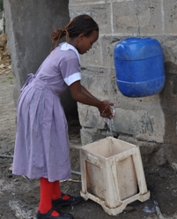
Objective 1 The components of a WASH programme
  Water
Water supply
Sources
Treatment
Storage
Transport
Distribution
Quality control
Monitoring and testing
IRIN Global, 2011

Slide 73
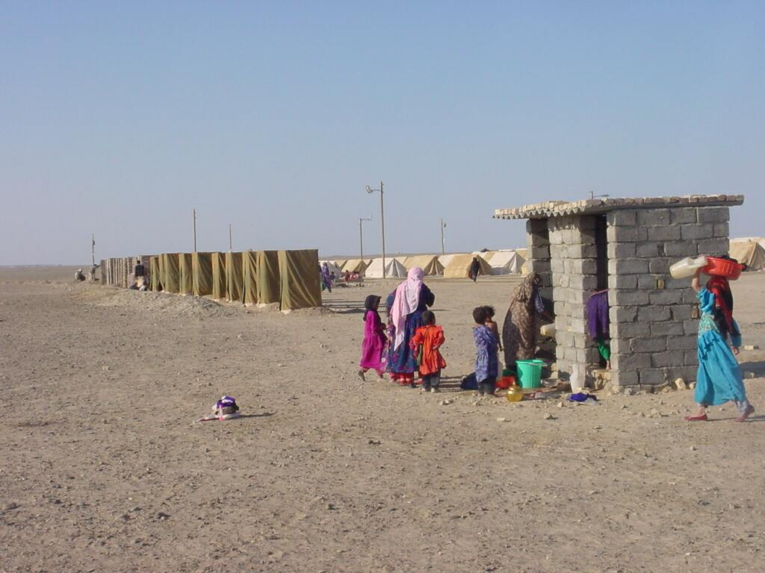
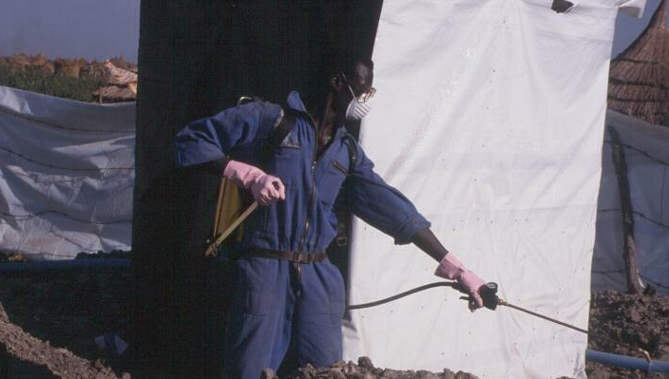
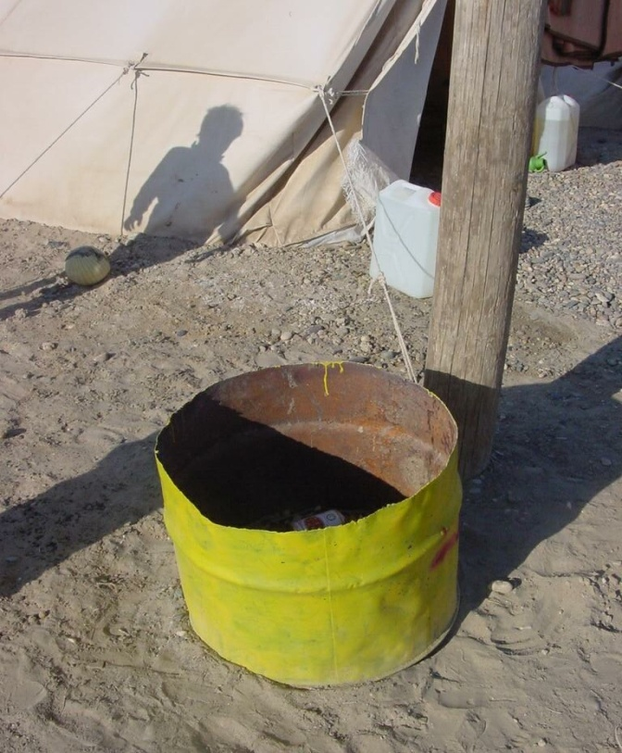
Objective 1 The components of a WASH programme
  Sanitation
Excreta disposal (emergency sanitation)
Vector control
Garbage collection
Incineration of medical waste
Disposal of cadavers
Waste water disposal and drainage
All images from IRIN Global, 2011

Slide 74
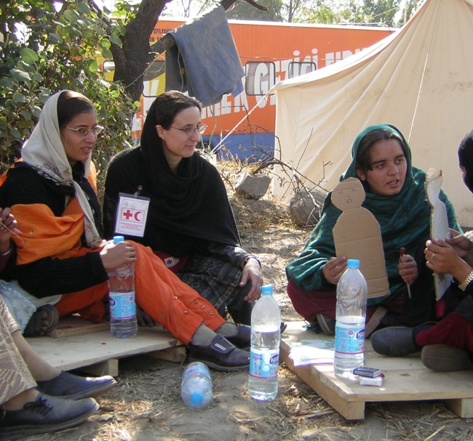
Objective 1 The components of a WASH programme
  Hygiene
Hygiene Promotion
Safe use and storage of water
Hand-washing at key times
Safe disposal of faeces
Appropriate use and maintenance of latrines
Control of flies and other vectors
(waste disposal, drainage)
Food hygiene, personal hygiene
PHAST (Participatory Health And Sanitation Promotion)
Assessment, planning, implementation, monitoring & evaluation
IRIN Global, 2011

Slide 75
Hygiene promotion exercise
Write down key points
Task 1 Present an example of a hygiene promotion subject to the group.
In groups, prepare either a poster, radio advert, pantomime or puppet show to teach a hygiene promotion subject.

Slide 76
Objective 2 The link between WASH and health
  WASH and health
‘Water affects health in the developing world mainly through helping or hindering the transmission of communicable diseases such as diarrhoea, scabies, schistosomiasis, and malaria. These diseases are characterized by an infectious agent (e.g. bacteria or parasites), a human or animal host containing these agents, and transmission routes from old hosts to new hosts.’
– WELL (1998) DFID guidance manual on water supply and sanitation programmes

Slide 77


Objective 2 The link between WASH and health
  Health and sanitation related diseases:
1.6 million deaths per year from diarrhea due to lack of sanitation and clean drinking water
90% of those deaths are children
IRIN Global, 2011

Slide 78
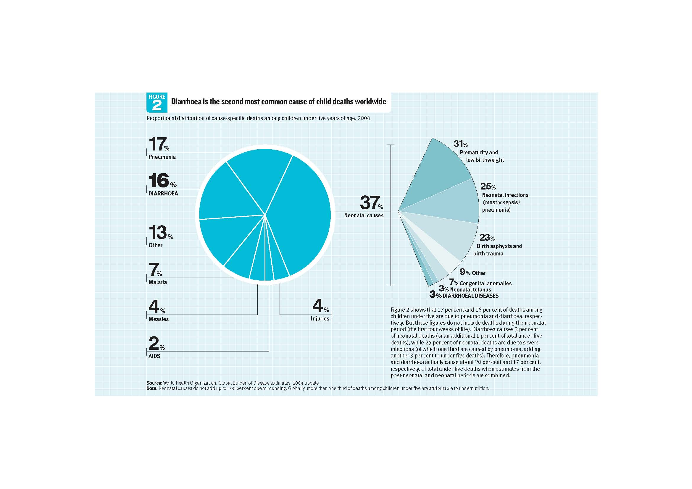
Objective 2 The link between WASH and health
- WHO (2004) Global Burden of Disease Estimates

Slide 79
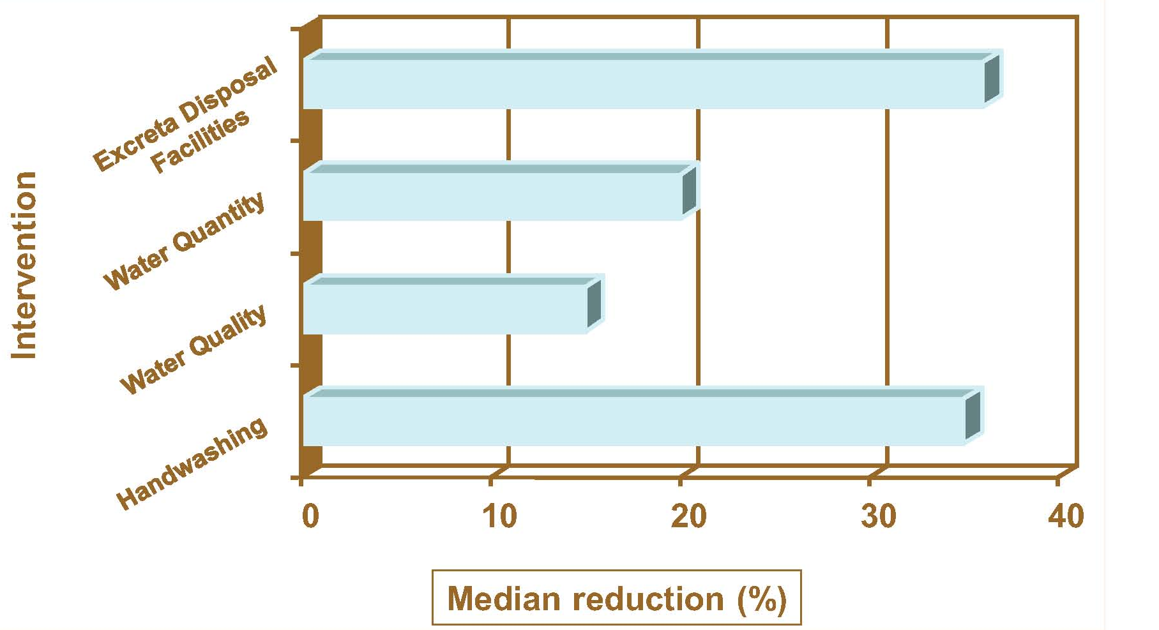
Objective 2 The link between WASH and health
  Effectiveness of WASH interventions in reducing disease morbidity
- Ersey et al. 1991; Hutley et al. 1997

Slide 80
Objective 2 The link between WASH and health
Behavioural indicators for a WASH programme
% of the population uses safe water for drinking
Environment free from all fecal matter
% of the population wash their hands with soap
Women are enabled to deal with menstrual hygiene issues in privacy and with dignity
All sectors of the community are enabled to practice the targeted hygiene behaviours
- USAID (2010) Access and Behavioral Outcome Indicators for WASH

Slide 81
Objective 3 Water related diseases
Classification of water-related infections
Waterborne
Water-washed
(or water-scarce)
Water-based
Water-related
Water contaminated by faeces or urine containing pathogenic bacteria or virus
Cholera, typhoid, dysentery and other diarrhoeal diseases
Caused by poor personal hygiene or eye contact with contaminated water
Scabies, lice, trachoma and tick-borne diseases
Caused by parasites living in intermediate organisms living in water
Worms and other parasites - schistosomiasis, leptospirosis, helminths
Caused by insect vectors, especially mosquitoes, that breed in water
Malaria, dengue fever, yellow fever

Slide 82
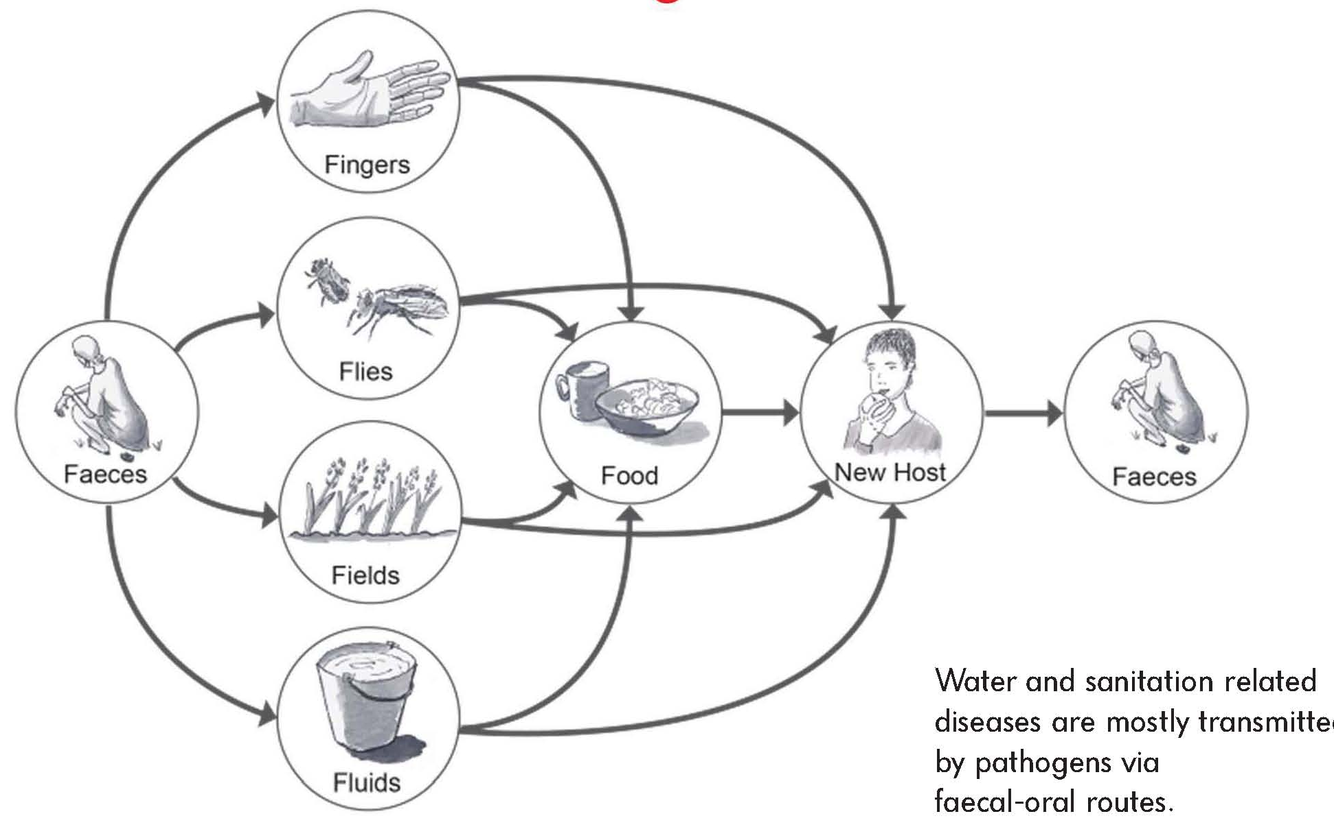
Objective 4 The transmission chain for sanitation related diseases
  F-Diagram (parasite pathways)
- Adapted from WELL (1998), DFID guidance manual on water supply and sanitation programmes

Slide 83
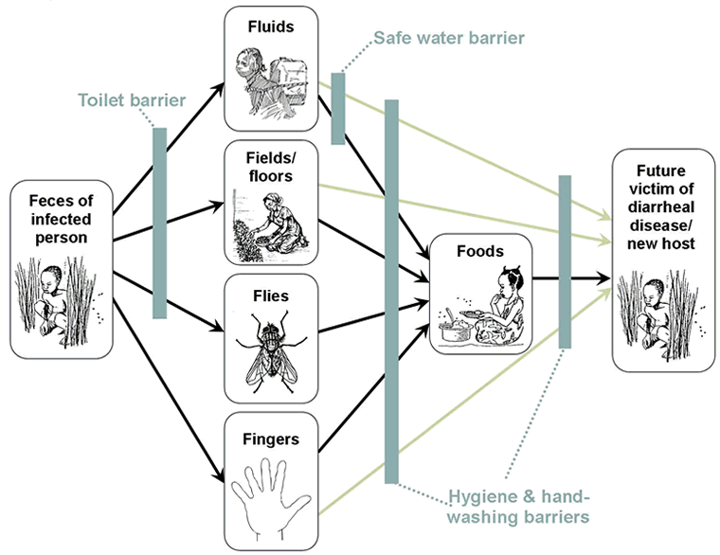
Objective 4 The transmission chain for sanitation related diseases
  F-Diagram (Barriers to transmission)
Water in sufficient quantity and quality
Prevent fecal pathogens (diseases) from entering human environment
Hand-washing at key times
Vector control
- Water 1st International (2010) Disease Barrier Diagram

Slide 84
Objective 4 The transmission chain for sanitation related diseases
Diarrhoea
Exposure to disease
Greater malnutrition
Decreased immunity

Slide 85
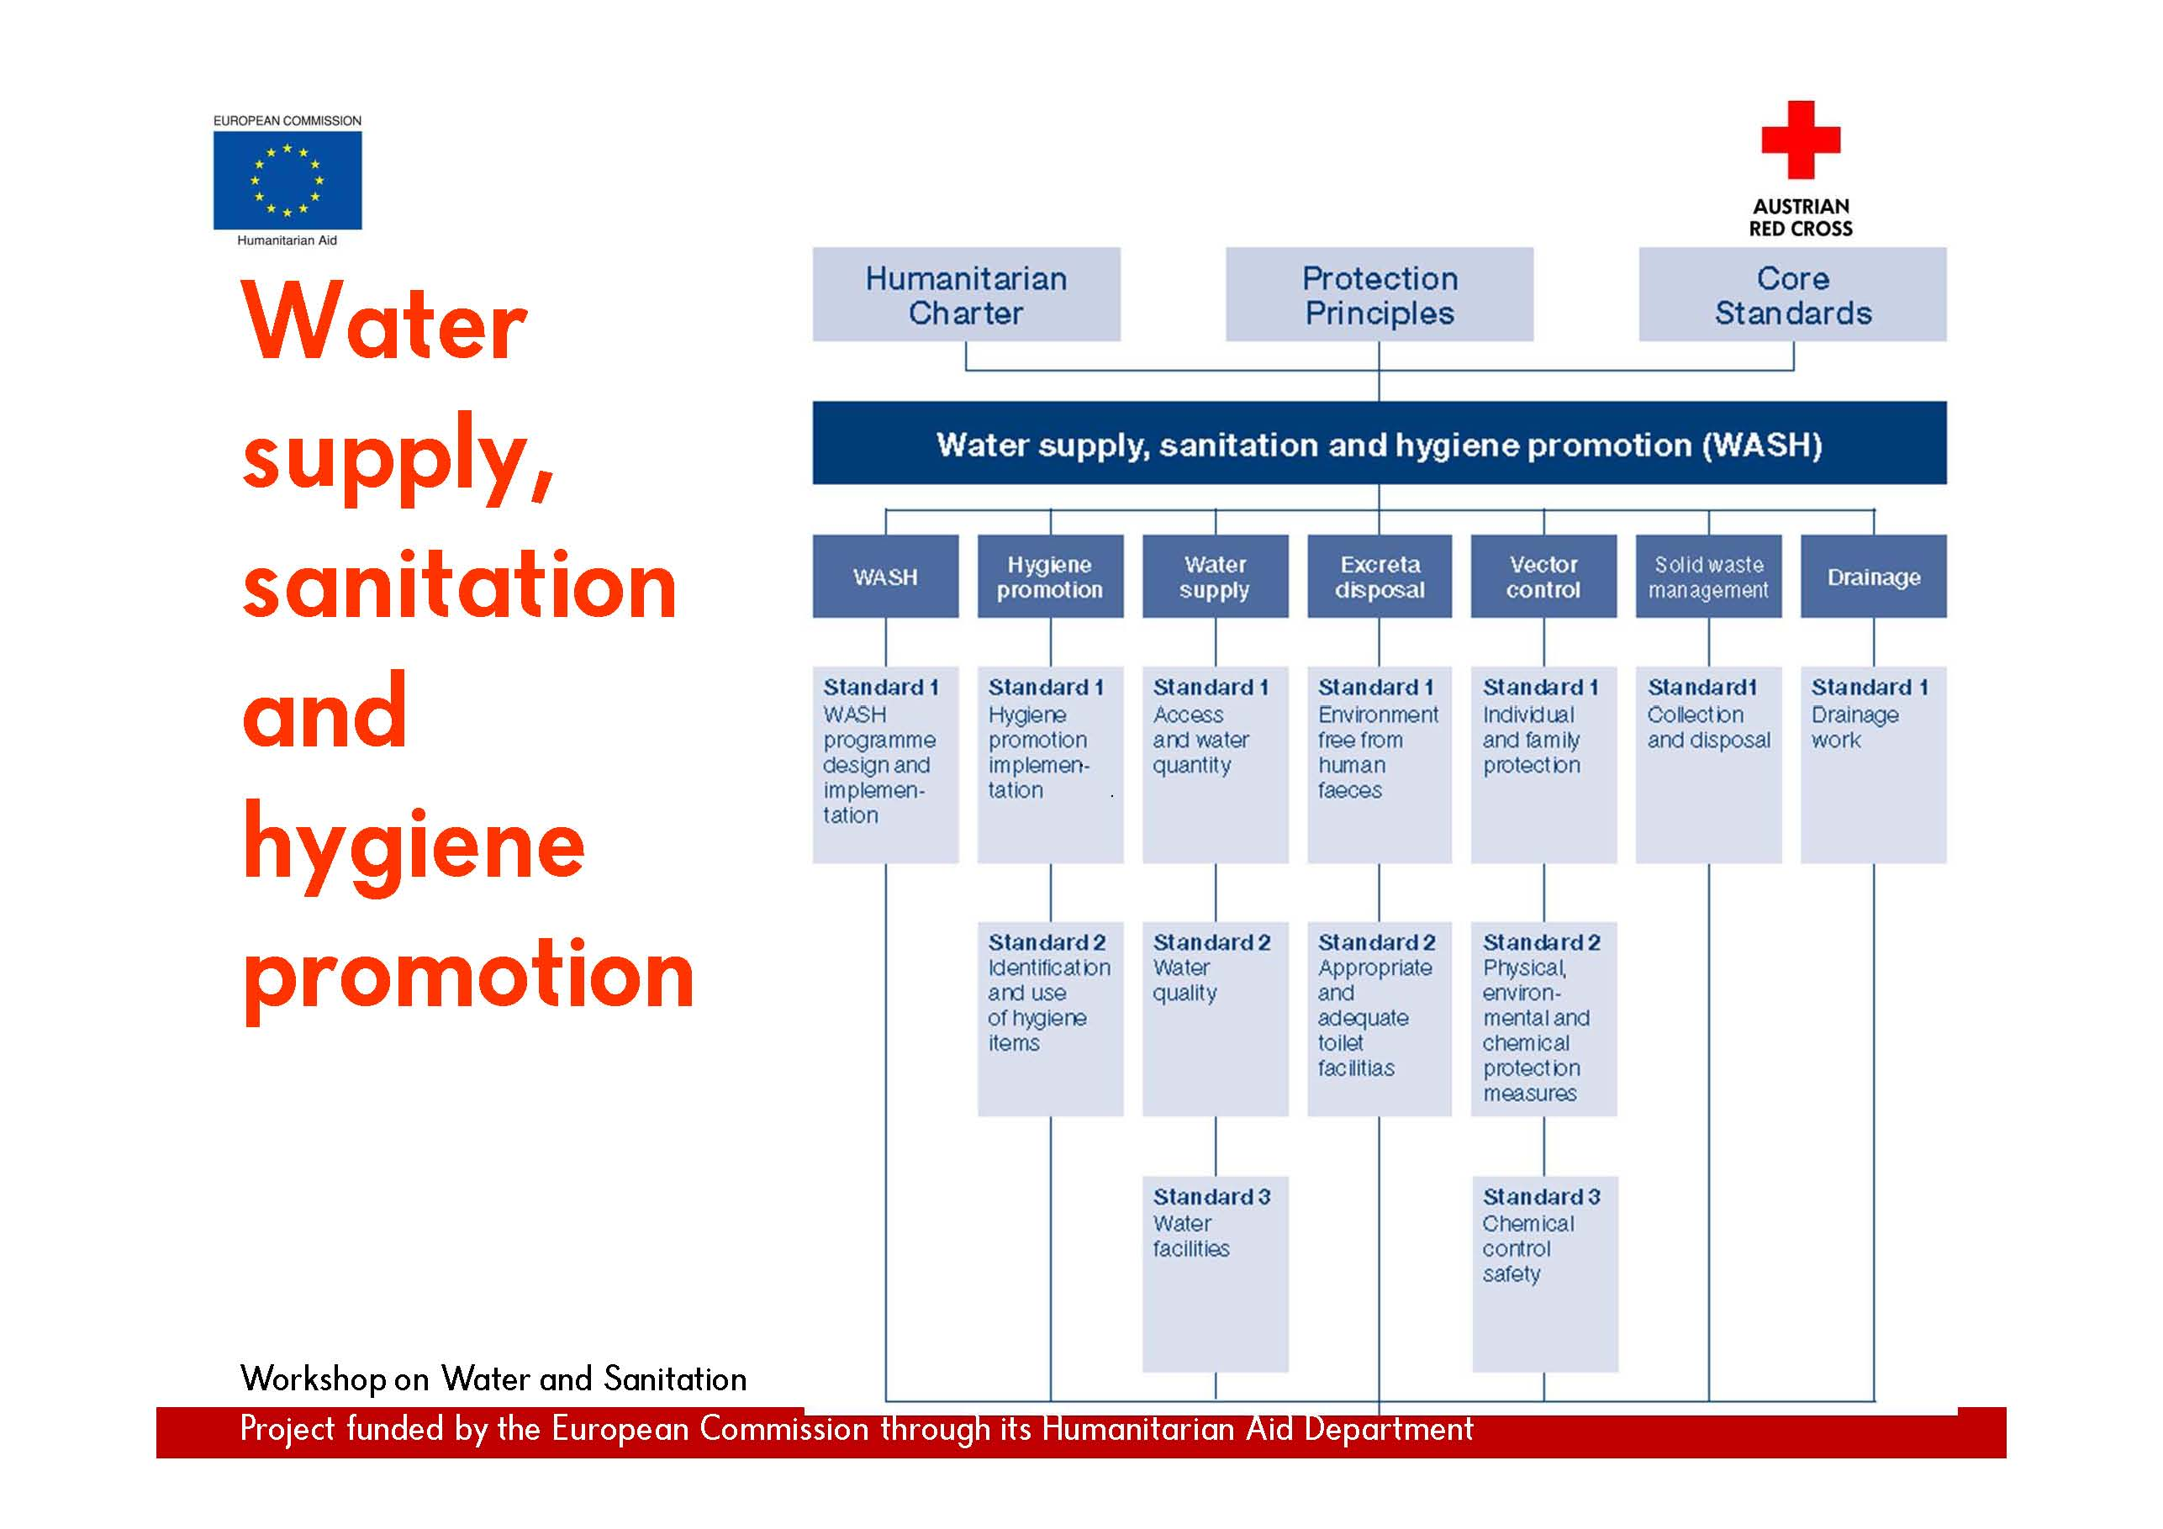
Objective 5 Sphere Standards for WASH

Slide 86
Flip chart paper presentation in groups
Task 1 Each group should present a standard, its three key indicators and three key actions from the WASH standards in the 2011 Sphere Handbook.
If there are more than three key indicators or actions, chose the most important according to you.
Resources WASH Standard 1 – WASH programme design and implementation; p. 88
Water Supply Standard 3.1 – access and water quantity; p.97
Water Supply Standard 3.2 – water quality; p.100
Water Supply Standard 3.3 – water facilities; p.103
Excreta Disposal Standard 4.1 – env. free from human faeces; p.105
Excreta Disposal Standard 4.2 – appropriate & adequate facilities; p. 107
Groups of 4 - 6
30 Minutes

Slide 87

Movie time!
Dancing in the loo http://www.youtube.com/watch?v=kAQIJaNP0LM
Winner of the Golden Poo Awards 2009
Sponsored by Poop Creative; www.poopcreative.org

Slide 88
Any questions?
Share your experiences
Do you have any comments or experiences you would like to share?
Do you have any questions?
Any
questions
15 Minutes

Slide 89


Further reading
Minimum standards in water supply, sanitation and hygiene promotion
The Sphere Project, 2011
Water Sanitation and Hygiene (WASH) Cluster Coordination Handbook
Global WASH Cluster, RedR UK, 2009
Water and sanitation in emergencies: good practice review 1
Overseas Development Institute, 1994

Slide 90

Online resources

Slide 91
Coffee break
Please be back in time for
30 min
Back at
16:00
Notes:
Notes in ITALICS are general training guidance
Facilitators can add notes below to assist training
Notes in BOLD are material references and sources
EC (30/03/10): from SC08b, Day 2 03, p.2 and 3
CM (26/04/10): changed objectives to make them shorter and more SMART

Slide 92
Supply chain management
Introduction into the principles of supply chain management

Slide 93
Supply chain management
4
Notes:
Notes in ITALICS are general training guidance
Facilitators can add notes below to assist training
Notes in BOLD are material references and sources
EC (30/03/10): from SC08b, Day 2 03, p.2 and 3
CM (26/04/10): changed objectives to make them shorter and more SMART

Slide 94
Objective 1 Key concepts of Supply Chain Management
Objective 2 Resources
Objective 3 Logistics
Objective 5 Stockpiles

Slide 95
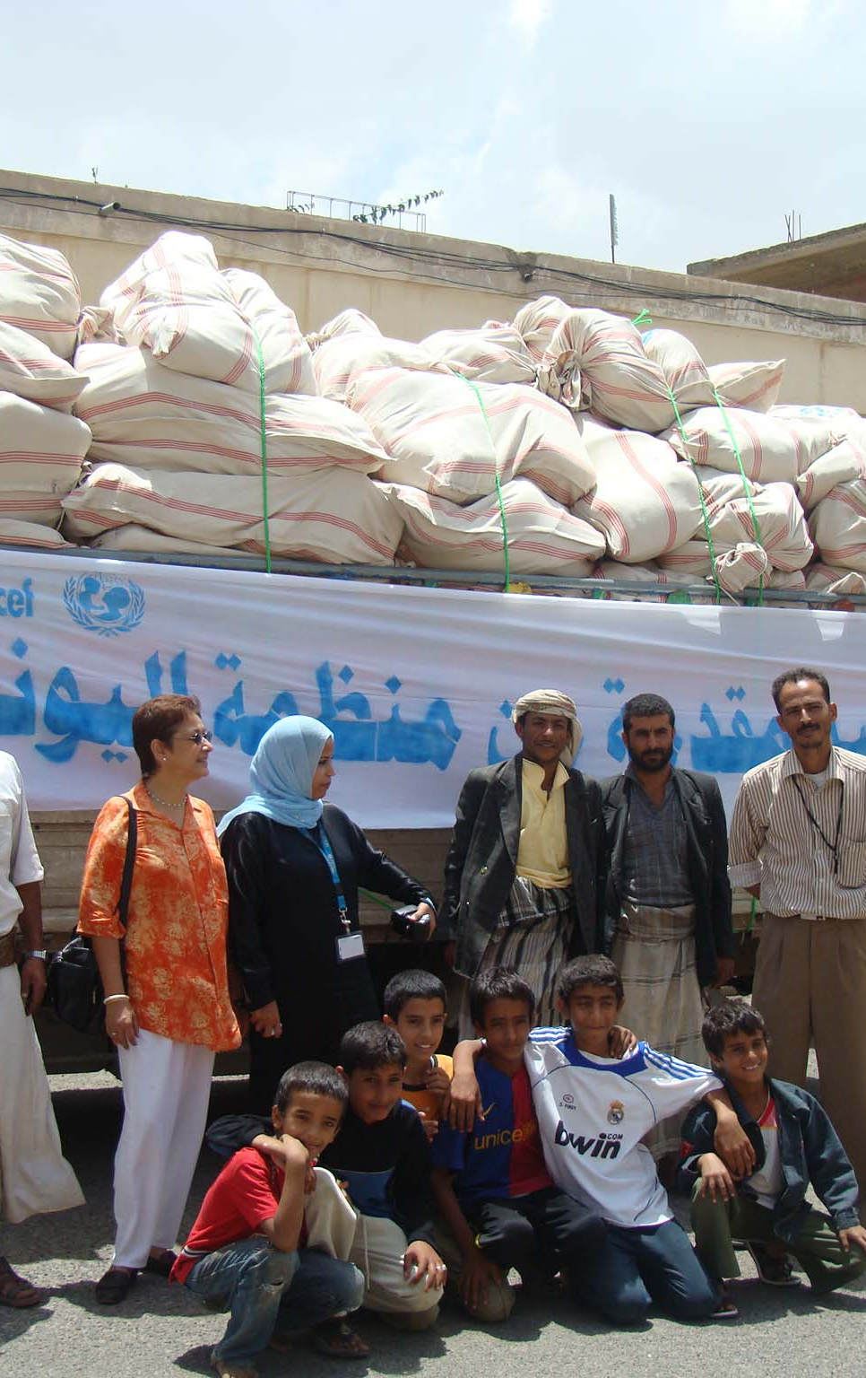
Objective 1 Key concepts
“The ability to deliver the right supplies to the right place at the right time and in the right quantities is a prerequisite for an effective emergency operation.”
UNHCR Handbook for emergencies, third edition, Feb.2007
Logistical support can become the key
to the success or failure of emergency response

Slide 96
Objective 1 Key concepts
Main resources required in humanitarian response are:
Funding: including emergency contingency funds, public appeals, government funds and bi-lateral donations to agencies
Capacity: including workforce, local production, local natural materials (timber, earth, water, etc.) and machinery
Logistics: non-food items (NFIs) including construction materials and items to support individual survival such as blankets, cooking and washing items
Storage and transport: suitable for the local climate and terrain

Slide 97

Objective 1 Key concepts
instant needs
pre-disaster
local capacity
recovery needs
Pre-conflict or pre-disaster:
Existing capacity to meet local needs
Local supply meets local demand
Infrastructure can cope with usage

Slide 98
Objective 1 Key concepts
instant needs
pre-disaster
local capacity
recovery needs
Disaster:
Rapid increase of demands: water, medication, blankets, shelter
Reduced ability to cope due to damage to livelihoods, infrastructure and production
Local capacity unable to cope with new higher demand
Humanitarian organisations can offer assistance from stockpiles

Slide 99
Objective 1 Key concepts
instant needs
pre-disaster
local capacity
recovery needs
Recovery:
Increased resource demand for recovery needs
Temporarily support of local capacity, e.g. regional, national or international capacity
Large demand/capacity will slowly decrease as recovery continues

Slide 100
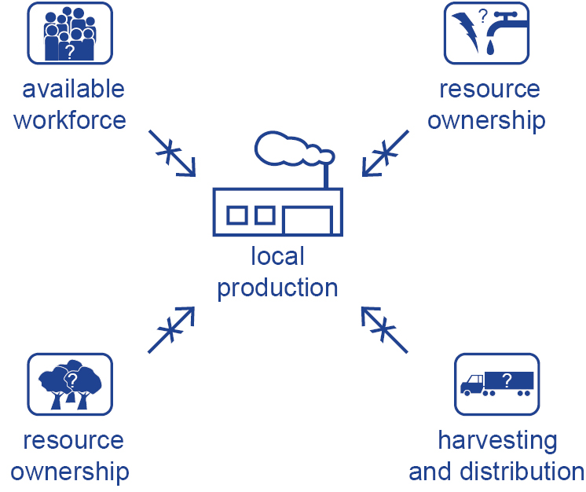
Objective 2 Resources
Local production capacity
In making an assessment of available resources it is important to
evaluate the impact of the disaster on local production

Slide 101


Objective 2 Resources
Resources can be sourced locally, nationally or from stockpiles
Assess the resources available, and how they will change over time according to demand
Developing a successful strategy requires close cooperation between logistics, programme and technical staff
Coordinate with government and other actors on the availability of resources
local production
regional production
national production

Slide 102
Objective 2 Resources
Natural resource management (NRM)
Purpose: ensure that local resources are sustainably harvested, distributed and used
A natural resource management plan must involve all
stakeholders in order to:
Provide both local and affected populations with resources key to their survival
Prevent conflicts resulting form competition over access to resources
Strengthen or establish a NRM coordination committee
Develop policies on access and rights to natural resources

Slide 103
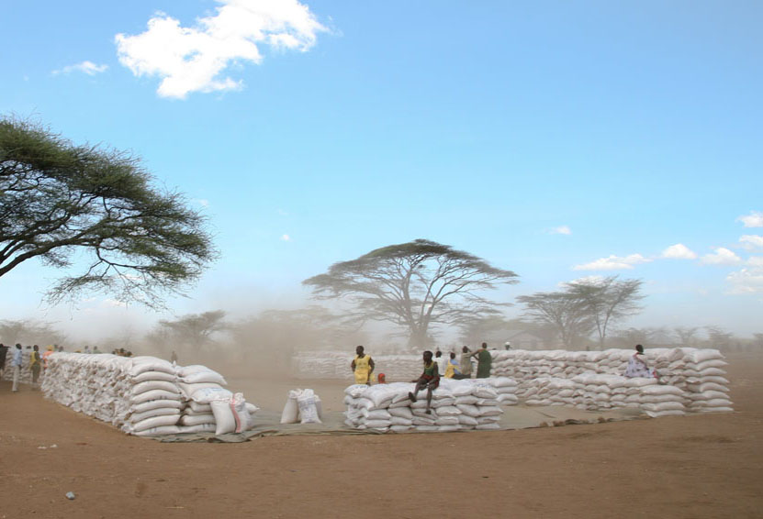

Objective 3 Logistics
Logistics = Supply + Materials Management + Distribution
“The process of planning, implementing and controlling the
efficient, cost-effective flow and storage of goods and materials
as well as related information, from the point of origin to the
point of consumption for the purpose of meeting the end
beneficiary’s requirements”
Logistic Cluster, log.logcluster.org

Slide 104
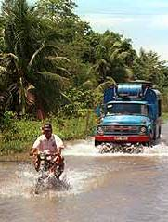
Objective 3 Logistics
In planning logistics it is important to assess the capacity
and access for moving materials including:
Damage to access routes
Reductions in transport capacity
Security during transportation
Barriers to transportation, such as border crossings
and hazardous areas
Assessment of markets

Slide 105
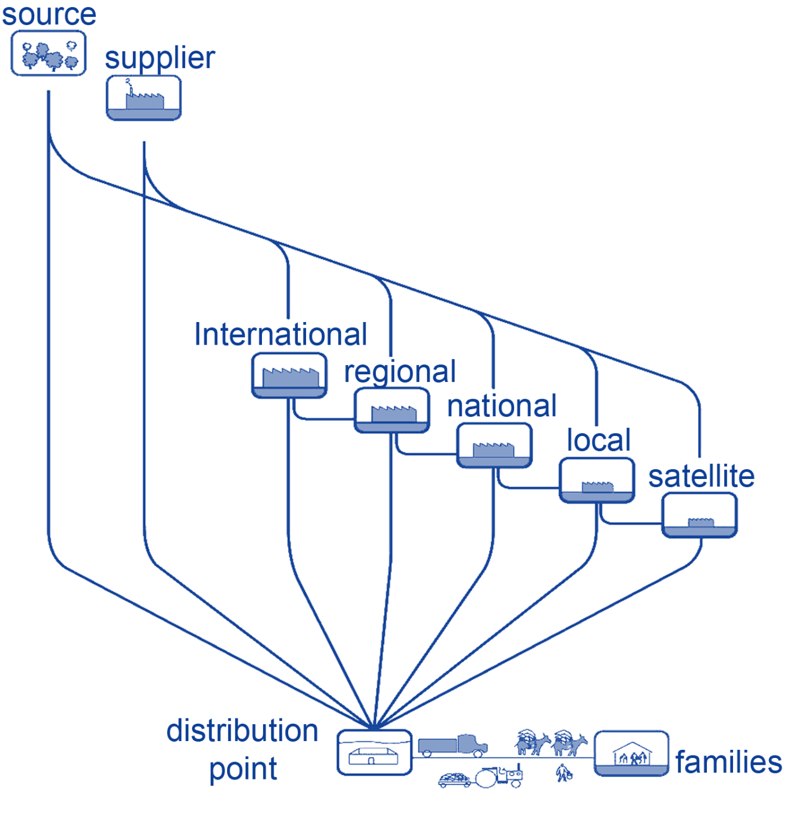
Objective 3 Logistics
The distribution chain:
The number of stages in the distribution chain should be kept to a minimum to reduce the amount of double handling and loss in transit

Slide 106
Discussion in groups
Group exercise
Task 1 Map in groups the paths from source to end use in
programmes you have been involved in
Which systems do you have to put in place?
15 Minutes

Slide 107
Discussion in groups
Consider your own supply map, how well do they address these issues?
Task needs and assessment
Rapidity
Flexibility
Security
Coordination
Comprehensive planning
Cost-effectiveness
Good communication
The use of local resources where possible
10 Minutes

Slide 108
Objective 4 Stockpiles
Stockpiling allows a rapid response to a major emergency.
A wide range of organisations hold stockpiles.
Non-food items which are commonly stockpiled include:
Tents
Plastic sheeting
Blankets
Tools
Water containers
Mosquito nets

Slide 109
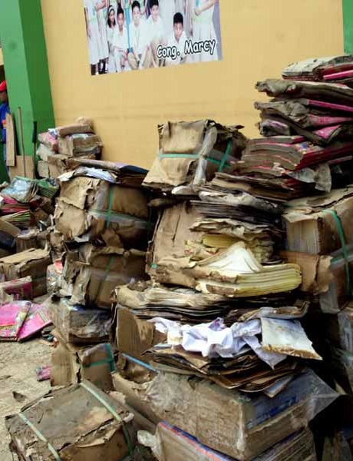
Objective 4 Stockpiles
Stockpiles must be:
Protected from bad handling, improper stacking, climatic effects
Accessible in all weather seasons
Organised so they can be handled and distributed in a minimum number of times
Protected form theft and pests

Slide 110
Objective 4 Stockpiles
Drawbacks:
Items may not be used for several years
Risk of items spoiling, becoming obsolete or simply disappearing
Airfreight costs can easily be the same order of magnitude as the purchase cost of the items
Stockpiled items rarely match the exact needs on the ground; element of wastage

Slide 111
Any questions?
Share your experiences
Do you have any comments or experiences you would like to share?
Do you have any questions?
Any
questions
15 Minutes

Slide 112


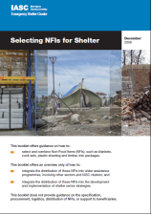
Further reading
UNHCR Handbook for emergencies
Third edition, 2007
Transitional Settlement: Displaced Populations Corsellis and Vitale, 2005
Selecting NFIs for Shelter
IASC Emergency Cluster, 2008
http://log.logcluster.org
Notes:
Notes in ITALICS are general training guidance
Facilitators can add notes below to assist training
Notes in BOLD are material references and sources
EC (30/03/10): from SC08b, Day 2 03, p.2 and 3
CM (26/04/10): changed objectives to make them shorter and more SMART

Slide 113
Afternoon break
Please be back in time for
90 min
Back at
19:00
Notes:
Notes in ITALICS are general training guidance
Facilitators can add notes below to assist training
Notes in BOLD are material references and sources
EC (30/03/10): from SC08b, Day 2 03, p.2 and 3
CM (26/04/10): changed objectives to make them shorter and more SMART

Slide 114
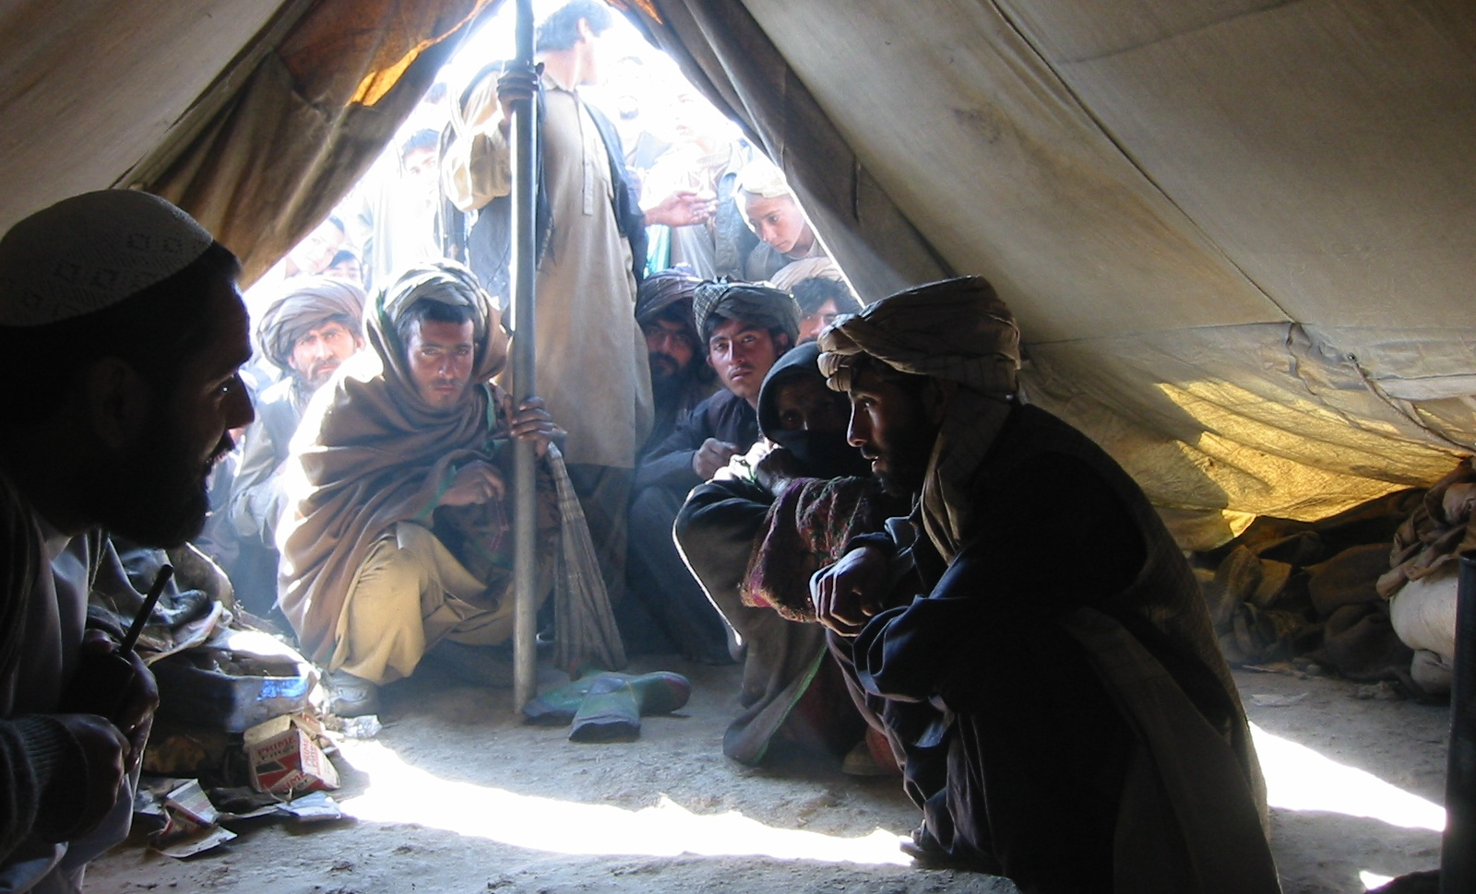
Monitoring and Evaluation
This module describes the scope and context of monitoring and evaluation
90
Minutes
Notes:
Notes in ITALICS are general training guidance
Facilitators can add notes below to assist training
Notes in BOLD are material references and sources
EC (30/03/10): from SC08b, Day 2 03, p.1

Slide 115
Monitoring & evaluation
5
Notes:
Notes in ITALICS are general training guidance
Facilitators can add notes below to assist training
Notes in BOLD are material references and sources
EC (30/03/10): from SC08b, Day 2 03, p.2 and 3
CM (26/04/10): changed objectives to make them shorter and more SMART

Slide 116
By the end of this session, you will have an understanding of:
Objective 1 M&E as part of the assessment cycle
Objective 2 Monitoring
Objective 3 Evaluation

Slide 117
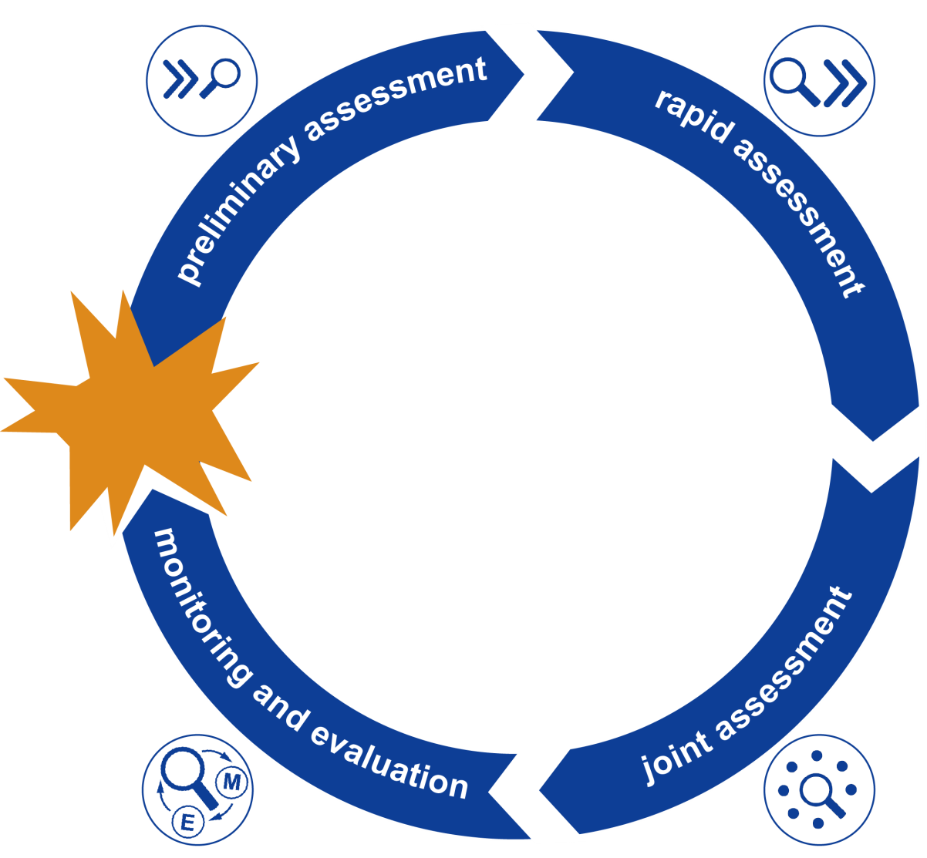
Objective 1 M&E as part of the assessment cycle

Slide 118

Objective 1 M&E as part of the assessment cycle
The purpose of monitoring and evaluation is to maintain an understanding of:
Creating hazard mitigation procedures and manage the risk
Accountability to beneficiaries of programmes
How the information changes over time
How the response has impacted the livelihoods of those affected
How the programme can be improved

Slide 119
Objective 1 M&E as part of the assessment cycle
Monitoring and evaluation address
Relevance – does the project address needs?
Efficiency– are we using the resources wisely?
Effectiveness – are we achieving the outputs?
Impact – has the goal be achieved?
Sustainability – will the impact last?

Slide 120
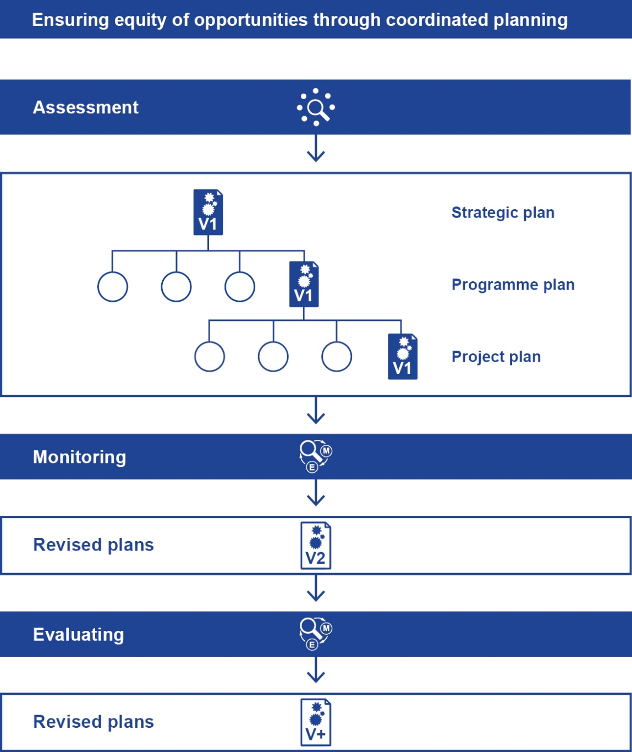
Objective 1 M&E as part of assessment the cycle

Slide 121
Objective 2 Monitoring
The purpose of monitoring is to track the:
Physical and financial progress
Ongoing priorities and allocation of resources
Equitable distribution of benefits among affected groups
Acceptance and usefulness of project among affected groups
Implementation problems and constraints

Slide 122
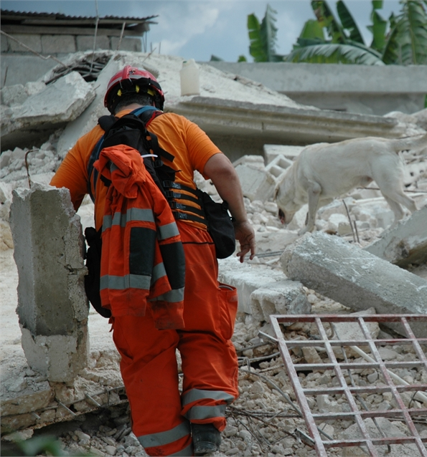
Objective 2 Monitoring
How is monitoring done
Carried out by generalists doing normal activities in standard and ad hoc reports
Information continuously gathered directly from activities
Results viewed by project staff to make minor changes
Shared with implementing partners, donors and beneficiaries

Slide 123
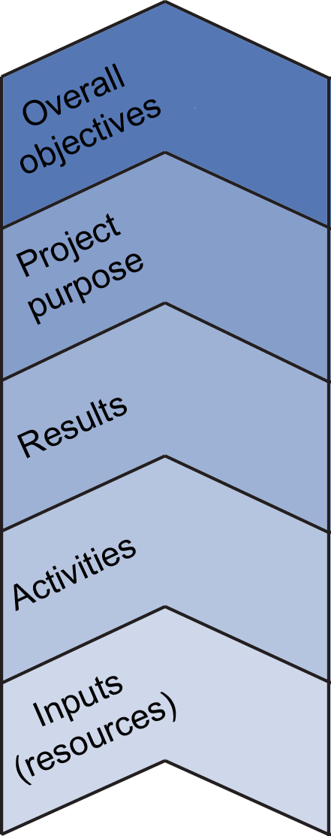
Objective 2 Monitoring
Monitoring plans should be linked to the logical framework analysis
Monitoring verifies that activities are producing desired results for activities
Monitoring confirms that results are meeting project purpose

Slide 124
Exercise
In 4 groups prepare a presentation on one of the monitoring tools below, emphasising the advantages and disadvantages:
Group 1 Questionnaires – feedback forms
Group 2 Observation
Group 3 Data entry and management
Group 4 Focus groups – beneficiaries and other stakeholders
Present this to the group
Write down key points
Discussion in groups
20 minutes

Slide 125
Objective 3 Evaluation
The aim of evaluation is:
To assess an on-going or completed project/ programme/ policy
To determine the relevance and fulfilment of objectives
To establish efficiency, effectiveness, impact and sustainability

Slide 126
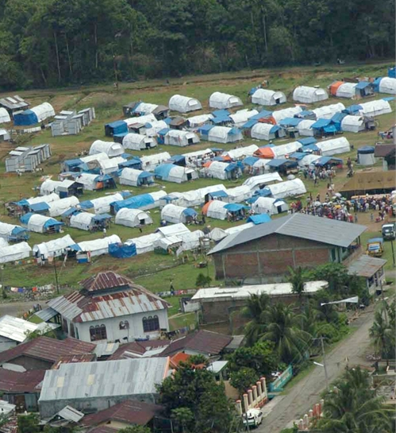
Objective 3 Evaluation
The purpose of evaluation is to:
Provide credible and useful information
Enable the incorporation of lessons into management decision-making
Provide improvements for other projects/ programmes/ policies

Slide 127
Objective 3 Evaluation
How is evaluation done:
At key stages and at end of project
Undertaken by staff and people outside the organisation
Information from monitoring activities and directly collected data or external sources
Results viewed to make changes to policy and future work

Slide 128
Objective 3 Evaluation
Example indicator evaluation table using indicators from logical framework
Final evaluation confirms that overall objectives are met and generates learning for future project planning
 |  | Means of verification
Target | Indicator | Data source | Frequency of collection | Responsibility for collection | Collection method | Reporting | Presentation
Purpose
Objective
Activity
Assumption

Slide 129

Discussion in pairs
Write down key points
Task In pairs, identify the main evaluation lessons learnt from your last project
Question How might these lessons improve your future projects?
Discussion in pairs
20 minutes

Slide 130
Any questions?
Any questions
Do you have any questions?
Do you have any comments or experiences you would like to share?
Share your experiences
10 minutes

Slide 131



Further reading
Shelter after disaster
1a. Assessment
Shelter Centre, 2010
HAP International accountability and quality management
HAP international, 2010
ALNAP Active Learning Network for Accountability and Performance in Humanitarian Action
www.alnap.org
Notes:
Notes in ITALICS are general training guidance
Facilitators can add notes below to assist training
Notes in BOLD are material references and sources
EC (30/03/10): from SC08b, Day 2 03, p.2 and 3
CM (26/04/10): changed objectives to make them shorter and more SMART

Slide 132
Thank you
Don’t forget to fill in your feedback form
Notes:
Notes in ITALICS are general training guidance
Facilitators can add notes below to assist training
Notes in BOLD are material references and sources
EC (30/03/10): from SC08b, Day 2 03, p.2 and 3
CM (26/04/10): changed objectives to make them shorter and more SMART

