Slide 1
Welcome to day 3
Notes:
Notes in ITALICS are general training guidance
Facilitators can add notes below to assist training
Notes in BOLD are material references and sources
EC (30/03/10): from SC08b, Day 2 03, p.2 and 3
CM (26/04/10): changed objectives to make them shorter and more SMART

Slide 2
Notes:
Notes in ITALICS are general training guidance
Facilitators can add notes below to assist training
Notes in BOLD are material references and sources
EC (30/03/10): from SC08b, Day 2 03, p.2 and 3
CM (26/04/10): changed objectives to make them shorter and more SMART

Slide 3
Mini Sessions by participants
90
Minutes

Slide 4
Mini sessions by participants
1
Notes:
Notes in ITALICS are general training guidance
Facilitators can add notes below to assist training
Notes in BOLD are material references and sources
EC (30/03/10): from SC08b, Day 2 03, p.2 and 3
CM (26/04/10): changed objectives to make them shorter and more SMART

Slide 5
Present
Answer questions
Sessions will be video recorded

Slide 6
Coffee break
Please be back in time for
30 min
Back at
11:00
Notes:
Notes in ITALICS are general training guidance
Facilitators can add notes below to assist training
Notes in BOLD are material references and sources
EC (30/03/10): from SC08b, Day 2 03, p.2 and 3
CM (26/04/10): changed objectives to make them shorter and more SMART

Slide 7
Preparation for maxi-sessions
with mentors
90
Minutes

Slide 8
Preparation for CORE sessions
2
Notes:
Notes in ITALICS are general training guidance
Facilitators can add notes below to assist training
Notes in BOLD are material references and sources
EC (30/03/10): from SC08b, Day 2 03, p.2 and 3
CM (26/04/10): changed objectives to make them shorter and more SMART

Slide 9
Participants allocated a session
Help from mentor
Receive feedback from video sessions
Participant led sessions on day 5

Slide 10
Lunch break
Please be back in time for
30 min
Back at
14:00
Notes:
Notes in ITALICS are general training guidance
Facilitators can add notes below to assist training
Notes in BOLD are material references and sources
EC (30/03/10): from SC08b, Day 2 03, p.2 and 3
CM (26/04/10): changed objectives to make them shorter and more SMART

Slide 11
Energiser session
Notes:
Notes in ITALICS are general training guidance
Facilitators can add notes below to assist training
Notes in BOLD are material references and sources
EC (30/03/10): from SC08b, Day 2 03, p.2 and 3
CM (26/04/10): changed objectives to make them shorter and more SMART

Slide 12
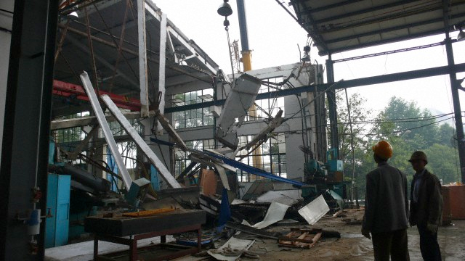
Assessment and disaster cycle
Post-Disaster Needs Assessment
90
Minutes
Notes:
Notes in ITALICS are general training guidance
Facilitators can add notes below to assist training
Notes in BOLD are material references and sources
EC (30/03/10): from SC08b, Day 2 03, p.1

Slide 13
Assessment & disaster cycle
3
Notes:
Notes in ITALICS are general training guidance
Facilitators can add notes below to assist training
Notes in BOLD are material references and sources
EC (30/03/10): from SC08b, Day 2 03, p.2 and 3
CM (26/04/10): changed objectives to make them shorter and more SMART

Slide 14
Group discussion
Discuss as a group the following:
Write down key points
The last response you were involved in?
Did you undertake an assessment?
What type of assessment was it?
Discussion as a group
10
Minutes
Notes:
Notes in ITALICS are general training guidance
Trainer should make sure there is at least 3 people in each group
Notes in BOLD are material references and sources
Developers can add notes below if changes are made to the slides
EC (26/04/10): new slide to integrate stakeholders perspectives

Slide 15
Learning objectives
By the end of this session, you will have an understanding of:
Objective 1 The disaster cycle
Objective 2 Stages of assessment
Objective 3 What to assess
Objective 4 Monitoring and evaluation
Notes:
Notes in ITALICS are general training guidance
Facilitators can add notes below to assist training
Notes in BOLD are material references and sources
EC (30/03/10): from SC08b, Day 2 03, p.2 and 3
CM (26/04/10): changed objectives to make them shorter and more SMART

Slide 16
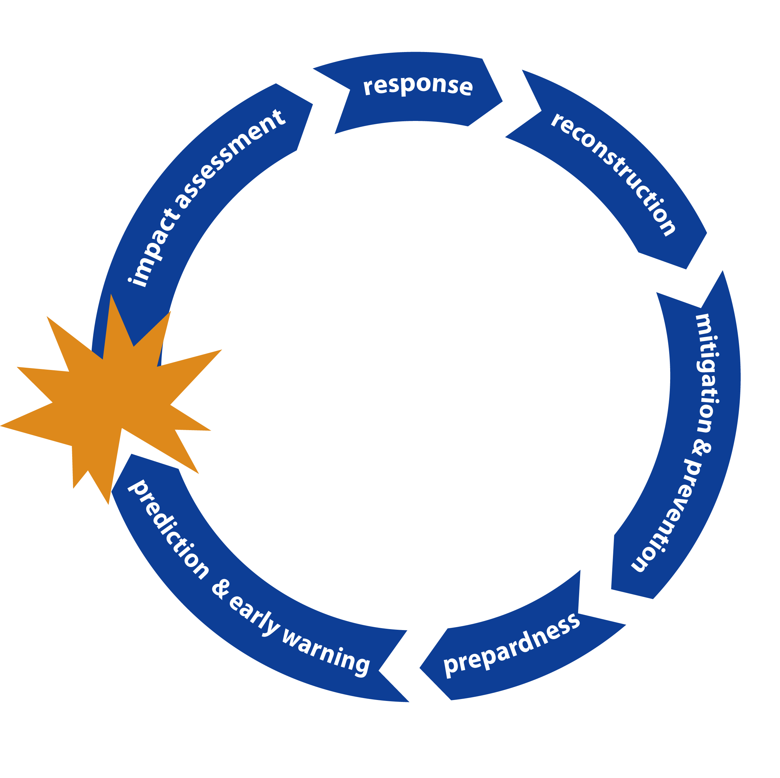
Objective 1 The disaster cycle
Notes:
Notes in ITALICS are general training guidance
Facilitators can add notes below to assist training
Notes in BOLD are material references and sources
EC (30/03/10): from SC08b, Day 2 03, p.2 and 3
CM (26/04/10): changed objectives to make them shorter and more SMART

Slide 17
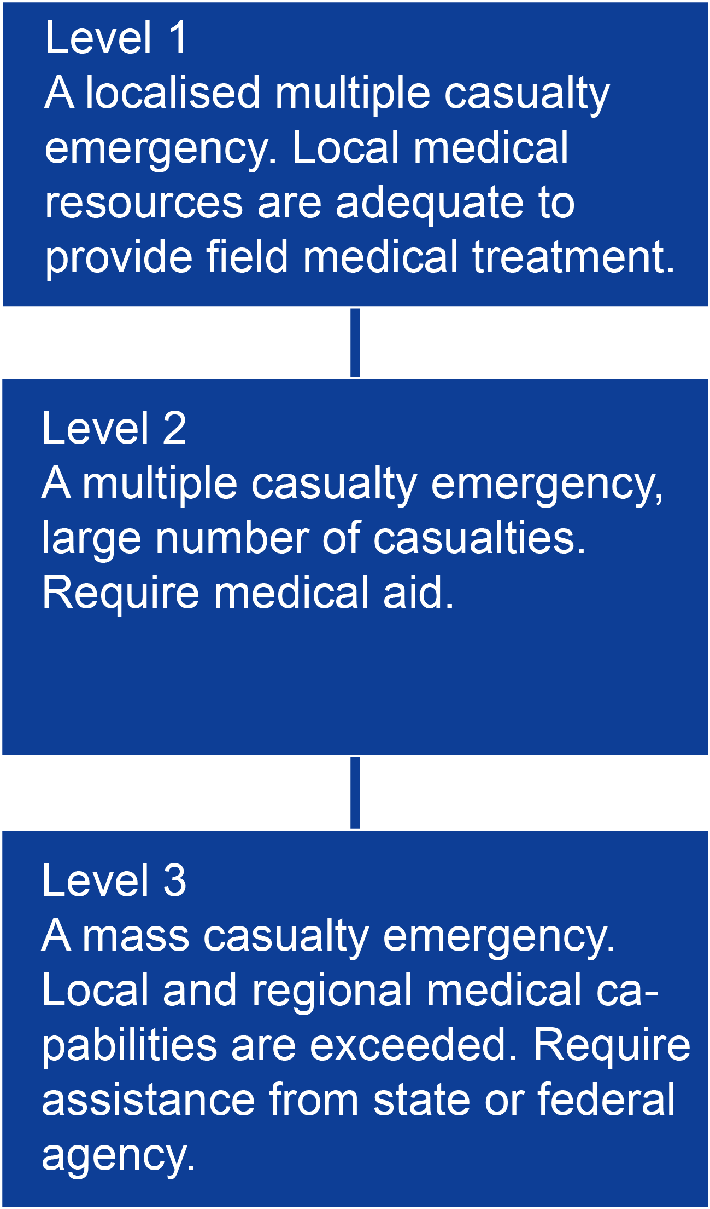
Objective 1 The disaster cycle
What is a disaster?
Types of disaster include, natural and conflict events
Events must have an effect on development
Property destruction, death and injuries define a disaster
Disaster plans show 3 levels of disaster
Disaster plan can be useful for planning different levels of response

Slide 18
Objective 2 Stages of assessment
Core Standard 3: Assessment
The priority needs of the disaster-affected population are identified through a systematic assessment of the context, risks to life with dignity and the capacity of the affected people and relevant authorities to respond.
Humanitarian Charter and Minimum Standards in Humanitarian Response, The Sphere Project, 2011

Slide 19
Objective 2 Stages of assessment
Many organisations and governments have their own assessments
There are some common assessments
Joint needs assessment task force, IASC
Post Disaster Needs Assessment, UNDP
Post Conflict Needs Assessment, UNDG
Damage and loss assessment (DaLA), World Bank
Main barriers to effective assessment are usually:
coordination to implement an effective response
access to the affected population
capacity of stakeholders to undertake assessment

Slide 20
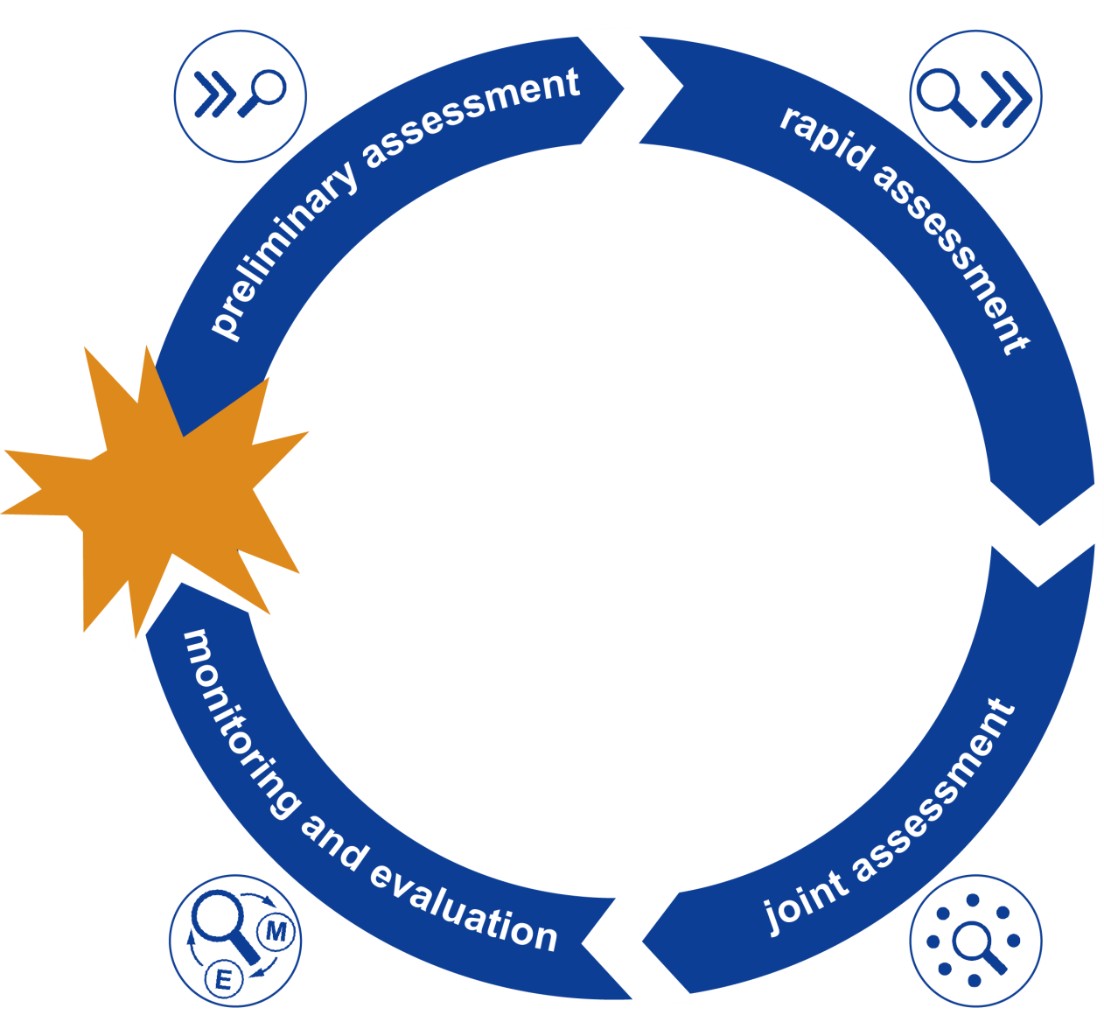
Objective 2 Stages of assessment
Post disaster or conflict there are a number of stages to assessment

Slide 21
Objective 2 Stages of assessment
Preliminary assessment: By first responders within 24-72 hours
Is an initial picture of situation focused around risks from immediate hazards
Rapid assessment: Within first week
Focusing on the immediate priorities of affected population
Joint assessment: Within first few weeks and after
Focussing on the extent of the impact and what responses are appropriate
Monitoring and evaluation: During and at end
Reviewing if the objectives are being achieved

Slide 22
Objective 2 Stages of assessment
Assessment effectiveness
Assessment Accuracy
Effectiveness of intervention
Potential to save lives
Time
Notes:
Notes in ITALICS are general training guidance
Facilitators can add notes below to assist training
Notes in BOLD are material references and sources
EC (30/03/10): from SC08b, Day 2 03, p.2 and 3
CM (26/04/10): changed objectives to make them shorter and more SMART

Slide 23
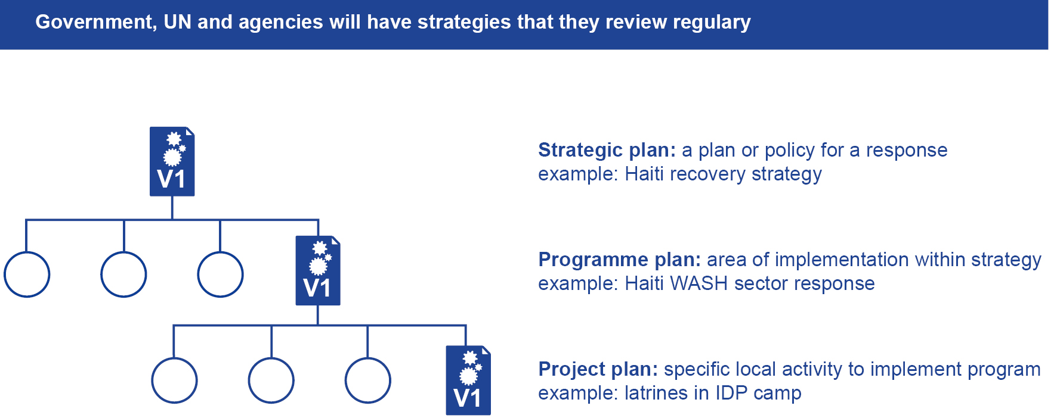
Objective 2 Stages of assessment
Assessment findings inform all levels of planning
Notes:
Notes in ITALICS are general training guidance
Facilitators can add notes below to assist training
Notes in BOLD are material references and sources
EC (30/03/10): from SC08b, Day 2 03, p.2 and 3
CM (26/04/10): changed objectives to make them shorter and more SMART

Slide 24
Objective 3 What to assess
To inform the response it is necessary to maintain an understanding of a number of interrelated categories of information
Risk and hazards including security
Affected & hosted populations
Damage to infrastructure and property
Resources

Slide 25
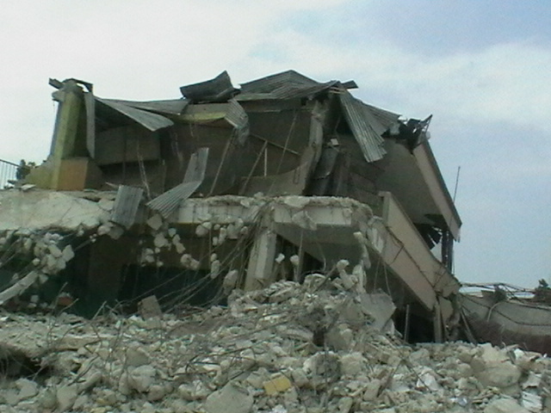
Objective 3 What to assess
Evaluation of risks and hazards including security
Mapping of hazards
Evaluation of risk
Political or social unrest
Security issues

Slide 26
Group discussion
Based on your last response, discuss in groups the following:
Write down key points
Task 1 The main hazards to the project
Task 2 The main risks to the project
We will discuss these further in session
6.2 Disaster Risk Reduction
Discussion in groups
10 Minutes
Notes:
Notes in ITALICS are general training guidance
Trainer should make sure there is at least 3 people in each group
Notes in BOLD are material references and sources
Developers can add notes below if changes are made to the slides
EC (26/04/10): new slide to integrate stakeholders perspectives

Slide 27
Objective 3 What to assess
Details on affected & hosted populations
Number of affected people
Location and conditions
Vulnerability
Needs and priorities
Skills and capacities

Slide 28
Objective 3 What to assess
Resource and capacities assessment should cover these areas
Human – skills, knowledge, health
Social assets – community, political structures
Natural assets – land, water,
Physical assets – buildings, transport, energy
Economic assets – money, tools, livestock

Slide 29
Objective 3 What to assess
Identification of stakeholders during assessment is part of good project planning
Stakeholders include
Government
Beneficiaries
User groups
Interest groups
Decision makers
Donors
Stakeholders can be split into two main types
Primary stakeholders – reason for the project
Secondary stakeholders – means by which project objectives are met

Slide 30
Exercise stakeholder analysis
Case study Read and discuss the case study in the CORE ToT participants manual
Task A request has been made to build a camp to house 5000 people displaced after the severe floods
Question 1 Who are the different stakeholders for the requested camp?
Question 2 Are they primary or secondary?
Write down key points
Discussion in groups
10
Minutes

Slide 31
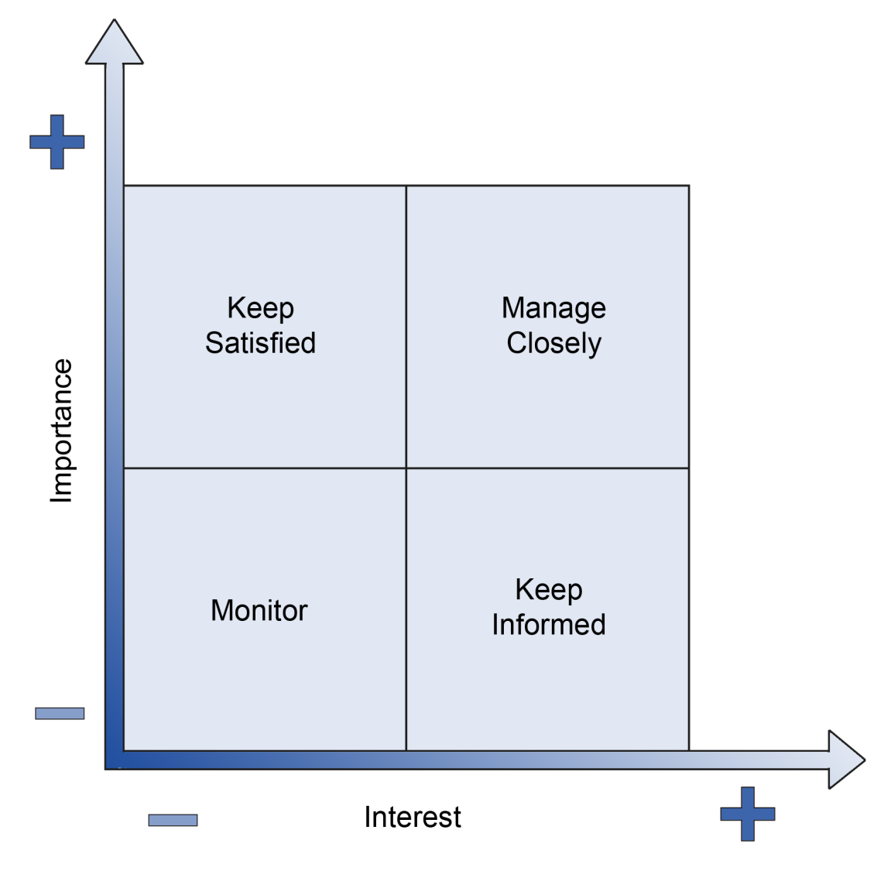
Exercise stakeholder analysis
Place the stakeholders on the priority diagram
Write down key points
Discussion in groups
5
Minutes

Slide 32
Objective 3 What to assess
Using disaggregation:
Disaggregation is the breaking of large amounts of data into smaller pieces
Useful within assessments to identify:
Needs of specific groups
Vulnerability
Guidance from Sphere Core Standards suggests disaggregation by:
sex, male/female
age, 0–5, 6–12, 13–17, and then in 10-year age brackets

Slide 33
Objective 4 Monitoring and evaluation
An integral part of the assessment cycle
Monitoring and evaluation issues will be covered further in ToT session 4.4

Slide 34
Discussion
From your experience, divide the following between the groups for discussion:
Write down key points
Group 1 What are the main information sources in assessments?
Group 2 What are the main methods for assessments?
Group 3 What are the main tools used to carry out assessments?
Also discuss how relevant and reliable are they?
Discussion in groups
15 Minutes
Notes:
Notes in ITALICS are general training guidance
Trainer should make sure there is at least 3 people in each group
Notes in BOLD are material references and sources
Developers can add notes below if changes are made to the slides
EC (26/04/10): new slide to integrate stakeholders perspectives

Slide 35
Any questions?
Any questions
Do you have any questions?
Do you have any comments or experiences you would like to share?
Share your experiences
10 minutes

Slide 36
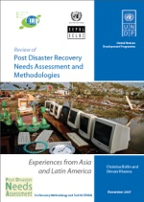
Further reading
www.haiticonference.org/
Haiti_Action_Plan_ENG.pdf
http://www.recoveryplatform.org/pdna/
Post Disaster Recovery Needs Assessment
and Methodologies
IRP, 2007
Notes:
Notes in ITALICS are general training guidance
Facilitators can add notes below to assist training
Notes in BOLD are material references and sources
EC (30/03/10): from SC08b, Day 2 03, p.2 and 3
CM (26/04/10): changed objectives to make them shorter and more SMART

Slide 37
Coffee break
Please be back in time for
30 min
Back at
16:00
Notes:
Notes in ITALICS are general training guidance
Facilitators can add notes below to assist training
Notes in BOLD are material references and sources
EC (30/03/10): from SC08b, Day 2 03, p.2 and 3
CM (26/04/10): changed objectives to make them shorter and more SMART

Slide 38
Humanitarian principles
Legal framework, Red Cross Code of Conduct
& The Sphere Project

Slide 39
Humanitarian principles
4
Notes:
Notes in ITALICS are general training guidance
Facilitators can add notes below to assist training
Notes in BOLD are material references and sources
EC (30/03/10): from SC08b, Day 2 03, p.2 and 3
CM (26/04/10): changed objectives to make them shorter and more SMART

Slide 40
By the end of this session, you will have an understanding of:
Objective 1 Legal framework
Objective 2 Red Cross Code of Conduct
Objective 3 The Sphere Project
Objective 4 Humanitarian Accountability Partnership

Slide 41
Objective 1 Legal framework
Law provides the framework for humanitarian action
National law – e.g. building codes
Customary law – e.g. land rights
International law – e.g. human rights law

Slide 42
Objective 1 Legal framework
International law can fill gaps in national law
Human rights law Ensures all people have the rights and freedoms inherent in human nature
Humanitarian law Distinguishes between combatants and non-combatants
Refugee law Principle of non-refoulement, no refugee sent back to a country in which they are threatened

Slide 43
Objective 1 Legal framework
Human Rights Law – Ensures all people have the rights and freedoms inherent in human nature:
Source documents? international bill of rights
Who has rights? everyone except in times of war
Who has duties? everyone morally, states legally
When applicable? always with some clauses suspended in time of war

Slide 44
Objective 1 Legal framework
Humanitarian law – Distinguishes between combatants and non-combatants:
Source documents? Geneva Convention
Who has rights? non-combatants in conflict
Who has duties? warring parties
When applicable? during conflict

Slide 45
Objective 1 Legal framework
Refugee Law – Principle of non-refoulement, no refugee sent back to a country in which they are threatened:
Source documents? convention on the state of refugees
Who has rights? non-combatants in conflict
Who has duties? host country
When applicable? anywhere with refugees

Slide 46
Discussion in groups
Write down key points
Task 1 Consider and discuss the aspects of your last response that were governed by customary law
e.g. land ownership
Discussion in groups
10 minutes

Slide 47
Objective 2 Red Cross Code of Conduct
Prepared by the International Federation of Red Cross and Red Crescent Societies in consultation with the ICRC
Code of Conduct (1994) is voluntary; enforced by the will of organisations:
The humanitarian imperative comes first
Aid is given regardless of race, creed, or nationality of recipient
Aid will not be used to further political or religious standpoints
Act not as instruments of government foreign policy
Respect culture and custom
Build disaster response on local capabilities
Involve programme beneficiaries in the management of relief aid
Reduce future vulnerabilities to disaster and meet basic needs
Accountable to those you assist and those who resource you
Recognise disaster victims as dignified humans

Slide 48
Objective 3 The Sphere Project
The Sphere Project is a:
Process of collaboration
Commitment to quality and accountability

Slide 49
Objective 3 The Sphere Project
Launched in 1997 by a group of humanitarian NGOs and the Red Cross and Red Crescent movement
Sphere is three things; a handbook, a broad process of collaboration, and an expression of commitment to quality and accountability
Handbook: Guidelines that are set out in the Humanitarian Charter, protection principles and Minimum Standards in Disaster Response

Slide 50
Objective 3 The Sphere Project
The Humanitarian Charter provides the ethical and legal backdrop to the Sphere Principles and Standards:
Key principles:
The right to life with dignity
The right to receive humanitarian assistance
The right to protection and security

Slide 51
Objective 3 The Sphere Project
Four basic Protection Principles, new to 2011 edition:
Avoid causing further harm as a result of your actions
Ensure people’s access to impartial assistance
Protect people from physical and psychological harm due to violence or coercion
Assist with rights claims, access to remedies and recovery from abuse

Slide 52
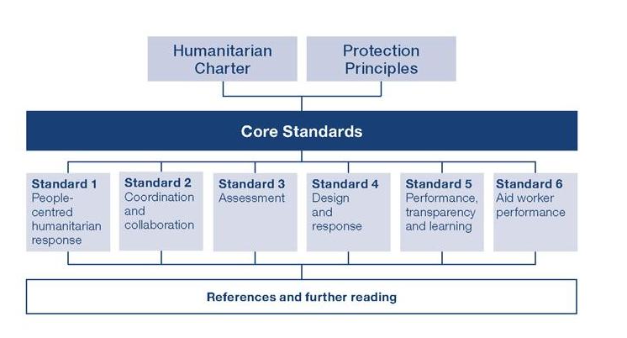
Objective 3 The Sphere Project
Core standards essential to achieving all the minimum standards

Slide 53
Objective 3 The Sphere Project
Minimum standards provided for four key lifesaving humanitarian sectors:
Water supply, sanitation and hygiene
Food security and nutrition
Shelter, settlement and non-food items
Health action

Slide 54
Discussion in groups
Write down key points
Task 1 Discuss the meaning of the right to dignity?
Discussion in groups
10 minutes

Slide 55
Objective 4 Humanitarian Accountability Partnership
Established in 2003, HAP International is the humanitarian sector's first international self-regulatory body
Members of HAP are committed to meeting the highest standards of accountability and quality management

Slide 56
Objective 4 Humanitarian Accountability Partnership
The vision of HAP International is of a humanitarian system championing the rights and the dignity of disaster survivors.
The mission of HAP International is to make humanitarian action accountable to its intended beneficiaries through self-regulation, compliance verification and quality assurance certification.

Slide 57
Objective 4 Humanitarian Accountability Partnership
The objectives of HAP International are to:
Develop and maintain principles of accountability
Support members and potential members of HAP
Communicate, advocate, promote, and report on principles of accountability
Monitor and report on implementation of HAP International's principles
Assist members in finding solutions where concerns or complaints are raised about them

Slide 58
Discussion in groups
Group 1 Which principles do you find most important towards informing humanitarian action?
Group 2 As well as Sphere and HAP which other tools do you use?
Group 3 How have you used Sphere and other tools to overcome project challenges?
Present the key points of your discussion
Write down key points
Discussion in groups
20 Minutes

Slide 59
Any questions?
Share your experiences
Do you have any comments or experiences you would like to share?
Do you have any questions?
Any
questions
15 Minutes

Slide 60
Further reading
Humanitarian Charter and Minimum Standards for Disaster Response
The Sphere Project, 2011
The 2010 HAP Standard in Accountability and Quality Management
HAP International, 2010
Code of Conduct for International Red Cross and Red Crescent Movement and NGOs in Disaster Relief
ICRC, 1994
Notes:
Notes in ITALICS are general training guidance
Facilitators can add notes below to assist training
Notes in BOLD are material references and sources
EC (30/03/10): from SC08b, Day 2 03, p.2 and 3
CM (26/04/10): changed objectives to make them shorter and more SMART

Slide 61
Afternoon break
Please be back in time for
90 min
Back at
19:00
Notes:
Notes in ITALICS are general training guidance
Facilitators can add notes below to assist training
Notes in BOLD are material references and sources
EC (30/03/10): from SC08b, Day 2 03, p.2 and 3
CM (26/04/10): changed objectives to make them shorter and more SMART

Slide 62
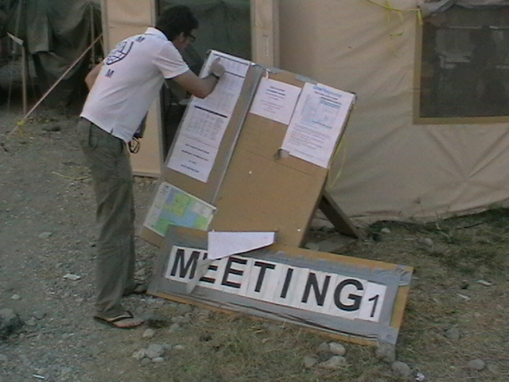
Humanitarian coordination
90
Minutes
Notes:
Notes in ITALICS are general training guidance
Facilitators can add notes below to assist training
Notes in BOLD are material references and sources
EC (30/03/10): from SC08b, Day 2 03, p.1

Slide 63
Humanitarian coordination
5
Notes:
Notes in ITALICS are general training guidance
Facilitators can add notes below to assist training
Notes in BOLD are material references and sources
EC (30/03/10): from SC08b, Day 2 03, p.2 and 3
CM (26/04/10): changed objectives to make them shorter and more SMART

Slide 64
By the end of this session, you will have an understanding of:
Objective 1 Context and aims of coordination
Objective 2 Coordination process
Objective 3 The humanitarian reform process
Objective 4 The cluster system
Objective 5 Humanitarian development coordination

Slide 65
Objective 1 Context and aims of coordination
Aims of coordination
It is essential to establish effective and integrated coordination in order to:
Provide an equitable response for the beneficiaries
Implement a consistent response over a period
Identify gaps in response
Increase efficiency and sustainability by enabling different stakeholder groups to work together
Coordination is the responsibility of all!

Slide 66
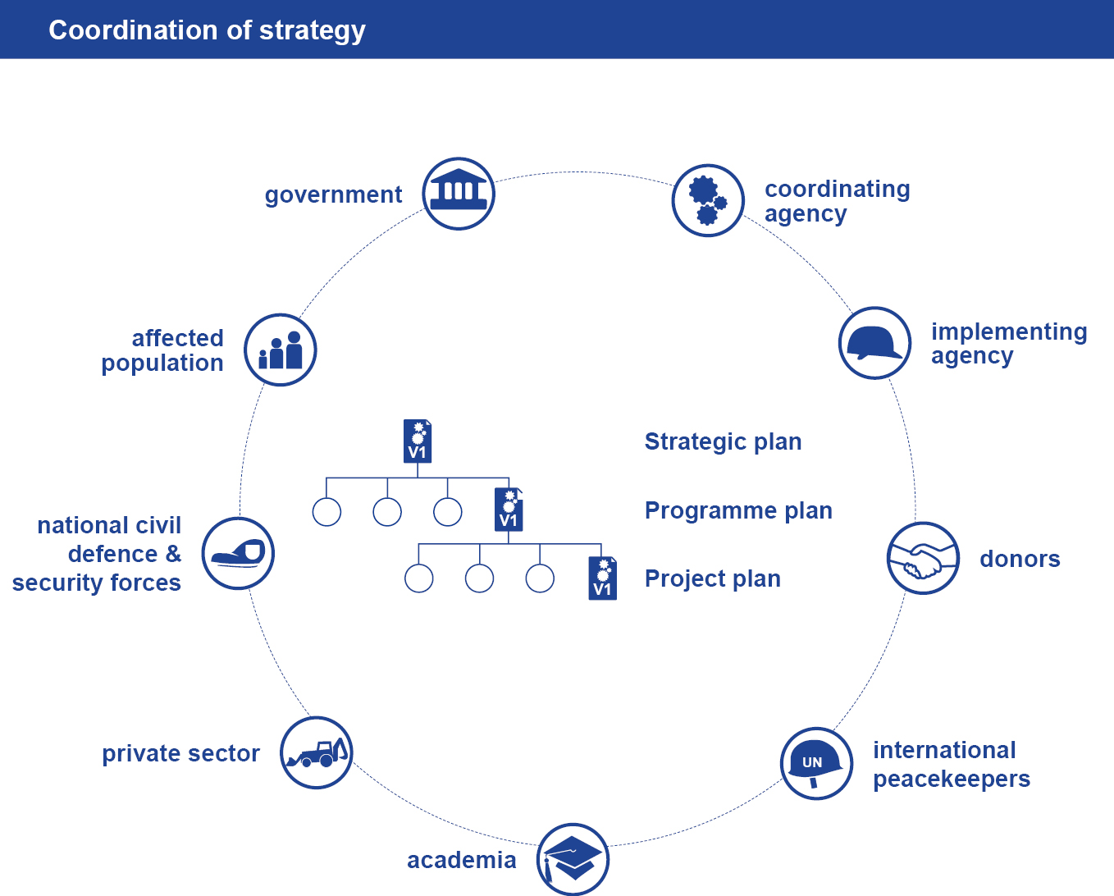
Objective 1 Context and aims of coordination

Slide 67
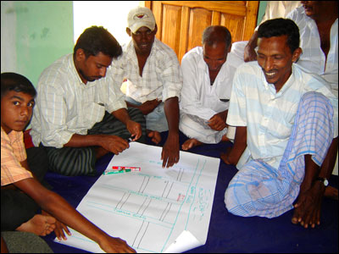
Objective 1 Context and aims of coordination
Coordination is a series of integrated participatory services
Those coordinating and those coordinated agree roles and responsibilities
Coordination may happen within:
Ad-hoc frameworks, such as between an agency and implementing partners
Mandated frameworks, such as a cluster process

Slide 68
Discussion in groups
Task 1 Create a diagram describing the coordination system (up, down, sideways) in your last humanitarian response
Write down key points
up
Discussion in groups
sideways
coordination
sideways
down
15 minutes

Slide 69
Objective 2 Coordination process
Coordinators
Coordinators and managers maximise the inclusion and value of participation by:
Supporting the agreement and implementation of a strategy
Involving national and local government
Maintaining services requested by those coordinated
Maintaining services relevant to all stakeholders
Linking central and localised coordination services
Linking other sectoral coordination services
Remaining responsive to the changing context

Slide 70
Objective 2 Coordination process
Those coordinated
Those coordinated maximise the value of their participation by:
Maintaining the capacity to participate productivety
Ensuring actions agreed are implemented
Contributing the information to the services
Roles, responsibilities and procedures need to be agreed both for coordination meetings and coordination process as a whole

Slide 71
Objective 2 Coordination process
Levels and stakeholders
Coordination levels:
Global
Regional
National
Local
Inter-field locations
Stakeholders include:
National beneficiaries, hosts, authorities, NGO, private sector
International donors, coordination bodies, implementers
IASC clusters

Slide 72
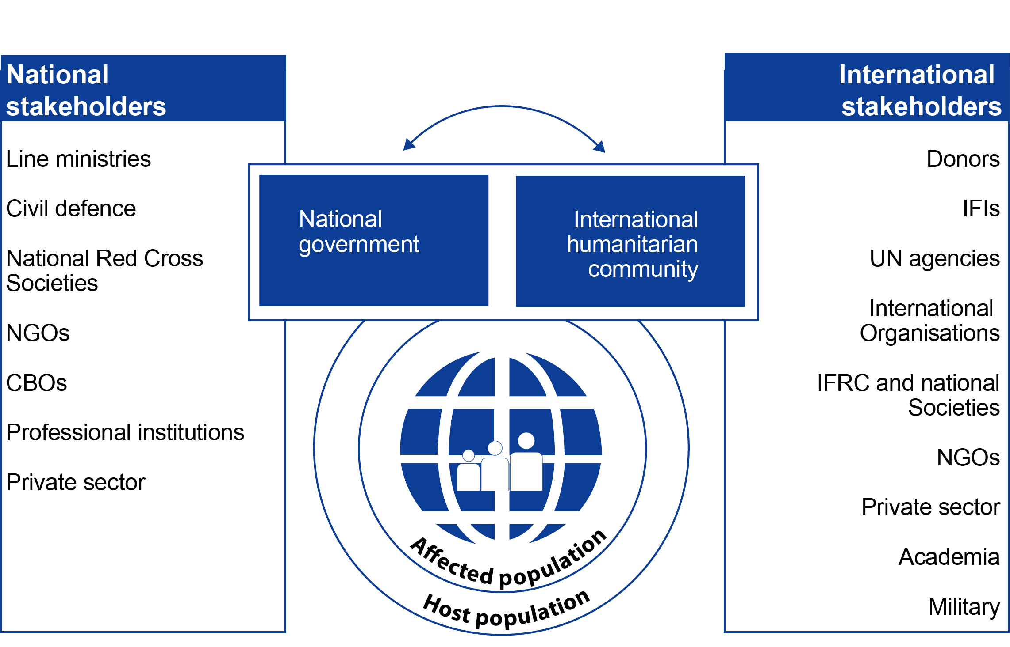
Objective 2 Coordination process
Levels and stakeholders

Slide 73
Discussion in groups
Write down key points
Task 1 List effective ways of coordinating humanitarian response
Task 2 List ineffective ways of coordinating humanitarian response
Discussion in groups
15 minutes

Slide 74
Objective 3 The humanitarian reform process
Aims
An effort by the international humanitarian community (2005) to:
Improving the effectiveness of humanitarian response
Ensuring greater predictability, accountability and partnership
Reaching more beneficiaries
More comprehensive needs-based relief and protection
In a more effective and timely manner

Slide 75
Objective 3 The humanitarian reform process
Pillars of reform
Humanitarian Coordinator (HC) responsible for effective leadership and coordination in humanitarian emergencies
Humanitarian financing
adequate, timely and flexible mechanisms to secure funding
Cluster system
to increase response capacity, sectoral accountability and predictability in leadership
Strong humanitarian partnership:
to enhance coordination between actors in a crisis response

Slide 76
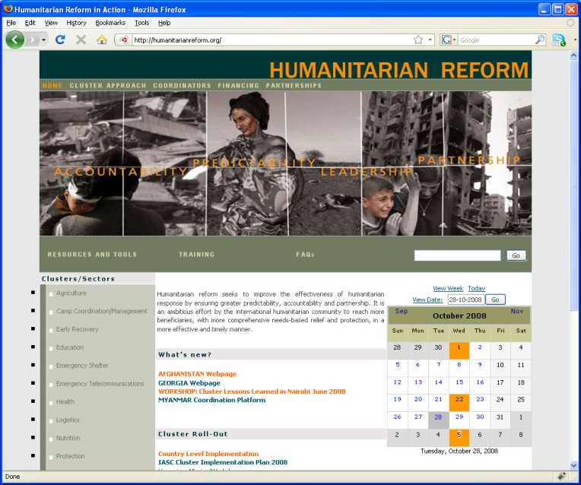
Objective 3 The humanitarian reform process
Website
www.humanitarianreform.org

Slide 77
Objective 4 Cluster system
The Cluster Approach is one example of a mandated process which is adapted in some countries.
It was endorsed by the Inter-Agency Standing Committee (IASC) in order to address identified gaps in humanitarian response (2005).
Sufficient global capacity
Predictable leadership
Strengthened accountability
Improved strategic field-level coordination and prioritising

Slide 78
Objective 4 Cluster system
Benefits
Strategic response, avoiding gaps and duplication
Consensus on responsibilities, reflecting organisations’ capabilities
Systems for sharing information
Early joint assessment and prioritisation of needs
Improved inter-sectoral communication

Slide 79
Objective 4 Cluster system
Cluster |  | Global Cluster Lead Agency
Agriculture |  | FAO
Camp coordination, camp management |  | UNHCR (conflict IDP’s) & IOM
Early recovery |  | UNDP
Education |  | UNICEF & Save the Children UK
Emergency shelter |  | UNHCR (conflict IDP’s) & IFRC
Emergency telecommunication |  | OCHA, UNICEF, WFP
Health |  | WHO
Logistics |  | WFP
Nutrition |  | UNICEF
Protection |  | UNHCR, OHCHR, UNICEF
Water, sanitation and hygiene |  | UNICEF
Food security |  | FAO, WFP

Slide 80
Objective 4 Cluster system
Global cluster |  | Global cluster head agency |  | Global cluster partners
CCCM |  | UNHCR IOM |  | OCHA CARE International Danish Refugee Council Norwegian Refugee Council International Rescue Committee Lutheran World Federation Shelter Centre UNEP

Slide 81
Objective 4 Cluster system
Cross-cutting themes
Cluster |  | Global Cluster Lead Agency
Age Environment Gender HIV / AIDS |  | Help Age International UNEP UNFPA & WHO UNAIDS

Slide 82
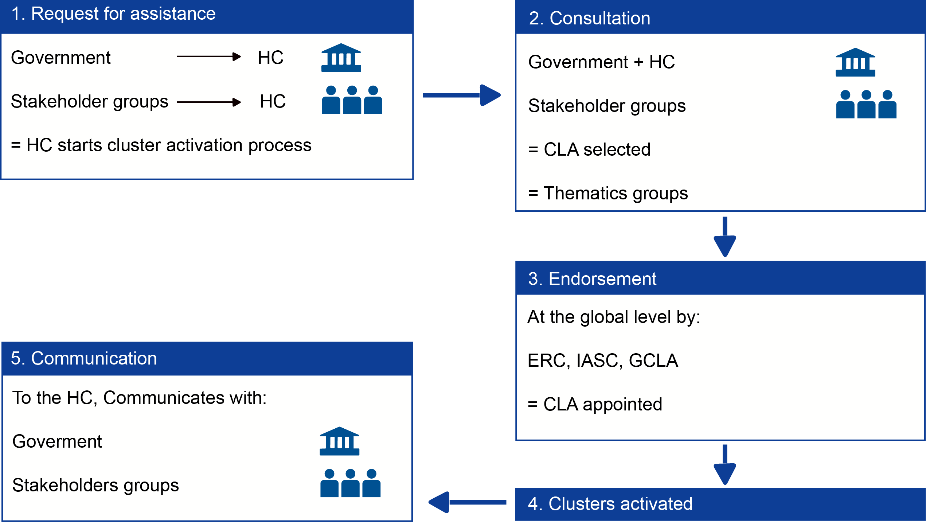
Objective 4 Cluster system
HC = Humanitarian Coordinator
CLA = Cluster Lead Agency
ERC = Emergency Relief Coordinator
GCLA = Global Cluster Lead Agency

Slide 83
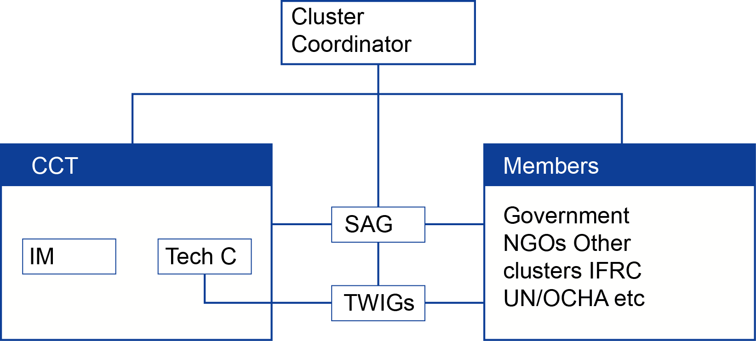
Objective 4 Cluster system
IM = Information Manager
Tech C = Technical Coordinator
SAG = Strategic Advisory Group
TWIGs = Technical Working Groups

Slide 84
Objective 4 Cluster system
2010 IASC cluster evaluation, 2nd phase
Improvements and benefits
Coverage
Gaps and duplications reduced
Learning through peer review
More predictable leadership
Partnership between UN agencies and other NGO’s
Challenges
Weak links to national and local actors has weakened capacity
Threatens humanitarian principles with close relationships with peacekeeping missions
Poor management and facilitation stops full potential
Neglect of multidimensional and cross-cutting issues

Slide 85
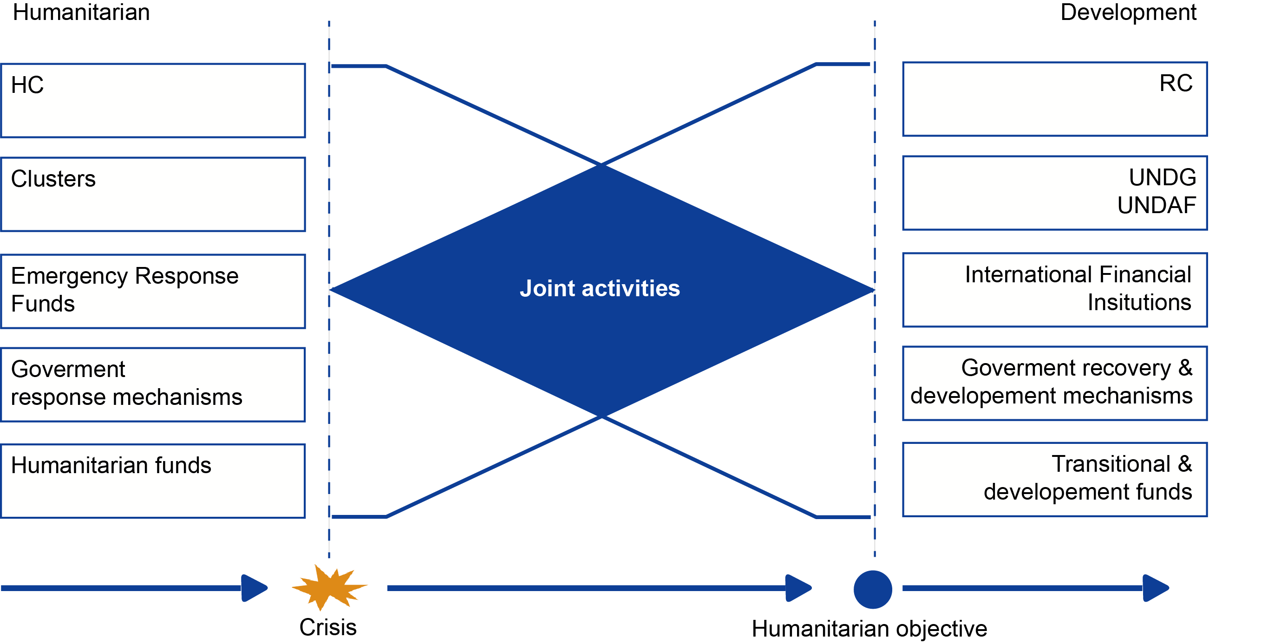
Objective 5 Humanitarian - Development coordination
HC = Humanitarian Coordinator
RC = Resident Coordinator
UNDG = United Nations Development Group
UNDAF = United Nations Development Assistant Framework

Slide 86
Discussion in groups
From your experience discuss:
Write down key points
Task 1 Where you are working, draw a diagram representing the coordination structure
Task 2 What are the main challenges you are facing?
Discussion in groups
15 minutes

Slide 87
Any questions?
Share your experiences
Do you have any comments or experiences you would like to share?
Do you have any questions?
Any
questions
15 minutes

Slide 88
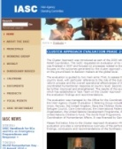
Further reading
Disaster Response: Principles of
Preparation and Coordination
Centre of Excellence in Disaster Management
and Humanitarian Assistance, 2000
Literature Review for Shelter after Disaster
Shelter Centre, 2011
http://goodintents.org/uncategorized/coordinationafter-a-disaster
IASC Cluster approach
2nd phase April 2010
Notes:
Notes in ITALICS are general training guidance
Facilitators can add notes below to assist training
Notes in BOLD are material references and sources
EC (30/03/10): from SC08b, Day 2 03, p.2 and 3
CM (26/04/10): changed objectives to make them shorter and more SMART

Slide 89
Thank you Don’t forget to fill in your feedback form
Notes:
Notes in ITALICS are general training guidance
Facilitators can add notes below to assist training
Notes in BOLD are material references and sources
EC (30/03/10): from SC08b, Day 2 03, p.2 and 3
CM (26/04/10): changed objectives to make them shorter and more SMART

