Slide 1
Welcome to day 2
Notes:
Notes in ITALICS are general training guidance
Facilitators can add notes below to assist training
Notes in BOLD are material references and sources
EC (30/03/10): from SC08b, Day 2 03, p.2 and 3
CM (26/04/10): changed objectives to make them shorter and more SMART

Slide 2
Notes:
Notes in ITALICS are general training guidance
Facilitators can add notes below to assist training
Notes in BOLD are material references and sources
EC (30/03/10): from SC08b, Day 2 03, p.2 and 3
CM (26/04/10): changed objectives to make them shorter and more SMART

Slide 3
Training Introduction into training techniques
105
Minutes

Slide 4
Training
1
Notes:
Notes in ITALICS are general training guidance
Facilitators can add notes below to assist training
Notes in BOLD are material references and sources
EC (30/03/10): from SC08b, Day 2 03, p.2 and 3
CM (26/04/10): changed objectives to make them shorter and more SMART

Slide 5
Objective 1 What are learning techniques and why do we use them
Objective 2 Examples of different learning techniques
Objective 3 Practice using learning techniques

Slide 6
Humanitarian principles

Slide 7
Objective 1 Why do we use learning techniques
Branches
To appeal to different learning styles
To change the rhythm or pace of your session
To offer a different learning experience

Slide 8
Objective 2 Examples of learning techniques
Brainstorming
Used to find different viewpoints on a topic.
Brainstorming is a radial diagram that expands one central point
Do not criticise ideas until evaluation at end
Wild ideas stimulate debate
Quantity is important
Adapt and build on others ideas

Slide 9
Objective 2 Examples of learning techniques
Margolis’ Wheel
Used to generate a wide range of ideas.
Margolis’ Wheel is an activity using two circles of chairs.
Everyone gets to individually discuss a topic
Learn to vocalize problems
Allows for creation of solutions
Allows quieter members to participate

Slide 10
Objective 2 Examples of learning techniques
Nominal group technique
Used to find answers or identify best practice
Nominal group technique is an activity involving all participants
Everyone gets to contribute an idea
Do not discuss ideas as they are written up
Rank and score ideas considered most useful
Allow people to clarify ideas

Slide 11
Objective 2 Examples of learning techniques
Conducting a debate
Used as a structured way to discuss opinion
Debates formed from 2 teams with 2 people each
Prepare an argument before-hand
Stick to the structure, and act as a mediator

Slide 12
Objective 2 Examples of learning techniques
How to conduct a debate
Prepare the argument
Presents
Opinion
Presents
Opinion
Team 1
Questions
15 mins
Team 2
Respond
Respond
Audience
Vote

Slide 13
Objective 2 Examples of learning techniques
Reviewing
Used to create memories through repetition
Reviewing is the process of re-visiting key topics
Review key topics often
Use creative methods
These learning techniques can be used to review
Use a different method for each review

Slide 14
Objective 2 Examples of learning techniques
Multiple cause diagramming
Used to understand causes of particular problem
Multiple cause diagramming is a group diagram activity
Work with real applicable problems
Ask why until ideas dry up
Look for common themes
Ensure focus on problems you can control

Slide 15
Objective 2 Examples of learning techniques
Quizzing
Used to understand causes of particular problem
Multiple cause diagramming is a group diagram activity
Work with real applicable problems
Ask why until ideas dry up
Look for common themes
Ensure focus on problems you can control

Slide 16
Objective 2 Examples of learning techniques
8. Strengths, weaknesses, opportunities and threats (SWOT analysis)
Used to discuss ideas that may be difficult or threatening
SWOT analysis is an activity conducting is small teams
Allow sufficient time for group ideas
Look for differing opinions
Allow discussion on differing opinions

Slide 17
Objective 2 Examples of learning techniques
9. Energizers
Used to reengage learners mentally and physically after breaks
Energisers are exercises conducted with the whole group
Engage both brain and body
Need not be on theme
Repeat until everyone is engaged

Slide 18
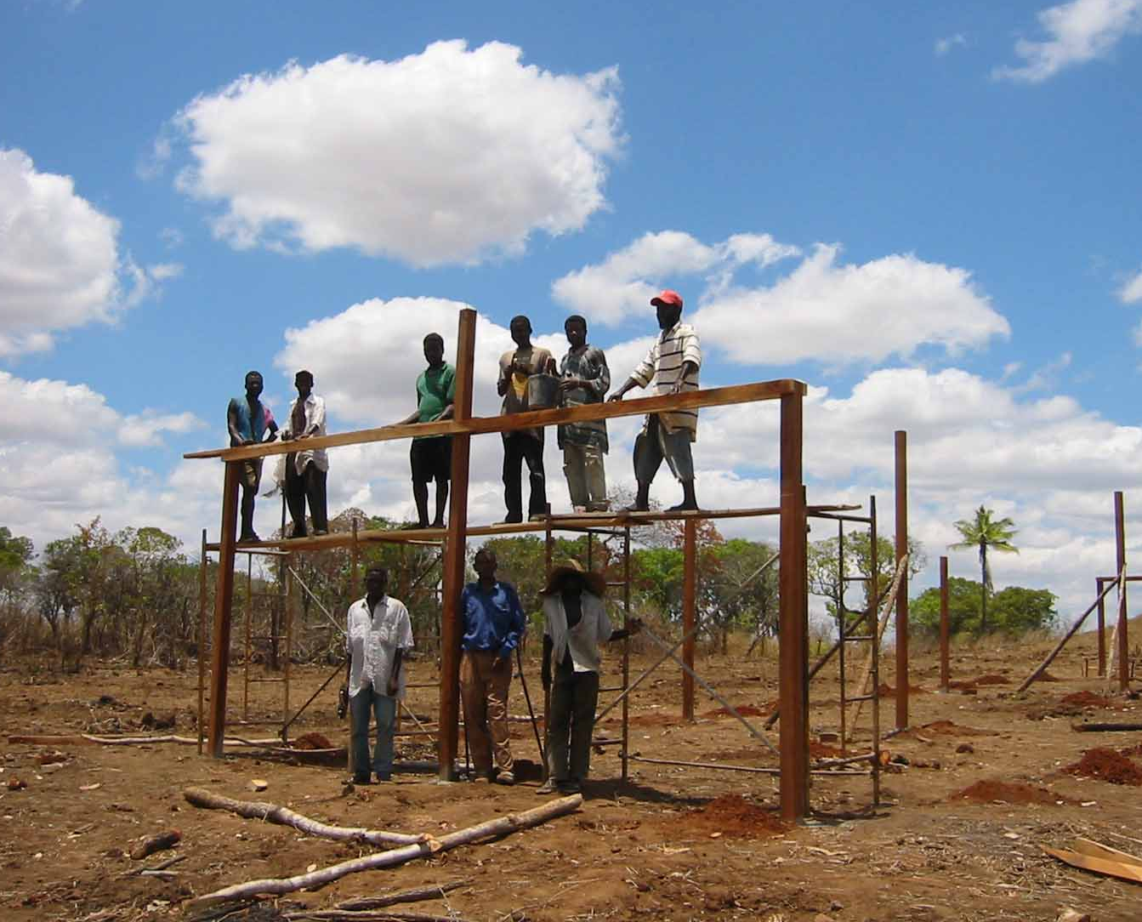
These techniques can also be used in an emergency response situation
Objective 3

Slide 19
Objective 3 Practice using learning techniques
In groups, discuss the following
Task 1 Discuss where and when these learning techniques could be useful within an emergency response setting
Example Multiple cause diagramming is a useful tool for project management in emergency response

Slide 20
Any questions?
Share your experiences
Do you have any comments or experiences you would like to share?
Do you have any questions?
Any
questions
15 Minutes

Slide 21
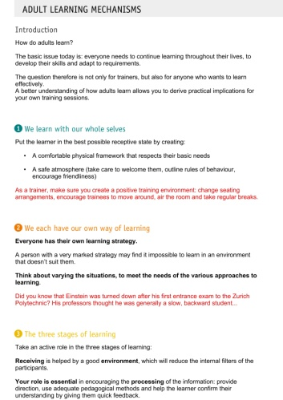
Further reading
Adult Learning Mechanisms
Cegos 2007
Delivering great training
Bryan Hopkins 2008
Designing Participatory Workshops
UNHCR 2008
How to organize and run learning workshops
UNICEF and UN staff college
Notes:
Notes in ITALICS are general training guidance
Facilitators can add notes below to assist training
Notes in BOLD are material references and sources
EC (30/03/10): from SC08b, Day 2 03, p.2 and 3
CM (26/04/10): changed objectives to make them shorter and more SMART

Slide 22
Coffee break
Please be back in time for
30 min
Back at
11:00
Notes:
Notes in ITALICS are general training guidance
Facilitators can add notes below to assist training
Notes in BOLD are material references and sources
EC (30/03/10): from SC08b, Day 2 03, p.2 and 3
CM (26/04/10): changed objectives to make them shorter and more SMART

Slide 23
Using Training Aids
90
Minutes

Slide 24
Using training aids
2
Notes:
Notes in ITALICS are general training guidance
Facilitators can add notes below to assist training
Notes in BOLD are material references and sources
EC (30/03/10): from SC08b, Day 2 03, p.2 and 3
CM (26/04/10): changed objectives to make them shorter and more SMART

Slide 25
Objective 1 The need for training aids
Objective 2 The different types of training aids
Objective 3 Selecting the appropriate training aids
Objective 4 Practice using training aids

Slide 26
Objective 1 The need for training aids

Slide 27
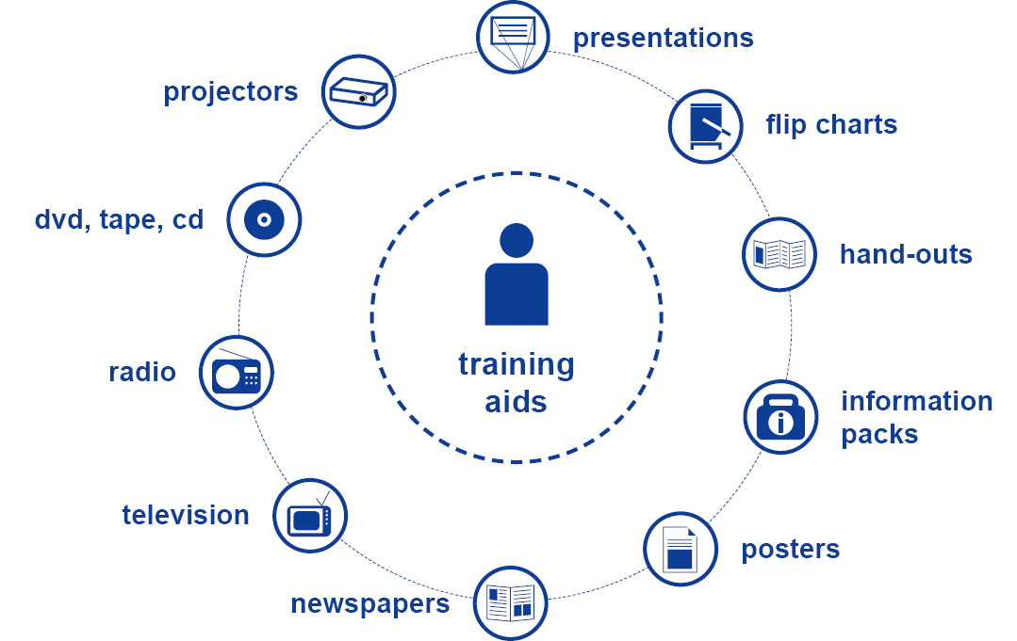
Objective 2 The different types of training aids
There are several types of training aids, consider the following
Power point presentations
Flip charts, white/black boards
Hand-outs
Other media

Slide 28
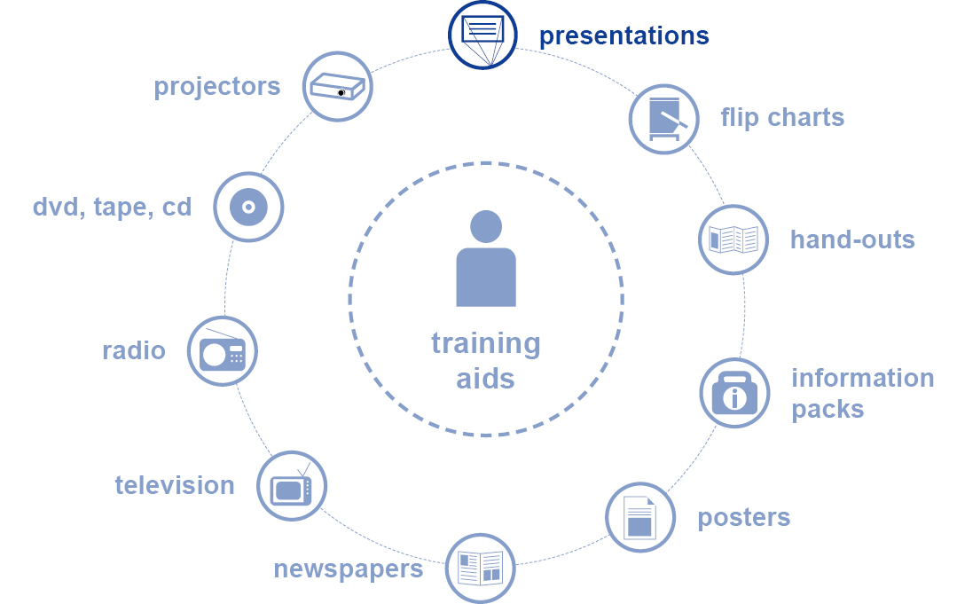
Objective 2 The different types of training aids
CORE power point slides key points:
Title page with subheading
Use up to 5 key objectives
Use the 5 and 5 rule
Use discussion/activity
slides
Remember to include
references

Slide 29
Objective 2 The different types of training aids
CORE power point slides graphics tips
Standard Header
Bold objective
Minimum size 22 pt
Consistent text
Alignment
Consistent images

Slide 30
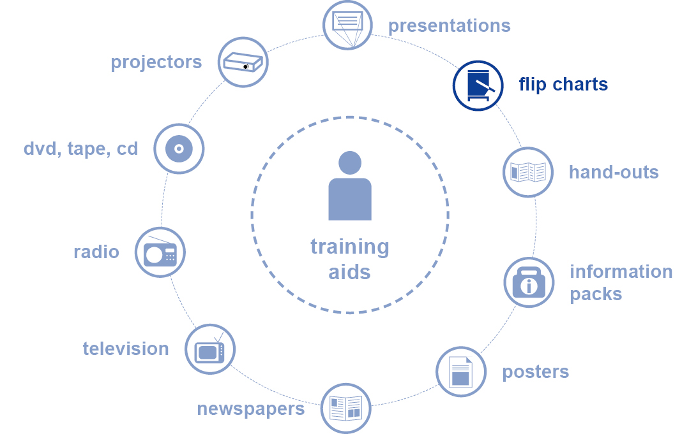
Objective 2 The different types of training aids
Flip charts key points:
Useful for training techniques.
Reinforces group contribution
Useful to record information
Useful when electricity is
unavailable

Slide 31
Objective 2 The different types of training aids
Tips for using a flip chart:
Use 25-40mm high lettering
Use distinctive titles
Use different coloured pens
Draw diagrams in advance
Stand sideways

Slide 32
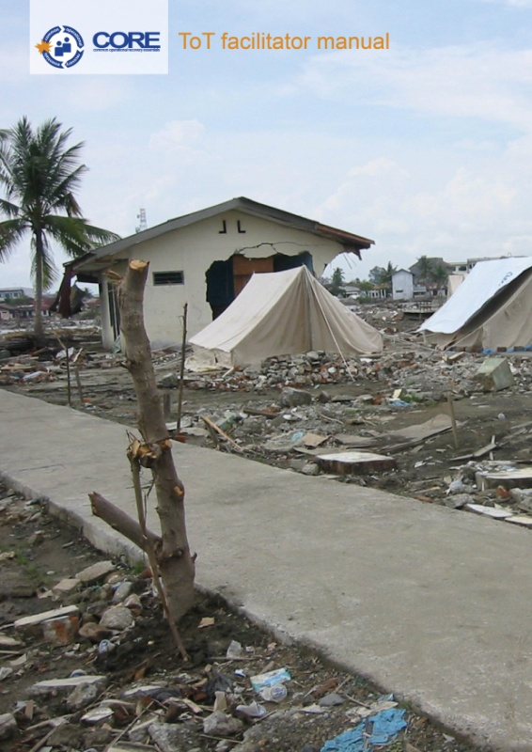
Objective 2 The different types of training aids
Hand-outs
We have developed a CORE standard participant manual

Slide 33
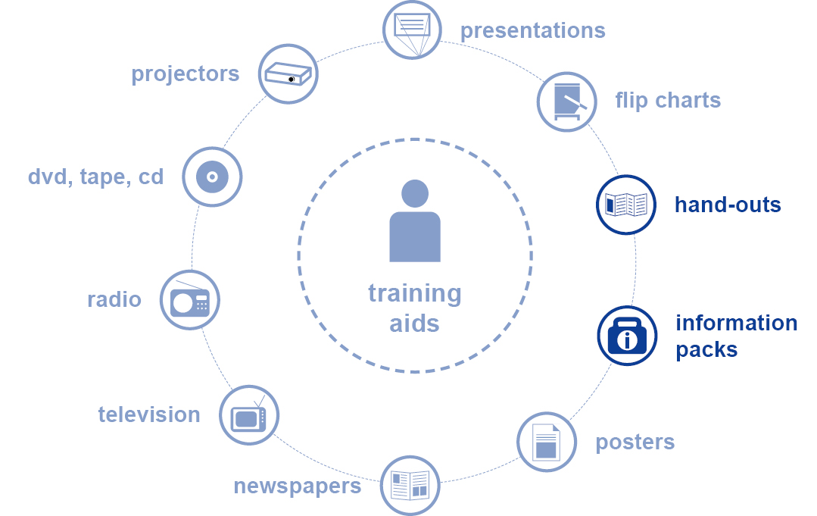
Objective 2 The different types of training aids
Tips for using hand-outs:
Refer to hand-outs during training
Use to expand on key points
Leave space for notes
Use images

Slide 34
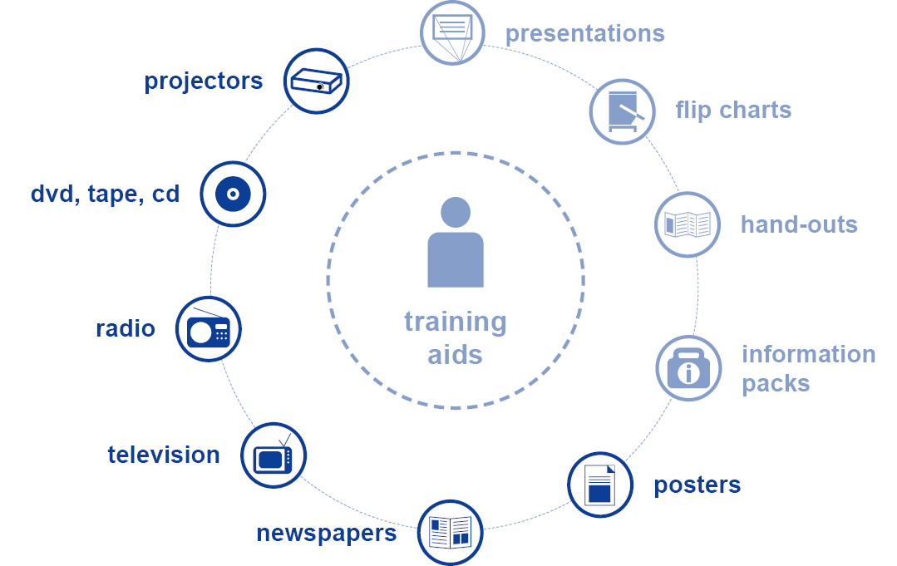
Other media:
Objective 2 The different types of training aids
Overhead projectors
DVD, tapes, CD
Newspapers
Radio, television
Posters

Slide 35
Objective 2 The different types of training aids
Physical visual aids to enhance teaching point
For example:
Get people to wear hard hats when talking about construction
Hold a mirror when asking participants to reflect back their thoughts

Slide 36
Objective 3 Selecting the appropriate training aids
Presentation
Power point, hand-outs, flip charts
Exercise
Hand-outs, flip-charts, video, news paper clippings
Group Work
Flip-charts,
Case studies
power-point, newspaper clipping, video, hand-outs etc

Slide 37
Discussion in groups
In groups, complete the following exercises
Exercise 1 Based on your experiences, put together a 2 minute presentation
Present to the group creatively, using a number of training aids.
Be as creative as you like!!

Slide 38
Any questions?
Share your experiences
Do you have any comments or experiences you would like to share?
Do you have any questions?
Any
questions
15 Minutes

Slide 39
Further reading
Adult Learning Mechanisms
Cegos, 2007
Delivering great training,
Bryan Hopkins 2008
Designing Participatory Workshops
UNHCR 2008
How to organize and run learning workshops
UNICEF and UN staff college
Notes:
Notes in ITALICS are general training guidance
Facilitators can add notes below to assist training
Notes in BOLD are material references and sources
EC (30/03/10): from SC08b, Day 2 03, p.2 and 3
CM (26/04/10): changed objectives to make them shorter and more SMART

Slide 40
Lunch break
Please be back in time for
30 min
Back at
14:00
Notes:
Notes in ITALICS are general training guidance
Facilitators can add notes below to assist training
Notes in BOLD are material references and sources
EC (30/03/10): from SC08b, Day 2 03, p.2 and 3
CM (26/04/10): changed objectives to make them shorter and more SMART

Slide 41
Energiser session
Notes:
Notes in ITALICS are general training guidance
Facilitators can add notes below to assist training
Notes in BOLD are material references and sources
EC (30/03/10): from SC08b, Day 2 03, p.2 and 3
CM (26/04/10): changed objectives to make them shorter and more SMART

Slide 42
Training Evaluation
90
Minutes

Slide 43
Training evaluation
3
Notes:
Notes in ITALICS are general training guidance
Facilitators can add notes below to assist training
Notes in BOLD are material references and sources
EC (30/03/10): from SC08b, Day 2 03, p.2 and 3
CM (26/04/10): changed objectives to make them shorter and more SMART

Slide 44
4.4 Training evaluation
This session is the last in the series of training sciences. This session will cover how to evaluate training.
In this session you will
Learn about different evaluation techniques;
Evaluate what you have learnt within this series; and
Discuss CORE evaluation methods

Slide 45
By the end of this session, you will have an understanding of:
Objective 1 Reviewing learning
Objective 2 Evaluating CORE training
Objective 3 The Kirkpatrick model

Slide 46
Objective 1 Reviewing learning
Why is it important to review learning?
“Without review, most information will be lost from memory.
The best time to review materials is within a day or two after the material has been read or presented in lecture.”
http://www.bucks.edu/~specpop/memory.htm

Slide 47
Objective 1 Reviewing learning
During daily feedback and summary, you should review learning
During sessions, use a number of learning techniques such as quizzing and Margolis wheel in order to check participants progress
Invite participants to share their own experiences and case studies

Slide 48
Use a number of learning techniques when reviewing learning

Slide 49
Objective 2 Evaluating CORE training
Daily feedback and summary sessions
Get participants to register on coreasia.org
Show participants how to upload their resources, and encourage them to do so
Show participants how to use the feedback form, and get them to fill it out during the session
Invite participants to share other websites, resources and literature that they use
www.coreasia.org

Slide 50
Hubasia.org exercise
In pairs, complete the following exercise
Task 1 Teach each other how to access and use coreasia.org
Task 2 Show each other how to access the online feedback forms
Discuss in pairs
15
Minutes

Slide 51
Objective 2 Evaluating CORE training
The Kirkpatrick model splits training evaluation into 4 steps
Training evaluation is the process of finding out how effective CORE training is
It enables you to see if CORE sessions, techniques and styles are effective methods; and
It enables you to check whether CORE goals and objectives are being met

Slide 52
Objective 3 The Kirkpatrick model
Four basic Protection Principles
Step 1 Did participants enjoy the training?
Step 2 Did they learn anything?
Step 3 Do they now do things differently?
Step 4 Has it made an overall impact?

Slide 53
Objective 3 The Kirkpatrick model
Step 1 Did participants enjoy the training?
Training is more effective when participants are enjoying themselves
Leave a mood board up so that at the end of each session, participants can place a sticker at the relevant point
Ask participants to fill out feedback forms every day during “daily summary and feedback”

Slide 54
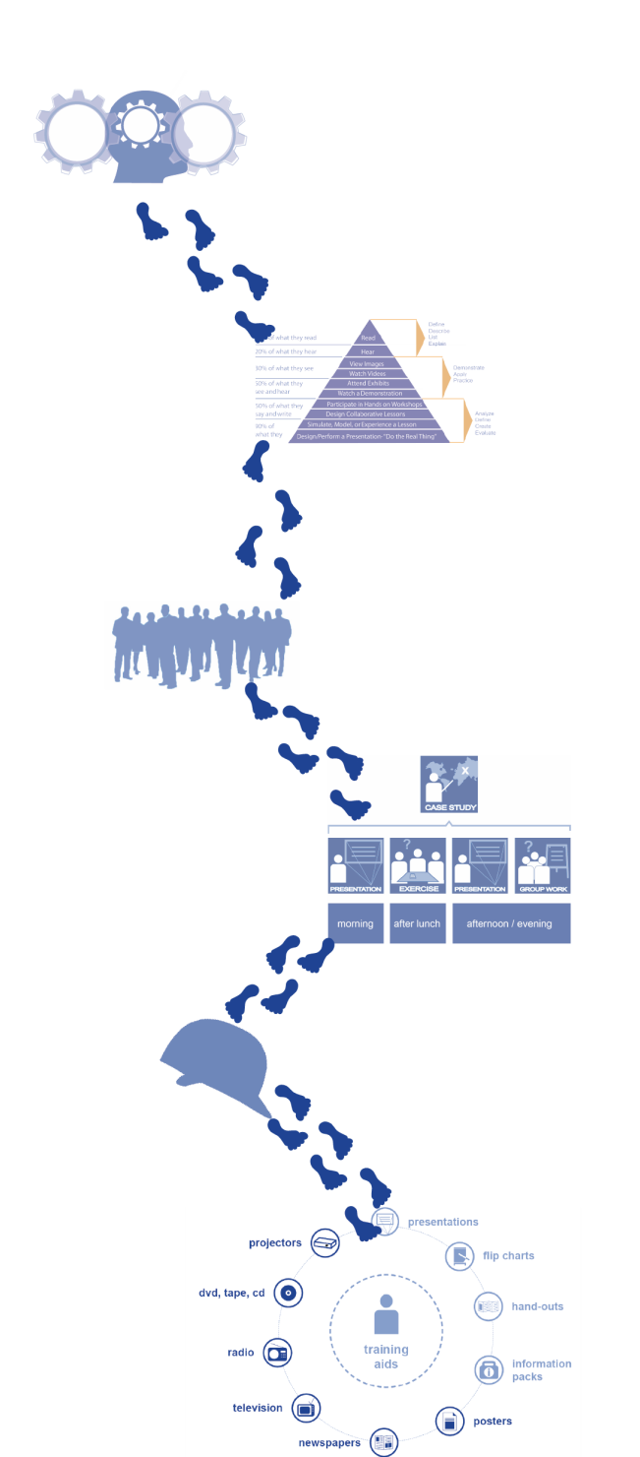
Objective 3 The Kirkpatrick model
Step 2 Did they learn anything?
The Map Method
Split participants into groups
Ask groups to draw a map of their journey without using words
Ask them to present and explain their map to the rest of the group

Slide 55
Objective 3 The Kirkpatrick model
Step 3 Do they do things differently?
Encourage participants to stay in touch using hubasia.org
Encourage them to actively use hubasia
as a resource within their work
Hubasia will be able to track the progress of each user

Slide 56
Objective 3 The Kirkpatrick model
Step 4 Did CORE make an overall impact?
This will be evaluated over a number of years
It is based upon the CORE objectives, and whether these have been achieved.
hubworld.org is a tool that will allow us to track this overall progress

Slide 57
Discussion in groups
Write down key points
Question 1 What training evaluation methods do you know of?
Question 2 Do you agree with the questions on the feedback forms? Do you have any suggestions?
Question 3 What other tools can we use to evaluate CORE training in the long term, ensuring that it is sustainably meeting it’s objectives?
Discussion in groups
30 Minutes

Slide 58
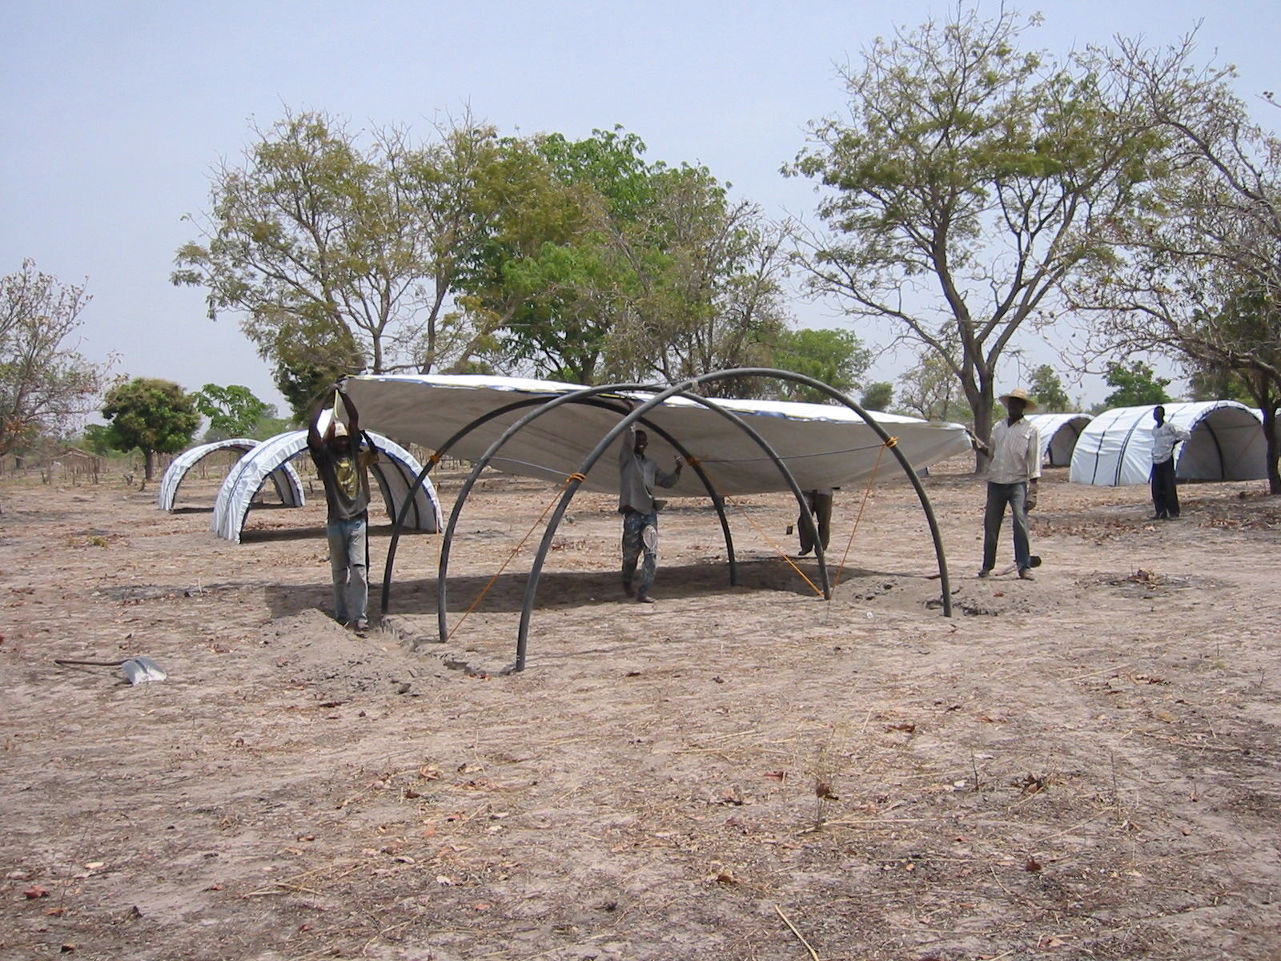
Reviewing/
Evaluation skills are essential in emergency response

Slide 59
Any questions?
Share your experiences
Do you have any comments or experiences you would like to share?
Do you have any questions?
Any
questions
15 Minutes

Slide 60
Further reading
Adult Learning Mechanisms
Cegos, 2007
Delivering great training,
Bryan Hopkins, 2008
Designing Participatory Workshops
UNHCR, 2008
How to organize and run learning workshops
UNICEF and UN staff college
Notes:
Notes in ITALICS are general training guidance
Facilitators can add notes below to assist training
Notes in BOLD are material references and sources
EC (30/03/10): from SC08b, Day 2 03, p.2 and 3
CM (26/04/10): changed objectives to make them shorter and more SMART

Slide 61
Coffee break
Please be back in time for
30 min
Back at
16:00
Notes:
Notes in ITALICS are general training guidance
Facilitators can add notes below to assist training
Notes in BOLD are material references and sources
EC (30/03/10): from SC08b, Day 2 03, p.2 and 3
CM (26/04/10): changed objectives to make them shorter and more SMART

Slide 62
Preparation for mini sessions with mentors
90
Minutes

Slide 63
Preparation for mini-sessions
4
Notes:
Notes in ITALICS are general training guidance
Facilitators can add notes below to assist training
Notes in BOLD are material references and sources
EC (30/03/10): from SC08b, Day 2 03, p.2 and 3
CM (26/04/10): changed objectives to make them shorter and more SMART

Slide 64
Prepare with help from mentor
Presentations for delivery in S2.5 and S3.1
Sessions will be video recorded

Slide 65
Afternoon break
Please be back in time for
90 min
Back at
19:00
Notes:
Notes in ITALICS are general training guidance
Facilitators can add notes below to assist training
Notes in BOLD are material references and sources
EC (30/03/10): from SC08b, Day 2 03, p.2 and 3
CM (26/04/10): changed objectives to make them shorter and more SMART

Slide 66
Mini sessions by participants
90
Minutes

Slide 67
Mini-sessions by participants
5
Notes:
Notes in ITALICS are general training guidance
Facilitators can add notes below to assist training
Notes in BOLD are material references and sources
EC (30/03/10): from SC08b, Day 2 03, p.2 and 3
CM (26/04/10): changed objectives to make them shorter and more SMART

Slide 68
Present
Answer questions
Sessions will be video recorded

Slide 69
Thank you Don’t forget to fill in your feedback form
Notes:
Notes in ITALICS are general training guidance
Facilitators can add notes below to assist training
Notes in BOLD are material references and sources
EC (30/03/10): from SC08b, Day 2 03, p.2 and 3
CM (26/04/10): changed objectives to make them shorter and more SMART

