Slide 1
Neighborhood - Based Response to Urban Disaster
Ravin Pintade, Haiti
Sohini Sarkar
On behalf of Global Communities/CHF International

Slide 2
Why Urban Disasters ? “Because it’s there” – George Mallory, 1924
Rapid Urbanization - By 2050, more than two thirds of the global population will live in cities with megacities absorbing most of this growth
Africa and Asia would lead the urban growth over the next four decades
Rapid Urbanization of Poverty –889 million by 2020
60 % of all mega cities are located in areas that are at risk for at least one major type of natural disaster, such as earthquakes, floods, landslides or droughts
Notes:
By 2050, some 9.3 billion people would inhabit the planet, more than two thirds of them in urban areas. Africa and Asia would lead urban population growth over the next four decades - 4.5 billion urban residents by 2050
http://esa.un.org/unup/pdf/FINAL-FINAL_REPORT%20WUP2011_Annextables_01Aug2012_Final.pdf

Slide 3
Shelter and Settlement (S&S)Responses in the Urban Context
Complexity of the urban context – S&S responses have to contend with high density, contestation over land use, high value land, infrastructure etc.
In developing/ transitional contexts - Weak policy and regulatory frameworks, weak enforcement/governance strains the system following disasters
Capacity gap in the Humanitarian Sector
Tools, approaches, lack of coordination between implementing entities, donors etc.
Notes:
http://www.eshelter-cccmhaiti.info/jl/images/pdf/final_dtm_v2_report_aug_2012_english.pdf
- In August 2012, approximately 369,000 disaster-affected Haitians (or 94,000 households) remained displaced in 541 sites for the IDPs with poor shelters, limited access to basic services, and exposed to hazards
In developing/ transitional contexts - Weak policy and regulatory frameworks, weak enforcement/governance that shapes housing supply for the urban poor in regular times gets even more strained during disasters

Slide 4
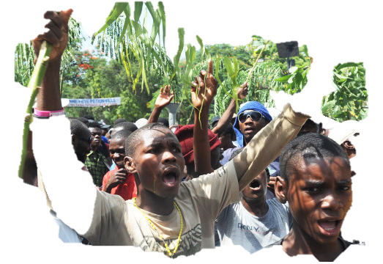
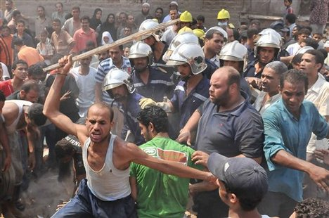
S&S Responses in the Urban Context
National/local governance response is critical
Lack of disaster response capacity at the national and local level
Urban Divide - Residents vs. Citizens
Disproportionate impact of urban disasters on the urban poor
Photo courtesy: Ripley.za.net
Photo courtesy: Ripley.za.net
Photo Courtesy:Mphammad Ahmed/AP
Notes:
Thousands of slum dwellers displaced by the 6 September rockslide at Dweiqa and Ezbat Bekhiet face an uncertain fate as they camp out on the streets of Cairo's oldest slum, Manshiet Nasser. Between 30 and 50 homes collapsed, and up to 250 people have died. The Association for the Development and Emancipation of Women (ADEW), an NGO working in Manshiet Nasser, has put the number of missing at 500. ‬‪However, the head of the emergency unit of the Ministry of Health and Housing, Muhammad Sultan, has said that according to the official count, 75 people died and 58 were injured. ‪The governor of Cairo, Abdel Azim Wazir, said on 12 September that 2,000 apartments would be given to the Dweiqa survivors. ‪Residents of Dweiqa and Ezbet Bekhiet remain unconvinced, however. ‬

Slide 5
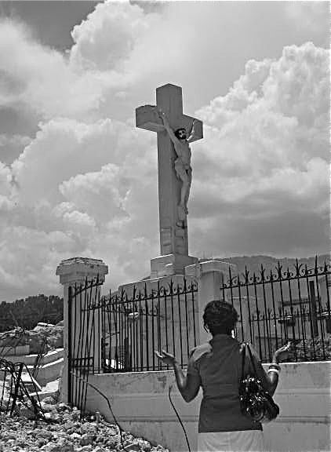
Context: Post-earthquake Haiti
Poorest country in the hemisphere
In PAP, 80% of population do not officially own land In PAP slums, 11 sq. m. for 6 people
Limited institutional capacities
High vulnerability to flooding, landslides, hurricanes, and, now earthquakes
Notes:
Poorest country in the hemisphere, about 149th of 182 countries listed in the UN's Human Development Index, just below PNG
80% unemployed or underemployed; 60% below the poverty line, making less than $2/day per capita
They lease, rent, squat, share accommodations!

Slide 6
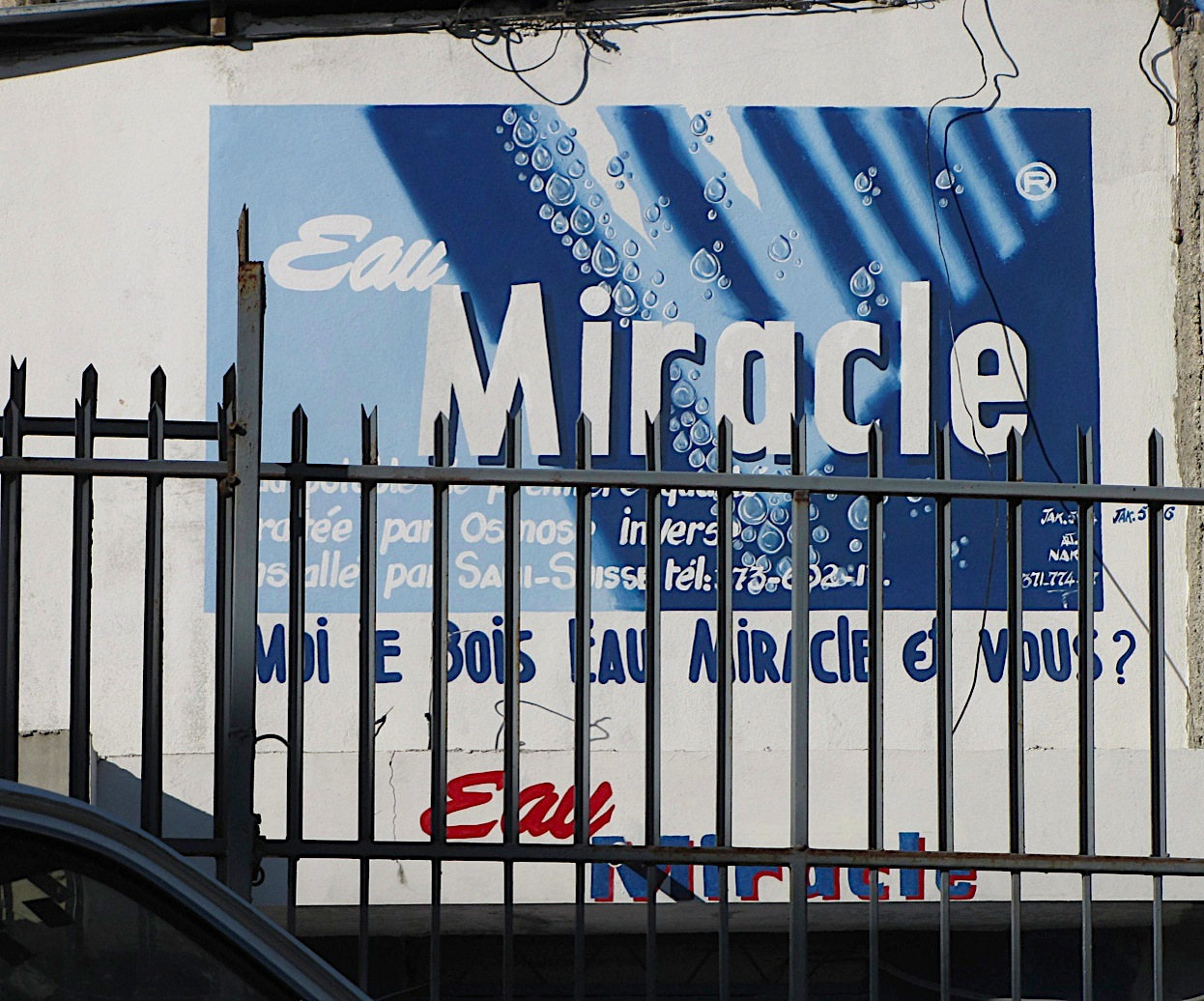
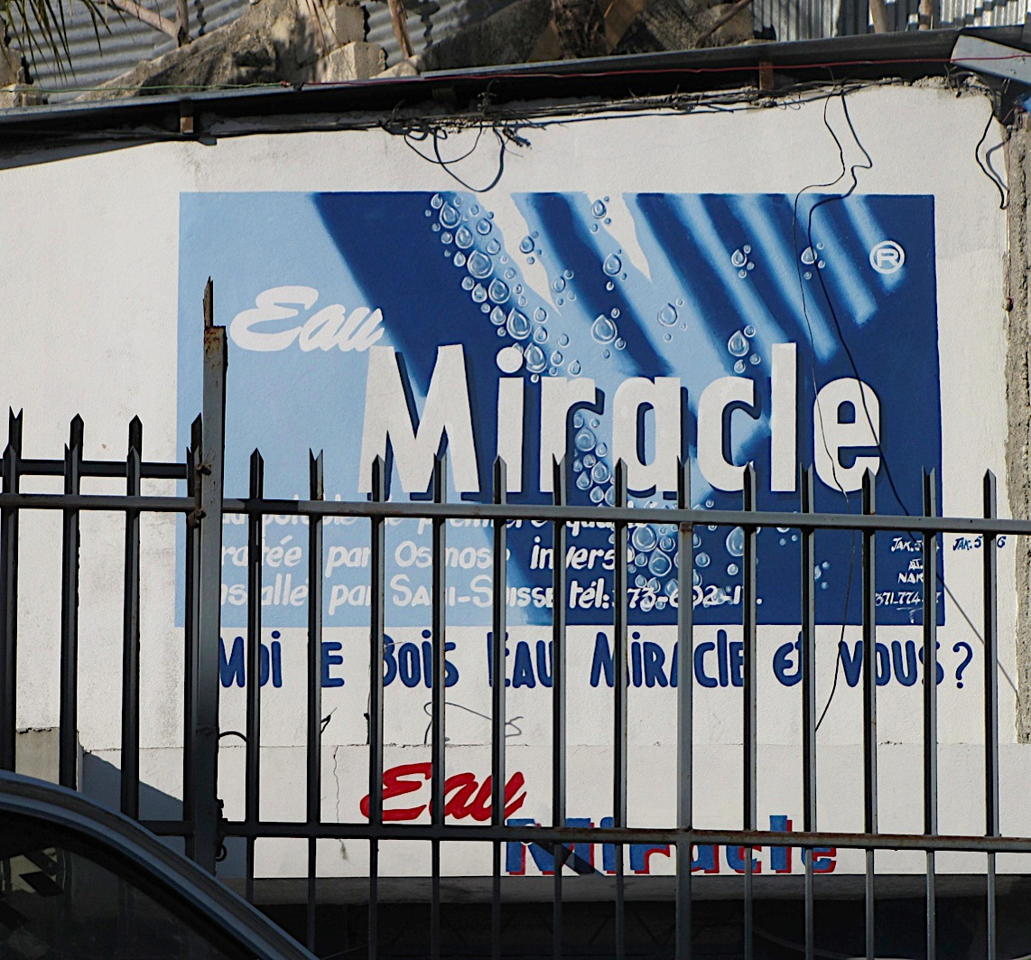
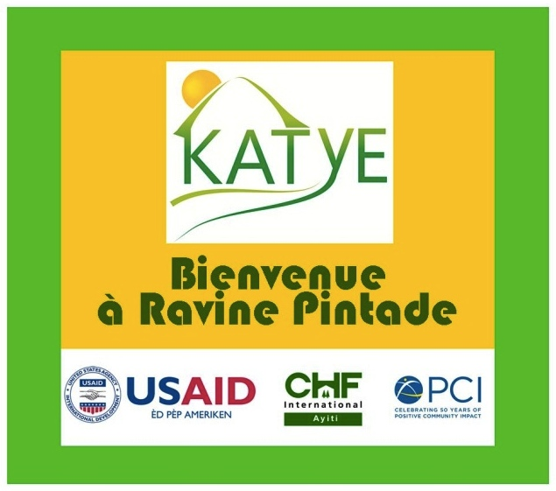
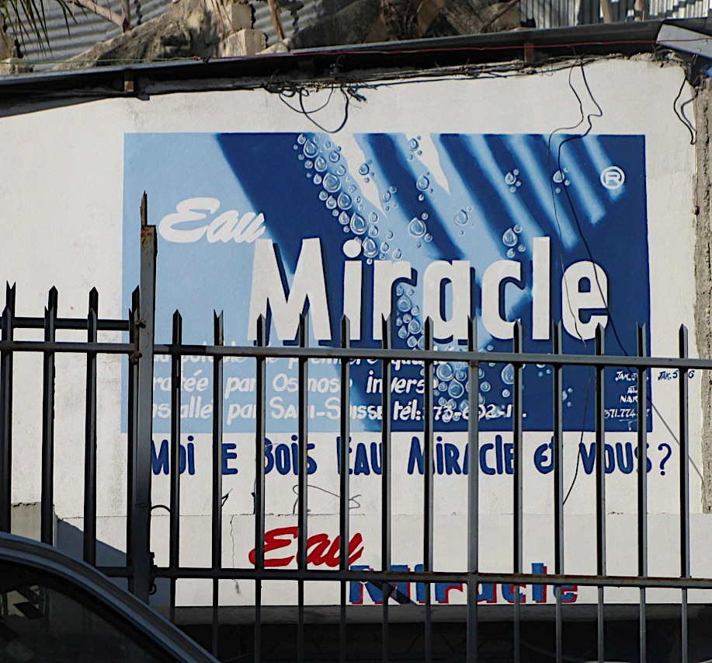
KATYE: Neighborhood Based Response to Urban Disaster

Slide 7
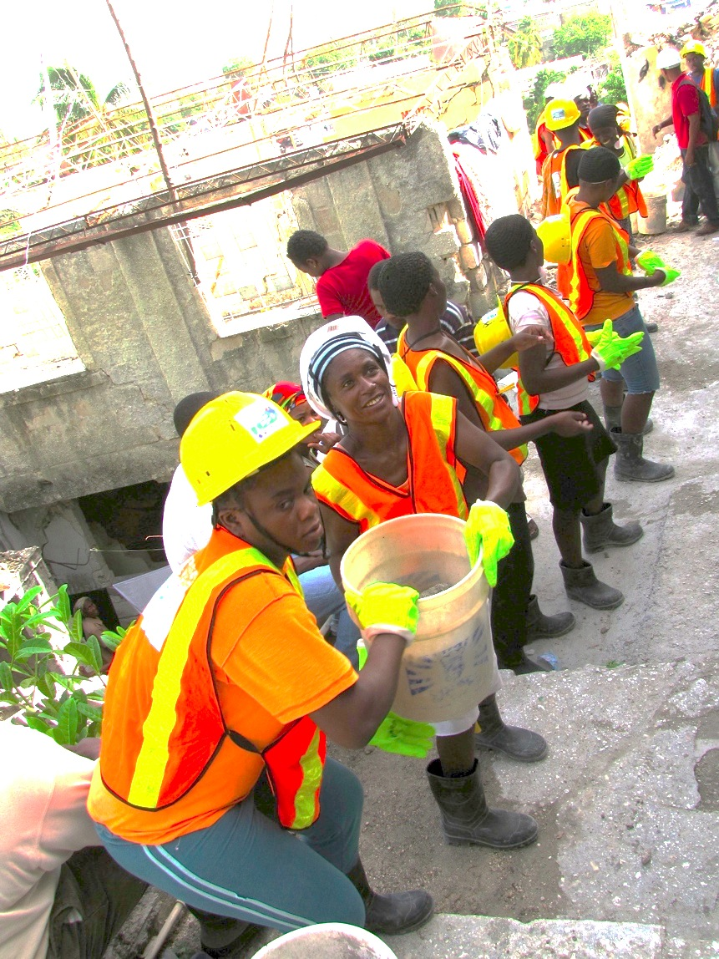
KATYE: Neighborhood-Based Recovery
17 month effort
Providing safe, habitable neighborhoods and creating the conditions for the upgrading of essential services
Total investment: nearly $9.7 million
OFDA allocated $8,644,193 (the rest came from partner contributions)
Partnership - CHF International (Global Communities) and Project Concern International (PCI)
Notes:
Community Livelihoods and Economic Assistance through Rubble Removal
and Shelter (CLEARS)
2. USAID/OTI, Cordaid (private European funds) PADF (USAID/OFDA) and Johnson & Johnson
3. OFDA support was critical to program flexibility, allowing CHF and PCI to modify implementation and identify additional opportunities to effectively invest the contract’s resources.

Slide 8
Pre-EQ Context: Ravine Pintade
Dense, vibrant urban community – developed informally over a period of more than 50 years
Important location: Center of Metropolitan Port-au-Prince
Halfway between Petion-Ville and Downtown
The zone is V- shaped, bisected by a ravine
KATYE Project Area - About 750 households on 16 steeply sloping acres on the north flank
Vulnerable to landslides and flooding
Vague and/or conflicting land tenure claims
Notes:
Bound by Rue Nord Alexis (west), Avenue Martin Luther King (east) and Avenue Poupelard (north), series of interconnected footpaths & small streets extending from Ave. Martin Luther King to Rue Nord Alexis along the top of the southern flank of the Ravine

Slide 9
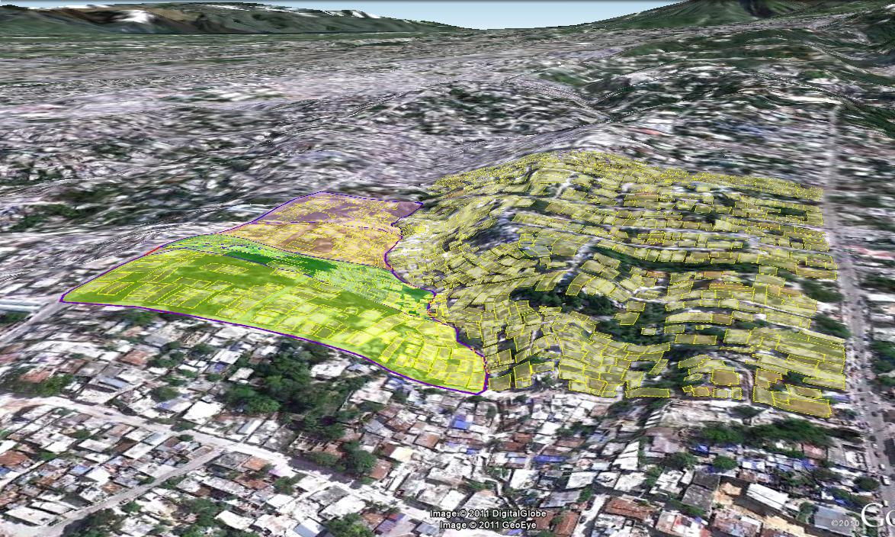
Ravine Pintade & the Surrounding Area

Slide 10
Pre-EQ Context: Ravine Pintade
Substantial economic activity - Restaurants, entertainment venues, hairdressers, repair shops, a silk screening operation, small-scale sewing, private schools, clinics and a vibrant market (south bank of the ravine)
About 69% of households - lived on less than US$5/day
“Relatively” stable and secured
Notes:
While UN called it a Red Zone- it was comparatively stable

Slide 11
Sources of Income: Pre and Post EQ

Slide 12
Pre-EQ Context: Ravine Pintade
Five sub-zones, divergent socio-economic profiles
Large landlords to whole families housed in sheds or tents
Inter-zone mistrust/conflict/rivalry
Ownership rights – vague /undocumented
Notes:
Robinson, Caravelle- Houblon, Corvington, Impasse 138/Poupelard and Ravine Pintade

Slide 13
Pre-EQ Context: Ravine Pintade
Multi-story/multi-family housing stock for a range of income levels
Apartments with kitchen and bath
One room units with no facilities
An existing and well-developed rental culture
Formal rentals of multi story apartments, rooms and houses
Informal rentals/share arrangement: floor space, sleeping privileges, etc
Notes:
The rental culture helped introduce the two-story transitional shelter design

Slide 14
Pre-EQ Context: Ravine Pintade
Poor and haphazard construction
Often on disaster prone and unstable lands
Minimal public infrastructure
Poor accessibility, mostly via narrow footpaths
Inadequate access to sanitation and water

Slide 15
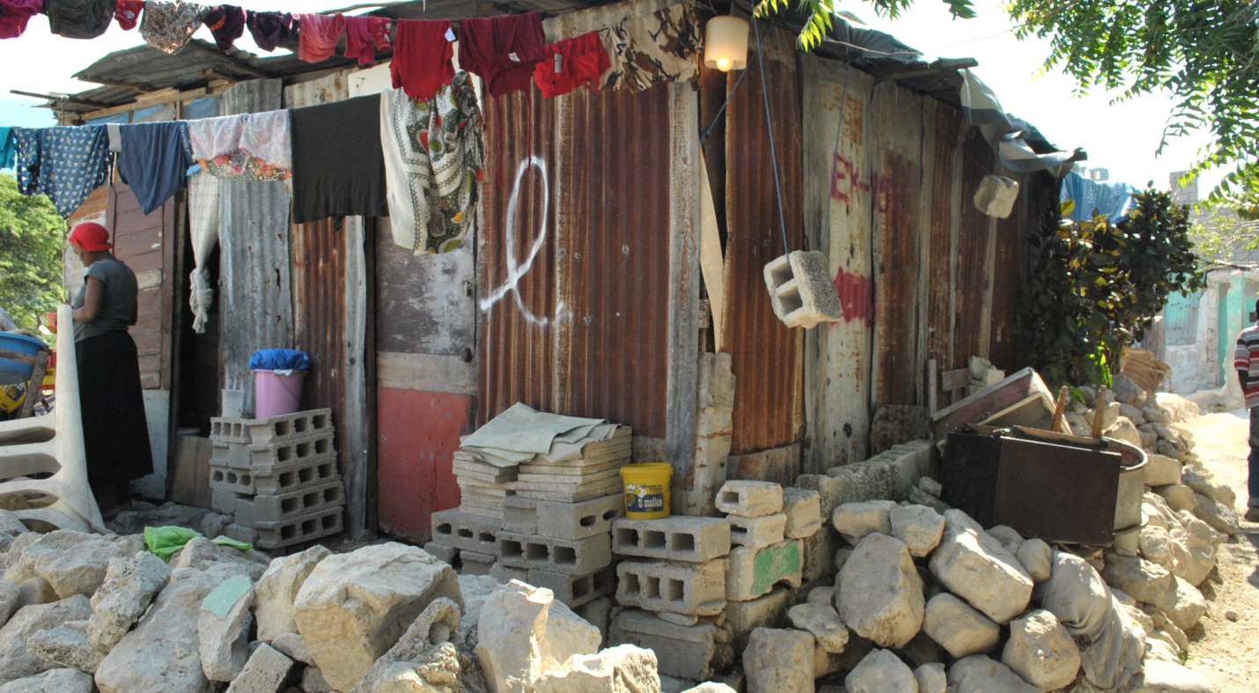
Ravine Pintade – Post EQ
Much of housing stock shattered; thousands homeless
Dangerously unstable structures
Loss of lives and livelihoods
Makeshift shelter
Post-EQ Ravine Pintade
Notes:
Population Drops
Deaths
Departure of informal renters and other recent arrivals
Even undamaged homes become unlivable
Stench of decaying bodies
Inaccessibility due to rubble
Dangers from surrounding structures
Water and sanitation Issues

Slide 16
Ravine Pintade – Post EQ
Few existing roads and paths blocked by rubble
People trapped and unable to escape to safety
Impeding relief and recovery
Social breakdown brings heightened risks of crime and violence
Health risks:
Destruction of inadequate WASH structures
Cholera epidemic

Slide 17
Notes:
Ravine Pintade has over 1,000 households in close to 800 structures. It was one of the worst hit neighborhoods with 70% of the housing structures damaged or destroyed and 10% of the population killed. Many were killed between buildings trying to escape due to lack of access roads.

Slide 18
KATYE: Building Blocks Place-based disaster response
Shelter and Settlements
Water, Sanitation and Hygiene (WASH)
Protection
Health
Cross-cutting – Community Mobilization AND Participatory Planning
Notes:
We will talk more about it in the later slides; But it is important to underscore the distinction between mobilization and participatory planning since there are often used interchangeably

Slide 19
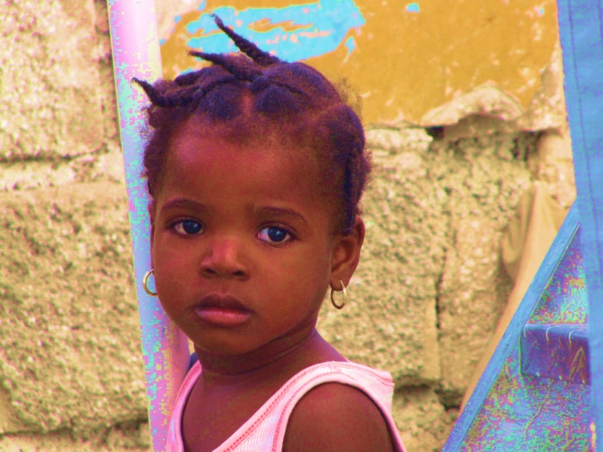
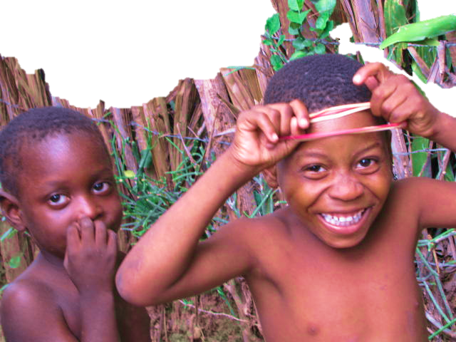
KATYE: Impact at a glance
Direct assistance to 1,984 families in and around the Ravine Pintade neighborhood
Repaired or constructed shelter for 620 households
Constructed 386 durable, transitional shelter units (TS), replacing all the units lost in the earthquake
Well planned neighborhood with infrastructure for reducing vulnerability to disasters

Slide 20
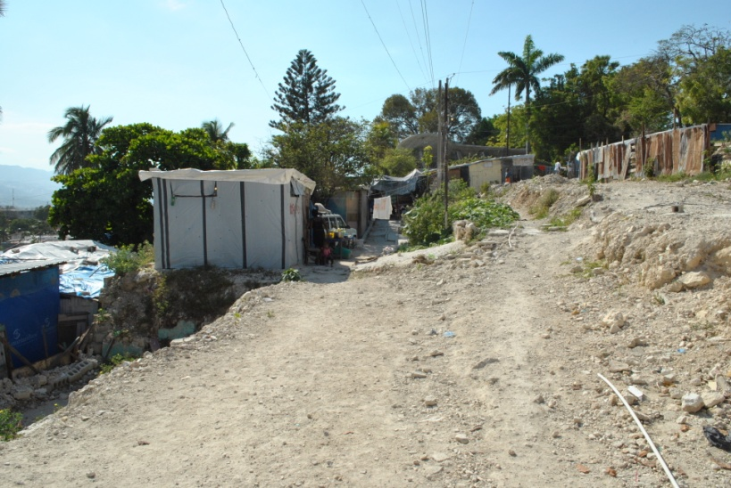
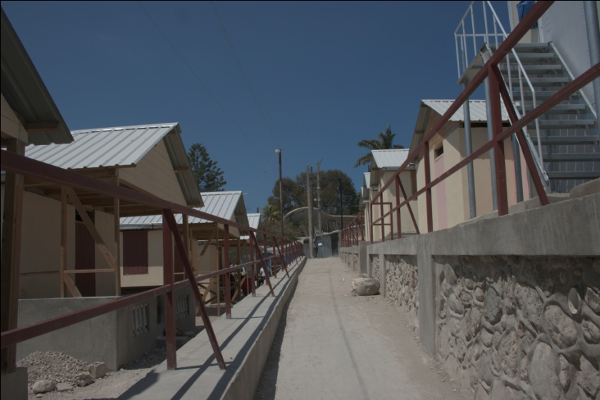
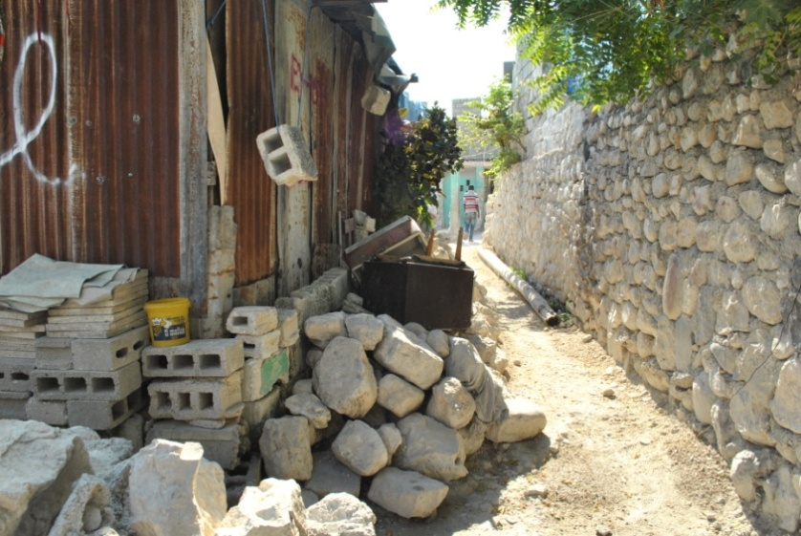
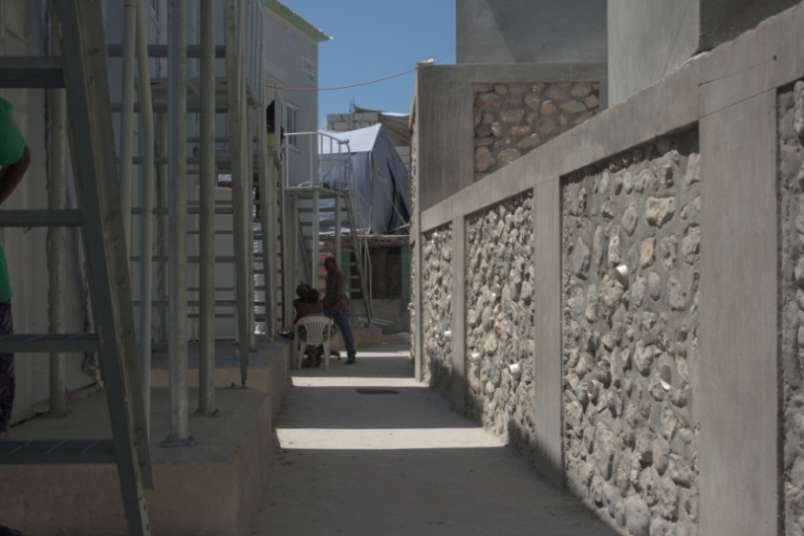
Before
After
Before
After

Slide 21
KATYE: Community Mobilization
Ensuring full buy-in on redevelopment plans including infrastructure, and DRR interventions
Notes:
Temporary shelters were needed for relocation of families while new shelters were built.

Slide 22
Community Mobilization (contd.)
Approaches to mobilization:
Enumeration process, to develop consensus on: Status of occupancy, Tenure, Family condition, Workable plans for temporary shelters
Capacity building and empowerment for existing community organizations
Capacity building in safe construction, health and protection
Outreach to surrounding areas
Institutional framework - site-wide and zonal committees comprising existing organizations and informal leaders
Notes:
Outreach to Surrounding Areas – Recognizing the potential for problems and threats by
residents of communities outside Ravine Pintade whose issues the program could not
address, KATYE carefully monitored the frustration level of surrounding areas and planned
deliberate outreach. These efforts were largely successful in preserving the peaceful
conditions necessary for the project’s implementation.

Slide 24
Katye: Participatory Planning
Negotiating land use
Many homeowners agreed to cede small portions of land, or permitted land boundaries to be redrawn to accommodate infrastructure, public spaces and facilities
Agreement on construction of two-story shelters
Retaining walls to terrace steep land creating space for walkways and other infrastructure
Notes:
Neighbors cooperate to share two-story shelters

Slide 25
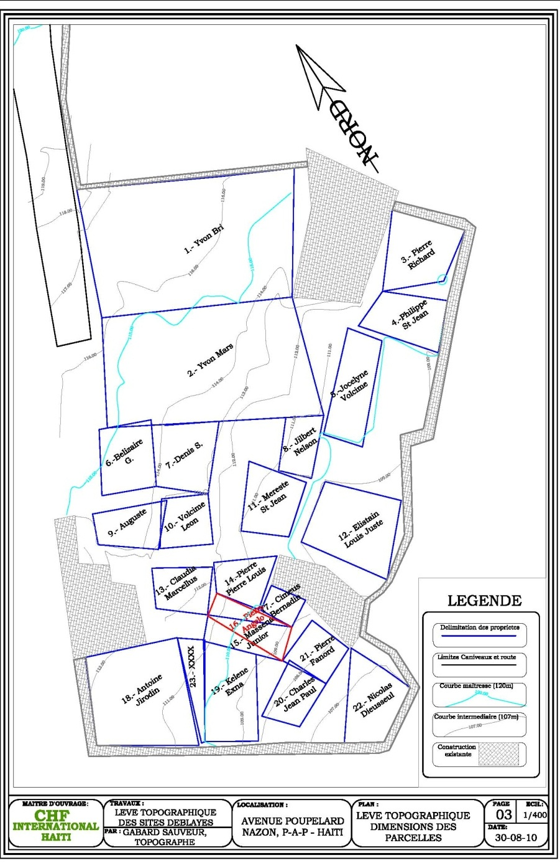
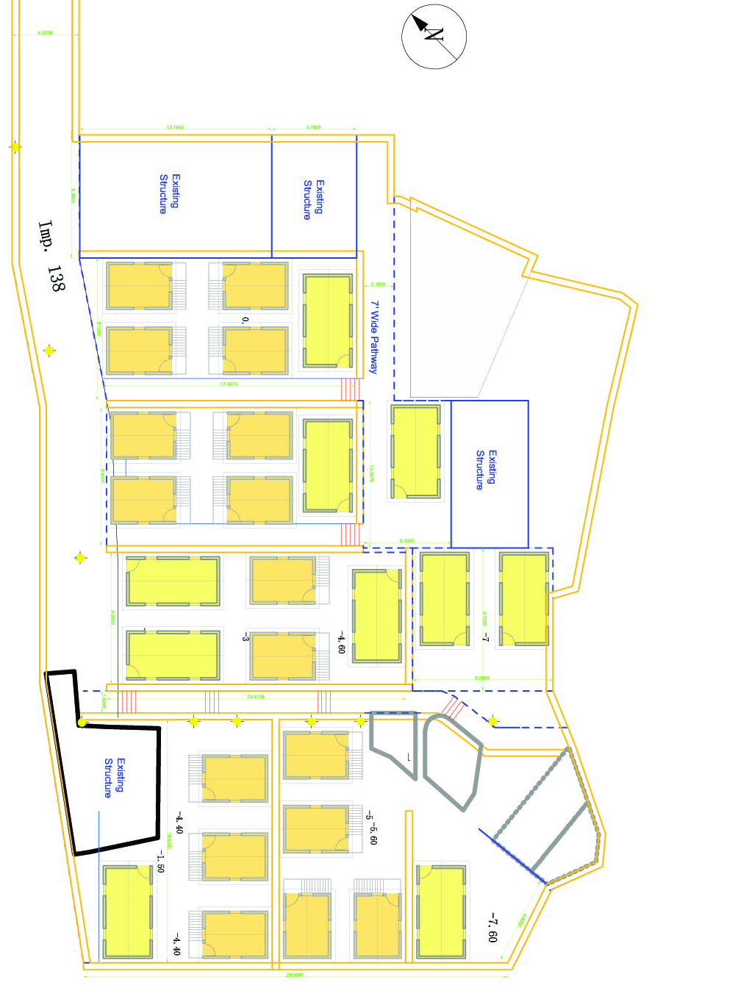
Notes:
We relied heavily on the community to map out their parcels or home sites. This was a feat in and of itself as only 3 of 32 buildings were standing. One lesson we learned quickly was how impossible the work would be without the community. We hired a local Haitian firm for the topographic survey and to map out each home site. It was a disaster. Neither the firm nor the KATYE team could differentiate between structures, dwelling units, parcels as so much damage had occurred, and identifying one pile of rubble between another was impossible.

Slide 26
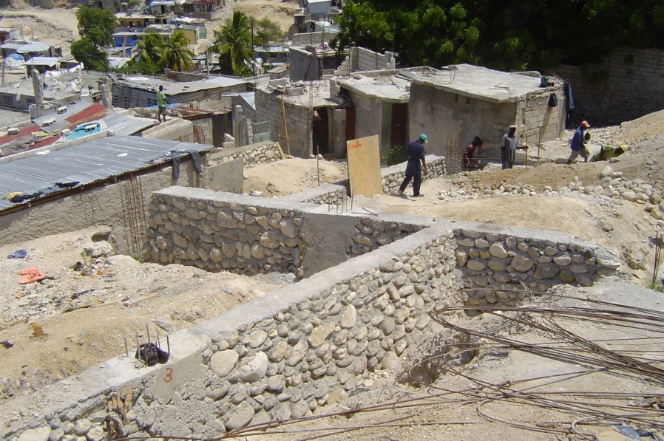
Role of Early and Visible Intervention
Accelerated community planning and recovery of the Impasse 138 neighborhood.
Notes:
This rapid startup produced early and visible progress that built people’s trust in the implementing partners and stimulated community engagement and mobilization.

Slide 27
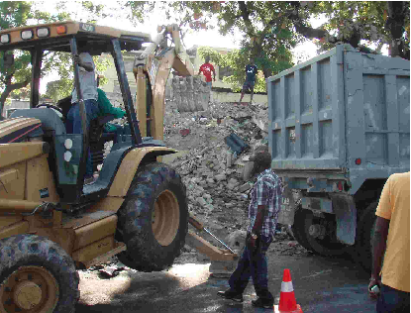
Katye: Key Features
Rubble removal
First priority on clearing roads and paths to create access
Clearing dangerous structures
Preparing sites for redevelopment

Slide 28
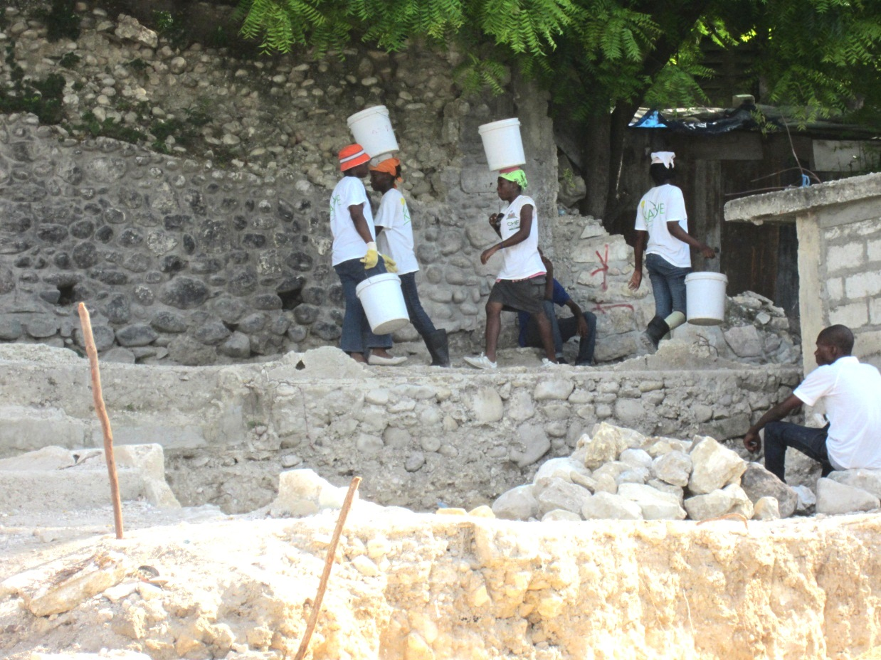
Katye: Key Features
Rapid Economic stimulus via Cash for Work
Efficient alternative to heavy equipment
Highly popular
Engages a broad swath of the community in the recovery process

Slide 29
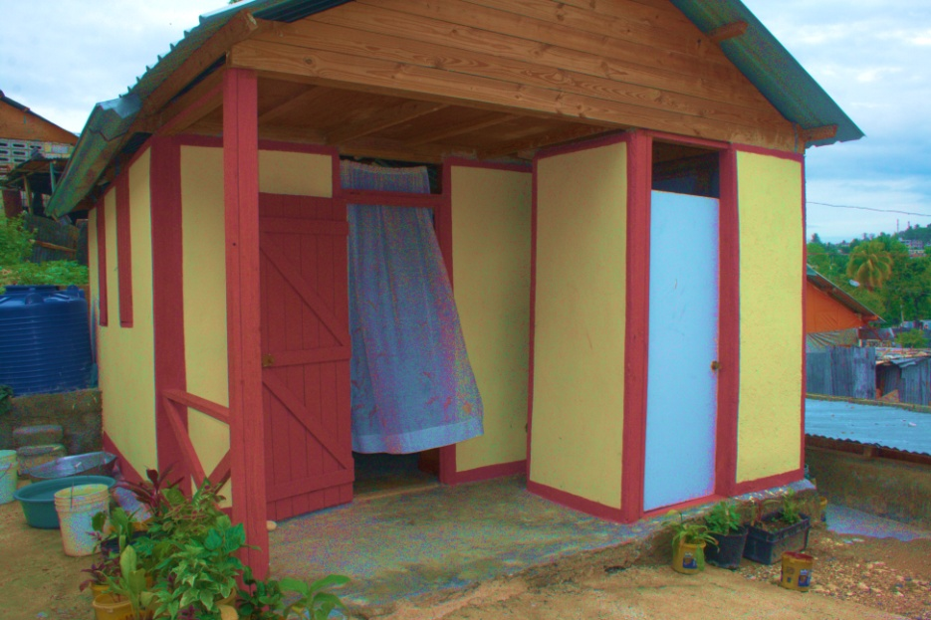
KATYE: Key Features
Transitional Shelters
Notes:
Designed to address the disproportionate impact of urban disasters on the urban poor living in densely packed urban spaces - slums/informal settlements, vulnerable land
Building Back Better - Using Vertical Density

Slide 30
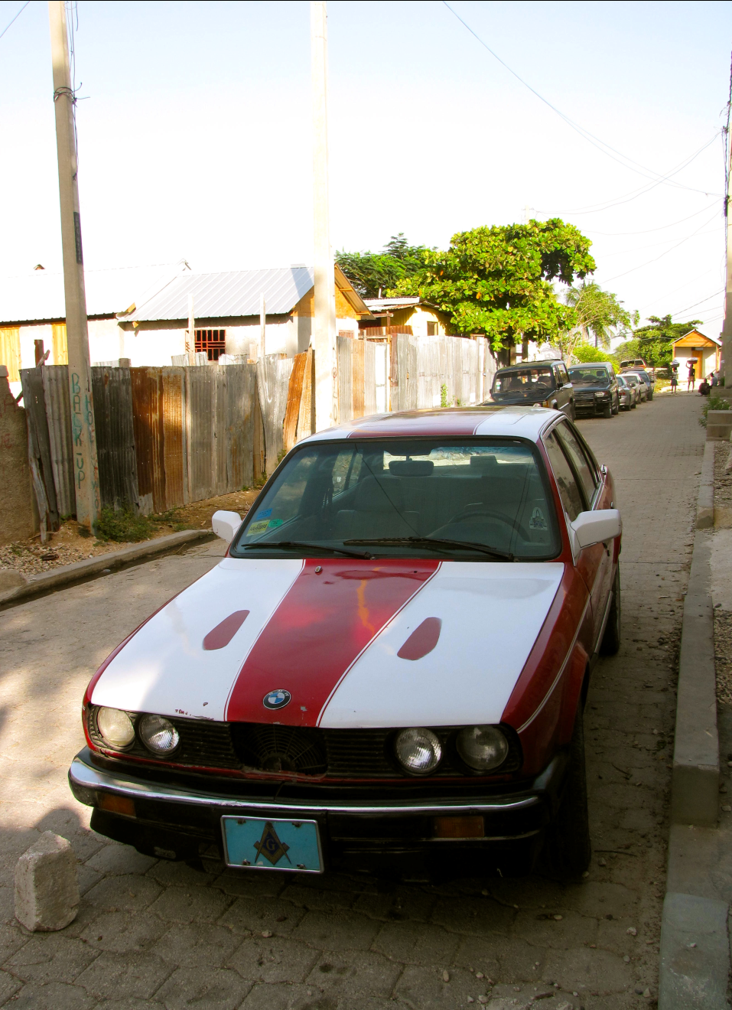
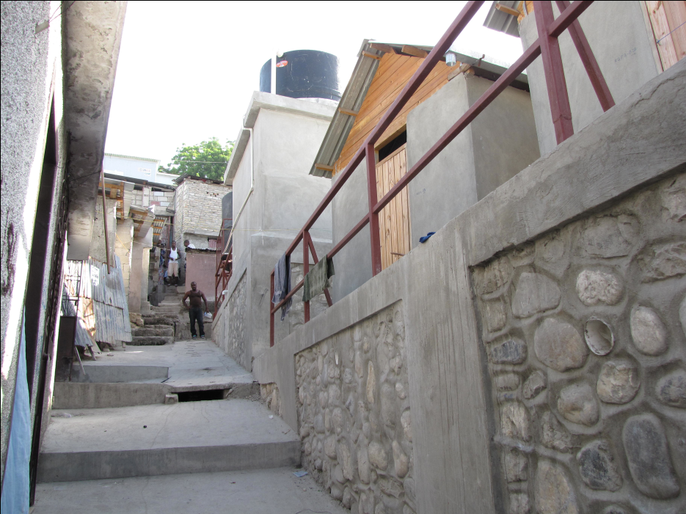
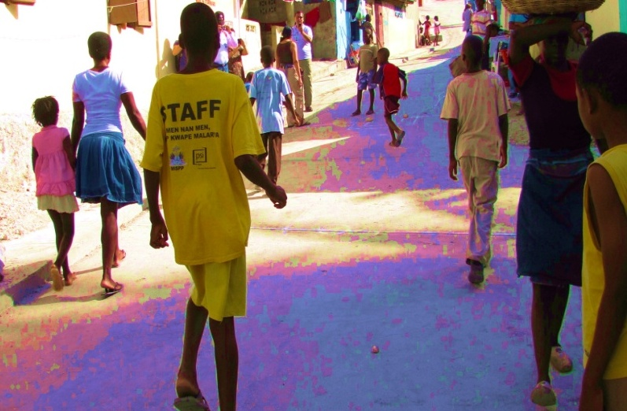
Katye Key Features: Retaining Walls, Public Spaces, Pathways,

Slide 31
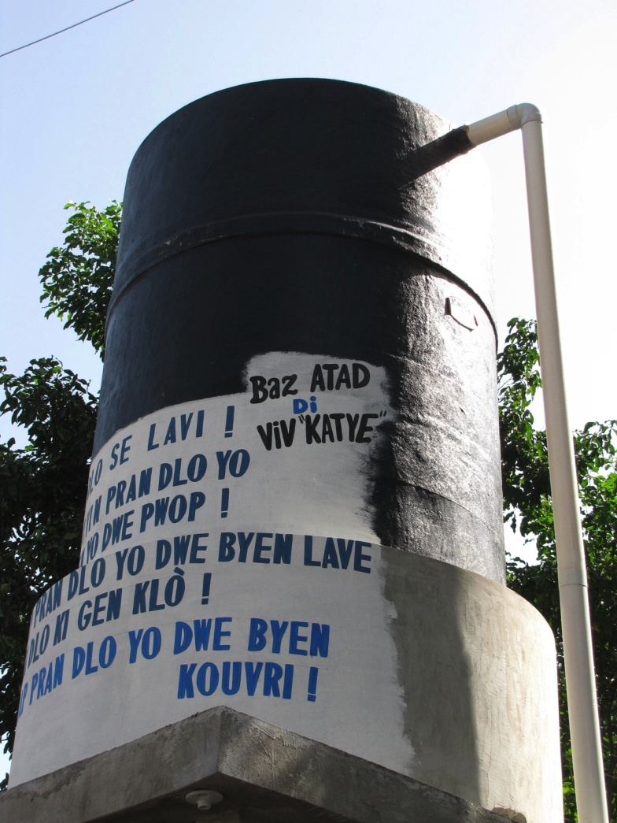
KATYE Key Features: Access to Cheaper and Better Water Distribution Points
Notes:
While CHF provided the hardware and physical improvements, PCI provided the necessary software. One example is the water point. The water point was built while PCI ensured a water committee would properly manage testing, treating and selling the water to the community. Similarly, latrines were built while the training on usage, maintenance was also equally important. Improved water quality, reducing the percent of households reliant on contaminated water from 37% to 1%Improved water quality, reducing the percent of households reliant on contaminated water from 37% to 1%

Slide 32
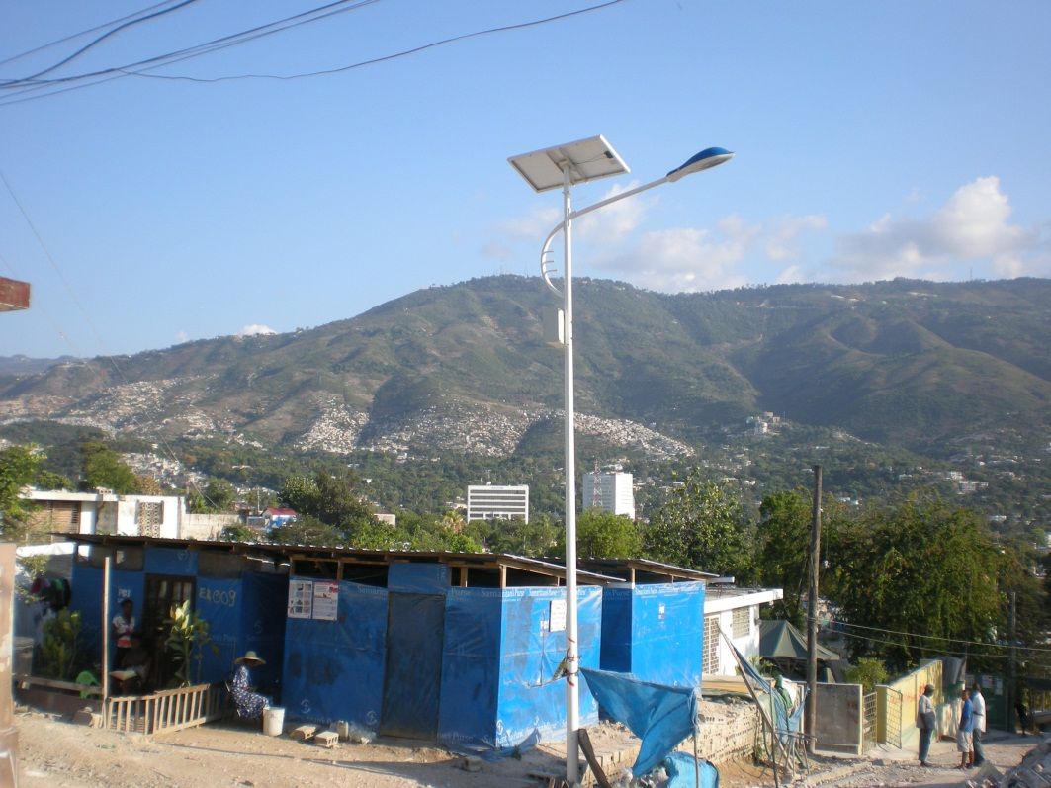
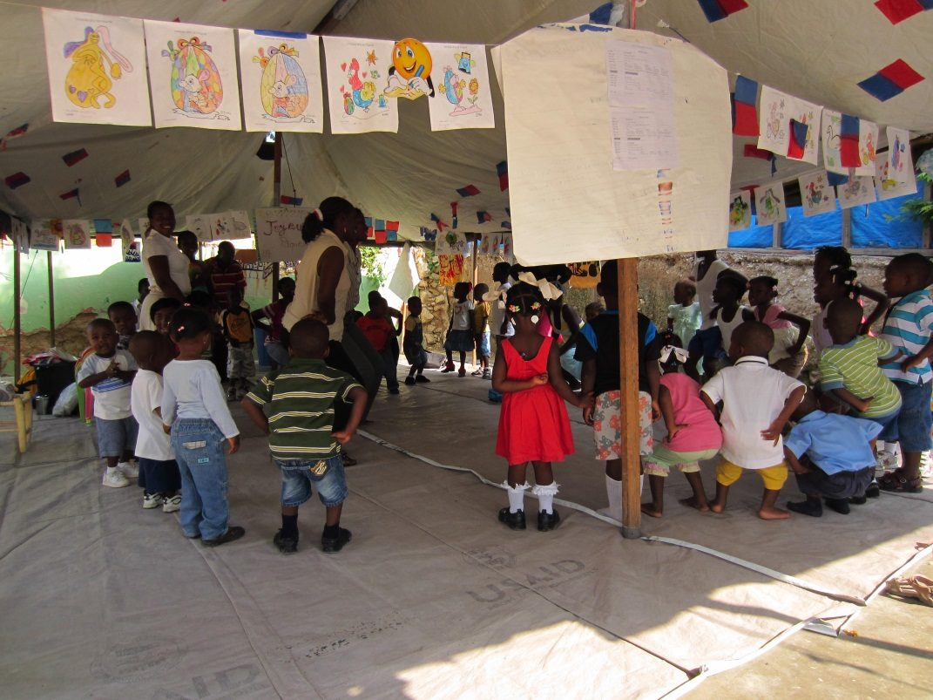
Katye: Key features
Health, Protection and other social interventions
Notes:
PCI Reintegrated children into the school system, with school enrollment rates increasing from 46% to 87%

Slide 33
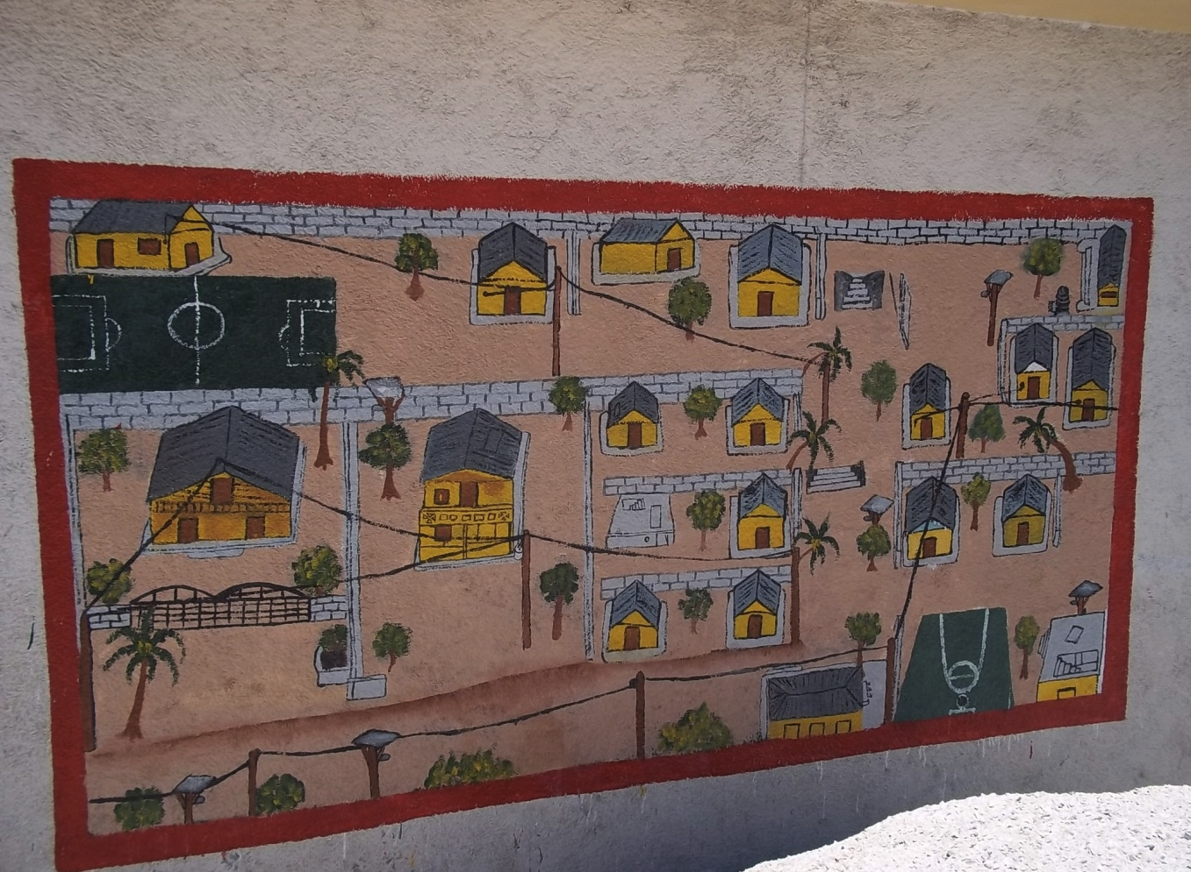
Outcome: A Stable Platform For Growth

Slide 34
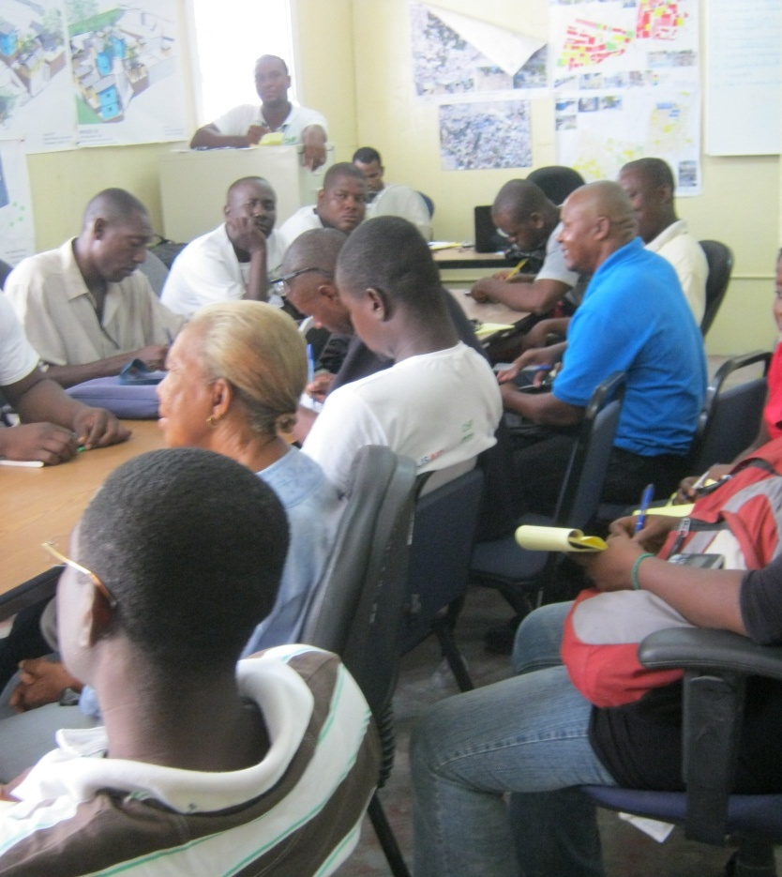
Progress Made
A better organized community
Notes:
Self – management/governance (e.g., water committees);
Better advocates vis-à-vis donor community and public authorities;
Community consensus on ownership/tenure
.

Slide 35
Community in Action

Slide 36
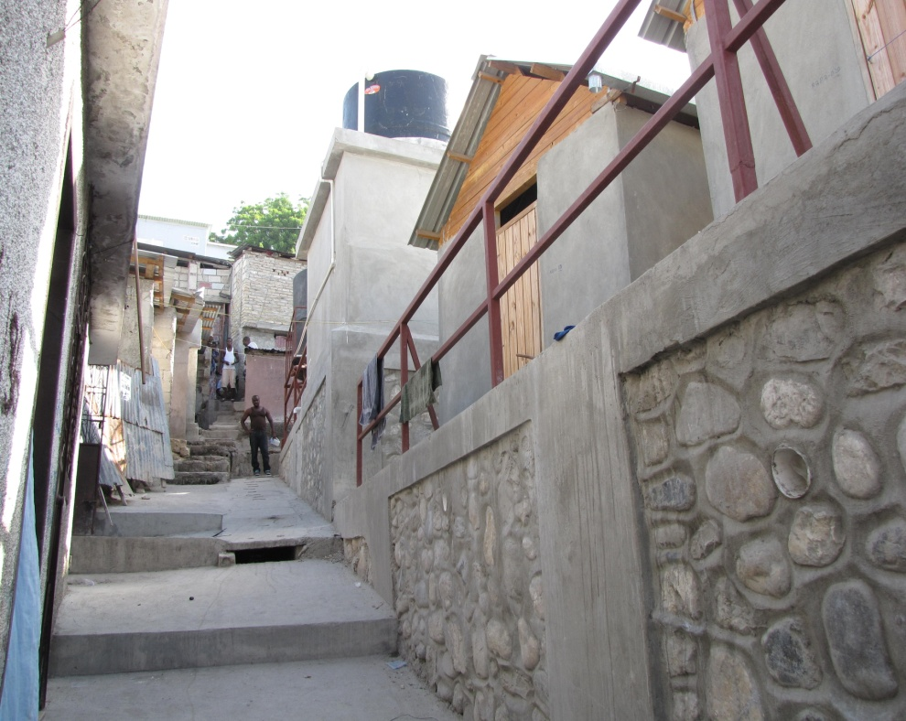
Progress Made
A giant pile of rubble — “bigger in volume than the Washington Monument” has been removed
The ravine’s slopes have been stabilized with 7,900 feet of retaining walls
Nearly 8,000 feet of buried pipe for draining rainwater
Notes:
Good

Slide 37
Economic revitalization and security
Two-story shelters have freed up space and set a precedent for planned land use
Economic activities and private investments on the rise
Community mobilization activities, T-shelters, street lamps, public space and roads have improved safety and security perception

Slide 38
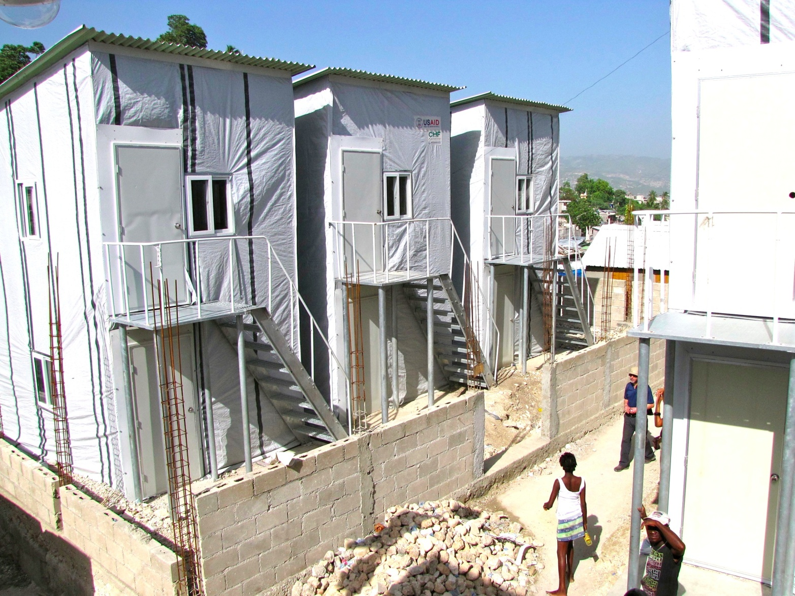
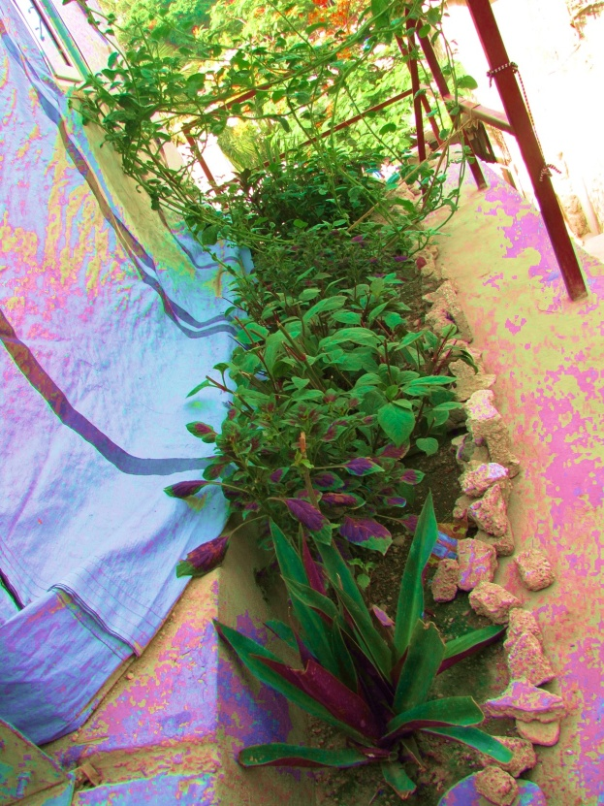
Private investments are being made to upgrade the T-shelters

Slide 39
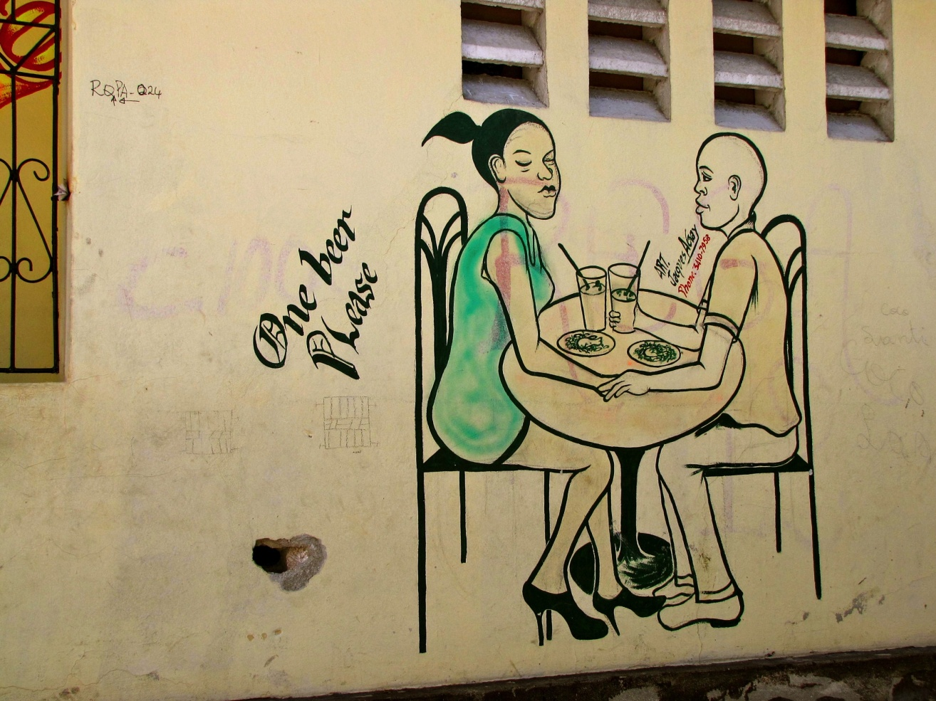
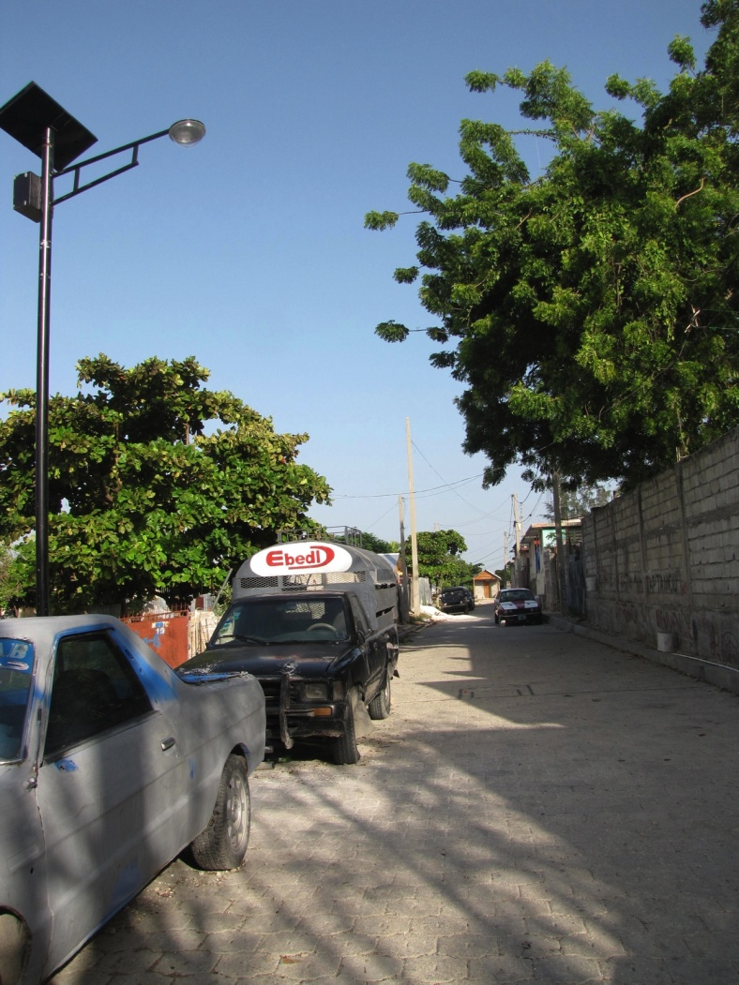

Slide 40
Ravine Pintade – Post EQ
Post-Katye population will likely exceed counts made soon after EQ
Enumeration estimates: 650 HH
Post-Katye forecast: 765*⁺ HH
Growth in rental housing market
*
Notes:
Including 75 2-Story Shelters
⁺Including 38 families doubling up in 2-Story Shelters and 100 families doubling up in solid structures
Growth in rental housing - Anecdotal evidence that families with houses have been taking in tenants from other areas/camps as livability improves Strong interest by property owners in receiving shelters for rental housing

Slide 41
Bumps on the Road to Recovery
Shifting topography due to unstable land, severe storms and ongoing recovery activities large to small
Inbound and outbound population flows in quake’s aftermath
External partners with different priorities
Weak local/national governance; lack of substantive participation by central or local authorities; inadequate planning and regulatory framework; inadequate disaster response capacity
Health/Protection/Social Interventions not easy to integrate
Contestation of interests
Lack of skilled personnel at the local level
Notes:
HR issues - Higher level computer aided design skills hard to find locally; Weak local governance eg - Near total lack of official statistics , cadastral information, etc.; contestation of interests eg - Sub-zones reluctant to collaborate toward overall site-wide goals
Rules of thumb, e.g. rubble volume per structure, individuals per household, etc. not applicable in chaotic post-EQ environment
Plus, Full land survey and enumeration of pre-Katye situation impossible
What is a family? Every family has a different definition
What is a structure? Is it one building or a warren of smaller structures
What is a parcel?

Slide 42
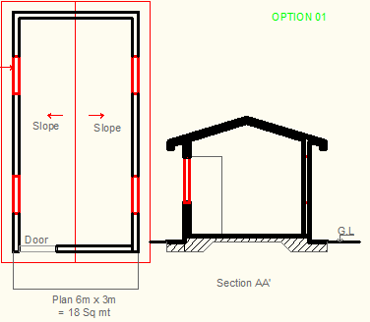
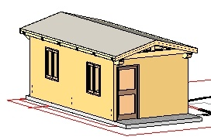
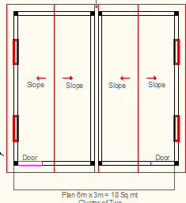
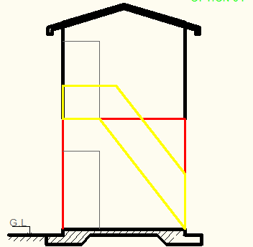
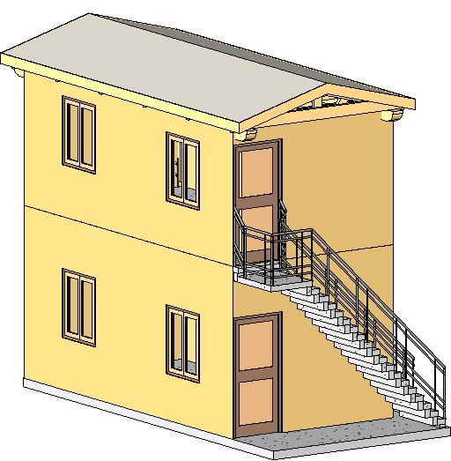
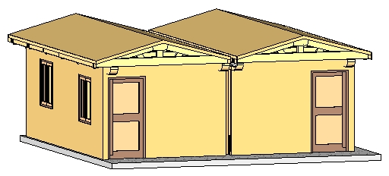
Bumps on the R2R: Limited Options
18 Sq meter
18 Sq meter Twin
24 Sq meter, 2 Story

Slide 43
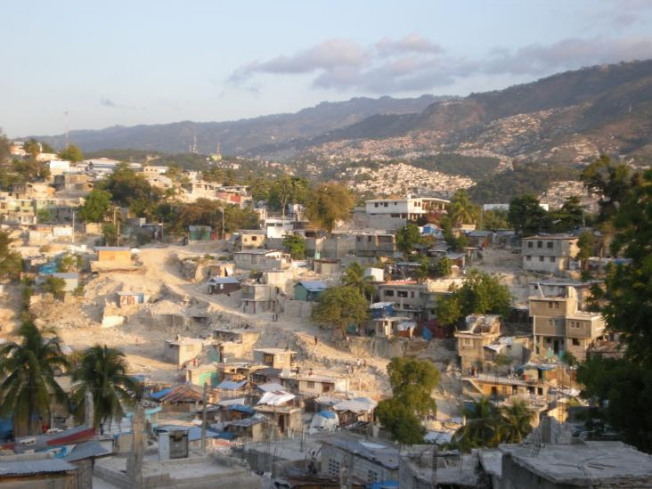
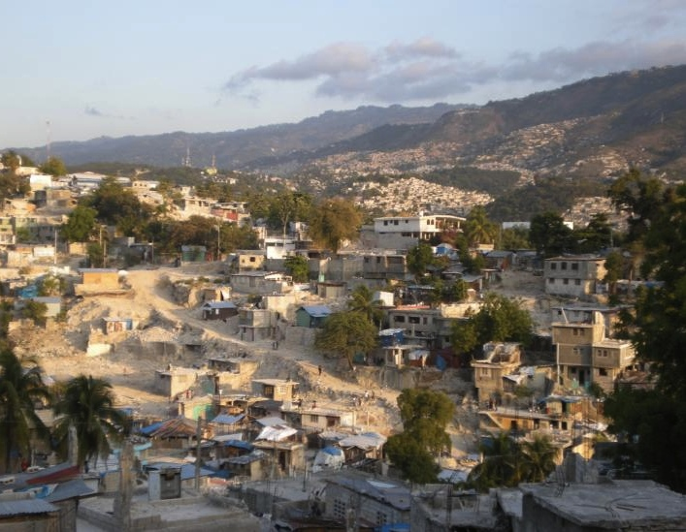
Bumps on the Road to Recovery
Balancing needs and responses
Sharp boundaries of program area hard for neighboring communities to understand
How to approach no-build zones
Just Outside KATYE’s Bounds
Notes:
E.g. of sharp boundaries and resultant issues Rivalry/Envy over resource distribution and (Cash for Production/Work etc);

Slide 44
Considerations for Disaster Recovery
Engaging national and local authorities
Brownfield development with land remediation; Revenue generation; Building public sector capacity for risk resilience planning and implementation
Densification through multi-story, multi-family housing solutions (including rental) for various income levels
Incremental Development Plan and training on incremental housing (from transition to permanence) for consumers, contractors etc.
Emergency intervention vs. longer-term needs (Settlement planning – roads, sanitation, housing types)
Beyond cash for work/production
Notes:
Beyond cash for work/production – (for e.g. job training, access to credit, etc. –timing and resource allocation constraints need to be addressed )

Slide 45
Considerations for Disaster Recovery
Refine enumeration/land survey instruments and methods to balance the complexities of urban demography in the aftermath of a disaster
Flexibility – OFDA support of changes to the program based on differences between original estimates and actual conditions found during implementation was critical to KATYE’s success
Free Service Model needs to be moderated
Thank You for letting me tell the story of Ravine Pintade!
Notes:
Enumeration - Rapid estimates prone to large margins of error
Informal settlers wary of providing too much information
Best results through ongoing close engagement with community
Always in flux

