Slide 1
Welcome to day 1
Notes:
Notes in ITALICS are general training guidance
Facilitators can add notes below to assist training
Notes in BOLD are material references and sources
EC (30/03/10): from SC08b, Day 2 03, p.2 and 3
CM (26/04/10): changed objectives to make them shorter and more SMART

Slide 2
Notes:
Notes in ITALICS are general training guidance
Facilitators can add notes below to assist training
Notes in BOLD are material references and sources
EC (30/03/10): from SC08b, Day 2 03, p.2 and 3
CM (26/04/10): changed objectives to make them shorter and more SMART

Slide 3
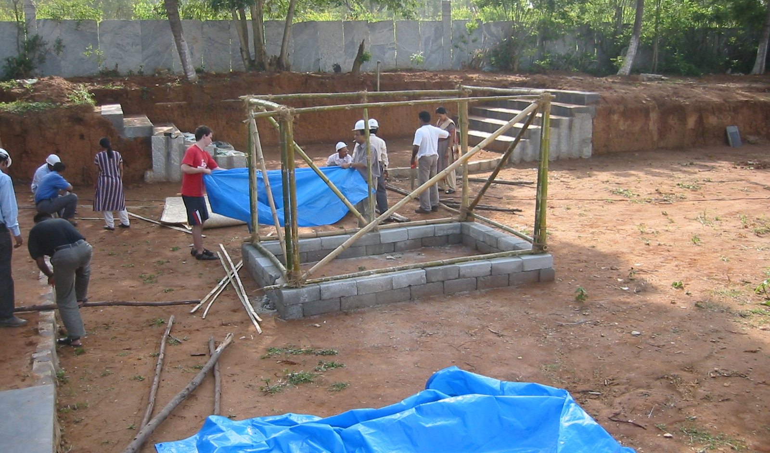
Adult learning
Introduction to the principles and methods of adult learning
105
Minutes
Notes:
Notes in ITALICS are general training guidance
Facilitators can add notes below to assist training
Notes in BOLD are material references and sources
EC (30/03/10): from SC08b, Day 2 03, p.1

Slide 4
Adult learning
1
Notes:
Notes in ITALICS are general training guidance
Facilitators can add notes below to assist training
Notes in BOLD are material references and sources
EC (30/03/10): from SC08b, Day 2 03, p.2 and 3
CM (26/04/10): changed objectives to make them shorter and more SMART

Slide 5
By the end of this session, you will have an understanding of
Objective 1 Principles of adult learning
Objective 2 The three stages of learning
Objective 3 Understanding and remembering
Objective 4 Adult learning environment
Objective 5 Adult learning strategies

Slide 6
Objective 1 Principles of adult learning
Adults need to know why they are learning something
Learning should be relevant to the individual
Problem based learning & task based learning is more effective

Slide 7
Objective 2 The three stages of learning
How can you assist the three stages of learning?
Receiving
Provide a good learning environment
Processing
Use a number of learning techniques
Using
Provide opportunities for practice.
Receiving
Processing
Using

Slide 8
Objective 3 Understanding and remembering
Key points on understanding and remembering
Understanding is developing initial perceptions
We remember based on what we already know
We understand better when learning is related to a project

Slide 9
Objective 3 Understanding and remembering
Edgar Dale’s cone of experience

Slide 10
Discussion in pairs
Write down key points
Question Which methods do you use to help you/others remember?
Task In pairs, come up with three examples
Discussion in pairs
15 minutes

Slide 11
Objective 4 Learning environment
Key points about learning environment
We learn best when we feel relaxed
Create a safe atmosphere, in which people are happy to share experiences
Create a comfortable physical environment

Slide 12
Objective 5 Learning styles
What is a learning style?
A learning style is a way in which an individual engages with learning
Each participant will have their own learning style, and it is up to you as a trainer to tailor the sessions and learning techniques to suit several learning styles

Slide 14
Objective 5 Learning styles
Consider the following eight learning methods
1
Groups
Games
Practice
2
Statistics
Examples
Relevant
3
Case-studies
Global-
Context
4
Questions
Problems
Theory
5
Reflection
Self-study
Questions
6
Objectives
Stages
Summaries
7
Discussion
Groups
Presenting
8
Images
Diagrams
Videos

Slide 15
Objective 5 Learning styles
1. Active
Encourage working In pairs or groups
Use techniques such as games, quizzing and brainstorming
Incorporate case studies, simulations and role play into the training

Slide 16
Objective 5 Learning styles
2. Factual
Use real statistics
Use concrete examples and case studies
Make the training relevant to participant’s professional experience

Slide 17
Objective 5 Learning styles
3. Global
Present an overall view of the subject
Use case studies
Invite participants to share regional experiences

Slide 18
Objective 5 Learning styles
4. Intuitive
Ask questions
Use problem-based, and task based scenario exercises
Ask participants to figure out the underlying theory themselves

Slide 19
Objective 5 Learning styles
5. Reflective
Allow time for reflection
Allow time for participants to develop questions
Invite participants to produce a written summary of the presentation

Slide 20
Objective 5 Learning styles
6. Sequential
Set out a clear agenda
Indicate the stage you are covering as you go through the presentation
Provide summaries and recap each stage

Slide 21
Objective 5 Learning styles
7. Verbal
Incorporate group work, discussion and debate into the training
Encourage participants to explain something to each other
Incorporate participant presentations

Slide 22
Objective 5 Learning styles
8. Visual
Use diagrams & images within the presentation and literature
Use charts when discussing statistics
Show videos and demonstrations

Slide 23
Discussion in groups
Write down key points
Task 1 Come up with eight examples of training methods,
based on the eight learning styles.
Discussion in groups
15 minutes

Slide 24
Any questions?
Share your experiences
Do you have any comments or experiences you would like to share?
Do you have any questions?
Any
questions
15 minutes

Slide 25
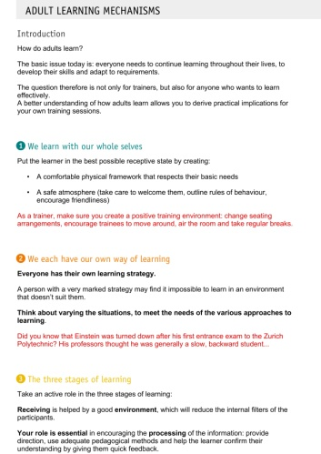
Further reading
Adult Learning Mechanisms
Cegos, 2007
Delivering great training
Bryan Hopkins, 2008
Notes:
Notes in ITALICS are general training guidance
Facilitators can add notes below to assist training
Notes in BOLD are material references and sources
EC (30/03/10): from SC08b, Day 2 03, p.2 and 3
CM (26/04/10): changed objectives to make them shorter and more SMART

Slide 26
Coffee break
Please be back in time for
30 min
Back at
11:00
Notes:
Notes in ITALICS are general training guidance
Facilitators can add notes below to assist training
Notes in BOLD are material references and sources
EC (30/03/10): from SC08b, Day 2 03, p.2 and 3
CM (26/04/10): changed objectives to make them shorter and more SMART

Slide 27
Planning a training event
Assessing learning needs & planning the structure of a training event
90
Minutes
Notes:
Notes in ITALICS are general training guidance
Facilitators can add notes below to assist training
Notes in BOLD are material references and sources
EC (30/03/10): from SC08b, Day 2 03, p.1

Slide 28
Planning a training event
2
Notes:
Notes in ITALICS are general training guidance
Facilitators can add notes below to assist training
Notes in BOLD are material references and sources
EC (30/03/10): from SC08b, Day 2 03, p.2 and 3
CM (26/04/10): changed objectives to make them shorter and more SMART

Slide 29
By the end of this session, you will have an understanding of:
Objective 1 Assessing learning needs
Objective 2 Setting goals and objectives
Objective 3 Planning the structure and agenda
Objective 4 Preparing participants, preparing yourself
Objective 5 Example logistics checklist

Slide 30
Discussion in groups
Write down key points
Task 1 Discuss your experiences of training events
Task 2 Make a list of 5 do’s and don’t of training
Task 3 Present your ideas to the group, noting common themes
Discussion in groups
15 minutes

Slide 31
Objective 1 Assessing learning needs
Who is your target audience?
Age, gender, education
Knowledge base
Job experience
Language
Motivation

Slide 32
Objective 1 Assessing learning needs
What is the current performance in humanitarian response?
It is estimated 85% of humanitarian workers have no formal training at all
Lack of common understanding
Poor collaboration and use of resources

Slide 33
Objective 2 Goals and objectives
It is important to set goals and objectives on different levels
General goals and objectives
Course Learning objectives
Enabling objectives

Slide 34
Objective 2 Goals and objectives
General objectives for CORE training
Basic understanding in DRR+R+R
Common language
Collaboration
Reference to other resources
Use of the regional learning platform

Slide 35
Objective 2 Goals and objectives
Enabling objectives (EO’s)
An enabling objective reflects the behaviour that should be adopted as a result of the training
Example: In CORE ToT, an enabling objective is:
For trainers to accompany participants, and be good facilitators

Slide 36
Objective 3 Planning the structure and agenda
Planning the structure and agenda should be determined by overall training objective, and target performance
“ Keeping the actual performance at the
heart of your training objective guarantees
relevant, activity-based training”
(UNMIL ToT workshop notes) p17

Slide 37
Objective 3 Planning the structure and agenda
Hierarchal task analysis
In a hierarchical analysis, a task is broken down from top to bottom, thereby, showing a hierarchical relationship amongst the tasks
To plan the structure and agenda, use flow charts and brain storming to break down your training objectives
The sessions will be formed from breaking down the training objectives

Slide 38
Objective 3 Planning the structure and agenda
Structure: key points
Think about the order in which you want people to learn
Think about time of day people are most effective at absorbing knowledge
Remember to use a number of training techniques (from the 8 learning methods)

Slide 39
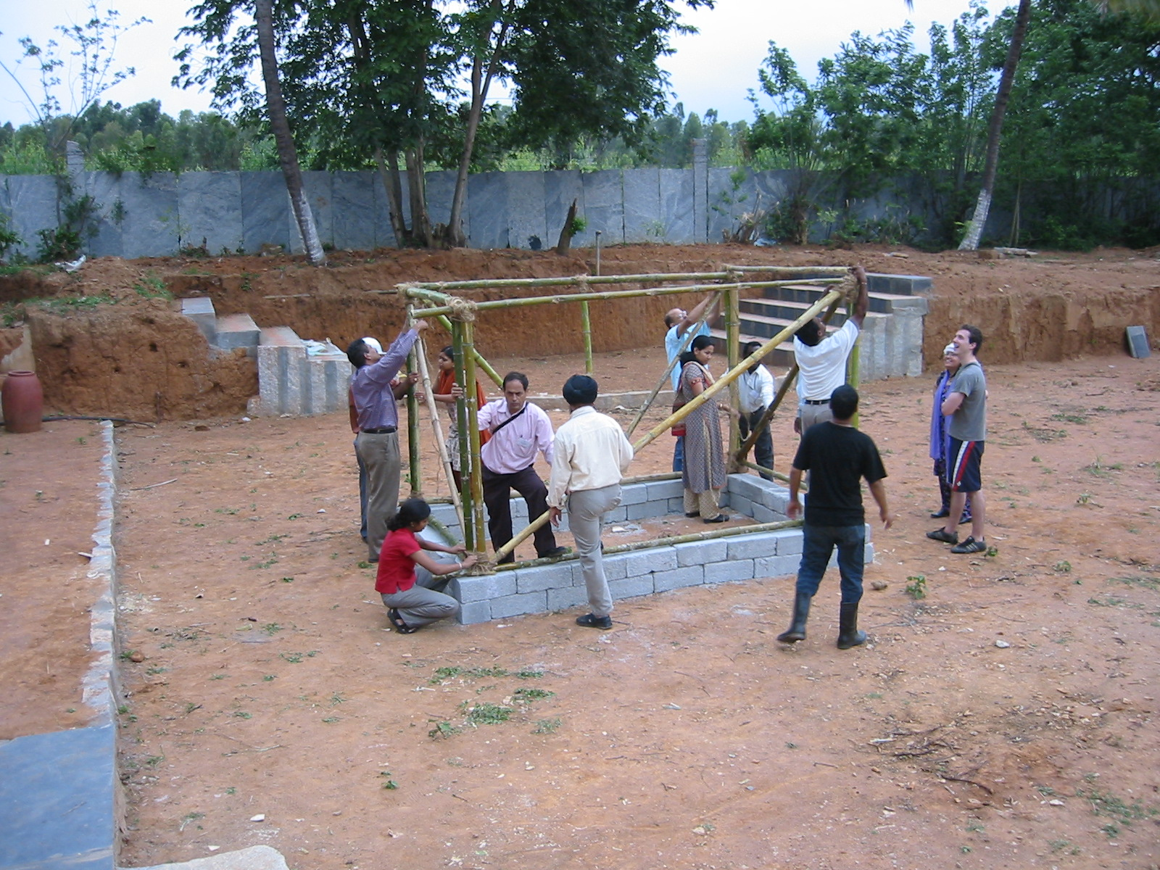
Consider how hierarchal analysis could be used in an emergency response evaluation

Slide 40
Objective 3 Planning the structure and agenda
Remember to include a mixture of different learning methods
1
Groups
Games
Practice
2
Statistics
Examples
Relevant
3
Case-studies
Global-
Context
4
Questions
Problems
Theory
5
Reflection
Self-study
Questions
6
Objectives
Stages
Summaries
7
Discussion
Groups
Presenting
8
Images
Diagrams
Videos

Slide 42
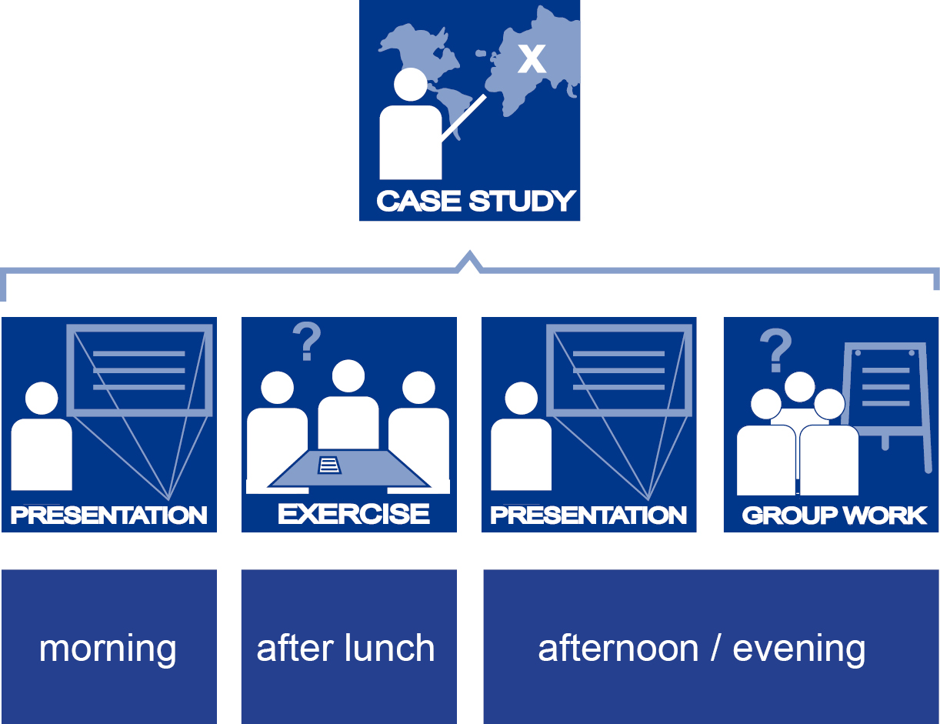
Objective 3 Planning the structure and agenda
Agenda: consider time of day people are most effective, and use a variety of learning approaches

Slide 43
Objective 4 Preparation
Prepare participants
Prepare yourself
Prepare equipment and venue

Slide 44
Objective 5 Example logistics checklist
Venue
Equipment
Security
Power supply
Rooms
Seating
Environment
Laptop, projector and screen
Flip chart stand, pads, pens
Participant manuals
Pens
Name badges

Slide 45
Discussion in groups
Split into 3 groups, and assess the CORE agenda for the following scenarios
Write down key points
Group 1 Assess the CORE agenda for several different stakeholder groups; think about what you might change for different audiences
Group 2 Assess the CORE agenda for two countries that you have worked in, think about what you might change for different settings
Group 3 Assess the CORE agenda for an area of disaster, and for an area of conflict, what might you change in these settings?
Discussion in groups
30 minutes

Slide 46
Any questions?
Share your experiences
Do you have any comments or experiences you would like to share?
Do you have any questions?
Any
questions
15 minutes

Slide 47
Further reading
Adult Learning Mechanisms
Cegos, 2007
Delivering great training
Bryan Hopkins, 2008
Designing Participatory Workshops
UNHCR, 2008
How to organize and run learning workshops
UNICEF and UN staff college
Notes:
Notes in ITALICS are general training guidance
Facilitators can add notes below to assist training
Notes in BOLD are material references and sources
EC (30/03/10): from SC08b, Day 2 03, p.2 and 3
CM (26/04/10): changed objectives to make them shorter and more SMART

Slide 48
Lunch break
Please be back in time for
30 min
Back at
14:00
Notes:
Notes in ITALICS are general training guidance
Facilitators can add notes below to assist training
Notes in BOLD are material references and sources
EC (30/03/10): from SC08b, Day 2 03, p.2 and 3
CM (26/04/10): changed objectives to make them shorter and more SMART

Slide 49
Energiser session
Notes:
Notes in ITALICS are general training guidance
Facilitators can add notes below to assist training
Notes in BOLD are material references and sources
EC (30/03/10): from SC08b, Day 2 03, p.2 and 3
CM (26/04/10): changed objectives to make them shorter and more SMART

Slide 50
Developing a session plan
Looking at setting key learning points and developing content
90
Minutes
Notes:
Notes in ITALICS are general training guidance
Facilitators can add notes below to assist training
Notes in BOLD are material references and sources
EC (30/03/10): from SC08b, Day 2 03, p.1

Slide 51
Developing a session plan
3
Notes:
Notes in ITALICS are general training guidance
Facilitators can add notes below to assist training
Notes in BOLD are material references and sources
EC (30/03/10): from SC08b, Day 2 03, p.2 and 3
CM (26/04/10): changed objectives to make them shorter and more SMART

Slide 52
By the end of this session, you will have an understanding of:
Objective 1 How to develop content
Objective 2 Mind mapping
Objective 3 Setting key learning points
Objective 4 Deciding appropriate methods for training

Slide 53
Objective 1 Developing content
In developing content, you should
Continue with the hierarchical task analysis method, but go into a finer level of detail
Use mind mapping methods

Slide 54
Objective 2 Mind mapping
Key points
Represents ideas around one subject
Present ideas in a non-linear manor
Encourages a brain-storming approach to organisational tasks
Branches represent a hierarchy

Slide 55
Objective 2 Mind mapping
Mind mapping demonstration
Your trainer will now give a brief demonstration on
mind-mapping, around the subject of WASH

Slide 56
Objective 3 Setting key learning points
Key learning points will be developed in your mind-mapping exercise
They are generally will come from the main branches of the mind map
Take key words from your mind map and develop them into sentences

Slide 57
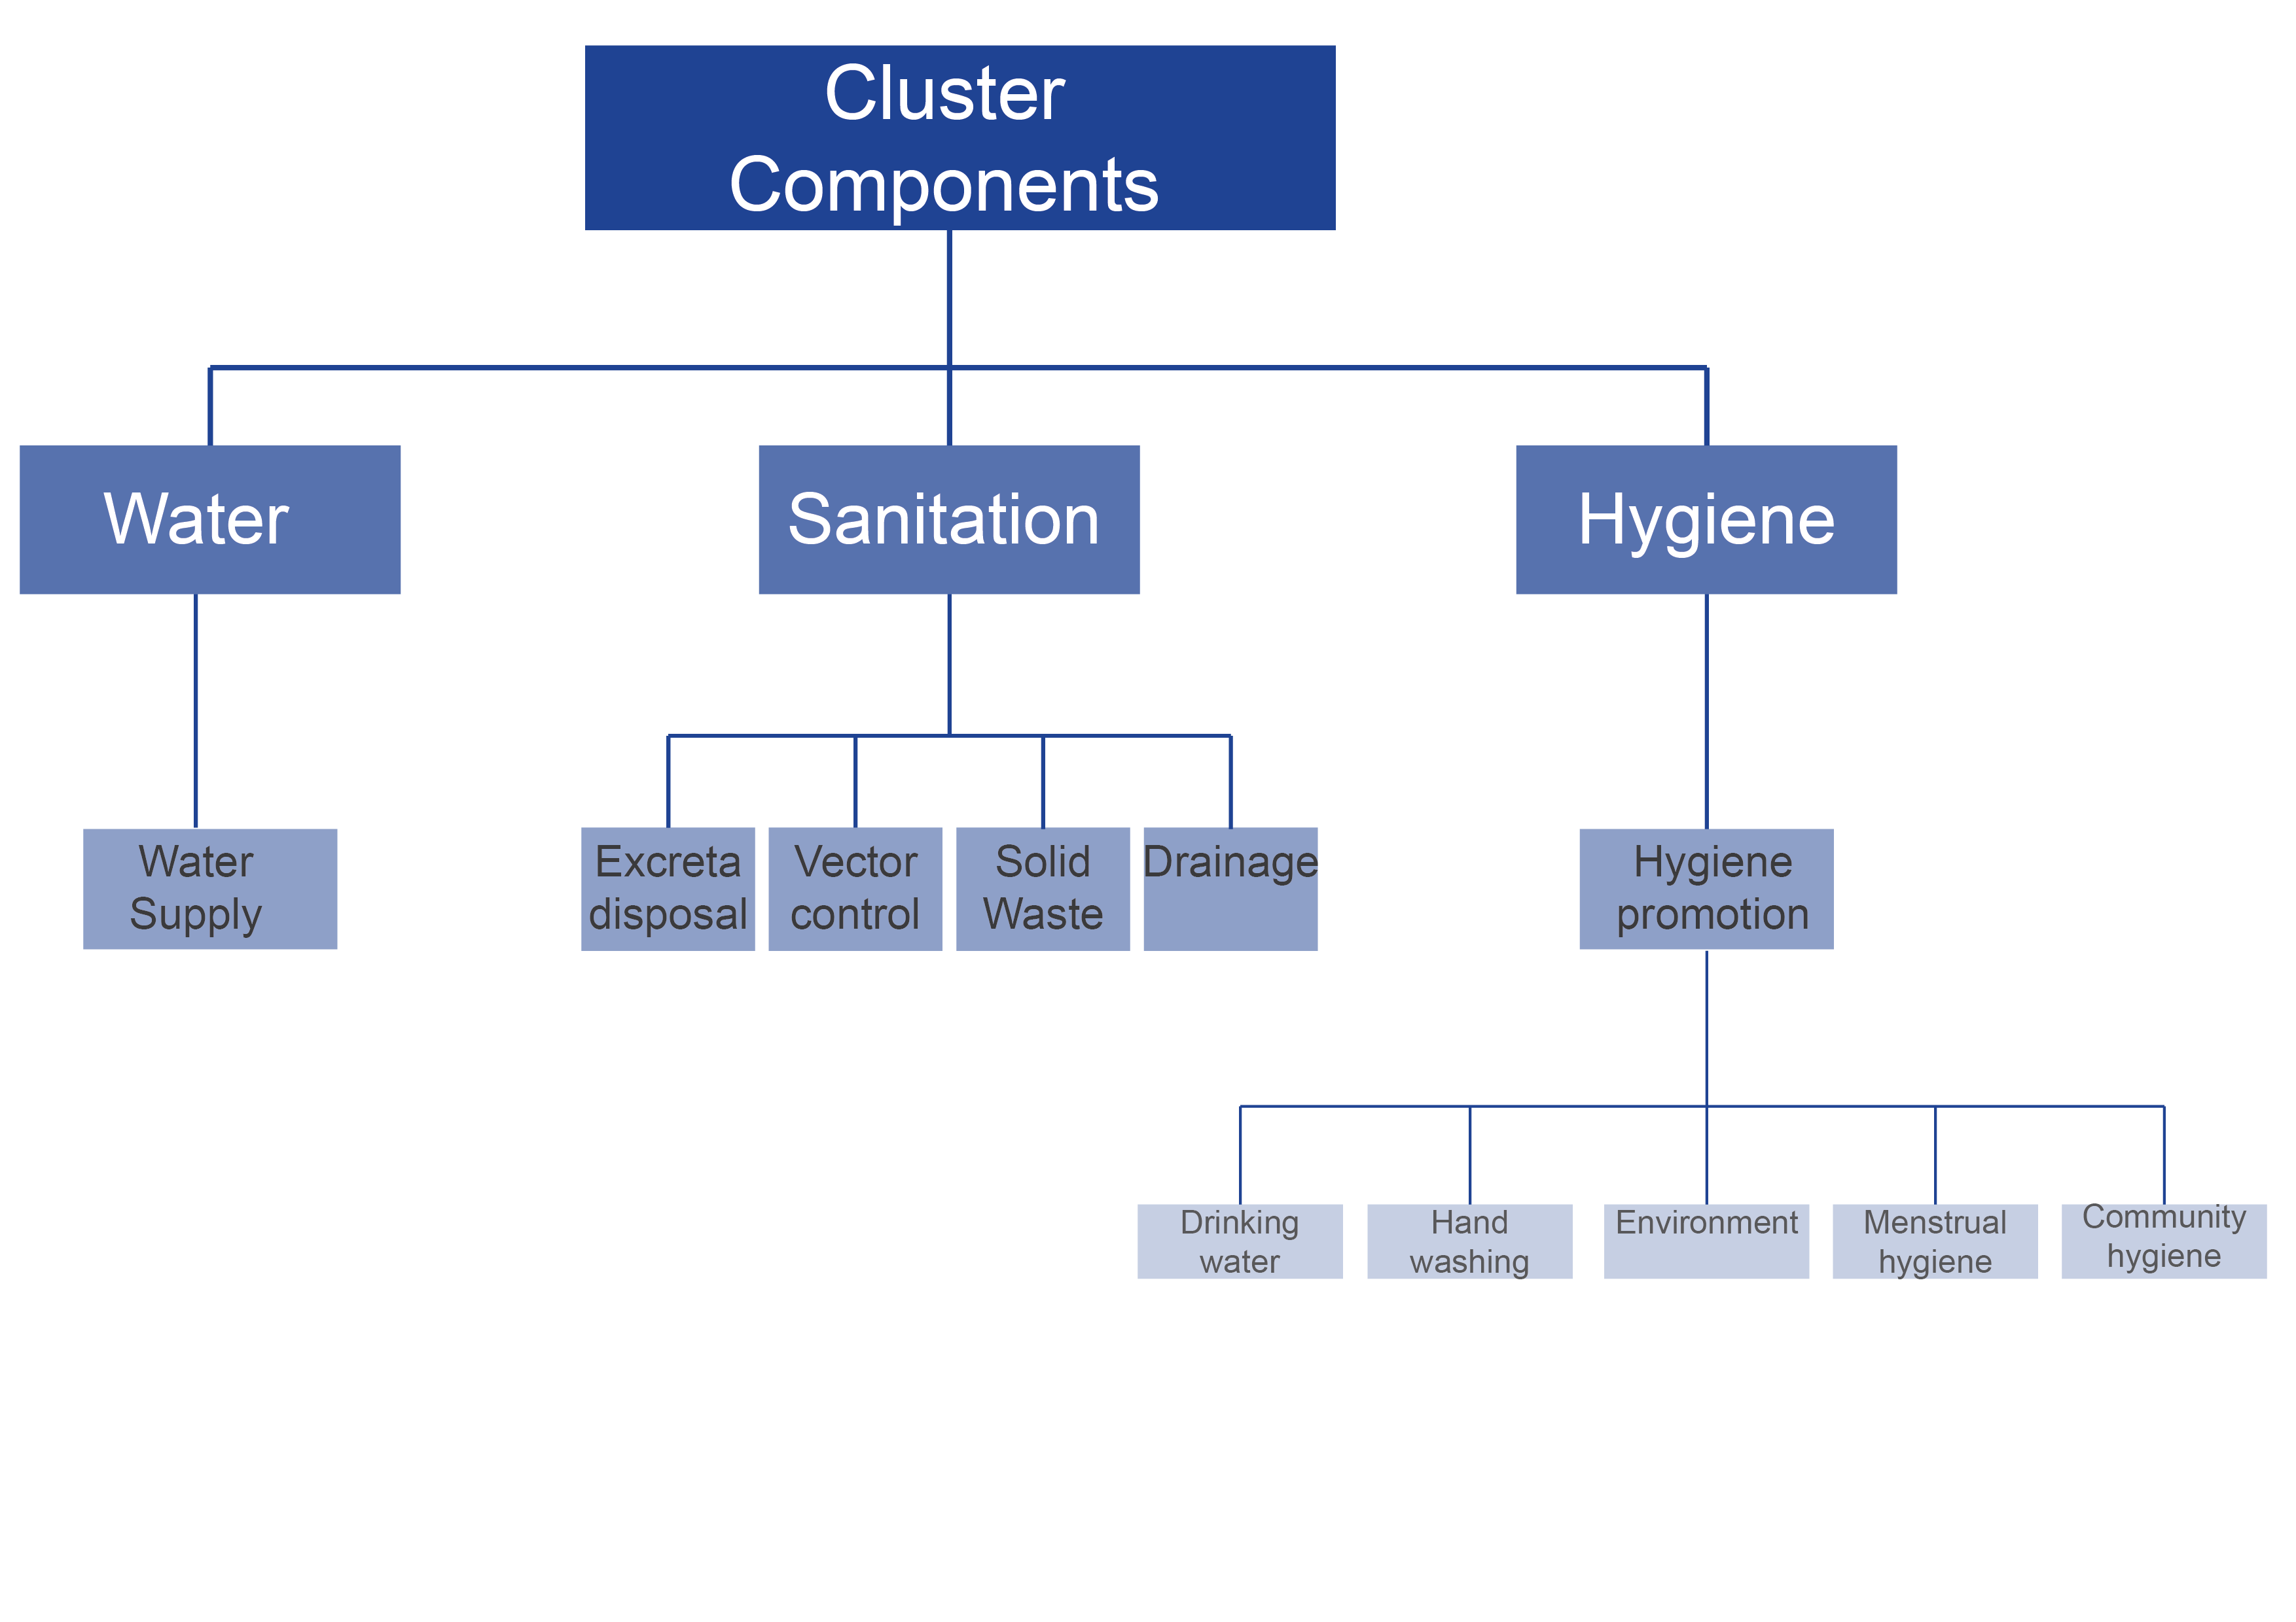
Objective 3 Setting key learning points
Example of expanding key learning points for WASH presentation

Slide 58
Discussion in groups
4 groups, each group is given a CORE session plan
Write down key points
Task 1 Review the session plan; do you agree with the key learning points?
Task 2 Discuss what you might change in different situations; use mind mapping to collect ideas
Consider Different stakeholder groups, different regions and settings
Discussion in groups
30 minutes

Slide 59
Objective 4 Deciding appropriate methods for training
There are four types of session within CORE training
Presentation
Case Study
Exercise
Group Work

Slide 61
Objective 4 Deciding appropriate methods for training
Presentation
Presentations appeal to verbal, sequential and visual learners used to cover technical content-based subjects
Use images, diagrams and charts
Use 5 lines per page, 5 words per line.
Include discussion and exercises

Slide 62
Objective 4 Deciding appropriate methods for training
Case study
Case studies appeal to global and factual learners
Used in presentations to add real context
Use recent, relevant studies
Point out ways in which the study was successful and unsuccessful
Invite participants to share their own case studies and experiences

Slide 63
Objective 4 Deciding appropriate methods for training
Exercise
Appeal to intuitive, active & reflective learners
Used for skills based learning
Give clear, realistic scenarios
Provide sufficient information
Define the roles that you want participants to play

Slide 64
Objective 4 Deciding appropriate methods for training
Group work
Appeal to active, verbal and intuitive learners
Used to provide a change of mood and pace
Gives less confident people a chance to speak
Listen to ideas
Give clear instructions, and make sure everybody understands the aim

Slide 65
Matching Learning styles to session approaches

Slide 66
Skills in developing a clear agenda can be used in emergency response

Slide 67
Any questions?
Share your experiences
Do you have any comments or experiences you would like to share?
Do you have any questions?
Any
questions
15 minutes

Slide 68
Further reading
Adult Learning Mechanisms
Cegos, 2007
Delivering great training
Bryan Hopkins, 2008
Designing Participatory Workshops
UNHCR, 2008
How to organize and run learning workshops
UNICEF and UN staff college
Notes:
Notes in ITALICS are general training guidance
Facilitators can add notes below to assist training
Notes in BOLD are material references and sources
EC (30/03/10): from SC08b, Day 2 03, p.2 and 3
CM (26/04/10): changed objectives to make them shorter and more SMART

Slide 69
Coffee break
Please be back in time for
30 min
Back at
16:00
Notes:
Notes in ITALICS are general training guidance
Facilitators can add notes below to assist training
Notes in BOLD are material references and sources
EC (30/03/10): from SC08b, Day 2 03, p.2 and 3
CM (26/04/10): changed objectives to make them shorter and more SMART

Slide 70
Facilitation skills
Managing difficulties, group dynamics and conflicts
105
Minutes
Notes:
Notes in ITALICS are general training guidance
Facilitators can add notes below to assist training
Notes in BOLD are material references and sources
EC (30/03/10): from SC08b, Day 2 03, p.1

Slide 71
Facilitation skills
4
Notes:
Notes in ITALICS are general training guidance
Facilitators can add notes below to assist training
Notes in BOLD are material references and sources
EC (30/03/10): from SC08b, Day 2 03, p.2 and 3
CM (26/04/10): changed objectives to make them shorter and more SMART

Slide 72
By the end of this session, you will have an understanding of:
Objective 1 Learning Environment
Objective 2 Presence and approach
Objective 3 Icebreakers and introductions
Objective 4 Working in small groups
Objective 5 Managing difficulties, conflicts and questions

Slide 73
Review
A video review of your own facilitation skills
Video
review
Task 1 Watch a video of your presentations
Task 2 In groups, discuss the good and bad points of your facilitation skills. Think about what you should have done differently
Discussion in groups
45 minutes

Slide 74
Objective 1 Learning environment
“A gifted teacher is as rare as a gifted doctor, and makes far less money”
Welcome participants- smile and greet
Promote friendliness and teamwork
Be on hand as soon as participants enter the room
Outline the rules: i.e. timekeeping, phones, etc
Specify objectives

Slide 75
Objective 1 Learning environment
Think about room layout, and try and match to your session approach
Space efficient
Very formal
Doesn’t encourage
discussion
Informal
Encourages
collaboration
Not space efficient
Informal
Encourages
collaboration
Trainer becomes the centre of attention

Slide 77
Objective 2 Presence and approach
Presence: dress, voice, and attitude:
Have pride in your appearance
Project your voice
Adapt style to make audience comfortable

Slide 78
Objective 2 Presence and approach
Approach: facilitate - It’s not just a lecture!
Be prepared and flexible
Build on participants’ person experience and knowledge
Use practical approaches, allow questions
Evaluate as you progress
Adapt to needs of the particular group

Slide 79
Objective 3 Icebreakers and introductions
In addition to name plates and badges!
As an instructor introduce yourself, and give a short biography of your experience
Icebreakers
Work well in small groups
Allow everyone to participate
Set tone for group dynamic
Learn names of group

Slide 80
Discussion in groups
In groups, complete the following exercises
Write down key points
Task 1 Discuss examples of your favourite icebreakers
Task 2 Each group should present one example
Discussion in groups
10 minutes

Slide 81
Objective 4 Working in small groups
Team development and behavior
Forming
Storming
Norming
Performing

Slide 82
Objective 4 Working in small groups
1. Forming
High dependence on leader
Leader must direct all objectives
Roles and responsibilities unclear

Slide 83
Objective 4 Working in small groups
2. Storming
People get to know one another but cliques can form
Leader must work to avoid friction
Sensitive to those who might shy from participating

Slide 84
Objective 4 Working in small groups
3. Norming
Group operates within mutually agreed rules
Group unity is strong
Roles and responsibilities are clear
Leader facilitates and enables

Slide 85
Objective 4 Working in small groups
4. Performing
The group begins to work together to achieve their task
Leader delegates and oversees

Slide 86
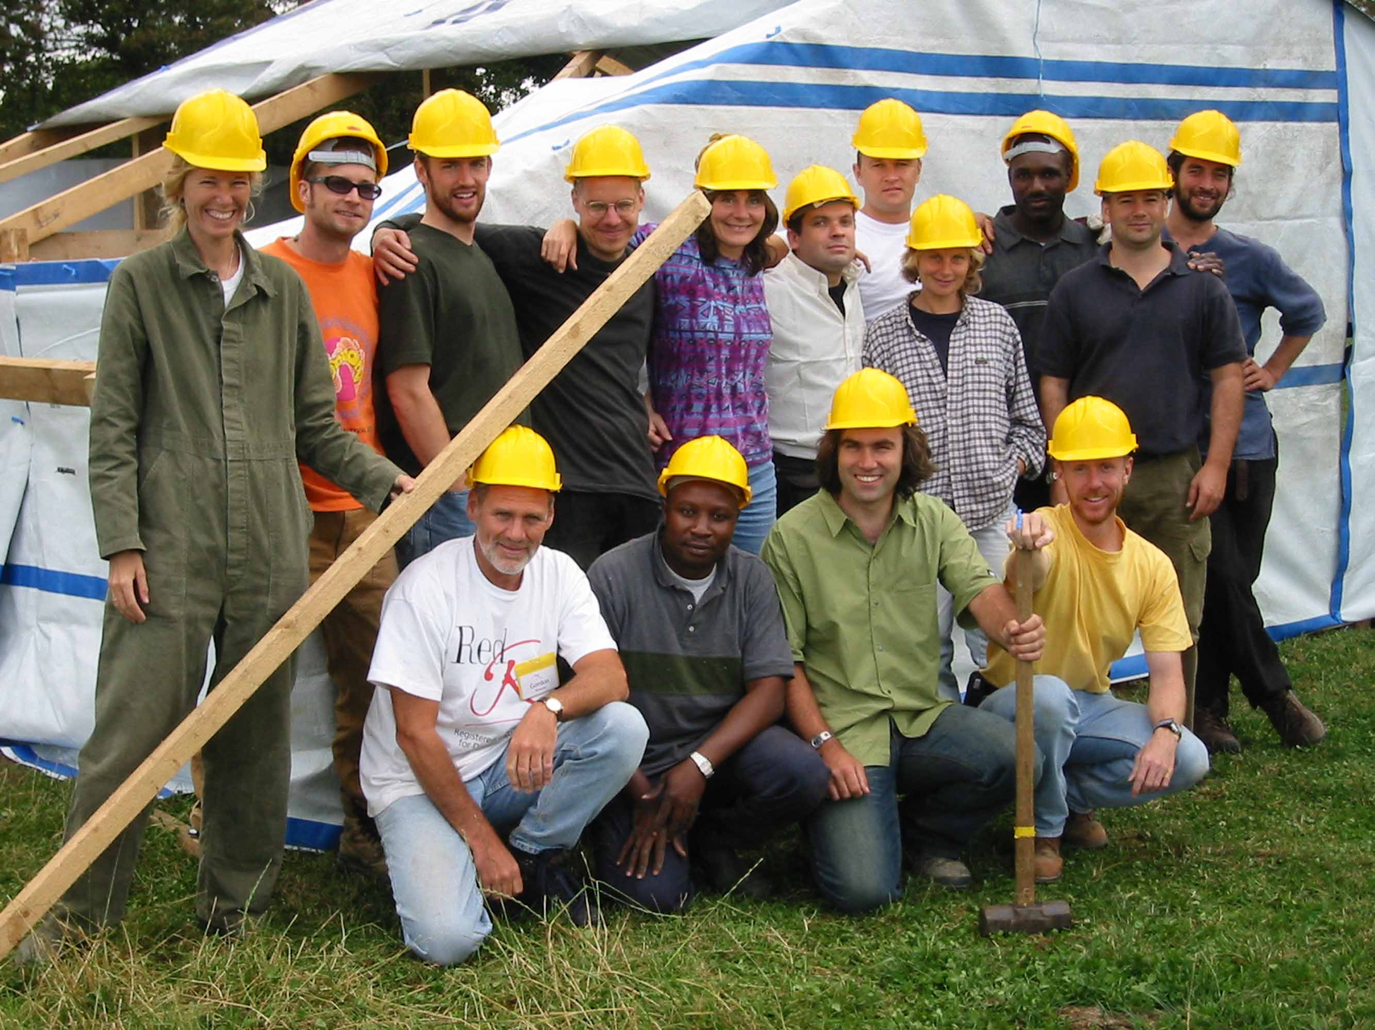
Good team facilitation skills can be used in emergency response situations

Slide 87
Discussion in groups
4 groups, each group is given a CORE session plan
Write down key points
Scenario 1 You have just arrived in the field, and are managing a team following a disaster. The team have only just met
Task 1 Discuss ways in which you can facilitate this process, in the most efficient way, so that your team can start working together effectively
Discussion in groups
15 minutes

Slide 88
Objective 5 Managing difficulties, conflicts and questions
Answering questions:
Make eye contact, ask a direct question
Pose question to group as a whole
Pose question to group in teams

Slide 89
Objective 5 Managing difficulties, conflicts and questions
Answering questions:
Listen carefully, thank participant for question
Ricochet – offer praise, then pose it to the rest of the group
Rebound – direct question back to the person who asked it
Give answer to question
Know when you don’t know an answer

Slide 90
Objective 5 Managing difficulties, conflicts and questions
Conflict is inevitable within groups
Causes
Consequences
Resolution
Positives and negatives

Slide 91
Any questions?
Share your experiences
Do you have any comments or experiences you would like to share?
Do you have any questions?
Any
questions
15 minutes

Slide 92
Further reading
Adult Learning Mechanisms
Cegos, 2007
Delivering great training
Bryan Hopkins, 2008
Designing Participatory Workshops
UNHCR, 2008
How to organize and run learning workshops
UNICEF and UN staff college
Notes:
Notes in ITALICS are general training guidance
Facilitators can add notes below to assist training
Notes in BOLD are material references and sources
EC (30/03/10): from SC08b, Day 2 03, p.2 and 3
CM (26/04/10): changed objectives to make them shorter and more SMART

Slide 93
Thank you Don’t forget to fill in your feedback form
Notes:
Notes in ITALICS are general training guidance
Facilitators can add notes below to assist training
Notes in BOLD are material references and sources
EC (30/03/10): from SC08b, Day 2 03, p.2 and 3
CM (26/04/10): changed objectives to make them shorter and more SMART

