Slide 1
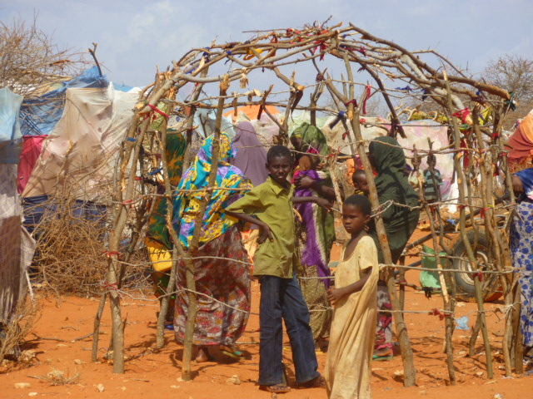
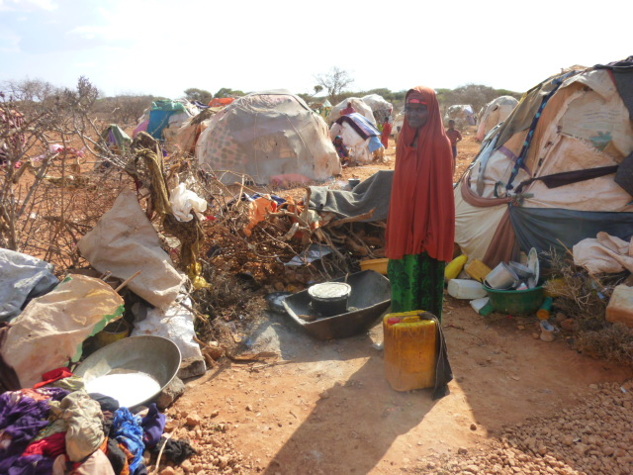
No Fixed Address: Housing, Land and Property Issues in a Stateless Somalia.
Brett Moore Global Rapid Response Team
Shelter and Infrastructure Advisor World Vision International

Slide 2
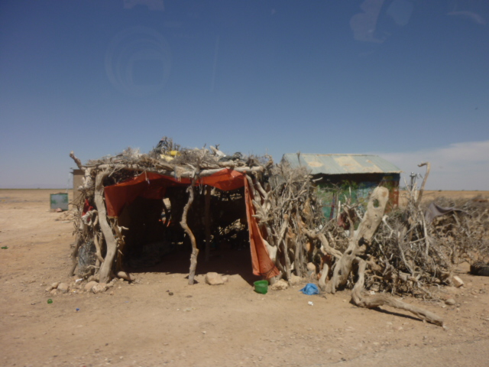
1. CONTEXT Complex Emergency
Drought
Conflict
Governance
Livelihoods
Clan
USING HOUSING AS A SOLUTION…..
Notes:
Advocacy and Action
Rapid Urbanisation
Growth on Mega cities
Coastward urbanisation: 50% of world pop < 100 km by 2030
Proliferation of slum settlements: 2 billion slum dwellers by 2030
Sinking cities (“over-development” and groundwater extraction)
Displacement of over 27M people in 2009
The first semester of 2010 shows the occurrence of over 160 natural disasters. These events killed almost 230,000 people, affected 107 million others. Floods and storms were the two most reported types of disasters.
By 2015, on average over 375 million people per year are likely to be affected by climate-related disasters. This is over 50% more than have been affected in an average year during the last decade.
IMPACT ON CHILDREN
The least developed countries are likely to bear the brunt of climate change. These countries often suffer from poor physical infrastructure and lack systems to cope with such climatic events as drought and flooding.
Intensifying natural disasters and ongoing armed conflicts are exacerbating penury and exclusion for millions of children. Humanitarian crises, which affect children and women disproportionately, are escalating in number and severity as natural disasters take an increasing toll and as conditions deteriorate in several areas that are experiencing protracted emergencies, particularly in sub-Saharan Africa.
It is estimated that low- and lower-middle-income countries account for 97 percent of global mortality risks from natural disasters”

Slide 3
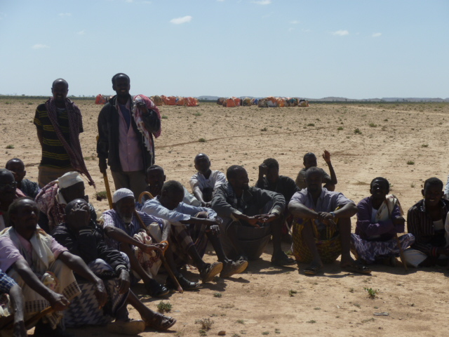
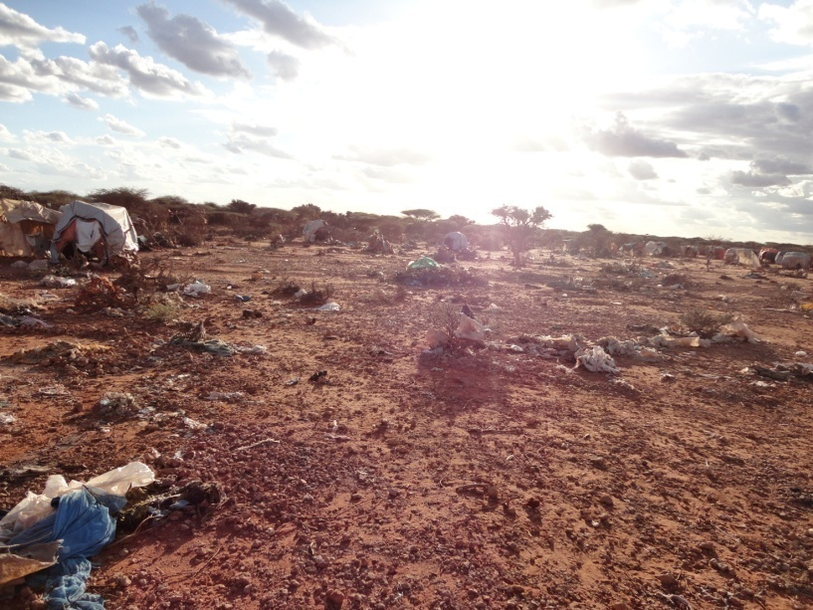
2. TSP LOCATION Land Identification
- Stakeholder mapping
- Coordination and
consensus
- Agreeing on process
Notes:
Infrastructure support for temporary health, education, WASH and Child focused activities such as CFSs are critical for effective running of the programmes. Normally these are tents or similar covering that enable health , education, CFS and WASH staff to provide appropriate lifesaving services to children and their families.
While these DADDs primarily focus on emergency response, the relevance of disaster preparedness and good development remains critical. Advocacy is a core component of any shelter and infrastructure projects to ensure good policies that address the most vulnerable needs is important.
Strategic Mandate 2 focuses on Strengthening our grass roots field capacity and ministry. The need to ensure the full participation of children and their families in the design and implementation is clear as is focusing on the most vulnerable through addressing the cross cutting themes in terms of inclusivity, safety , accountability and accessibility. Building capacity and appropriate business processes for designing and implementing high quality, cultural and climate appropriate and environmentally friendly buildings is part of this strategic mandate.
Strategic Mandate 4 focuses on Being an authoritative voice at all levels driving change. The need to advocate for better housing for the poor and holding duty bearers accountable is a critical aspect of any shelter and infrastructure process.
The HEA Strategic Intent highlights the humanitarian industry increased focus on managing urban disasters more effectively.

Slide 4
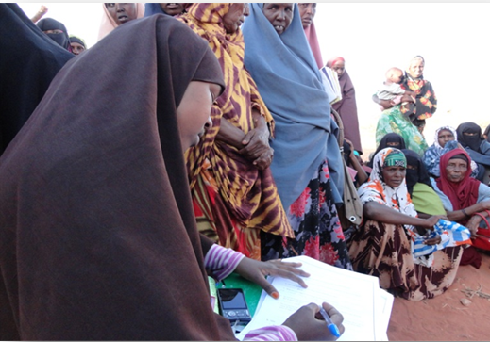
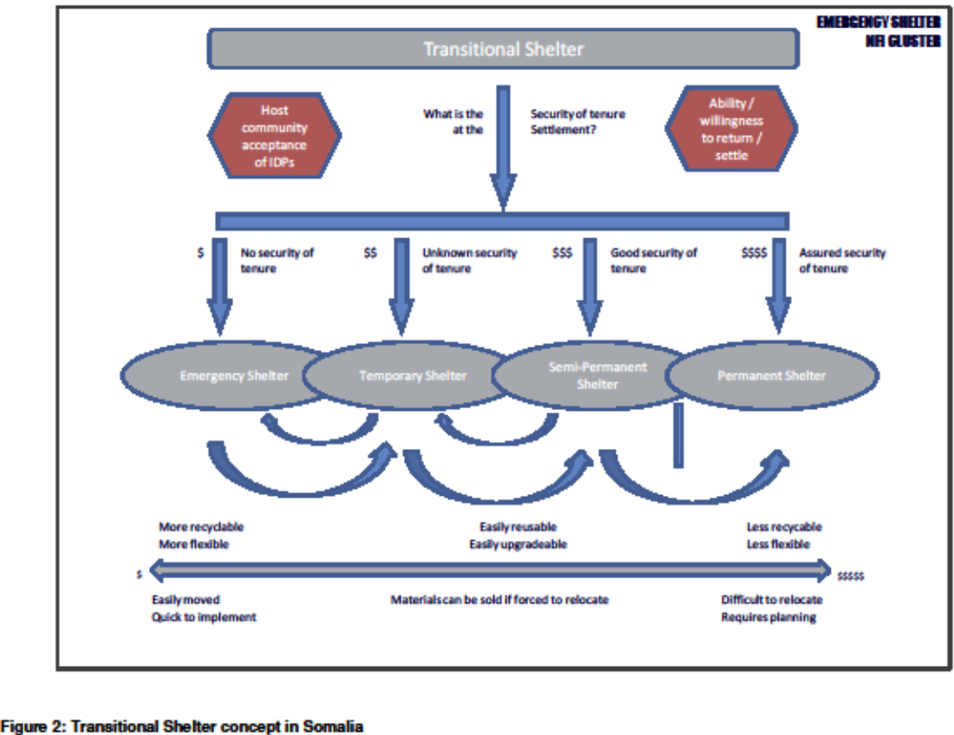
4. STAKEHOLDER engagement
Council of Elders
Sha’aria Courts
Community (B & H)
Local Gov

Slide 5
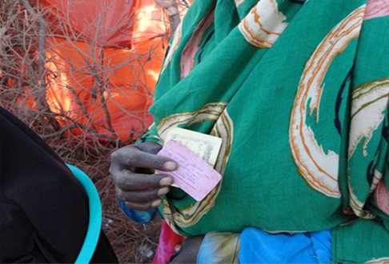
5. SELECTION families, communities
Beneficiary NO: | KAL2/WV/ 0029 |  | Family Size: | 8
Household Head: | Faadumo Ibraahim Xuseen |  | Gender: | Female
Spouse Name: | Died |  | Gender: | Male
Contact Name: | Maxamed Shafeec |  | Gender: | Male
Children Under Five Years |  |  | Children Above Five Years
Male | Female |  | Male | Female
1 |  |  | 3 | 4
Original Home: | Jigjiga |  | Beneficiary criteria | Poor family life with host community and get support from them
Camp Name: | Kalkaaal 2 |  | Camp Location: | Burtinle
FUNDED BY: PEOPLE OF CANADA Vulnerability Criteria: | Lame(leg),Age
- Vulnerability Criteria
- Equity
- Host Community
- Self-selection &
Community Endorsement

Slide 6
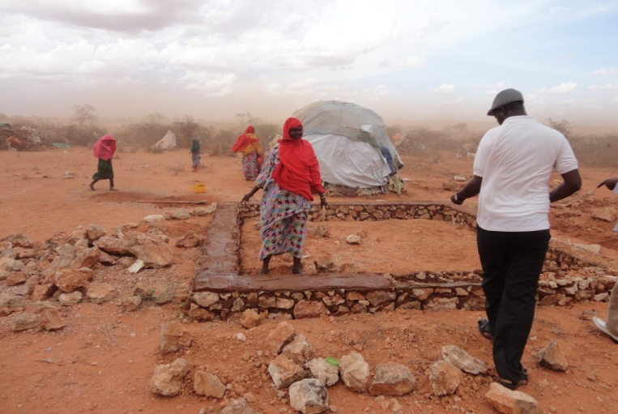
6. HOUSING design

Slide 7
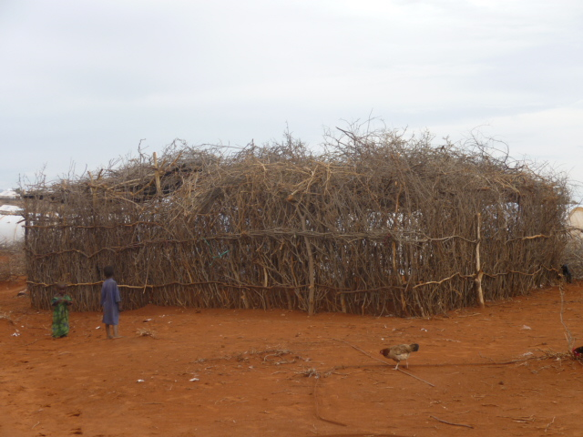
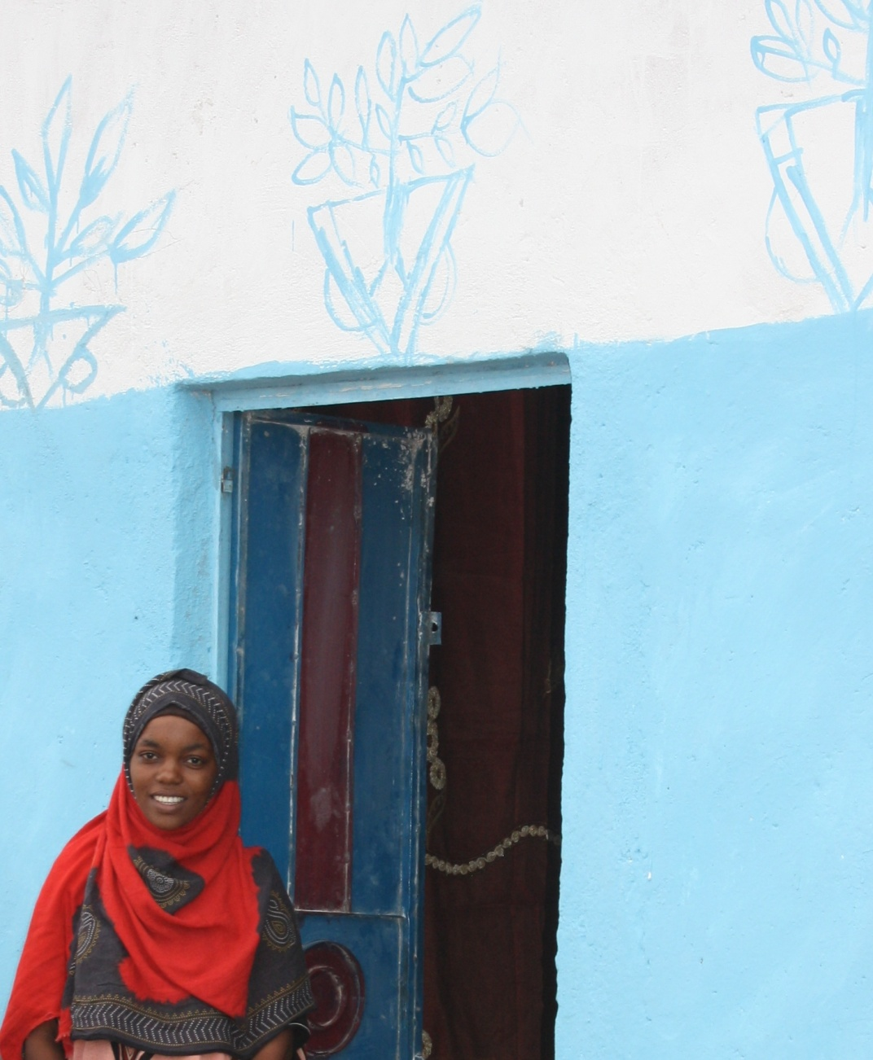
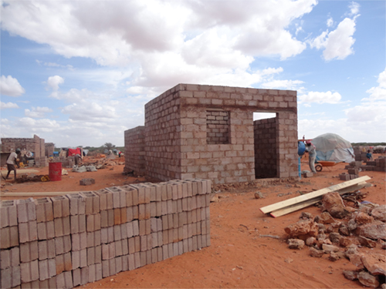
7. HOUSING construction & participation
- Community, contractor
- Equity outcomes
- Capital investment
- Urban/peri-urban issues

Slide 8
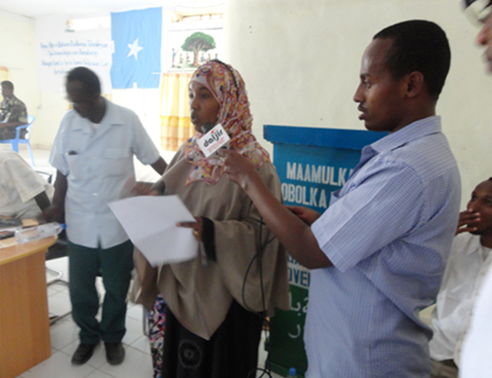
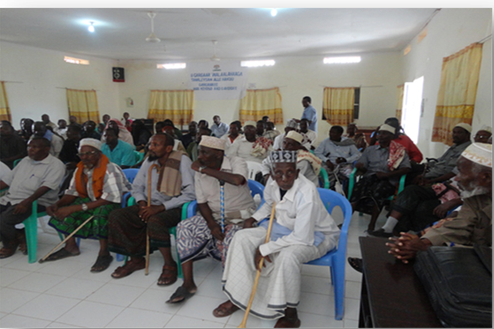
8. OWNERSHIP participation, feedback, accountability
- Committees: Gender & Representation
- Xeer: Customary & Religious Law
- Advocacy: social change and inclusion
- Transparency: stakeholders - legitimacy
- Security of Tenure: Principles & Standards

Slide 9
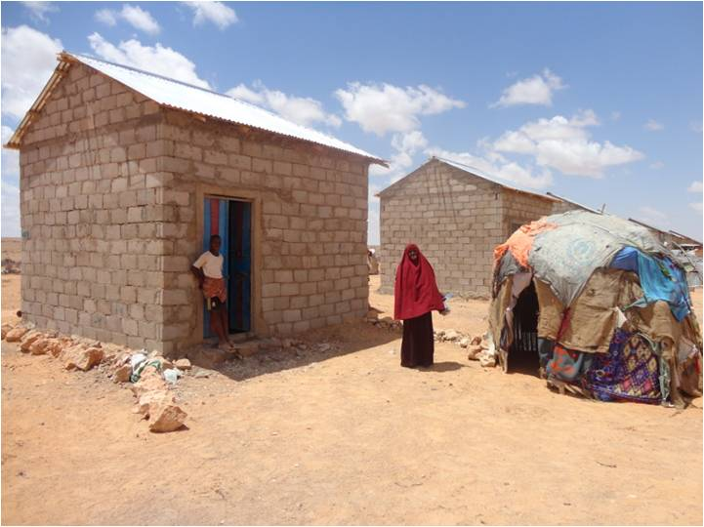
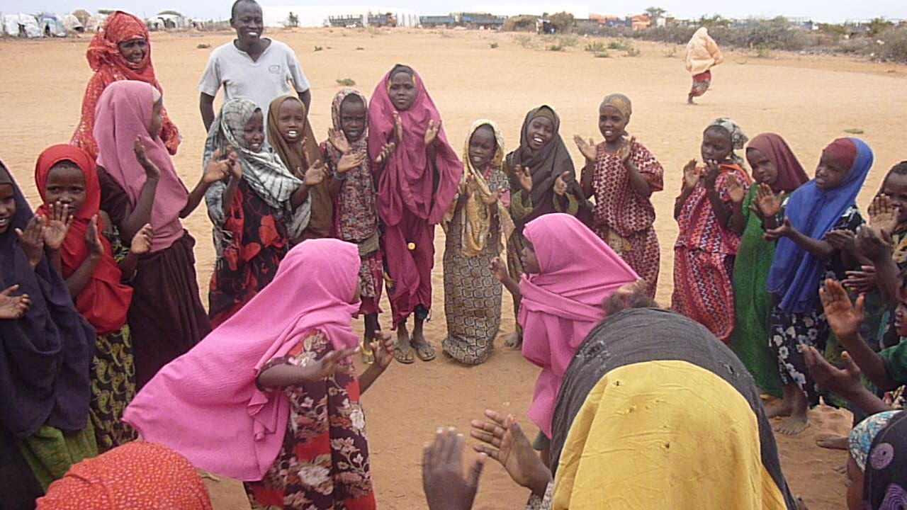
9. TSP issues and outcomes
Early and ongoing engagement
Donors: flexibility, relationships
Accountability: esp community
Transparency with stakeholders
Governance and decision-making
Outcomes: process over product

